Slide 1
PROXY DESIGN PATTERN
Sravan Appana(3)
Architha Mukka(30)
Vikesh Padarthi(39)
Manikanta Maddula(24)

Slide 2
In proxy pattern, a class represents functionality of another class. This type of design pattern comes under structural pattern.
Proxy pattern is divided in to three types
REMOTE PROXY: Used to hide the communication
mechanisms between remote objects.
VIRTUAL PROXY: Used for lazy instantiation of objects.
The real object would get created only when the client actually
gets requests for some of its functionality.
ACCESS PROXY: Used to provide control over a sensitive
Master object. This proxy check for client’s access permission
before allowing methods to be executed on the
actual object.

Slide 3
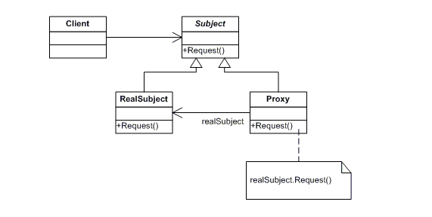
CLASS DIAGRAM FOR PROXY DESIGN PATTERN
The three participants are: proxy, subject and real subject. Proxy maintains a reference that lets the proxy access the real subject. Proxy refer to a subject if the real subject and subject interfaces are same. Proxy provides an interface identical to Subject's so that a proxy can be substituted for the real subject. Proxy controls access to the real subject and may be responsible for creating and deleting it.

Slide 4
BENEFITS OF PROXY DESIGN PATTERN:
One of the advantages of Proxy pattern as you have seen in the above example is about security.
This pattern avoids duplication of objects which might be huge size and memory intensive. This in turn increases the performance of the application.
The remote proxy also ensures about security by installing the local code proxy (stub) in the client machine and then accessing the server with help of the remote code.

Slide 5
DISADVANTAGES OF PROXY DESIGN PATTERN:
Proxy pattern introduces another layer of abstraction which sometimes may be an issue if the Real Subject code is accessed by some of the clients directly and some of them might access the Proxy classes. This might cause disparate behaviour.
Less efficiency due to indirection.
Complex implementation.

Slide 6
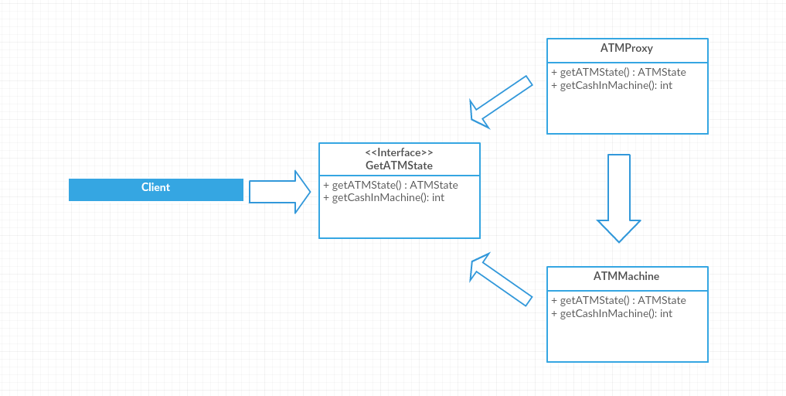
CLASS DIAGRAM FOR PROXY DESIGN PATTERN OF AN ATM SYSTEM

Slide 7
PROXY DESIGN PATTERN
List of Java Classes :
ATMMachine.java
ATMProxy.java
ATMState.java
GetATMData.java
HasCard.java
HasPin.java
Testing_Design_Pattern.java

Slide 8
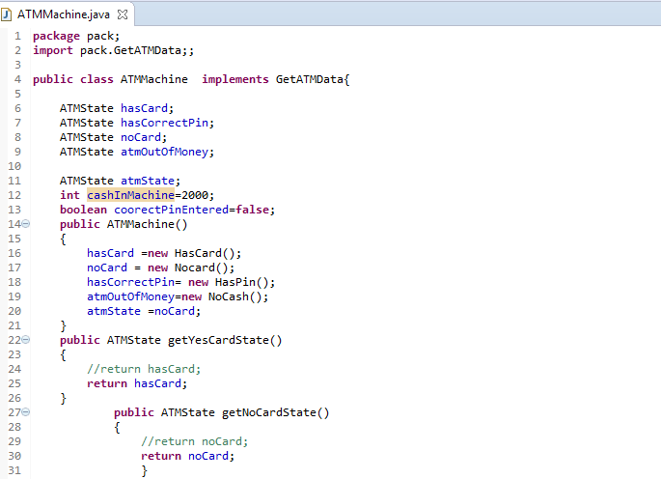

Slide 9
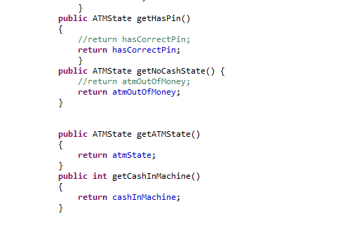

Slide 10
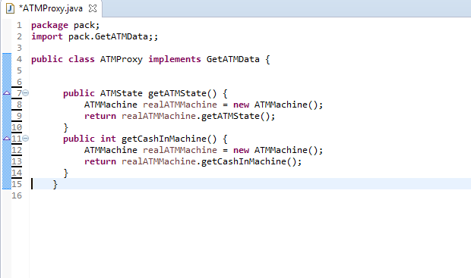

Slide 11
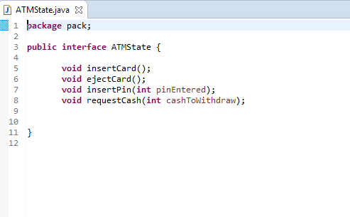

Slide 12
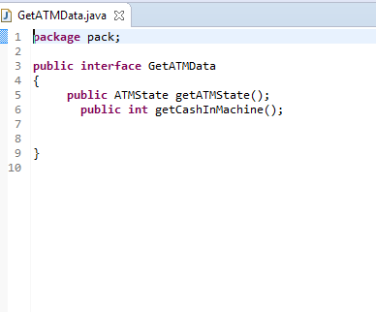

Slide 13
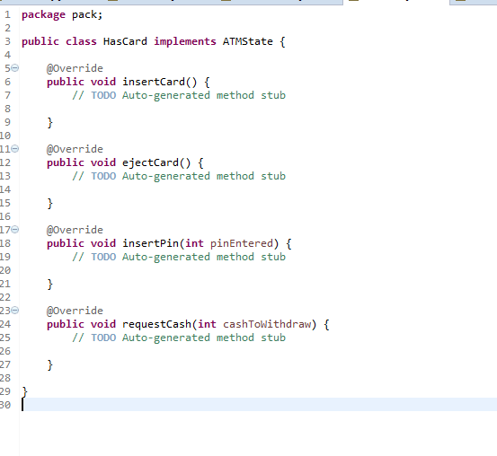

Slide 14
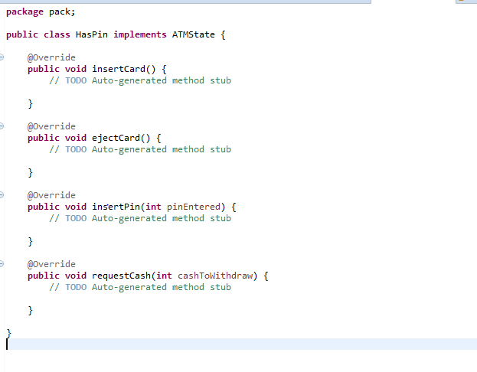

Slide 15
