Slide 1
Software Engineering
for
Big Data Systems
Manikanta Maddula (24)
Vikesh Padarthi (39)
Nikitha Katta (22)
Naga Mounika Dandamudi (09)

Slide 2
Big Data
YouTube
More than a billion users in 2015
Watched 4 billion videos daily
Uploaded 300 hours of videos per minute
Facebook
Stored 15 billion photos -1.5Petabytes(2009)
Uploaded 2 billion photos daily-40 Petabytes(2015)

Slide 3
Big Data
Immense Societal Change
Growth rate of Internet based systems
New Datacenters – tens of thousand machines
Rate of Innovation
Immense business opportunities
Era of Big Data

Slide 4
Big Data, Big Challenges
New technologies Social networking, mobile computing, cloud computing and the Internet of things.
Short project life cycles, speed business interactions.
Future – Computation availability as commodity.
Data and analysis will be available efficiently and transparently using scalable technologies and tools.
Problems can be solved by growing datasets.

Slide 5
Big Data, Big Challenges
New Specialization: Data-intensive or Big Data
Variety of open source data management systems

Slide 6
Big Data, Big Challenges
SQL database technologies – Vertical scaling
RDBMS – Normalized models, data consistency
New – Schema less, intentionally denormalized data models, weak consistency, API’s that expose data management mechanisms
NoSQL products scale horizontally across clusters of low cost servers.
High performance, elastic storage capacity, availability, replicating, partitioning of data.
Cassandra, Riak, MongoDB

Slide 7
CAP Theorem
Consistency :
All the replicas in the systems should contain the same data and every reader should be able to read same data.
Availability :
A guarantee that every request receives a response about whether it succeeded or failed
Partition tolerance :
The system continues to operate despite arbitrary partitioning due to network failures

Slide 8
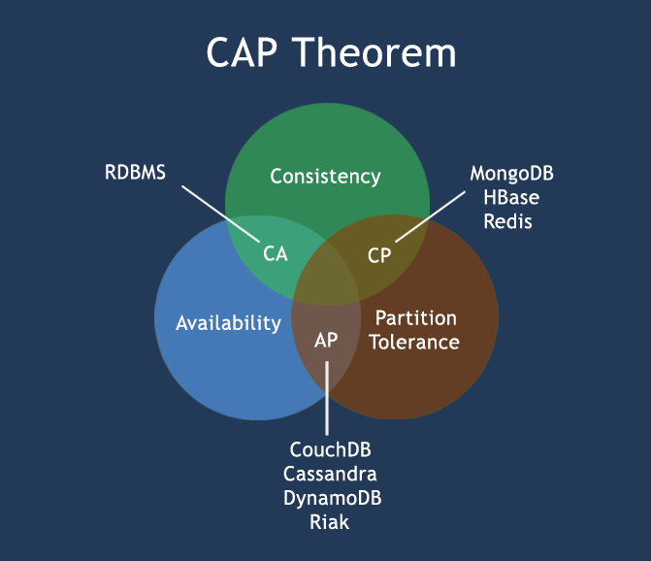
MongoDB – EA Sports, Cisco
HBase – Adobe , Facebook
Redis – Twitter, Github
CouchDB – BBC
Cassandra – Accenture, eBay
DynamoDB – HTC, New York Times
Riak – At & t

Slide 9
Issue 1:Pervasive Distribution
This is a design challenge for scalable data-intensive systems.
Highly distributed systems are resulted to achieve high scalability and availability.
As the data volume's increase, the hardware resources grows from hundreds to thousands servers.

Slide 10
Issue 2: Write - Heavy Workloads
As writes are more costly than reads, big data systems must be able to sustain high data collection from social sites.
Replication can be used to provide high availability.
Data partitioning and distribution (sharding) can be used to spread write operations across disks.
Sharding and replication introduce availability and consistency issues that the system must address.

Slide 11
Issue 3: Variable Request Loads
Business and government systems experience highly variable workloads for product promotions, emergencies, and statutory deadlines such as tax submissions.
To handle these occasional spikes, cloud platforms are to be elastic, letting applications add processing capacity when needed and release resources when the load drops.
Effectively exploiting this deployment mechanism requires an architecture that has application-specific strategies to detect increased load, rapidly add new resources to share load, and release resources as load decreases.

Slide 12
Issue 4: Support Diverse Query
Big data systems must support diverse query workloads.
Diverse requests that require fast response with long running requests that perform complex analytics.
Cost-effectively meeting the different demands of transactional and analytical workloads at large scale is a huge software engineering design challenge.

Slide 13
Issue 5: High Availability
Hardware and network failures become inevitable in an application with thousands of nodes.
Common approaches for high availability are replicating data across geographical regions, stateless services, and application-specific mechanisms to provide degraded service in the face of failures.

Slide 14
More Challenges
Scaling also brings a new Software engineering challenges
1. Optimizing the testing time.
2. Additional Business requirements make system and architecture more complex.
3. Teams must be able to work and take decisions independently to build more sophisticated features.

Slide 15
Conclusion
Centralized management creating road blocks isn't simply effective.
Small optimizations in design and algorithms can lead to major cost reductions.
These trade offs also require new software architecture, design, engineering, and deployment approaches.
For many software engineers, scalability is becoming a driving requirement.

Slide 16
Thank You !!!

