Slide 1
OpenDL-The deep learning training library based on Spark framework
GuoDing

Slide 2
Abstract
The deep leaning is a hot point in machine learning field recently. For project usage, how to do the DL training work is still under various attempts, especially for large scale data. I just do practice refer to Google’s DistBelief, based on Spark, a new lighting-fast cluster computing platform.

Slide 3
Contents
Core idea
My implementation
Code architecture
Future plan

Slide 4
Core idea
The Google scientist, Jeffrey Dean promotes one way to large scale data’s DL training with distributed platform, named DistBelief [1].
The key idea is model replica, each one takes the same current model parameters, but get the different data shards to train; then each model replica update the gradient to central parameter server.

Slide 5
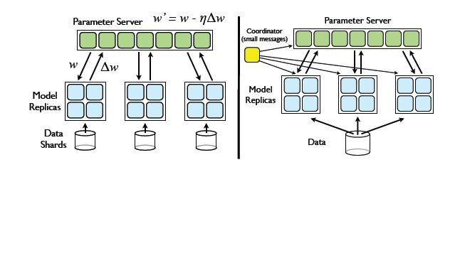
Core idea
The draft picture from the paper:

Slide 6
Core idea
Google’s DistBelief includes two layer of distribution: one is the model replica distribution, the other is model inner network node’s distribution.
The detail can refer to the paper[1], [2].

Slide 7
My implementation
The model can be trained with gradient descent algorithm, eg, Logistic Regression(Softmax), Backpropagation, AutoEncoder, RBM, Convolution.
The framework splits the train data into different data shards, each one will be trained by the model replica.
After all model replica finish the current epoch train, the update gradient will be reduced to update totally; then each model replica will start the next epoch train with new parameter until convergence or get to some stop conditions.

Slide 8
My implementation
The model replica can train the data with different way based on gradient update; eg, mini-batch gradient descent, Conjugate gradient, or L-BFGS.(CG always win the best result).
OpenDL only support model replica distribution with standalone mode with multiple thread or Spark cluster platform.
Thanks to other open library, like with Mallet(http://mallet.cs.umass.edu/) for CG, and Jblas(http://mikiobraun.github.io/jblas/) for fast matrix computing.

Slide 9
Code architecture

