Slide 1

-Analysis on prices of the Smart Phones available in flipkart

Slide 2
About me
Name : Jadala Manikanta
Background : B.tech(Computer Science Engineering)
Batch No: 458
Course : Data Analysis
Linkdin : https://www.linkedin.com/in/manikanta-jadala-6930a5320
I want to learn Data Analysis to turn real-world data into useful insights that support smarter decisions.
It enables practical, data-driven problem solving and provides strong career growth opportunities.

Slide 3
Business Problem and Use case domain understanding
Business Problem :
Customers and sellers often find it difficult to understand why smartphone prices vary across brands,specifications, and features.
There is a lack of clear insight into how factors such as RAM, storage, camera quality, battery capacity, processor, and customer ratings influence the final price.
Use Case :
Helps customers choose value-for-money smartphones.
Assists retailers in setting competitive prices.
Supports manufacturers in understanding market demand.

Slide 4
Objective of the Project :
To analyze smartphone pricing based on key features such as brand, RAM, storage, camera quality, battery capacity, processor, and network support
To understand the relationship between technical specifications and price, identifying which features have the strongest impact on cost
To study how customer ratings vary across different price ranges and product segments (Budget, Mid-Range, Premium)
To identify value-for-money smartphones that offer good features with high ratings at reasonable prices
To perform data visualization using charts and graphs for clearer insights and trend identification
To support data-driven decision-making for customers, retailers, and manufacturers

Slide 5
Web Scraping – Details
1.Data Collection :
Website : Flipkart
Tools : Python, Requests,BeautifulSoup
Collected data : Brand, RAM, Storage, Price, Camera, Battery, Ratings.
2. Data Cleaning :
Removed missing and duplicate values.
Converted data into proper formats.
Stored cleaned data in a structured DataFrame.

Slide 6
3. Exploratory Data Analysis :
Analyzed price distribution and ratings.
Studied feature impact on pricing.
Segmented products into Budget, Mid-range, and Premium.
4. Data Cleaning :
Removed missing and duplicate values.
Converted data into proper formats.
Stored cleaned data in a structured DataFrame.

Slide 7
5. Visualization
Used charts and graphs to identify trends.
Compared prices across brands and segments.
Created correlation heatmaps.

Slide 8
Summary of the Data
The dataset consists of smartphone information gathered from various e-commerce platforms.
It covers attributes such as brand, RAM, storage, camera specifications, battery capacity, operating system, user ratings, and price.
The data includes a mix of quantitative features (like price, RAM, battery) and qualitative features (such as brand and OS).
Data preprocessing was carried out to remove inconsistencies, correct errors, and manage missing entries.
This dataset was utilized to analyze smartphone pricing trends and create meaningful visualizations.

Slide 9
Exploratory Data Analysis:
Data Cleaning :
Eliminated duplicate smartphone records from the dataset
Treated missing values using suitable techniques such as removal or imputation
Converted columns into appropriate numerical and categorical data types
Renamed fields to ensure clarity, uniformity, and readability
Identified and handled outliers and inconsistent entries to improve data quality
Data Preparation & Manipulation :
Selected relevant smartphone attributes required for analysis
Arranged data based on price and key specifications
Engineered new features to enhance analytical insights
Applied normalization to numerical variables for fair comparison
Grouped and filtered data to uncover meaningful trends and patterns

Slide 10
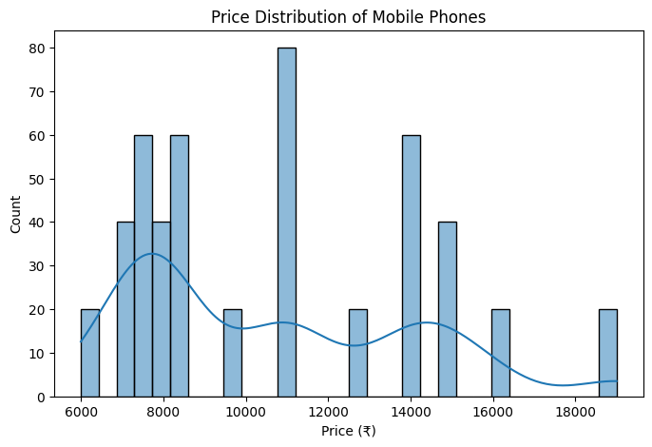
Univariate Analysis
Univariate Analysis – Price Distribution :
The histogram represents the distribution of smartphone prices.
Most smartphones are concentrated between ₹7,000 and ₹15,000, showing a strong budget to mid-range segment.
There is a noticeable peak around ₹8,000–₹12,000, indicating this is the most popular price range.
A smaller number of smartphones are priced above ₹15,000, which creates a right-skewed distribution.
The KDE curve confirms that prices are not evenly distributed and instead cluster around specific price bands.
A few high-priced smartphones (around ₹18,000–₹19,000) act as outliers.

Slide 11
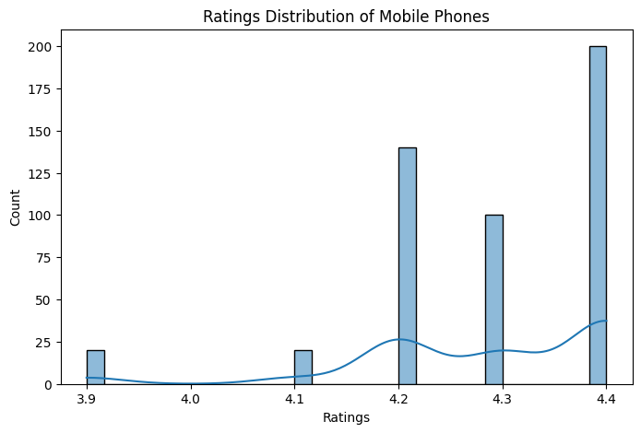
Univariate Analysis – Ratings Distribution :
This analysis shows the distribution of customer ratings for refrigerators
Most products have ratings between 4.0 and 4.5, indicating good customer satisfaction
Very few refrigerators have low ratings, showing overall positive feedback
The distribution is slightly left-skewed, with ratings concentrated at the higher end
This helps understand overall product quality perception

Slide 12
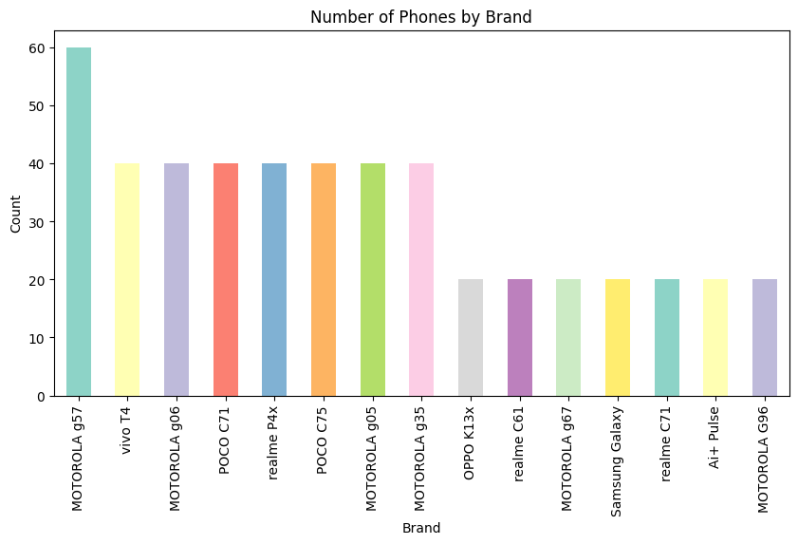
Brand-wise Distribution of Smartphones
The bar chart shows the distribution of smartphones across different brands in the dataset.
Motorola models appear most frequently, indicating a strong presence and wider product range compared to other brands.
Brands such as Realme, Poco, Vivo, and Samsung also have a significant number of smartphones, reflecting their popularity in the market.
Some brands have a moderate count of devices, suggesting a more focused or limited product lineup.
The variation in bar heights indicates that smartphone availability is not evenly distributed across brands.
This analysis helps identify dominant brands, market competition, and brands with lower representation in the dataset.

Slide 13
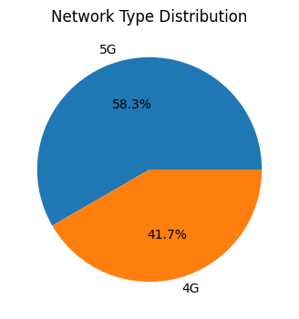
Univariate Analysis – Smartphone Network Type Distribution
Pie chart
Network Type Distribution of Smartphones
The pie chart shows the distribution of smartphones based on network connectivity in the dataset.
5G-enabled smartphones form the majority, indicating a strong shift toward next-generation network technology.
4G smartphones still account for a significant portion, showing that they remain widely used and relevant in the market.
The difference in percentage shares highlights that network support is not evenly distributed across smartphone models.
This analysis helps understand technology adoption trends, market readiness for 5G, and the continuing demand for 4G devices.

Slide 14
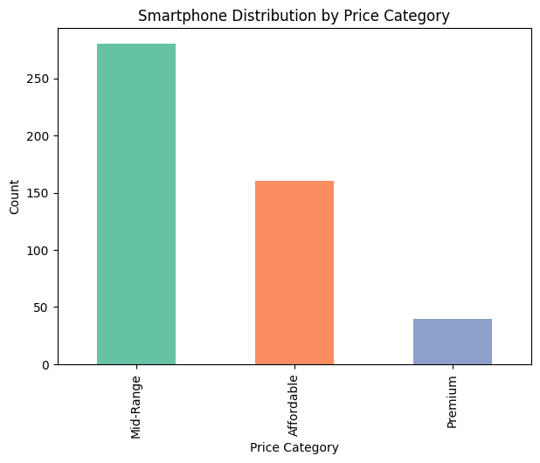
Univariate Analysis – Distribution of Smartphones by Price Category
This analysis explains how smartphones are grouped into pricing segments such as Affordable, Mid-Range, and Premium.
The Mid-Range segment contains the largest number of smartphones, indicating strong customer demand and a balance between price and features.
A smaller portion of smartphones falls under the Affordable category, which mainly targets price-sensitive consumers.
The Premium segment includes fewer smartphone models, but these devices are typically priced higher and offer advanced specifications and features.
Overall, this segmentation helps in understanding the market structure, brand positioning, and consumer purchasing preferences within the smartphone industry.

Slide 15
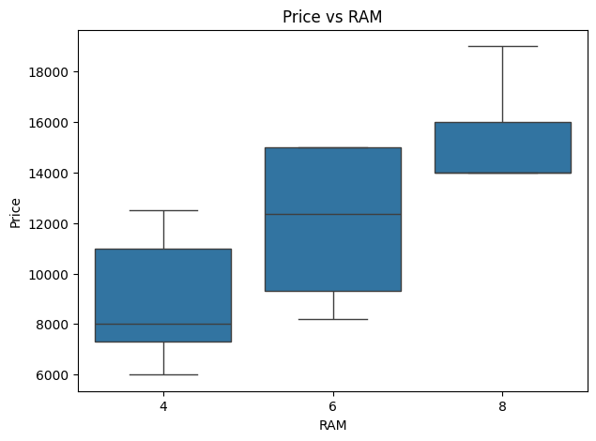
Bivariate Analysis – Relationship Between RAM and Smartphone Price
Price vs RAM Analysis
The box plot illustrates the relationship between smartphone RAM capacity and price.
Smartphones with higher RAM tend to have higher prices, indicating a positive relationship between RAM size and cost.
Devices with 4 GB RAM are mostly priced in the lower to mid-range, reflecting their budget-friendly positioning.
Smartphones with 6 GB RAM show a wider price spread, suggesting availability across both mid-range and premium segments.
8 GB RAM smartphones are generally priced higher, with less variation, indicating a focus on premium and performance-oriented models.
This analysis helps in understanding how RAM influences smartphone pricing and supports product differentiation strategies.

Slide 16
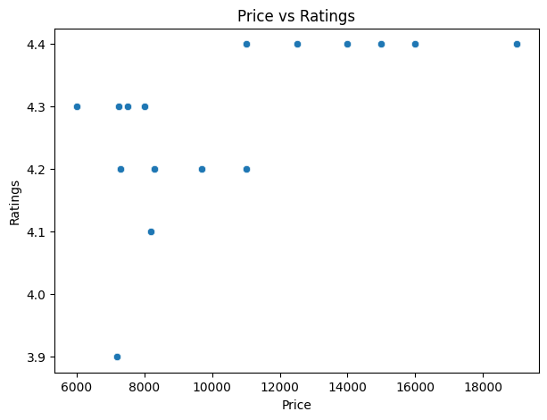
Bivariate Analysis – Relationship Between Smartphone Price and Ratings
Price vs Ratings Analysis
The scatter plot shows the relationship between smartphone price and customer ratings.
Most smartphones, regardless of price, receive ratings between 4.1 and 4.4, indicating generally positive user feedback.
Higher-priced smartphones tend to have slightly higher and more consistent ratings, suggesting better overall user satisfaction.
Lower-priced smartphones show greater variation in ratings, indicating mixed customer experiences in the budget segment.
The overall trend suggests a weak positive relationship between price and ratings, meaning higher price does not always guarantee significantly higher ratings.
This analysis helps in understanding how price influences customer satisfaction and highlights that value-for-money devices can also receive good ratings.

Slide 17
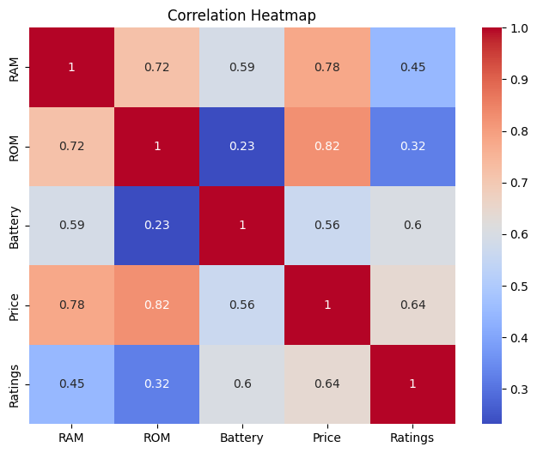
Multivariate Analysis – Correlation Between Smartphone Specifications, Price, and Ratings
Correlation Heatmap Analysis
The heatmap displays the correlation between smartphone features such as RAM, ROM, Battery, Price, and Ratings.
Price shows a strong positive correlation with ROM (0.82) and RAM (0.78), indicating that smartphones with higher storage and memory are generally priced higher.
Battery capacity has a moderate positive relationship with Price (0.56), suggesting that larger batteries slightly influence pricing.
Ratings are moderately correlated with Price (0.64), indicating that higher-priced smartphones tend to receive better user ratings.
RAM and ROM are strongly correlated (0.72), showing that smartphones with higher RAM usually come with higher internal storage.
The weak correlation between ROM and Battery (0.23) suggests that storage size does not strongly depend on battery capacity.

Slide 18
Key Business Question
How does RAM and storage capacity affect the pricing of smartphones?
Which price segment (Affordable, Mid-Range, or Premium) shows the highest market demand?
Do higher-priced smartphones tend to receive better customer ratings?
How do different smartphone brands position their devices across various price categories?
Which technical features have the strongest impact on smartphone prices?

Slide 19
Experience / Challenges :
The project encountered difficulties due to frequently changing e-commerce website layouts and dynamic content, which affected data extraction.
Handling missing values, inconsistent entries, and duplicate records required thorough data preprocessing to ensure reliability.
Transforming raw textual information (such as prices, ratings, and specifications) into usable numerical formats was a time-intensive task.
Working with a large volume of smartphone data while maintaining accuracy and consistency posed additional challenges.
Overall, this project offered practical exposure to real-world data collection, cleaning, and exploratory analysis, strengthening skills in handling complex datasets.

Slide 20
Conclusion
The analysis indicates that smartphone prices generally increase with higher specifications, such as RAM and storage, showing a positive relationship between features and price.
The mid-range segment dominates the smartphone market, as it offers a good balance between performance, features, and affordability.
Higher-priced smartphones do not always receive significantly better customer ratings, suggesting that user satisfaction depends on overall value rather than price alone.
Price-based segmentation helps in understanding brand positioning, competitive strategies, and market targeting within the smartphone industry.
Overall, data analysis and visualizations provide meaningful insights that help customers choose value-for-money devices, assist retailers in pricing strategies, and enable manufacturers to design products aligned with market demand.

Slide 21

THANK YOU

