Slide 1
American Express Campus Analyze This 2015
Submission Deck - TEMPLATE

Slide 2
Team Details
Team Name :Telugu Knights
Name | Campus | Roll No. | Mobile No. | Email Id
Nallagatla Manikanta | IIT ROORKEE | 13116045 | 8755699770 | manikanta001nallagatla@gmail.com
Deepak Jannarapu | IIT ROORKEE | 13116021 | 9897771383 | djjannarapudeepak@gmail.com

Slide 3
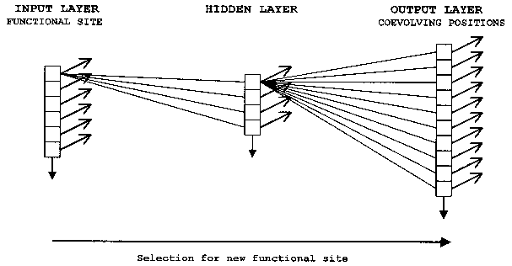
Equation to Identify Citizen’s Vote
Please provide the final equation used to identify the citizen’s vote
We have used neural networks model as shown in figure to model the prediction.
We have used the size of input layer as 6, hidden layer as 36 and finally output layer as 5 because output can take 5 values depending on which party to win.

Slide 4
Details of each Variable used in the Equation
Please provide details of each variable used in the equation to identify citizen’s vote
mvar_1 Party voted for in previous elections
mvar_23 Number of Centaur rallies attended
mvar_24 Number of Ebony rallies attended
mvar_25 Number of Tokugawa rallies attended
mvar_26 Number of Odyssey rallies attended
mvar_28 Number of Cosmos rallies attended

Slide 5
Estimation Technique Used
Please provide the estimation/modeling technique(s) used to arrive at the solution/equation
We have used neural networks model for training and predicting the data set.
We have used the size of input layer as 6, hidden layer as 36 and finally output layer as 5 because output can take 5 values depending on which party to win.
For Final data set where output can’t take Odyssey we have taken the next best possibility for the party to predict.
For training the data set we have tried different values of lambda(Regularization constant) and achieved its optimum value.
We have also tried different sizes for the Hidden layer by which we can vary the complexity of the equation for prediction and achieved its optimum value.
Finally, We have trained the neural network with above parameters iteratively and achieved the solution.

Slide 6
Reasons for Technique(s) Used
Why do you think this is the best technique(s) for this particular problem?
Neural networks can learn from the data set given and can predict the output for the new data set more efficiently.
In the given problem, there are two data sets for training and prediction which can be done effectively by artificial neural networks.
Parallel organization can achieve solutions if there are multiple constraints and they must be satisfied in parallel.
In the given problem, there are more than one parameter like rallies, actual vote, so on which are need to be satisfied in parallel.
So we have used neural networks to model the given problem.

Slide 7
Final Submission File
Please embed your final submission file (.csv) here.
Please find the Final_Dataset.csv file in the link given below.
https://drive.google.com/file/d/0BxL4WqnNQaZ4ZWRwanlQNGJ2bEE/view?usp=sharing

