Slide 1
Smart car parking
Nallagatla Manikanta COG16/04367 Palakonda Shiva Prasad COG16/07331
Keetha Indraneel Varma COG16/04357

Slide 2
Problem statement
Conventionally, car parking systems do not have any intelligent monitoring. Parking lots are monitored by human beings. All vehicles enter into the parking and waste time searching for parking slots. Sometimes this can create blockages. Conditions worsen when there are multiple parking lanes and each lane has multiple parking slots. Use of automated system for car parking monitoring will reduce human efforts. 1. The system has to increment whenever a car is coming into the parking lot.
2. When a car leaves, the system has to decrement by 1 from the total count.
3. Assume parking lot is finite (restricted the limit of parking spots to be 1024)

Slide 3
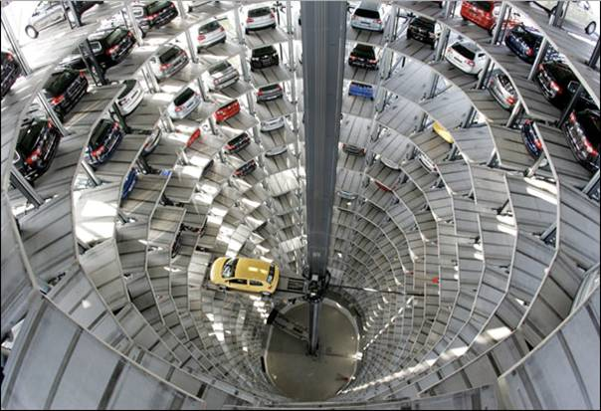
Multicar parking system

Slide 4
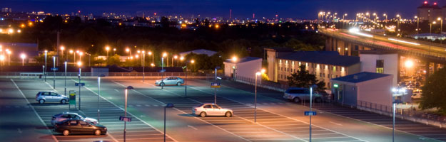
Traditional car parking system

Slide 5
introduction
Increase in population implies Number of Automoblies increase
Need of Automatic Car parking system
Reduce Strain

Slide 6
Our approach
Store the count of the number of cars in a variable
Whenever a new car comes:
If count of cars less than the maximum limit:
Allow car into parking area and increase the count
Else close the gate
Whenever a car leaves from the parking area
Decrease the count by one

Slide 7
State table
A | B | Count | Count New
1 | 1 | <1024 | Count
1 | 0 | <1024 | Count+1
0 | 1 | <1024 | Count-1
0 | 0 | <1024 | Count
1 | 1 | =1024 | Count
1 | 0 | =1024 | Count
0 | 1 | =1024 | Count-1
0 | 0 | =1024 | Count

Slide 8
State diagram
A = 0
B = 0
A = 1
B = 1
Present State
A = 1
B = 0
A = 0
B = 1
Past state
Next State

Slide 9
Results Code
library IEEE;
use IEEE.STD_LOGIC_1164.ALL;
use IEEE.STD_LOGIC_ARITH.ALL;
use IEEE.STD_LOGIC_UNSIGNED.ALL;
use ieee.numeric_std.all;

Slide 10
Results
entity carParking is
port(
A : in std_logic;
B : in std_logic;
reset : in std_logic;
clock : in std_logic;
entranceA : out std_logic;
exitB : out std_logic;
count : out std_logic_vector(9 downto 0));
end carParking;

Slide 11
Results
architecture Behavioral of carParking is
signal cou : std_logic_vector(9 downto 0);
begin
process(clock)
begin
if(rising_edge(clock)) then
if(reset = '1') then

Slide 12
Results
cou(0) <= '0';
cou(1) <= '0';
cou(2) <= '0';
cou(3) <= '0';
cou(4) <= '0';
cou(5) <= '0';
cou(6) <= '0';
cou(7) <= '0';

Slide 13
Results
cou(8) <= '0';
cou(9) <= '0';
entranceA <= '0';
exitB <= '0';
end if;
if(A = '1' and B = '0' and cou < "1111111111" and reset = '0') then
cou <= cou+1;
entranceA <= '1';
exitB <= '0';

Slide 14
Results
if(A = '0' and B = '1' and cou > "000000000" and reset = '0') then
cou <= cou-1;
entranceA <= '0';
exitB <= '1';
end if;
end if;
end process

Slide 15
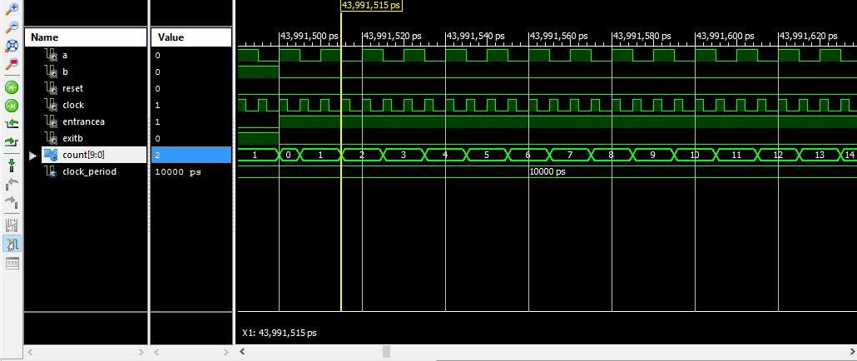
Waveforms

Slide 16
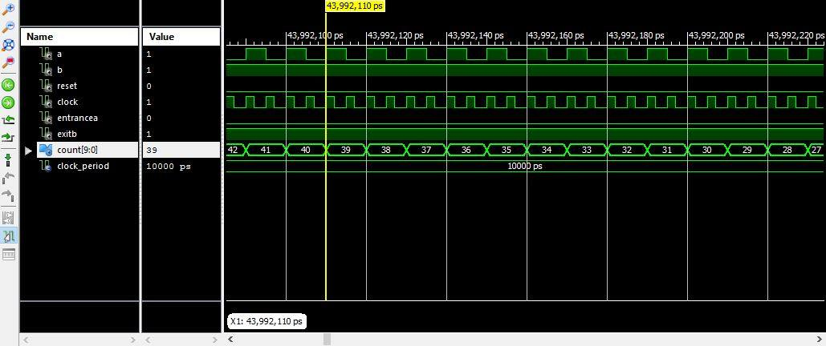
Waveforms

Slide 17
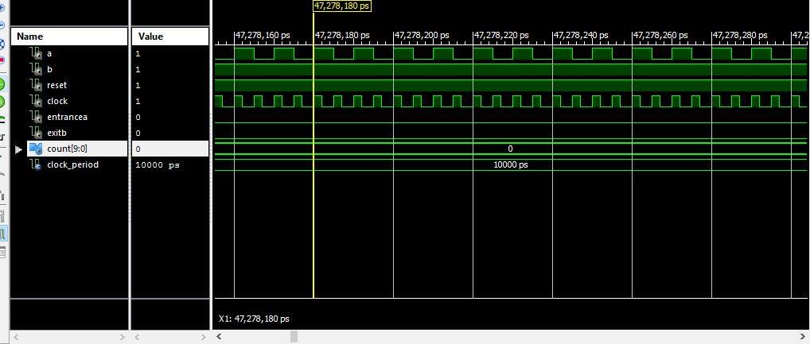
Waveforms

Slide 18
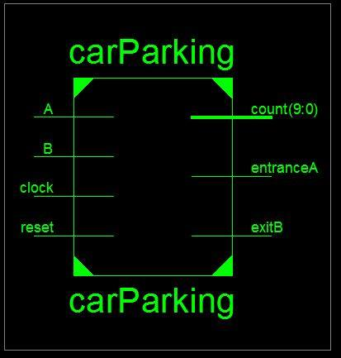
RTL SChematic
Notes:
This schematic is generated after the HDL synthesis phase of the synthesis process. It shows a representation of the pre-optimized design in terms of generic symbols, such as adders, multipliers, counters, AND gates, and OR gates, that are independent of the targeted Xilinx device

Slide 19
Advantages of smart car parking system
• Accurately predict and sense spot/vehicle occupancy in real-time.
• Guides residents and visitors to available parking.
• Optimize Parking Space Usage
• Help traffic in the city flow more freely leveraging IoT technology.
• Smart Parking plays a major role in creating better urban
environment by reducing the emission of CO2 and other pollutants

Slide 20
CONclusion
Algorithm is implemented using VHDL language
using Xilinx 14.2 ISE interface

Slide 21
REFERENCES
Automated parking system by Lina Lo in 2012
Smart Parking System with Image Processing Facility by M.O. Reza, M.F. Ismail, A.A. Rokoni, M.A.R. Sarkar in 2012.
Smart Parking Applications Using RFID Technology by Zeydin PALA and Nihat INAN in 2009 IEEE explore
Smart Parking by Gongjun Yan Weiming

Slide 22
THANK YOU

