Slide 1
Presented By
By
Manikanta
shashikala

Slide 2
Introduction to digital video technology

Slide 3
Basic Terminology

Slide 4

What is an image? Image is collections of pixel An image can be thought of as a 2D matrix. If we think about colors, we can extrapolate this idea seeing this image as a 3D matrix where the additional dimensions are used to provide color data.
R
G
B
100 | 0 | 0 | 0
100 | 7 | 0 | 0 | 0
100 | 7 | 2 | 0 | 0 | 0
100 | 100 | 2 | 2 | 2 | 2
 | 100 | 100 | 6 | 0 | 0
 |  | 100 | 6 | 6 | 6
2D
3D
color intensity

Slide 5

What is picture element (pixel) ? Pixel is the small single component of a digital image.
R
100 | 0 | 0 | 0 | G
100 | 7 | 0 | 0 | 0 | B
100 | 7 | 2 | 0 | 0 | 0
100 | 100 | 2 | 2 | 2 | 2
 | 100 | 100 | 6 | 0 | 0
 |  | 100 | 6 | 6 | 6

Slide 6
What is bit (color) depth? The number of bits used to represent each pixel in an image. ... For example, a typical color image using 8 bits per channel is often referred to as a 24-bit color image (8 bits x 3 channels).
R
100 | 0 | 0 | 0 | G
100 | 7 | 0 | 0 | 0 | B
100 | 7 | 2 | 0 | 0 | 0
100 | 100 | 2 | 2 | 2 | 2
 | 100 | 100 | 6 | 0 | 0
 |  | 100 | 6 | 6 | 6
the range
0-255
8R+8G+8B = 24 bits

Slide 7



Color depth
24 bpp
10 bpp
8 bpp

Slide 8
What is resolution? Another property of an image is the resolution, which is the number of pixels in one dimension. It is often presented as width × height, for example, the 4×4 image below.
width
height
4
4

Slide 9
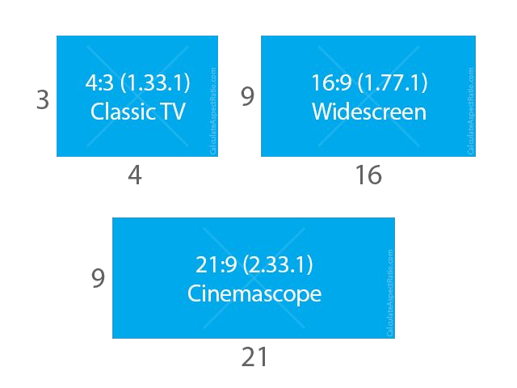
What is display aspect ratio (DAR)? aspect ratio which simply describes the proportional relationship between width and height of an image or pixel.
16:9 (1.7777777778) 4:3 (1.3333333333)
1280/720 (1.7777777778) 1024/768 (1.3333333333)
When people says this movie or picture is 16x9 they usually are referring to the Display Aspect Ratio (DAR), however we also can have different shapes of individual pixels, we call this Pixel Aspect Ratio (PAR).

Slide 10


What is pixel aspect ratio (PAR)?
PAR 1:1
PAR 2:1

Slide 11

What is a video? we can define a video as a succession of n frames in time which can be seen as another dimension, n is the frame rate or frames per second (FPS).
time
a single frame
30 frames per sec (FPS)
framerate
4D

Slide 12
Interlaced | progressive In the early days, engineers came up with a technique for doubling the perceived frame rate of a video display without consuming extra bandwidth. This technique is known as interlaced video; it basically sends half of the screen in 1 "frame" and the other half in the next "frame". Today screens render mostly using progressive scan technique. Progressive is a way of displaying, storing, or transmitting moving images in which all the lines of each frame are drawn in sequence.

Slide 13
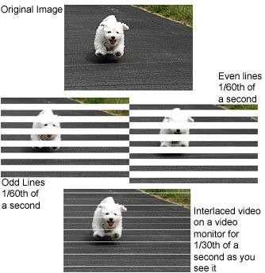
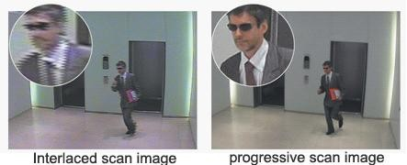

Slide 14
What are 480p, 1080i, 1080p formats?
[number][letter]
number is the resolution's height and letter: p means progressive and
I means interlaced.

Slide 15
What is bitrate?
WIDTH * HEIGHT * BITS_PER_PIXEL * FPS
4 * 4 * 24 * 30
11,520 bits per second
30 FPS

Slide 16
Space needed to store 1h of video at 720p 30fps
WIDTH * HEIGHT * BITS_PER_PIXEL * FPS 1280 * 720 * 24 * 30
663,552,000 (663.552Mb) bits per second
2,388,787,200,000 (278GB)

Slide 17
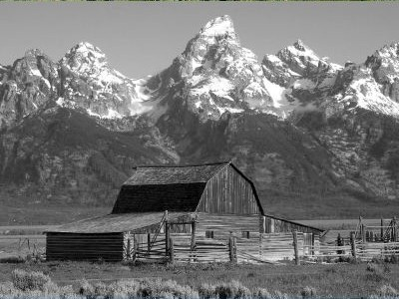
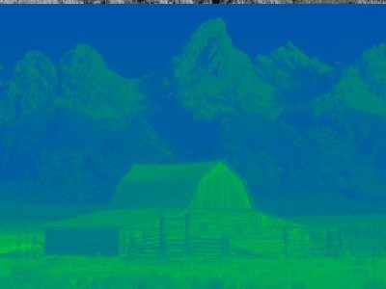




Color space YUV (YCbCr, YpbPr): The Y′UV model defines a color space in terms of one luma component (Y′) and two chrominance components, called U (blue projection) and V (red projection) respectively
Y (luma)
U (chroma blue)
V (chroma red)

Slide 18
Chroma subsampling YUV 4:4:4 4:2:2 4:2:0 the U and V color values are shared between pixels, which frees bandwidth and may increase frame rate. Known as “chroma subsampling,”
Y (luma)
U (chroma blue)
V (chroma red)

Slide 19
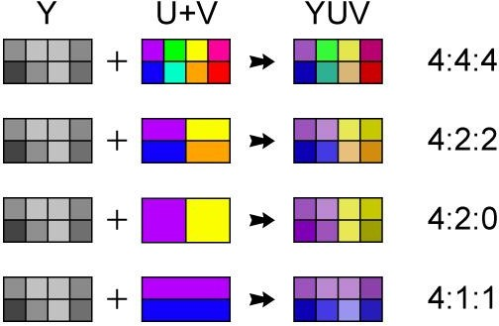
Chroma subsampling YUV 4:4:4 4:2:2 4:2:0

Slide 20
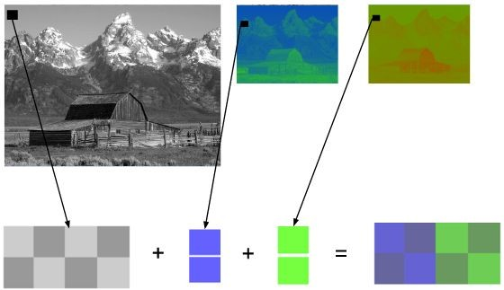
Chroma subsampling 4:2:0

Slide 21
Space needed to store 1h of video at 720p 30fps
WIDTH * HEIGHT * BITS_PER_PIXEL * FPS 1280 * 720 * 24 * 30
663,552,000 (663.552Mb) bits per second
2,388,787,200,000 (278GB)
with chroma subsampling YUV420
WIDTH * HEIGHT * BITS_PER_PIXEL * FPS 1280 * 720 * 12 * 30
331,776,000 (331.776Mb) bits per second
1,194,393,600,000 (139GB)

Slide 22
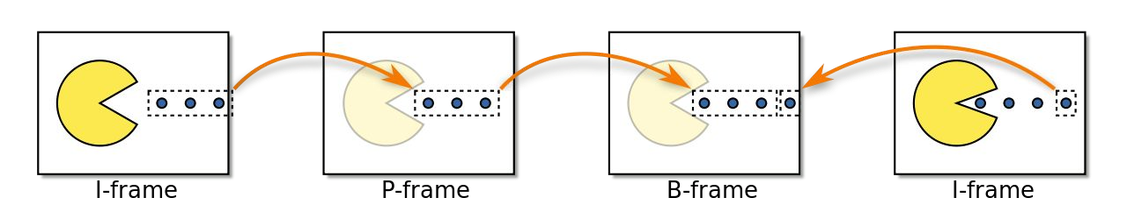
Frame types

Slide 23
What is I frame?Intra coded frame
It constructed from itself only and it is used as a reference for other frames It never constructed from other frames.
What is P frame?Predictive frame
It is constructed from previous i and p frames.It contains previous frame changes.It can construct from another P-frame.
What is B frame?Bi-directional predictive frame.
It is constructed from past and future frames. It is not constructed from another B-frame means never used as a reference.

Slide 24
CODEC - enCOder / DECoder

Slide 25
CODEC
“A codec is a device or computer program for encoding or decoding a digital data stream or signal.”

Slide 26
Container vs CODEC
Containers
OGG
MP4
WMA
AVI
MKV, WebM
TS
MOV
CODEC
H264 / AVC
H265 / HEVC
MPEG-4
VP9
AV1
Theora
Daala

Slide 27
V4L2:
Video4Linux is a collection of device drivers and an API for supporting realtime video capture on Linux systems. It supports many USB webcams, TV tuners, and related devices, standardizing their output, so programmers can easily add video support to their applications that use the V4L framework.

Slide 28
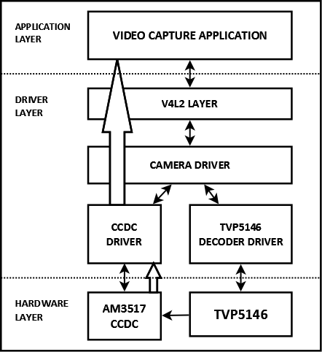

Slide 29
V4L2 framework
What is V4L2 Framework ?
Video for linux or V4L is set of APIs and driver framework for video capture
applications and for O/P devices.
Since we don’t have any common framework, we need to do the setup of device
instance and connecting to sub-devices themselves for all the drivers. And there is also
lot of common code that could never be refactored due to lack of framework.
To avoid this complexity, introduced a framework with common fuctionalities for all
the drivers which is know as V4L2 framework.
Note : The videobuf layer fuctions as a sort of glue layer between V4L2 driver and userspace.

Slide 30
Conti..
Structure of V4L driver ?
Note : All the drivers will follow the same structure.
1. A struct for each device instance containing the device state.
2. A way of initializing and commanding sub-devices (if any).
3. Creating V4L2 device nodes (/dev/videoX, /dev/vbiX and /dev/radioX) and keeping track of device- node specific data.
4. Filehandle-specific structs containing per-filehandle data;
5. video buffer handling.
Important functions provided by V4L2 Framework are:
1.Buffer Management – videobuf2-core.c
2.Controls – v4l2-controls.c
3.Events – V4l2-events.c

Slide 31
Buffer Management
What is buffer mangagment ?
It Handles the allocation and managemet of buffers for the storage of video frames.
There are two set of functions,
One is for standard I/O system calls like read(), poll(), mmap().
Another set of functions used to implement bulk of the V4L2 ioctl() calls related to streaming I/O, including buffer allocation, queueing, dequeueing and streaming controls.
What are different type of buffers ?
Buffers which are scatterd in both the physical and (kernel) virtual.
Buffers which are physically scattered, but which are virtual contigious.
Buffers which are physically contigious.
Note: Based on type of buffers used, need to include the following header files. <media/videobuf-dma-sg.h> /* Physically scattered */
<media/videobuf-vmalloc.h> /* vmalloc() buffers */
<media/videobuf-dma-contig.h> /* Physically contiguous */

Slide 32
Conti..
Memory type for VB2 buffers
This is type of memory module to make buffers visible on userspace.
VB2_MEMORY_UNKNOWN Buffer status is unknow or it is not used yet on userspace.
VB2_MEMORY_MMAP The buffers are allocated by the kernel and its memory mapped via mmap() ioctl call. This model is used when the user is using the buffers via read() or write() system calls.
VB2_MEMORY_USERPTR The buffers are allocated in userspace and its memory mapped via mmap() ioctl call.
VB2_MEMORY_DMABUF The buffers are passed to userspace via DMA buffer.

Slide 33
Conti..
int (*buf_setup) (struct videobuf_queue *q, unsigned int *count, unsigned int *size); buf_setup() is called early in the I/O process, when streaming is being instead. Its purpose is to tell videobuf about the I/O streaming.
int (*buf_init)(struct vb2_buffer *vb); Whenever buffer is getting allocated (in MMAP) or after acquiring new USERPTR buffer. Driver may perform initialization, if initialization fails will prevent the queue setup.
int (*buf_prepare)(struct vb2_buffer *vb); This is called everytime when the buffer is queued and from VIDIOC_PREPARE_BUF() ioctl. buf_prepare will set the buffer’s size, width, height, and field.

Slide 34
void (*buf_queue)(struct vb2_buffer *vb); 1. When buffer is queued for I/O, it is passed to buf_queue() for driver to handle it. 2. Which means passes a buffer vb to driver, driver may perform operation on this buffer. 3. Driver should give the buffer back by calling vb2_buffer_done() function. Mostly it is called after VIDIOC_STREAMON(). Note : Sometime buf_queue() can be called before start_streming(), if user pre-queue buffers before calling streamon().
Void (*buf_release)(struct videobuf_queue *q, struct videobuf_buffer *vb); 1. This is called when the buffer is not going to use.
int (*start_streaming)(struct vb2_queue *q, unsigned int count); 1. This is called when the streaming is starts. 2. The driver gets the number of already queued buffers in conunt parameter.
void (*stop_streaming)(struct vb2_queue *q); 1. This is called when streaming stops (stream-off called).

Slide 35
Controls
With respect to controls, the driver developer is intrested in following aspects.
1. How do I add a control?
2. How do I set the control’s value? (i.e. s_ctrl)
3. How do I get the control’s value? (i.e. g_volatile_ctrl)
4. How do I validate the user’s proposed control value? (i.e. try_ctrl)
All the rest is something which can do something centrally. The control framework is was created in order to implement all the rules of the V4L2 specification with respect to controls in central place. And to make life as easy as possible.
v4l2_ctrl describes the control properties and keep track of control’s value.
v4l2_ctrl_handler tracks the controls. It maintaine the list of v4l2_ctrl objects that it owns and another list of references to controls, posibilly to controls owned by other handlers. Note: refer v4l2-ctrl.c file for more on controls.

Slide 36
Types of controls : V4L2_CTRL_TYPE_INTEGER V4L2_CTRL_TYPE_BOOLEAN
V4L2_CTRL_TYPE_MENU
V4L2_CTRL_TYPE_BUTTON
V4L2_CTRL_TYPE_INTEGER64
V4L2_CTRL_TYPE_STRING
V4L2_CTRL_TYPE_CTRL_CLASS
V4L2_CTRL_TYPE_BITMASK
V4L2 control flags :
V4L2_CTRL_FLAG_DISABLED – control is permanently disabled.
V4L2_CTRL_FLAG_GRABBED – control is temporarily unchangable, ex other app took ctrl. V4L2_CTRL_FLAG_READ_ONLY – control is permanently is read only. V4L2_CTRL_FLAG_UPDATE – hint change in this control will effect the other controls with in same control class

Slide 37
Conti..
V4L2_CTRL_FLAG_INACTIVE - control is not applicable for current configuration. V4L2_CTRL_FLAG_SLIDER – control is best represented as slider like element in user interface V4L2_CTRL_FLAG_WRITE_ONLY – control permanently writable. Note: refer v4l2-ctrl.c file for more on controls.

Slide 38
Events
The V4L2 events provide a generic way to pass events to user space.
Events are defined by a type and an optional ID. The ID may refer to a V4L2 object such as a control ID.
Userspace/client has to subscribe to events it wants to listen to.
Following are the important functions related to events: - v4l2_event_queue() Queue events from hardware into v4l2 events queues. - v4l2_events_dequeue() Dequeue events from v4l2 events queue. - v4l2_event_subscribe() Subcribe to a pirticular event - v4l2_event_unsubscribe() Unsubscribe to an event. Client will no longer be reported of these events.

Slide 39
Thank You

