Slide 1



Python
Presented by
Srivalli Oguri

Slide 2
1. Files
2. Multithreading
3. Date - Time - Calendar
4. Exception handling
5. Excel Read/write
6. Class - OOPS
7. TKinter
7. Garbage collection

Slide 3


1. Files

Slide 4
Files
File is a collection of related information.
Used to store data in a non-volatile memory. (Hard Disk – RAM)
File Operations:
Open a file
Perform Read / Write operation
Append a file
Close a file

Slide 5
Files
S.NO | File Method | What it does
1 | close() | Closes the file.
2 | flush() | Flushes the internal buffer.
3 | fileno() | Returns the file descriptor of the file.
4 | next() | Returns the next line from the file.
5 | read(size) | Reads size number of bytes from the file. Reads the entire file if you don’t pass any argument value.
6 | readline(size) | Reads one line from a file.
7 | readlines() | Reads the entire file and returns a list of the lines.
8 | seek(offset, whence) | Lets us control the position of the file pointer.
9 | tell() | Returns the current position of the file pointer.
10 | truncate(size) | It truncates the file to the specified size.
11 | writable() | Returns True if we can write into the file.
12 | write(string) | Writes string into the file.
13 | writelines(list_of_strings) | Writes each element of the list_of_strings into the file.

Slide 6
Files
1. Open()
file_object = open()
f = open("list.py") # Relative path
f = open("C:\Users\sri\Desktop\Python_Material\list.py") # Absolute Path
Syntax :
file = open( file_name [, access_mode] [ ,buffering] )
file_name -> name of the file, always a string
access_mode -> by default it is read (r)
buffering -> if 0 (default), no buffering takes place; if 1, line buffering is performed
File Object Attributes:
file.closed -> Returns True if file is closed, false otherwise
file.mode -> Returns access mode
file.name -> Returns name of the file

Slide 7
Files
Access modes:
S.NO | Mode | Description
1 | r | Opens a file for reading only
2 | ‘b’ | Open in binary mode
3 | r+ | Opens a file for both reading and writing
4 | rb+ | Opens a file for both reading and writing in binary format
5 | w | Opens a file for writing only
6 | a | Opens a file for appending
7 | a+ | Opens a file for both appending and reading
8 | ‘t’ | Open in text mode (default)
9 | x | Opens a file for exclusive creation. If file already exists, this operation fails

Slide 8
Files
Opening a File : Methods
fi = open("python.txt", mode='r')
print("Name of the file : " , fi.name)
print("Closed or Not : " , fi.closed)
print(" Opening mode : " , fi.mode)
When working with files in text mode, it is highly recommended to specify the encoding type.
fi = open(“test.txt”, mode=‘r’, encoding = ‘utf-8’)
print(“Name of the file : ” , fi.name)
print(“Closed or Not : “ , fi.closed)
print(“ Opening mode : “ , fi.mode)
fi.close()

Slide 9
Files
Opening a File :
Safer way to close the file in case of exceptions :
try:
fi = open(“myfile.txt”, mode=‘r’, encoding = ‘utf-8’)
print(“Name of the file : ” , fi.name)
print(“ Opening mode : “ , fi.mode)
finally:
fi.close()
print(“file read succesfully”)
print(“Closed or Not : “ , fi.closed)
try:
fi = open(“myfile.txt”, mode=‘r’, encoding = ‘utf-8’)
print(“Name of the file : ” , fi.name)
print(“ Opening mode : “ , fi.mode)
except IOError:
print(“File doesn’t exist”)
finally:
fi.close()
print(“file read succesfully”)
print(“Closed or Not : “ , fi.closed)
with open(“myfile.txt”, mode = ‘r’, encoding = ‘utf-8’) as fi:
# file operations
# with will ensure that the file is closed when the block inside with is exited. Need not call close() explicitly.

Slide 10
Files
Writing to a File :
Need to be careful with ‘w’ mode as it may overwrite into the file if it already exists.
Using write() method, we can write a specific line in the file. fi.write(“Text”)
Using writelines() method, we can write multiple lines to a file. fi.write(“Text lines”)
Example:
with open(“test.txt”, ‘w’, encoding = ‘utf-8’) as fi:
fi.write(“writing to a file”)
fi.write(“welcome to file operations”)
fi.writelines(“Hello, welcome to \
python programming”)
# This program will create a new file named ‘test.txt’ if it does not exist, else it overwrites.

Slide 11
Files
Reading from a File :
To read the content of a file, open the file in read mode ‘r’
read() method can read the characters specified in the size. Else it reads the complete file.
Syntax: fi.read([size])
Example:
with open(“test.txt”, ‘r’, encoding = ‘utf-8’) as fi:
print(fi.read(3)) # read first 3 characters
print(fi.read()) # read remaining characters till end of file
print(fi.read()) # further reading returns empty string
Example: display number of characters in a file
with open(“test.txt”, ‘r’, encoding = ‘utf-8’) as fi:
chars = fi.read()
print(“No. of characters read are :”, len(chars))

Slide 12
Files
Reading from a File :
Use readline() to read individual lines of a file
Syntax: fi.readline()
Example:
with open(“test.txt”, ‘r’, encoding = ‘utf-8’) as fi:
print(fi.readline()) # read first 3 characters
readlines()
# readlines() returns a list of remaining lines of the file
Example: Display number of lines in a file
with open(“test.txt”, ‘r’, encoding = ‘utf-8’) as fi:
lines= fi.readlines()
print(“No. of lines read are :”, len(lines))

Slide 13
Files
Appending a File :
Example:
with open(“test.txt”, ‘a’, encoding = ‘utf-8’) as fi:
fi.write(“Appending the file\n”)
fi.write(“Thank you\n”)
print(“Successfully appended”)

Slide 14
Files
File cursor positions:
tell() method gives the current cursor position within the file
Syntax:
fi.tell()
Example:
with open(“test.txt”, ‘r’, encoding = ‘utf-8’) as fi:
print(fi.read(5))
str = fi.read(10)
print(“read string is : “, str)
position = fi.tell()
print(“position of cursor is : “, position)

Slide 15
Files
File cursor positions:
Example:
with open(“test.txt”, ‘r’, encoding = ‘utf-8’) as fi:
print(fi.read(5))
str = fi.read(10)
print(“read string is : “, str)
position = fi.seek(0,0)
print(“position of cursor is : “, position)
Seek() method changes cursor position in the file
Syntax:
seek(offset [, from])
The offset - indicates the number of bytes to be moved.
The from - specifies the reference position from where
the bytes are to be moved.
0 - beginning
1 – current position
2 – end of file is taken as reference position
Example:
with open(“test.txt”, ‘r’, encoding = ‘utf-8’) as fi:
print(fi.read(5))
str = fi.read(10)
print(“read string is : “, str)
position = fi.seek(0,0)
str = fi.read(10)
print(“position of cursor is : “, fi.tell())

Slide 16
Files
Renaming and Deleting Files:
import os -> This module provides methods to perform file processing operations.
Syntax:
os.rename( current_file_name, new_file_name )
os.remove( file_name )
Example:
fi = open(“test.txt”, ‘x’, encoding = ‘utf-8’)
print(“Is file created? “, fi.closed)
os.rename(“test.txt” , “text.txt”)
printf(“ File name after renaming : “, fi.name())
os.remove(“text.txt”)

Slide 17
Files
Working with Directories
import os
os.mkdir(“newDir”) -> Creates Directory
os.getcwd() -> Displays current working directory
os.chdir(“Existing Dir”) -> change directory
os.rmdir() -> deletes directory
os.listdir() -> List all files and sub directories
import shutil
shutil.rmtree(“Non_empty_dir”) -> delete non empty directory

Slide 18
Files
Working with .csv files
import csv
with open("MyFile.csv",'w') as fp:
a = csv.writer(fp, delimiter=',')
data = [['Stock', 'Sales'],
['100','24'],
['120','33'],
['123','15']]
a.writerows(data)
with open("MyFile.csv",'r') as fp:
a = csv.reader(fp)
data = []
for row in a:
if(len(row))!=0:
data = data+[row]
print("Data : ", data)
with open("MyFile.csv",'r') as fp:
for line in fp:
print(line,end="")
with open("MyFile.csv",'a', newline="") as fp:
a = csv.writer(fp, delimiter=',')
data = ['300', '54']
a.writerows(data)

Slide 19
2. Multithreading

Slide 20
Multi Threading
Threading
Threads are lightweight processes (subparts of a large process) that can run concurrently in parallel to each other,
where each thread can perform some task.
Threads are usually contained in processes.
More than one thread can exist within the same process.
Within the same process, threads share memory and the state of the process.
Multithreading
Modern computers have a CPU that has multiple processing cores and each of these cores can run many threads
simultaneously which gives us the ability to perform several tasks concurrently.
This process of running multiple Threads concurrently to perform tasks parallelly is called Multithreading.

Slide 21
Multi Threading
Multithreading provides the following benefits:
Multiple threads within a process share the same data space and can, therefore, share information or communicate with each other more easily than if they were separate processes.
Threads do not require much memory overhead; they are cheaper than processes in terms of memory requirements.
Multithreaded programs can run faster on computer systems with multiple CPUs because these threads can be executed concurrently.
Multithreading in python:
For performing multithreading in Python threading module is used. The threading module provides several functions/methods to implement multithreading easily in python.

Slide 22
Multi Threading
import time
import threading
def thread1(i):
time.sleep(3)
print('No. printed by Thread 1: %d' %i)
def thread2(i):
print('No. printed by Thread 2: %d' %i)
t1 = threading.Thread(target=thread1, args=(10,))
t2 = threading.Thread(target=thread2, args=(12,))
# start the threads
t1.start()
t2.start()
# join the main thread
t1.join()
t2.join()

Slide 23
Multi Threading
To import the threading module, include the statement
import threading
To create a new thread, we create an object of the Thread class
t1 = threading.Thread(target=thread1, args=(10,))
t2 = threading.Thread(target=thread2, args=(12,))
target : The function which will be executed by the thread.
args : The arguments to be passed to the target function. We can pass multiple arguments separated by a comma.
To start a thread, we have used the start() method of the Thread class.
t1.start()
t2.start()
Once the threads start, the current program (you can think of it as the main thread) also keeps on executing. In order to prevent the main program from completing its execution until the thread execution is complete, we use the join() method.
t1.join()
t2.join()

Slide 24
Multi Threading
threading.active_count()
This function returns the number of Thread objects currently alive.
threading.current_thread()
This function will return the current Thread object, corresponding to the caller's thread of control
threading.get_ident()
This function returns the thread identifier of the current thread.
This is a nonzero integer value.
If we started the thread, then this method will return its identifier,
otherwise, it will return None.
threading.main_thread()
This method returns the main Thread object.
In normal conditions, the main thread is the thread from which the python interpreter was started.

Slide 25
Multi Threading
threading.enumerate()
This method returns a list of all Thread objects currently alive.
The list includes daemonic threads(when the program quits, all the daemon threads associated with it are killed automatically),
dummy thread objects created by the current thread, and the main thread.
Terminated threads and threads that have not yet been started are not present in this list.
threading.stack_size([size])
This method returns the thread stack size utilised when creating new threads.
The size argument is optional and can be used to set the stack size to be used for creating subsequent threads,
and must be 0 or a positive integer (D=default value is 0).
If changing the thread stack size is unsupported, a RuntimeError is raised.
If the specified stack size is invalid, a ValueError is raised.
Currently 32 KiB is the minimum stack size which is supported to provide enough stack space for the interpreter.

Slide 26
Multi Threading
import time
import threading
def thread1(i):
time.sleep(3)
print('No. printed by Thread 1: %d' %i)
print("current_thread() in thread1 : ", threading.current_thread())
def thread2(i):
print('No. printed by Thread 2: %d' %i)
t1 = threading.Thread(target=thread1, args=(10,))
t2 = threading.Thread(target=thread2, args=(12,))
t1.start()
print("current_thread() before t2 : ", threading.current_thread())
t2.start()
t1.join()
t2.join()

Slide 27
Multi Threading
import time
import threading
def thread1(i):
time.sleep(3)
print('No. printed by Thread 1: %d' %i)
print(" get_ident() in thread 1 : ", threading.get_ident())
def thread2(i):
print('No. printed by Thread 2: %d' %i)
t1 = threading.Thread(target=thread1, args=(10,))
t2 = threading.Thread(target=thread2, args=(12,))
t1.start()
print(" get_ident() before t2 : ", threading.get_ident())
t2.start()
t1.join()
t2.join()

Slide 28
Multi Threading
import time
import threading
def thread1(i):
time.sleep(3)
print('No. printed by Thread 1: %d' %i)
print("active_count() in thread1 : ", threading.active_count())
def thread2(i):
print('No. printed by Thread 2: %d' %i)
t1 = threading.Thread(target=thread1, args=(10,))
t2 = threading.Thread(target=thread2, args=(12,))
t1.start()
t2.start()
print("active_count() in main : ", threading.active_count())
t1.join()
t2.join()

Slide 29
Multi Threading
Synchronization Issue:
from threading import *
import time
var = 100
l= Lock()
def increment(num):
for i in range(3):
#l.acquire()
global var
var = var+num
print("var is now \n", var)
#l.release()
t1=Thread(target=increment, args=(1,))
t2=Thread(target=increment, args=(-5,))
t1.start()
t2.start()
t1.join()
t2.join()
Output:
var is now
var is now
10196
var is now
var is now
9792
var is now
var is now
9388

Slide 30
Multi Threading
Thread Synchronization:
The threading module provided with Python includes a simple-to-implement locking mechanism that allows you to synchronize threads.
For Lock mechanism a new lock is created by calling the Lock() method, which returns the new lock.
The acquire(blocking) method of the new lock object is used to force threads to run synchronously.
The optional blocking parameter enables you to control whether the thread waits to acquire the lock.
If blocking is set to 0, the thread returns immediately with a 0 value if the lock cannot be acquired and with a 1 if the lock was acquired.
If blocking is set to 1, the thread blocks and wait for the lock to be released.
The release() method of the new lock object is used to release the lock when it is no longer required.

Slide 31
Multi Threading
Thread Synchronization:
from threading import *
import time
var = 100
l= Lock()
def increment(num):
for i in range(3):
l.acquire()
global var
var = var+num
print("var is now \n", var)
l.release()
t1=Thread(target=increment, args=(1,))
t2=Thread(target=increment, args=(-5,))
t1.start()
t2.start()
t1.join()
t2.join()
Output:
var is now
101
var is now
102
var is now
103
var is now
98
var is now
93
var is now
88

Slide 32
3. Date and Time

Slide 33
Date and Time
import datetime
obj = datetime.date.today()
print(obj)
obj = datetime.date(2021,5,31)
#constructor (year, month, date)
print(obj)
obj = datetime.datetime.now()
#class #method
print(obj)
obj = datetime.datetime.today()
print(obj.year)
print(obj.month)
print(obj.day)

Slide 34
Date and Time
from datetime import time
a = time()
print("a : ",a)
b = time(11,34,56) # hour, minute, second
print("b : ",b)
c = time(hour = 10, minute=34, second=40)
print("c : ",c)
d = time(11,34,56,232)
print("d : ",d)
print("hour : ", d.hour)
print("minute : ",d.minute)
print("second : ", d.second)
print("microsecond : ", d.microsecond)

Slide 35
Date and Time
from datetime import datetime
now=datetime.now()
t = now.strftime("%H:%M:%S")
print("time : ",t)
s1 = now.strftime("%m%d%Y, %H:%M:%S")
print("s1 : ",s1)
s2 = now.strftime("%d%m%Y, %H:%M:%S")
print("S2 : ",s2)
s3 = "8 May, 2021"
print("s3 : ",s3)
ob = datetime.strptime(s3, "%d %B, %Y")
print("ob : ", ob)

Slide 36
Calendar
import calendar
cal = calendar.month(2021,3)
print(cal)
print(calendar.month(2021,3, 2, 2))
x = calendar.isleap(2024)
print(x)
y = calendar._prevmonth(2021,15)
print(y)
print(type(y))
z = calendar._nextmonth(2021,15)
print(z)
print(type(z))
calendar.setfirstweekday(calendar.MONDAY)
c = calendar.firstweekday()
print(c, type(c))
print(calendar.leapdays(1990, 2024))
#print(calendar.weekday(2021, 3, 27))
#print(calendar.calendar(2021, 3, 1, 4))
print(calendar.prcal(2000))
print(calendar.prmonth(2021,3))
ob = calendar.TextCalendar(calendar.SUNDAY)
month = ob.formatmonth(2021,3)
print(month)

Slide 37
4. Exception Handling

Slide 38
Exception Handling
Abnormal termination is the undesirable situation in any programming language.
Python provides two important features to handle any unexpected error in the programs.
Exception Handling
Assertions
Syntax: 1
try:
Some statements Here
except:
Exception Handling
Example:
try:
x = int(input("Enter a value : "))
print("Try block: number is ", x)
except ValueError:
print("Except block: Invalid input, enter only numbers")

Slide 39
Exception Handling
Python Built-in exceptions
S.No | Exception | Cause of Error
1 | NameError | Raised when a variable is not found in local or global scope
2 | KeyError | Raised when a key is not found in a dictionary
3 | FloatingPointError | Raised when a floating point operation fails
4 | ImportError | Raised when the imported module is not found
5 | IndentationError | Raised when there is incorrect indentation
6 | ValueError | Raised when a function gets argument of correct type but improper value
7 | ZeroDivisionError | Raised when second operand of division or modulo operation is zero

Slide 40
Exception Handling
import time
try:
x = int(input("Enter x value : "))
y = int(input("Enter y value : "))
print("Sleep for 5 secs")
time.sleep(5)
z = x/y
print("Result is ", int(z))
except ValueError:
print("Except block: Invalid input, enter only numbers")
except Exception as arg:
print(" divide by zero exception is raised")
print("Error", arg)
except KeyboardInterrupt:
print("Interrupt – cntrl C")
Syntax: 1
try:
Some statements Here
except A :
Exception Handling
except B:
Exception Handling
except C:
Exception Handling

Slide 41
Exception Handling
Exception Handling
import time
try:
x = int(input("Enter x value : "))
y = int(input("Enter y value : "))
print("Sleep for 5 secs")
time.sleep(5)
print("Result is ", int(x/y))
except ValueError:
print("Except block: Invalid input, enter only numbers")
except Exception as arg:
print("Error", arg)
except KeyboardInterrupt:
print("Interrupt – cntrl C")
else:
print("No exceptions are raised")
Syntax: 2
try:
Some statements Here
except:
Exception Handling
else:
No exception? Then execute this block

Slide 42
Exception Handling
Syntax: 3
try:
Some statements Here
except:
Exception Handling
#else:
# No exception? Then execute this block
finally:
This will execute always
try:
x = int(input("Enter x value : "))
y = int(input("Enter y value : "))
print("Result is ", int(x/y))
except ValueError:
print("Invalid input, enter only numbers")
except Exception as arg:
print("Error", arg)
finally:
print("This program divides two integers")
Note: Else cannot be used with finally

Slide 43
Exception Handling
Syntax: 4
try:
Some statements Here
try:
Some statements
finally:
This will execute always
except:
Exception Handling
try:
x = int(input("Enter x value : "))
y = int(input("Enter y value : "))
try:
print("Result is ", int(x/y))
except Exception as arg:
print("Error", arg)
except:
print("Invalid input, enter only numbers")
finally:
print("This program divides two integers")

Slide 44
Exception Handling
User defined exceptions:
class Error(Exception):
pass
class custom_error(Error):
pass
try:
x = int(input("Enter x value : "))
if x<0:
raise custom_error
except custom_error:
print("Invalid input, enter only positive numbers")

Slide 45
Assertions
Exception Handling
When the program encounters an assert statement, Python evaluates the accompanying expression,
which is hopefully true.
If the expression is false, Python raises an AssertionError exception.
Syntax:
assert Expression[, Arguments]
assert 2+2 == 4
assert 3+3 == 4
assert 3+3 == 4 , “That’s not right”
Assert Vs Try..Except
Recoverable errors (try .. Except)
User can take corrective action
Un recoverable errors (assert)
not enough info to fix/ no alternative action is possible

Slide 46
Exception Handling
def voterEligibility(x):
assert x>18, "Age must not be less than 18 years"
print("You are eligible")
x = int(input("Enter age : "))
voterEligibility(x)
def voterEligibility(x):
try:
assert x>18, "Age must not be less than 18 years"
print("You are eligible")
except AssertionError:
print("Caught it!")
x = int(input("Enter age : "))
voterEligibility(x)
Assertions are like air bags to the software
Pre conditions and post conditions
Most powerful debugging tool
Automatic debugging
Powerful to catch all bugs or defects

Slide 47
5. Excel Read/Write

Slide 48
Excel read/write
Openpyxl is a Python library for reading and writing Excel (with extension xlsx/xlsm/xltx/xltm) files.
The openpyxl module allows Python program to read and modify Excel files.
Accessing excel sheet
import openpyxl
wb = openpyxl.load_workbook("C:\\Users\\sri\\Documents\\PAT_Database.xlsx")
# load_workbook() accepts an xlsx file name which already exists
# This returns a workbook object using which we can access the excel sheet (any tab)
sheet_names = wb.sheetnames # get total sheets available in the excel in the form of a list
print(sheet_names) - Output : ['credentials', 'database’]
print(wb.active.title)
# get active sheet title which was open before closing the file - Output : 'credentials'

Slide 49
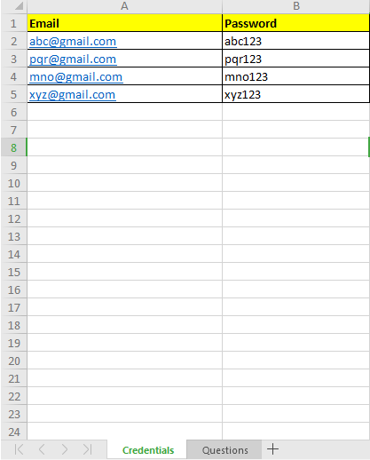
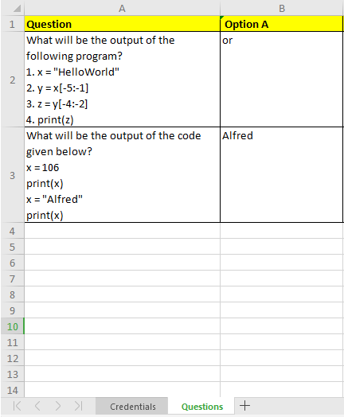
Excel read/write
Snap shot of the database
used in a mini project.

Slide 50
Excel read/write
Reading the data from the excel sheet:
sh1 = wb['credentials’] # sh is object of wb class
data = sh1['B2'].value
#print(data)
# or
d = wb['credentials']['B4'].value
#print(d)
# or
d = sh1.cell(4,2).value # cell(row,col)
#print(d)
# or
d = sh1.cell(column=2,row=4).value #using keyword arg #d is an object of cell class
print(d)

Slide 51
Excel read/write
# using wb directly
print("...",wb.get_sheet_by_name('credentials').cell(row =2, column=2).value)
# get max rows and columns
r = sh1.max_row
c = sh1.max_column
print(r,c)
for i in range(1,r+1):
for j in range(1, c+1):
print(sh1.cell(i,j).value) # gets value in each cell
pass
# to add data to excel and save
sh1.cell(row=6,column=1,value="atoz@gmail.com")
sh1.cell(row=6,column=2,value="atoz123")
wb.save("reports.xlsx")

Slide 52
Excel read/write
Create a new excel sheet
from openpyxl import Workbook
wb = Workbook() # creates a new workbook
print(wb.active.title)
print(wb.sheetnames)
wb['Sheet'].title ="automation_report“ # gives a name to the active sheet
sh1 = wb.active
sh1['A1'] = "Name"
sh1['B1']="Status"
sh1['A2']="Python"
sh1['B2']="Active"
sh1['A3']="Perl"
sh1['B3']="Active"
sh1['A4']="C"
sh1['B4']="Inactive“
wb.save("Final_automation_Report.xlsx") # saves the content

Slide 53
6. Classes - OOPS

Slide 54
OOPS
Sr. No. | Key | Object Oriented Programming (OOP) | Procedural Oriented Programming (POP)
1 | Definition | Object-oriented Programming is a programming language that uses classes and objects to create models based on the real world environment. In OOPs it makes it easy to maintain and modify existing code as new objects are created inheriting characteristics from existing ones. | On other hand Procedural Oriented Programming is a programming language that follows a step-by-step approach to break down a task into a collection of variables and routines (or subroutines) through a sequence of instructions. Each step is carried out in order in a systematic manner so that a computer can understand what to do.
2 | Approach | In OOPs concept of objects and classes is introduced and hence the program is divided into small chunks called objects which are instances of classes. | On other hand in case of POP the the main program is divided into small parts based on the functions and is treated as separate program for individual smaller program.

Slide 55
OOPS
Sr. No. | Key | Object Oriented Programming (OOP) | Procedural Oriented Programming (POP)
3 | Access modifiers | In OOPs access modifiers are introduced namely as Private, Public, and Protected | On other hand no such modifiers are introduced in POP.
4 | Security | Due to abstraction in OOPs data hiding is possible and hence it is more secure than POP. | On other hand POP is less secure as compare to OOPs.
5 | Complexity | OOPs due to modularity in its programs is less complex and hence new data objects can be created easily from existing objects making object-oriented programs easy to modify | On other hand there’s no simple process to add data in POP at least not without revising the whole program.

Slide 56
OOPS
Class
Object
Methods
A class is a blueprint for the objects.
Inheritance
Polymorphism
Abstraction
Encapsulation
An object is an entity that has attributes and behavior.
+
Behavior(s) of objects are called methods in programming.

Slide 57
OOPS
What is class?
Predefined keyword
User defined data type
Class is a template or blue print for objects
Collection of Variables and functions
Collection of objects that has common properties etc.
What is Object?
Collection of data and its functionality (or)
An entity that has states and behaviours (or)
An instance of class which contains variables and methods

Slide 58

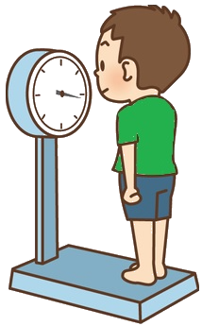


OOPS
Class Human
Object
Dhoni
Object attributes
Class
Human
Name
Height
Weight
Object Attributes
Name, Weight, Height
Object behaviour
Walking, Eating
Object behaviour
Walk
Eat

Slide 59
OOPS
class Human:
class Human
# instance attributes
def __init__(self, name, height, weight):
self.name = name
self.height = height
self.weight = weight
Object attributes
Name
Height
Weight
# instance methods (behaviors)
def eating(self, food):
return "{} is eating {}".format(self.name, food)
Object behaviour
Walk
Eat
# creating object of class Human
Dhoni = Human(“MS Dhoni", 1.75, 70)

Slide 60





OOPS
class Human:
# instance attributes
def __init__(self, name, height, weight):
self.name = name
self.height = height
self.weight = weight
# instance methods (behaviours)
def eat(self, food):
return "{} is having ice cream - {} flavor ".format(self.name, food)
def walk(self, speed):
return "{} walks {} ".format(self.name, speed)
# creating objects of class Human
dhoni = Human("MS Dhoni", 1.75, 70)
sindu = Human("PV Sindu", 1.79, 65)
# accessing object information
print("Height of {} is {}".format(dhoni.name, dhoni.height))
print("Weight of {} is {}".format(dhoni.name, sindu.weight))
print(dhoni.eat("strawberry"))
print(dhoni.walk("slow"))
print("Weight of {} is {}".format(sindu.name, sindu.height))
print("Weight of {} is {}".format(sindu.name, sindu.weight))
print(sindu.eat("chocolate"))
print(sindu.walk("fast"))
class Human
Object attributes
Name
Height
Weight
Object behaviour
Walk
Eat
Obj1 = Human(n, h, w)
Obj2 = Human(n, h, w)
Obj1.walk()

Slide 61
OOPS
Difference between Function and Method:
Function:
It is always independent, not related to any class
No self parameter is required
NO instance is required to be called
Method:
It is always related to a class
Self parameter is required
Always an instance is required to call the method

Slide 62
OOPS
#Class members can be accessed using class name.
class Test:
a=10
#print(a) # error : NameError: name 'a' is not defined
print(Test.a)
#class level method m() can be accessed using class name.
class Test:
a=10
def m():
print("a value : ", Test.a)
return
Test.m()

Slide 63
OOPS
#Local variable can be accessed directly with in the method.
class Test:
a=10
def m():
a=20
print("local - a : ", a)
print("class level - a : ", Test.a)
return
Test.m()
#We can modify the value of a variable from a method:
class Test:
a=10
def m1():
print("a value : ",Test.a)
Test.a = Test.a + 20
Test.m2()
return
def m2():
print("a value : ",Test.a)
return
Test.m1()

Slide 64
OOPS
#We can define more than one class in the same .py file
class Test1:
a=10
class Test2:
def m():
print("a value : ",Test1.a)
return
Test2.m()
#We can define global variables outside to all the classes in python program:
a=10
class Test:
a=20
def m():
print(a)
print(Test.a)
return
Test.m()

Slide 65
OOPS
#We can access global variable inside the function using global keyword.
a=10
class Test:
a=20
def m():
global a
print(a)
a=a+30
print(Test.a)
return
Test.m()
print(a)
print(Test.a)
#Parameter(local variable) and class level variable can have the same name:
class Test:
a=10
def m(a):
print(a)
Test.a += a
return
Test.m(20)
print(Test.a)

Slide 66
OOPS
#Global variable and function parameter should not match:
a=10
class Test:
def m(a):
global a # error : parameter name match with global variable 'a'
print(a)
a=a+30
return
Test.m(20)
print(a)

Slide 67
OOPS
Object level members:
Object level members are specific to object.
These variables get memory allocation everytime when we create object.
These members need to access using object address.
#How to create object:
class Test:
pass
obj=Test()
print("Object address : ", obj)

Slide 68
OOPS
#printing Object address using __hash__() method:
class Test:
pass
obj1 = Test()
obj2 = Test()
print("Object address : ", obj1.__hash__())
print("Object address : ", obj2.__hash__())

Slide 69
OOPS
Object level method:
Object level methods must be defined using an argument(self).
'self' variable holds the object address.
Using 'self', we can access object members from that function.
class Test:
def m(self):
print("Object level method")
return
obj = Test()
obj.m()

Slide 70
OOPS
#Printing object address using 'self' keyword.
class Test:
def fun(self):
print("Object address : ", self)
return
obj=Test()
obj.fun()
#'self' is optional but recommended.
class Test:
def fun(obj_ref):
print("Object address : ", obj_ref)
return
obj=Test()
obj.fun()

Slide 71
OOPS
Object level variable:
Belongs to object
Get memory everytime when we create object.
Need to initialize using constructor.
class Test:
def __init__(self, a):
self.a = a
return
obj = Test(10)
print("a value : ",obj.a)

Slide 72
OOPS
#Object members need to access from object level functions using 'self' keyword.
class Test:
def __init__(self, a):
self.a = a
return
def display(self):
print("a value : ",self.a)
return
obj = Test(10)
obj.display()

Slide 73
OOPS
'''
Class level members : Access using class
Object level members : Access using object address
Local members : direct access
'''
class Test:
a=10
def __init__(self, a):
self.a = a
return
def display(self):
a=30
print("method - a : ",a)
print("object - a : ", self.a)
print("class - a : ", Test.a)
return
obj = Test(20)
obj.display()

Slide 74
OOPS
#Display address using self keyword and object reference variable:
class Test:
def display(self):
print("Address : ",self)
return
t1 = Test()
t2 = Test()
print("t1-address : ", t1)
t1.display()
print("t2-address : ", t2)
t2.display()

Slide 75
OOPS
#Account operations :
class Account:
def __init__(self,balance):
self.balance = balance
return
def withdraw(self, amount):
print("Withdrawing.... : ", amount)
print("Avail balance : ", self.balance)
if amount<=self.balance :
self.balance = self.balance - amount
print("Collect cash : ",amount)
else:
print("Low balance error")
return
amount = int(input("Enter initial amount : "))
acc = Account(amount)
print("balance : ",acc.balance)
amount = int(input("Enter amount to withdraw : "))
acc.withdraw(amount)
print("Final balance : ", acc.balance)

Slide 76
OOPS
class Institute:
def __init__(self, course):
self.course = course
return
def whichClass(self):
print(self.course," class is going on")
return
def reception():
room1 = Institute("C")
room2 = Institute("Python")
room3 = Institute("Java")
room2.whichClass()
room3.whichClass()
return
Institute.reception()

Slide 77
#Withdraw operations:
class Account:
def __init__(self, pin , balance):
self.pin = pin
self.balance = balance
return
def withdraw(self):
pin = int(input("Enter PIN : "))
if pin==self.pin :
amt = int(input("Enter amt to withdraw : "))
print("Avail balance : ", self.balance)
if amt<=self.balance :
self.balance = self.balance - amt
print("Collect cash : ",amt)
else:
print("Low balance error")
else:
print("Invalid pin")
print("Final balance : ", self.balance)
return
OOPS
a1 = Account(1234 , 9000)
a2 = Account(0000 , 12000)
print("Balance of a1 : ", a1.balance)
print("Balance of a2 : ", a2.balance)
print("Perform withdraw operations : ")
a1.withdraw()
a2.withdraw()

Slide 78
OOPS
OOPS
Class : It is a logical entity that has some specific attributes and methods.
Object : When we define a class, it needs to create an object to allocate the memory.
Method : The method is a function that is associated with an object.
Inheritance : By using inheritance, we can create a class which uses all the properties
and behavior of another class.
Polymorphism : Poly means many, and morph means shape. By polymorphism, we
understand that one task can be performed in different ways.
Data Abstraction : Data abstraction is achieved through encapsulation.
Encapsulation : Abstraction is used to hide internal details and show only functionalities.

Slide 79
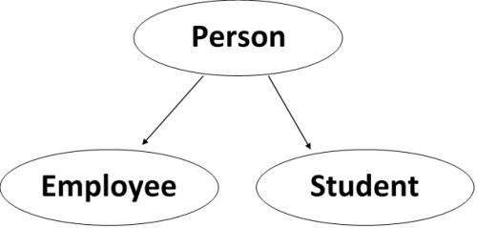
OOPS
Multithreading
Inheritance
Defining a class from existing object functionality.
Classes can inherit from other classes.
A class can inherit attributes and behavior methods from another class, called the superclass.
A class which inherits from a superclass is called a subclass, also called heir class or child class.
Syntax :
class BaseClassName:
pass
class DerivedClassName ( BaseClassName ) :
pass

Slide 80
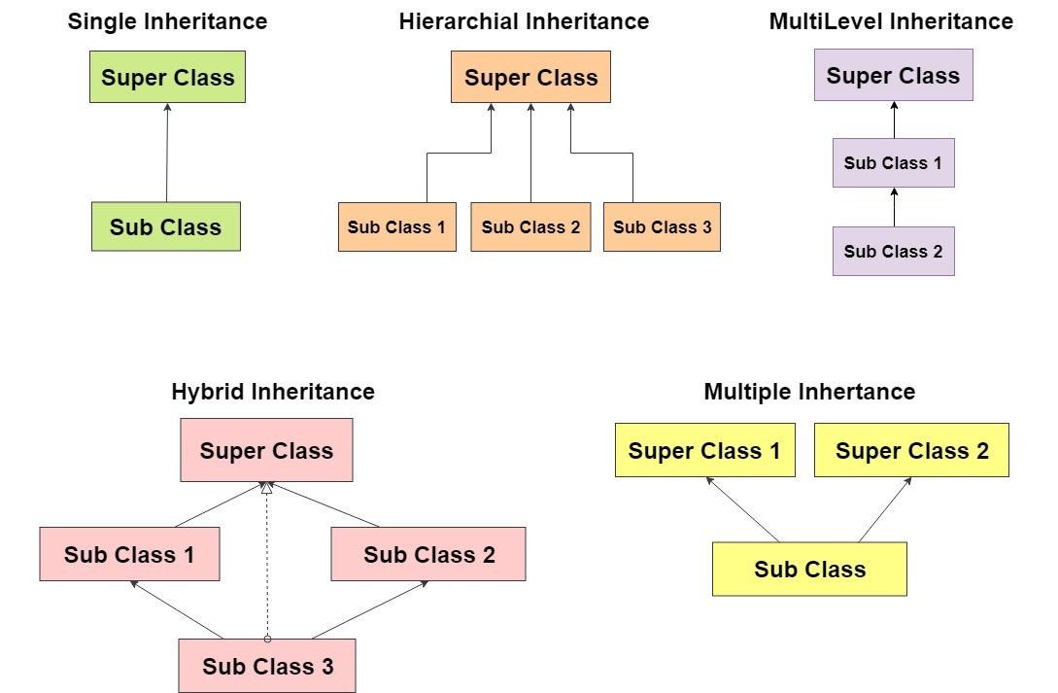
OOPS
OOPS
Types of inheritance:

Slide 81
OOPS
OOPS
Single Inheritance:
We need to instantiate Child class to Access Parent class funcationality as well as Child class.
Class level functionality can be accessed directly by using class name.
In Child object creation, first Parent object will be created.
Parent and Child objects get memory allocation at same place(combined object)
class Parent():
def first(self):
print('first function')
return
class Child(Parent):
def second(self):
print('second function')
return
ob = Child()
ob.first()
ob.second()
class Parent :
def m1():
print("Parent's functionality")
return
class Child(Parent):
def m2():
print("Child's functionality")
return
Child.m1()
Child.m2()

Slide 82
OOPS
OOPS
Multi level Inheritance:
class Parent:
def par_func(self):
print("this is parent function ")
class Child1(Parent):
def func1(self):
print("this is function 1")
class Child2(Child1):
def func2(self):
print("this is function 2")
ob = Child2()
ob.par_func()
ob.func1()
ob.func2()
Accessing more than one level
of objects functionality

Slide 83
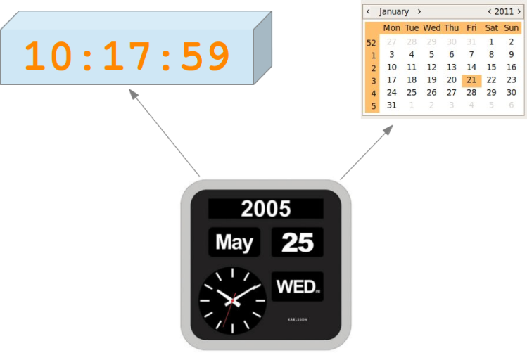
OOPS
OOPS
Multiple Inheritance:
class Time :
def getTime(self):
print("Print System time")
return
class Date :
def getDate(self):
print("Print System Date")
return
class Watch(Time,Date):
def display(self):
self.getTime()
self.getDate()
return
obj = Watch()
obj.display()
class Parent:
def func1(self):
print("this is function 1")
class Parent2:
def func2(self):
print("this is function 2")
class Child(Parent , Parent2):
def func3(self):
print("this is function 3")
ob = Child()
ob.func1()
ob.func2()
ob.func3()

Slide 84
OOPS
OOPS
class Parent:
def func1(self):
print("this is function 1")
return
class Child1(Parent):
def func2(self):
print("this is function 2")
return
class Child2(Parent):
def func3(self):
print("this is function 3")
return
ob1 = Child1()
ob2 = Child2()
ob1.func1()
ob1.func2()
ob2.func1()
ob2.func3()
Hierarchical Inheritance:
class Vehicle:
def fuel(self):
return "Petrol"
class Car(Vehicle):
def fuel(self):
return "CNG"
class Bike(Vehicle):
pass
c = Car()
print("Car fuel type : ", c.fuel())
b = Bike()
print("Bike fuel type : ", b.fuel())

Slide 85
OOPS
OOPS
Hybrid Inheritance:
class Parent:
def par_func(self):
print("this is parent function ")
class Child1(Parent):
def func1(self):
print("this is function 1")
class Child2(Parent):
def func2(self):
print("this is function 2")
class Child3(Child1 , Child2):
def func3(self):
print("this is function 3")
ob = Child3()
ob.par_func()
ob.func1()
ob.func2()
ob.func3()

Slide 86
OOPS
OOPS
Super()
Super function allows us to call a parent method from the child class.
class Parent:
def func1(self):
print("this is function 1")
return
class Child(Parent):
def func2(self):
super().func1()
print("this is function 2")
return
ob = Child()
ob.func2()

Slide 87
OOPS
OOPS
Object initialization:
Assigning values to object level variables of class.
Object initialization must be done through constructor.
Parent class constructor need to be called from the Child class in object creation process.
Following example shows how to access Parent class constructor from Child class constructor.
Connecting constructors in object creation process is called ‘Constructor Chaining’.
class Parent :
def __init__(self):
print("Parent's object creation")
return
class Child(Parent):
def __init__(self):
Parent.__init__(self)
print("Child's object creation")
return
obj = Child()

Slide 88
OOPS
OOPS
Initializing Parent Object in Child object creation process:
class Parent :
def __init__(self, a):
self.a = a
return
class Child(Parent):
def __init__(self, a, b):
Parent.__init__(self, a)
self.b = b
return
obj = Child(10,20)
print("Parent's a value : ", obj.a)
print("Child's b value : ", obj.b)

Slide 89
OOPS
OOPS
Initializing objects in Multiple inheritance:
class Parent1 :
def __init__(self,a):
self.a = a
return
class Parent2 :
def __init__(self,b):
self.b = b
return
class Child(Parent1, Parent2):
def __init__(self,a,b):
Parent1.__init__(self,a)
Parent2.__init__(self,b)
return
def display(self):
print("a value : ", self.a)
print("b value : ", self.b)
return
obj = Child(10,20)
obj.display()

Slide 90
OOPS
OOPS
Overriding:
Defining a method in the Child class with the same name and same number of arguments of Parent class method.
Method overriding is the concept of updating existing object functionality if it is not sufficient to extended class
class SamsungGuru :
def call(self):
print("GURU - Calling....")
return
def camera(self):
print("GURU - VGA camera....")
return
class SamsungGalaxy(SamsungGuru):
# we can access existing(call) functionality
def videoCall(self):
print("Galaxy - Video calling....")
return
def camera(self):
print("Galaxy - 12MP camera....")
return
galaxy = SamsungGalaxy()
galaxy.call() # existing method
galaxy.camera() # updated method
galaxy.videoCall() # new method

Slide 91
OOPS
OOPS
Accessing Overridden functionality of Parent class:
class Parent:
def fun(self):
print("Parent")
return
class Child(Parent):
def fun(self):
super().fun()
print("Child")
return
def getIdentity(self):
self.fun()
return
obj = Child()
obj.getIdentity()

Slide 92
OOPS
OOPS
We can access the functionality of all the objects in the hierarchy from the child class by specifying class type along with object address.
class Grand:
def fun(self):
print("Grand parent")
return
class Parent(Grand):
def fun(self):
print("Parent")
return
class Child(Parent):
def fun(self):
print("Child")
return
def getIdentity(self):
self.fun()
super(Child, self).fun()
super(Parent , self).fun()
return
obj = Child()
obj.getIdentity()

Slide 93
OOPS
OOPS
Accessing overridden functionality in Multiple inheritance
class Parent1:
def fun(self):
print("Parent-1")
return
class Parent2:
def fun(self):
print("Parent-2")
return
class Child(Parent1,Parent2):
def fun(self):
super().fun()
print("Child")
return
def getIdentity(self):
self.fun()
return
obj = Child()
obj.getIdentity()

Slide 94
OOPS
OOPS
Private variables in Python:
A variable declaration representation using __identity is called private variable.
We can access private variable only with in the class.
Access class level variable within the class:
class A:
__a=10
def display():
print("private a value : ", A.__a)
return
A.display()
Access class level variable from outside class gives error:
class A:
__a=10
class B:
def display():
print("private a value : ", A.__a)
return
B.display()

Slide 95
OOPS
OOPS
Access object level private variable within the class :
class A:
def __init__(self, a):
self.__a = a
return
def display(self):
print("private a value : ", self.__a)
return
obj = A(10)
obj.display()
Access object level private variable from another class:
class A:
def __init__(self, a, b):
self.a = a
self.__b = b
return
class B:
def display():
obj = A(10,20)
print("public a value : ", obj.a)
print("private b value : ", obj.__b)
return
B.display()

Slide 96
OOPS
OOPS
Protected variable access using Parent-Child class :
Representing a variable using ‘ _ ‘ is called protected variable.
Protected variable can be accessed only if parent-child relation is present.
class A:
def __init__(self, a, b):
self.a = a
self._b = b # protected variable
return
class B(A):
def display():
obj = A(10,20)
print("public a value : ", obj.a)
print("private b value : ", obj._b)
return
B.display()

Slide 97
OOPS
OOPS
Accessing Protected functionality of Parent class:
class Parent:
def __init__(self, x, y):
self.__x = x
self._y = y
class Child(Parent):
def __init__(self, x, y):
Parent.__init__(self,x,y)
super().__init__(x,y)
def getPrint(self):
print("x value : ", self.__x)
print("y value : ", self._y)
return
obj = Child(10,20)
obj.getPrint()
Output:
print("x value : ", self.__x)
AttributeError: 'Child' object has no attribute '_Child__x'

Slide 98
OOPS
OOPS
Compiler error when we access a private function from another class:
class A:
def __fun(self):
print("Hello")
return
class B:
def access():
obj = A()
obj.__fun()
return
B.access()
output:
obj.__fun()
AttributeError: 'A' object has no attribute '_B__fun'

Slide 99
OOPS
OOPS
Overridden function accessing in
Multiple inheritance:
class Parent1:
def fun(self):
print("Parent1")
return
class Parent2:
def fun(self):
print("Parent2")
return
class Child(Parent1,Parent2):
def fun(self):
print("Child")
return
def access(self):
self.fun()
super().fun()
return
obj = Child()
obj.access()
#Accessing all the Parents functionality in Multiple inheritance :
class Parent1:
def fun(self):
print("Parent1")
return
class Parent2:
def fun(self):
print("Parent2")
return
class Child(Parent1,Parent2):
def fun(self):
print("Child")
return
def access(self):
self.fun()
Parent1.fun(self)
Parent2.fun(self)
return
obj = Child()
obj.access()

Slide 100
OOPS
OOPS
Hybrid or Diamond inheritance:
When we access the functionality of Parent class and it is present in both the parent classes, it will access from left.
class A:
def fun(self):
print("A class fun")
return
class B(A):
def fun(self):
print("B class fun")
return
class C(A):
def fun(self):
print("C class fun")
return
class D(B,C):
pass
obj = D()
obj.fun()

Slide 101
OOPS
OOPS
Check this out:
class A:
def fun(self):
print("A class fun")
return
class B(A):
pass
class C(A):
def fun(self):
print("C class fun")
return
class D(B,C):
pass
obj = D()
obj.fun()
Check this example:
class A:
def fun(self):
print("A class fun")
return
class B(A):
pass
class C(A):
def fun(self):
print("C class fun")
return
class D(B,C):
pass
obj = D()
A.fun(obj)
B.fun(obj)
C.fun(obj)
D.fun(obj)

Slide 102
OOPS
OOPS
Accessing Parent class constructor from Child class using super() method:
class A :
def __init__(self , x):
self._a = x
class B(A):
def __init__(self , x):
super(B,self).__init__(x)
def getDetails(self):
print("Child's a value : " , self._a)
return
obj = B(10)
obj.getDetails()

Slide 103
OOPS
OOPS
Encapsulation:
Concept from capsule
It is the concept of protecting object
We can apply encapsulation by following few rules.
class Emp:
def __init__(self, eno=0, ename=''):
self.__eno = eno
self.__ename = ename
return
def getEno(self):
return self.__eno
def setEno(self,eno):
self.__eno = eno
return
#cont…
def getEname(self):
return self.__ename
def setEname(self,ename):
self.__ename = ename
return
class Access:
def main():
e1 = Emp(101 , 'Syam')
e2 = Emp()
e2.setEno(102)
e2.setEname('Annie')
# print("e1-ename : ", e1.__eno) #error :
print("e1-ename : ", e1.getEname())
print("e2-ename : ", e2.getEname())
return
if __name__ == '__main__':
Access.main()

Slide 104
OOPS
OOPS
Abstraction:
class Parent:
def m1(self):
pass
class Child(Parent):
def m1(self):
print("m1")
return
def m2(self):
print("m2")
return
obj = Child()
obj.m1()
obj.m2()

Slide 105
OOPS
OOPS
Method Overriding
Method Overloading – not possible
class Father():
def Fname(self):
print("Father's First Name")
def Lname(self):
print("Father's Last Name")
class Son(Father):
def Fname(self):
print("Son's First Name")
objSon = Son()
objSon.Fname()
objSon.Lname()
class Calculate():
def add(self,a,b):
return a+b
def add(self,a,b,c):
return a +b+c
obj = Calculate()
print(obj.add(3,1,3))
print(obj.add(3,1))
TypeError: add() missing 1 required positional argument: 'c'

Slide 106
7. Tkinter

Slide 107
GUI
Graphical User Interface
Kivy.
Libavg.
PyQT.
PySimpleGUI.
Pyforms.
Tkinter.
Wax.
WxPython.
We can implement GUI programming in Python in different ways
Tkinter :
Tkinter is the standard GUI library for Python.
Python when combined with Tkinter provides a fast and easy way to create GUI applications.
Tkinter provides a powerful object-oriented interface to the Tk GUI toolkit
wxPython :
This is an open-source Python interface for wxWindows.
It is cross platform application development.
It was developed using C++.

Slide 108
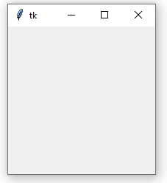
GUI
Simple window creation:
import tkinter
window = tkinter.Tk()
# widgets logic is here
window.mainloop()
Tk() need to be initialized to get Window with a title bar.
It is the root widget and it should be created before all other widgets.

Slide 109
GUI
Tk supports 3 pre-defined Layouts.
1. pack
2. grid
3. place
Note : We cannot use all the 3 layout managers pack, grid, and place in the same master window.
Pack:
Pack is the easiest layout to use of the three geometry managers of Tk and Tkinter.
Pack is recommended layout for Simple applications.
For example simple applications like placing a number of widgets side by side, or on top of each other.

Slide 110
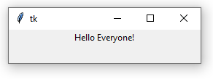
GUI
Label widget:
It is used to display Image or Text.
First parameter is the name of Parent window(root).
So our Label widget is a child of the root widget.
The keyword parameter "text" specifies the text to be shown
w = tkinter.Label(root, text="Hello Tkinter!")
pack() method tells Tk to fit the size according to text.
w.pack()
The window won't appear until we enter the Tkinter event loop:
root.mainloop()
import tkinter
root = tkinter.Tk()
label = tkinter.Label(root, text="Hello Everyone!")
label.pack()
root.mainloop()

Slide 111
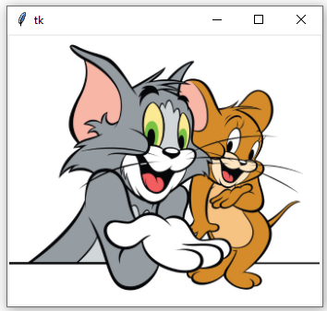
GUI
Image as Label:
import tkinter
window = tkinter.Tk()
logo = tkinter.PhotoImage(file="mickey.png")
label = tkinter.Label(window, image=logo)
label.pack()
window.mainloop()
Displaying text on image and arrange the label right side to window:
import tkinter as tk
root = tk.Tk()
logo = tk.PhotoImage(file="TomJerry.png")
names = 'This is Tom and Jerry'
label = tk.Label(root, compound = tk.CENTER,
text=names,
image=logo)
label.pack(side="right")
root.mainloop()

Slide 112
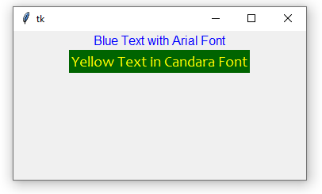
GUI
Fonts, backgrounds and foregrounds:
import tkinter as tk
root = tk.Tk()
tk.Label(root, text="Blue Text with Arial Font",
fg = "blue",
font = "Arial").pack()
tk.Label(root, text="Yellow Text in Candara Font",
fg = "yellow",
bg = "dark green",
font = "Candara 14").pack()
root.mainloop()

Slide 113
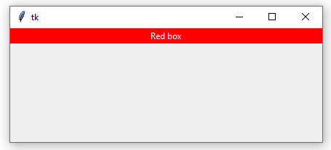
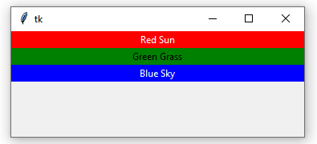
GUI
Layout : Arrangement of components(widgets) on the window.
Fill Option: If you want to make the widgets as wide as the parent widget, you have to use the fill=X option:
code-1:
import tkinter
root = tkinter.Tk()
w = tkinter.Label(root, text="Red box", bg="red", fg="white")
w.pack(fill=tkinter.X)
code-2:
from tkinter import *
root = Tk()
w = Label(root, text="Red Sun", bg="red", fg="white")
w.pack(fill=X)
w = Label(root, text="Green Grass", bg="green", fg="black")
w.pack(fill=X)
w = Label(root, text="Blue Sky", bg="blue", fg="white")
w.pack(fill=X)
mainloop()

Slide 114
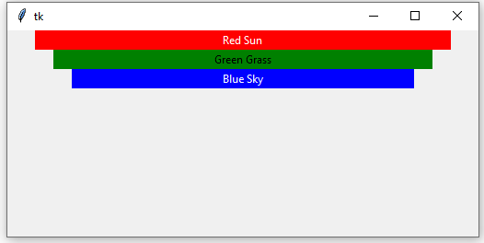
GUI
Padding: The pack() manager knows four padding options, i.e. internal and external padding
and padding in x and y direction:
from tkinter import *
root = Tk()
w = Label(root, text="Red Sun", bg="red", fg="white")
w.pack(fill=X,padx=30)
w = Label(root, text="Green Grass", bg="green", fg="black")
w.pack(fill=X,padx=50)
w = Label(root, text="Blue Sky", bg="blue", fg="white")
w.pack(fill=X,padx=70)
mainloop()

Slide 115
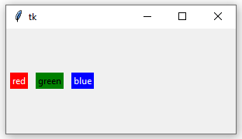
GUI
from tkinter import *
root = Tk()
w = Label(root, text="red", bg="red", fg="white")
w.pack(padx=5, pady=10, side=LEFT)
w = Label(root, text="green", bg="green", fg="black")
w.pack(padx=5, pady=20, side=LEFT)
w = Label(root, text="blue", bg="blue", fg="white")
w.pack(padx=5, pady=30, side=LEFT)
mainloop()

Slide 116
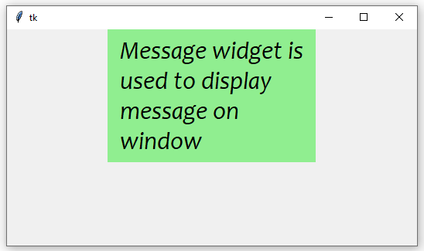
GUI
Display Msg on Window without Label:
import tkinter as tk
master = tk.Tk()
msg = "Message widget is used to display message on window"
msg = tk.Message(master,
text = msg,
bg='lightgreen',
font=('Candara', 24, 'italic'))
msg.pack()
tk.mainloop()

Slide 117
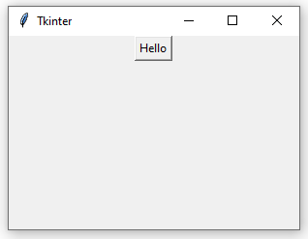
GUI
We can set size manually to Master window using geometry() method of Tk class.
We use geometry() function is used to set the size of Master window.
We cannot use geometry() function to place the widgets on the window.
Command: A property is used to access a function from the widget. Using command attribute only we can set functionality to widgets like Buttons, Radio Buttons etc
from tkinter import *
def hello():
print("Hello, world!")
win = Tk()
win.title("Tkinter")
win.geometry("300x200") # Size 300, 200
btn = Button(win, text="Hello", command=hello)
btn.pack()
mainloop()

Slide 118
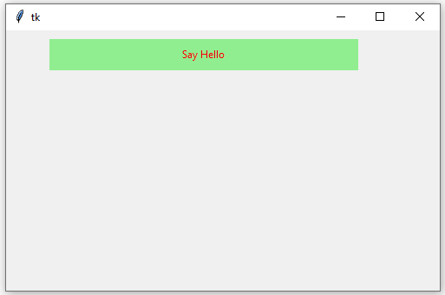
GUI
place() method is used to arrange the components on the window.
Once widget is ready with specific width, height and with other properties, we use place() method to set co-ordinates.
import tkinter as tk
root = tk.Tk()
root.geometry("500x300")
label = tk.Label(root, width=50, height=2, bg="light green", text="Say Hello", fg='red')
label.place(x=50,y=10)
root.mainloop()

Slide 119
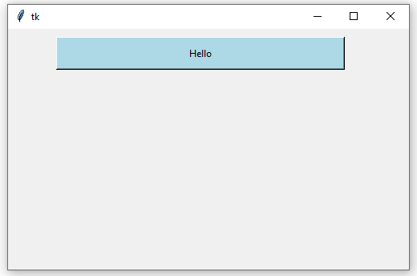
GUI
Set bounds to button :
import tkinter as tk
def hello():
print("Hello, world!")
root = tk.Tk()
root.geometry("500x300")
btn = tk.Button(root, text="Hello", command=hello, width=50, height=2, bg="light blue")
btn.place(x=60,y=10)
root.mainloop()

Slide 120
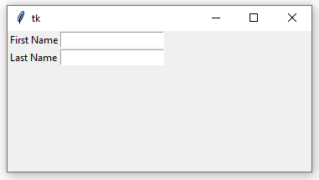
GUI
Text boxes :
from tkinter import *
master = Tk()
l1 = Label(master, text="First Name")
l2 = Label(master, text="Last Name")
l1.grid(row=0,column=0)
l2.grid(row=1,column=0)
e1 = Entry(master)
e2 = Entry(master)
e1.grid(row=0, column=1)
e2.grid(row=1, column=1)
mainloop()

Slide 121
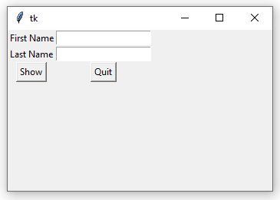
GUI
Grid Layout:
from tkinter import *
def show():
print("First Name:", e1.get())
print("Last Name : ", e2.get())
master = Tk()
l1 = Label(master, text="First Name")
l2 = Label(master, text="Last Name")
e1 = Entry(master)
e2 = Entry(master)
b1 = Button(master, text='Show', command=show)
b2 = Button(master, text='Quit', command=quit)
l1.grid(row=0,column=0)
e1.grid(row=0,column=1)
l2.grid(row=1,column=0)
e2.grid(row=1,column=1)
b1.grid(row=2, column=0)
b2.grid(row=2, column=1)
mainloop()

Slide 122
GUI
The Variable Classes:
Classes are BooleanVar, DoubleVar, IntVar, StringVar.
Variables can be used with most entry widgets to track changes to the entered value.
The Checkbutton and Radiobutton widgets require variables to work properly.
Variables can also be used to validate the contents of an entry widget, and to change the text in label widgets.
To create a Tkinter variable, call the corresponding constructor:
var = StringVar()
We can use setters to set values to widgets.
var = StringVar()
var.set("hello")

Slide 123
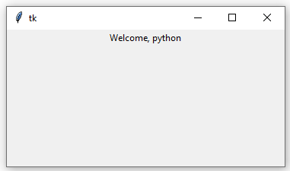
GUI
from tkinter import *
root = Tk()
var = StringVar()
label = Label(root, textvariable=var)
var.set("Welcome, python")
label.pack()
root.mainloop()

Slide 124
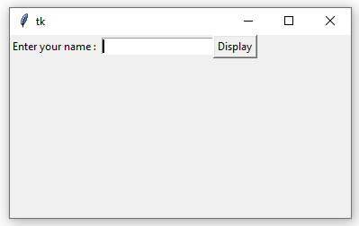
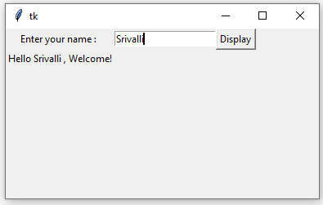
GUI
from tkinter import *
def setValue():
name = e.get()
msg = "Hello "+name+" , Welcome!"
var.set(msg)
print(msg)
return
master = Tk()
var = StringVar()
l = Label(master, text="Enter your name : ")
e = Entry(master)
b = Button(master, text='Display', command=setValue)
m = Label(master, textvariable=var)
l.grid(row=0,column=0)
e.grid(row=0,column=1)
b.grid(row=0,column=2)
m.grid(row=1)

Slide 125
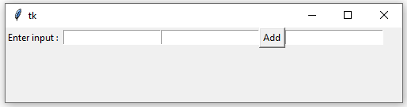
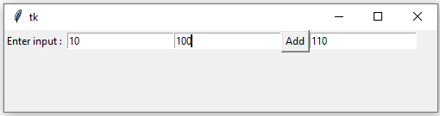
GUI
from tkinter import *
def add():
x = int(e1.get())
y = int(e2.get())
z = x+y
sum.set(str(z))
return
master = Tk()
sum = StringVar()
l = Label(master, text="Enter input : ")
e1 = Entry(master)
e2 = Entry(master)
plus = Label(master, text=" + ")
b = Button(master, text='Add', command=add)
e3 = Entry(master, textvariable=sum)
l.grid(row=0,column=0)
e1.grid(row=0,column=1)
e2.grid(row=0,column=2)
b.grid(row=0,column=3)
e3.grid(row=0,column=4)

Slide 126
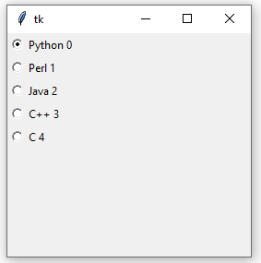
GUI
Radio Buttons :
import tkinter as tk
root = tk.Tk()
v = tk.IntVar()
v.set(0) # initializing the choice, i.e. Python
languages = [("Python",0),("Perl",1),("Java",2),("C++",3),("C",4)]
def ShowChoice():
print(v.get())
for val, language in enumerate(languages):
tk.Radiobutton(root, text=language,
variable=v,
command=ShowChoice,
value=val).pack(anchor=tk.W)
root.mainloop()

Slide 127
Iterators
Self Study

Slide 128
Generators
Self Study

Slide 129
Decorators
Self Study

Slide 130
Garbage Collection
Self Study

