Slide 1

CS207 DATA STRUCTURES & ALGORITHMS PROJECT
BANK MANAGEMENT SYSTEM
Full-Stack C++ Engine & Cloud Architecture
PROJECT GROUP MEMBERS:
• 1. Manikanta (Student 1)
• 2. Lokesh (Student 2)
• 3. Anil (Student 3)
• 4. Shishira (Student 4)
• 5. Chathwik (Student 5)

Slide 2
INTRODUCTION & MOTIVATION
Project Overview & Engineering Objectives
1. Problem Statement & Motivation
2. Core Deliverables & Highlights
• Bridging Theory and Practice: Traditional academic DSA assignments are often isolated code snippets. This project binds all concepts into a unified banking software ecosystem.
• Financial Precision: Eliminates floating-point rounding errors by utilizing integer paise calculations (`balancePaise`) for exact currency accounting.
• Multi-Developer Synergy: Modularized across 5 team members with zero variable pollution or header compilation collisions.
• 100% Syllabus Coverage: Covers Arrays, Structs, Linear/Binary Search, Insertion Sort, 2D Matrices, Strings, Stacks, Queues, and STL Containers.
• Modular Multi-File C++: Organized into `bank.h` and `student1.cpp` through `student5.cpp` for individual student evaluation.
• Full-Stack Web Interface: Paired with a modern React Vite dashboard, REST backend, and MongoDB Atlas dual-sync persistence.

Slide 3
ARCHITECTURE & TECHNOLOGY LAYERS
Full-Stack System Architecture & Tech Stack
Core C++ Engine
Node.js REST API
React Web Dashboard
Cloud Persistence
• Modular 5-file C++ build
• student1.cpp to student5.cpp
• In-memory Data Structures
• Fast O(1) / O(log n) logic
• Zero memory leak safety
• Express Server Architecture
• REST API CRUD routes
• Atomic Deposit & Withdraw
• Ledger Audit log dispatch
• Auto-reconnect controller
• React 19 + Vite 8 SPA
• Glassmorphic Dark UI
• 6-Account Pagination
• Money Studio deposit flow
• Real-time Toast Alerts
• MongoDB Atlas Cluster
• Mongoose Schema Validation
• Localhost data.json fallback
• Immutable Transaction log
• Fault-tolerant Dual Sync

Slide 4
5-STUDENT WORK BREAKDOWN STRUCTURE
Team Division & Student Responsibilities Matrix
Member Name | Module Focus | DSA Concepts | Key Deliverables & Functions
Manikanta (Student 1) | Account Management & Composite Structures | Modules I, II, VI Struct Nesting & Vectors | seedInitialData(), displayAllCustomers(), addNewCustomer(), Date/Address Structs
Lokesh (Student 2) | Financial Transactions & Search Algorithms | Modules II, III, VII Linear & Binary Search | linearSearchByPhone() O(n), binarySearchByAccountNo() O(log n), depositFunds(), withdrawFunds()
Anil (Student 3) | Sorting Algorithms & 2D Matrix Algebra | Modules III, IV, VII Insertion Sort & 2D Array | insertionSortByBalance() O(n^2), sortCustomers(), Matrix Add/Sub/Mult/Transpose demo
Shishira (Student 4) | String Processing & Stack ADT (LIFO) | Modules V, VIII Strings & Stack (LIFO) | reverseString(), countCharacterFrequency(), searchPattern(), Stack ADT & Parenthesis Check
Chathwik (Student 5) | Queue ADT, STL & Driver Controller | Modules I, II, IX, X Queues & STL Library | LinearQueue, CircularQueue with Modulo %, vector/pair/deque/set/map demos, main() menu

Slide 5
MODULES I, II, VI — STUDENT1.CPP
Student 1: Manikanta — Account Management & Structs
Core Composite Structures
Key Functions & Implementations
• Composite Entity Architecture: Defined `Customer` struct combining primitive types with nested `Date` (day, month, year) and `Address` (city, state, pincode) structs.
• Audit Record Entity: Engineered `Transaction` struct recording `txnId`, `accountNo`, `type` (OPENING, DEPOSIT, WITHDRAW), `amount`, and `balanceAfter`.
• Global Data Storage: Maintains master collections `customerList` and `transactionList` vectors with auto-increment ID counters.
• seedInitialData(): Pre-populates the database with 6 benchmark customer records and initial transaction audit logs for instant demonstration.
• displayAllCustomers(): Generates formatted tabular reports using `<iomanip>` (`setw`, `left`, `right`, `fixed`, `setprecision`).
• addNewCustomer(): Enforces strict input validation: minimum ₹500 initial deposit for SAVINGS accounts, verifies phone uniqueness, and auto-journals the opening transaction.

Slide 6
MODULES II, III, VII — STUDENT2.CPP
Student 2: Lokesh — Search Algorithms & Transactions
Searching Algorithms & Complexity
Financial Transactions & Audit Trail
• Linear Search (Phone Numbers): Performs sequential scan across unsorted `phone` records. Time Complexity: O(n), Space Complexity: O(1). Used for duplicate phone checks.
• Binary Search (Account Numbers): Divide-and-conquer search on sorted `accountNo`. Computes `mid = low + (high - low) / 2` to eliminate half the search space per iteration. Time Complexity: O(log n), Space: O(1).
• Lookup Efficiency: Guarantees logarithmic response time even with large account volumes.
• depositFunds(): Locates account via Binary Search, increases balance, and journals transaction log to `transactionList`.
• withdrawFunds(): Validates positive amount, overdraft protection, and enforces that SAVINGS account balance cannot fall below ₹500.00.
• viewTransactionHistory(): Displays chronological transaction ledger for any account with timestamp, amount, and updated balance.

Slide 7
MODULES III, IV, VII — STUDENT3.CPP
Student 3: Anil — Sorting Algorithms & 2D Matrix Math
Insertion Sort Algorithm
2D Numeric Array Matrix Operations
• Mechanics: Maintains a sorted subarray on the left and iteratively inserts incoming elements by shifting adjacent elements right.
• Bidirectional Support: Supports Ascending (lowest to highest balance) and Descending (highest to lowest balance) sorting.
• Complexity: Best Case: O(n) when already sorted. Worst/Average: O(n^2). Auxiliary Space: O(1) in-place sort.
• Practical Role: Enables portfolio rank ordering to identify high-net-worth customers.
• Branch Cash Flow Modeling: Simulates regional branch liquidity using 2x2 integer matrices (`int mat[2][2]`).
• 1. Matrix Addition (A + B): Consolidates total cash reserves across Branch A and Branch B.
• 2. Matrix Subtraction (A - B): Evaluates regional asset variance and cash disparities.
• 3. Matrix Multiplication (A * B): Projects compounded multi-period financial liquidity.
• 4. Matrix Transpose (A^T): Exchanges rows and columns for multidimensional financial reporting.

Slide 8
MODULES V, VIII — STUDENT4.CPP
Student 4: Shishira — String Processing & Stack ADT
String Algorithms & Analysis
Stack Abstract Data Type (LIFO)
• In-Place String Reversal: Swaps `str[i]` with `str[n-1-i]` moving towards center with O(n/2) = O(n) time and O(1) space.
• Character Frequency Histogram: Direct-address 256-bucket ASCII array counting character distribution in customer names.
• Naive Substring Matching: Sliding-window pattern search verifying account codes and transaction identifiers.
• Array-Based Stack ADT: Implements `SimpleStack` structure with `top` index pointer managing Last-In, First-Out (LIFO) order.
• Stack Primitives: `initStack()`, `isStackEmpty()`, `isStackFull()`, `push()` with Overflow check, and `pop()` with Underflow guard.
• Parentheses Balance Checker: Real-world stack application checking expression balance (e.g. `(A+B)*(C-D)`) for mathematical formula integrity in interest calculations.

Slide 9
MODULES I, II, IX, X — STUDENT5.CPP
Student 5: Chathwik — Queue ADT, STL & Driver Menu
Queue ADT (Linear & Circular)
STL Containers & Main Controller
• Linear Queue (FIFO): Implements `LinearQueue` with `front` and `rear` pointers for bank teller customer token management.
• Circular Queue (Modulo Wraparound): Solves linear queue false-overflow using modulo arithmetic: `rear = (rear + 1) % MAX`.
• Optimal Efficiency: `circularEnqueue()` and `circularDequeue()` run in guaranteed O(1) time.
• STL Demonstration (Module X): Showcases `std::vector` + `std::pair` (account & balance), `std::deque` (VIP priority lines), `std::set` (unique phone numbers), and `std::map` (O(log n) account lookups).
• Console Menu Interface: 14-option interactive console menu cleanly categorized by student responsibilities.
• Main Application Driver: Central execution event loop handling error checking and routing requests to all 5 student modules.

Slide 10

VISUAL ALGORITHMIC MAPPING
Data Structures & Algorithmic Architecture
Core Algorithmic Foundations
• Binary Search Tree Logic: Fast divide-and-conquer lookups guaranteeing O(log n) performance for customer identification.
• LIFO Stack Primitives: Memory-safe push and pop execution for financial formula validation.
• FIFO & Circular Queues: Modulo wrap-around token dispatching for zero memory wastage.
• STL Red-Black Tree Maps: High-speed key-value lookups linking account numbers directly to customer names.

Slide 11
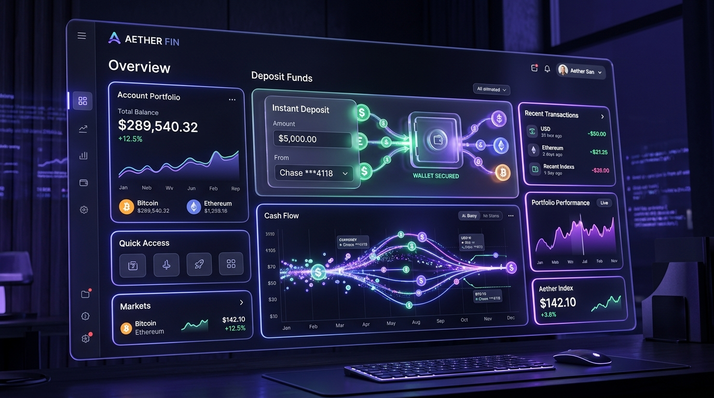
REACT 19 + VITE 8 UI ENGINEERING
Modern Web Dashboard & User Experience
User Experience Innovations
• Initial 6-Account Pagination: Renders first 6 accounts on load (`slice(0, 6)`) to maintain clean visual balance.
• Interactive 'Show More' Toggle: Expands to show all remaining accounts upon click and toggles to 'Show Less' to collapse.
• Money Studio & Presets: Dedicated deposit/withdrawal cards with quick presets (+₹500, +₹1,000, +₹5,000, +₹10,000).
• Confetti & Feedback: Interactive particle celebrations on successful transactions and floating toast alert alerts.

Slide 12

MONGODB ATLAS & LOCALHOST FALLBACK
Cloud Persistence & Dual-Sync Engine
Dual-Persistence Architecture
• MongoDB Atlas Cloud: Primary cloud cluster storing accounts and transaction audit history with Mongoose schema validation.
• Zero-Downtime Fallback: If cloud is unreachable, backend auto-switches to local `data.json` without interrupting user transactions.
• Integer Currency Accuracy: Calculates in integer paise (`balancePaise`) to eliminate floating-point rounding errors.
• Instant Reconnect: One-click reconnect button on dashboard to re-synchronize local data with MongoDB Atlas.

Slide 13
MODULE VII — THEORETICAL & PRACTICAL BENCHMARKS
Algorithm Complexity & Performance Analysis
Algorithm / Operation | Best Time | Worst Time | Aux Space | Practical Application in Project
Linear Search (Phone) | O(1) (First element) | O(n) (Last element) | O(1) | Duplicate phone validation
Binary Search (Acc No) | O(1) (Mid match) | O(log n) (Subdivisions) | O(1) | Fast account lookups & deposits
Insertion Sort (Balance) | O(n) (Already sorted) | O(n^2) (Reversed) | O(1) | Portfolio balance sorting
Matrix Operations (2x2) | O(N^3) / O(N^2) | O(N^3) / O(N^2) | O(N^2) | Branch cash flow simulation
Stack Push / Pop | O(1) | O(1) | O(N) | Expression validation
Queue Enqueue / Dequeue | O(1) | O(1) | O(N) | Teller token dispatch line

Slide 14
SUMMARY & EVALUATION Q&A
Conclusion & Future Enhancements
Future Scope & Extensions
Thank You & Group Evaluation
• AVL / B-Tree Indexing: Integrate self-balancing B+ Trees for large-scale disk-based account index lookups.
• Multi-Threaded Concurrency: Implement POSIX mutex locking for multi-teller transaction safety.
• AI Anomaly Detection: Deploy graph algorithms to detect fraudulent transaction spikes.
Presented by:
• Group Members: Manikanta, Lokesh, Anil, Shishira, Chathwik
• Source Code: github.com/manikantareddemoni-glitch/bank-management-system
• Live Deployment: Dual-Sync Cloud Web Engine
• Open Floor: We welcome your questions and algorithmic evaluation!

