Slide 1

CS207 DATA STRUCTURES & ALGORITHMS
BANK MANAGEMENT
SYSTEM
GROUP MEMBERS:
• Manikanta
• Lokesh
• Anil
• Shishira
• Chathwik

Slide 2
Project Overview
Introduction & Purpose
• Core Objective: Build a unified, full-stack banking engine applying core Data Structures & Algorithms.
• Dual Architecture: High-performance modular C++ engine paired with a modern React web dashboard.
• 100% Syllabus Coverage: Implements Structs, Searching, Sorting, 2D Matrices, Strings, Stacks, Queues, and STL.
• Financial Precision: Integer paise arithmetic (`balancePaise`) eliminates floating-point rounding errors.
• Cloud Persistence: MongoDB Atlas cloud storage with automated localhost fallback (`data.json`).

Slide 3
System Architecture
Multi-Tier Technology Stack
• 1. Core Engine (C++): Modular 5-student architecture (`bank.h`, `student1.cpp` to `student5.cpp`).
• 2. REST API (Node.js & Express): Endpoints for account onboarding, deposits, withdrawals, and ledger streaming.
• 3. Web Frontend (React 19 + Vite 8): Glassmorphic dark dashboard with initial 6-record pagination and analytics.
• 4. Database (MongoDB Atlas): Dual-sync cloud cluster persistence with automatic offline recovery.

Slide 4
Team Division & Student Responsibilities
5-Student Modular Work Breakdown
• Student 1 (Manikanta): Account Management, Composite Structures & Tabular Reporting (`student1.cpp`)
• Student 2 (Lokesh): Linear Search, Binary Search, Deposit/Withdraw Transactions (`student2.cpp`)
• Student 3 (Anil): Insertion Sort (Asc/Desc) & 2D Matrix Cash Flow Algebra (`student3.cpp`)
• Student 4 (Shishira): String Algorithms, Frequency Analysis & Stack ADT (`student4.cpp`)
• Student 5 (Chathwik): Linear & Circular Queue ADT, STL Containers & Main Controller (`student5.cpp`)

Slide 5
Student 1: Manikanta
Account Management & Data Structures (Modules I, II, VI)
• Composite Structures: Nested `Date` and `Address` structs inside the core `Customer` entity.
• Demo Initialization (`seedInitialData`): Pre-loads 6 benchmark accounts and opening ledger logs.
• Account Onboarding (`addNewCustomer`): Enforces ₹500 minimum initial deposit and duplicate phone checks.
• Formatted Reports (`displayAllCustomers`): Tabular console formatting with `<iomanip>` (`setw`, `fixed`).

Slide 6
Student 2: Lokesh
Financial Transactions & Search Algorithms (Modules II, III, VII)
• Linear Search (O(n)): Sequential scan across customer phone numbers for duplicate detection.
• Binary Search (O(log n)): Divide-and-conquer search on sorted account numbers for instant lookup.
• Deposit & Withdraw Engine: Validates positive amount and enforces ₹500 minimum balance for Savings.
• Audit History Ledger: Generates chronological transaction logs for account deposits and withdrawals.

Slide 7
Student 3: Anil
Sorting Algorithms & 2D Matrix Math (Modules III, IV, VII)
• Insertion Sort (O(n^2)): In-place balance sorting supporting Ascending and Descending order.
• Portfolio Rank Ordering: Enables bank managers to identify high-net-worth customer tiers.
• 2D Numeric Matrix Operations: Simulates regional branch cash flow using 2x2 integer arrays.
• Matrix Algebra (Module IV): Implements Matrix Addition, Subtraction, Multiplication, and Transposition.

Slide 8
Student 4: Shishira
String Algorithms & Stack ADT (Modules V, VIII)
• In-Place String Reversal: Two-pointer swap algorithm reversing text in O(n) time and O(1) space.
• Frequency Histogram: Direct-address 256-bucket ASCII array counting character distribution.
• Stack ADT (LIFO): Array-based stack implementing `push`, `pop`, `isFull`, and `isEmpty`.
• Parenthesis Balance Checker: Stack application validating mathematical formula syntax in calculations.

Slide 9
Student 5: Chathwik
Queue ADT, STL Containers & Driver Menu (Modules I, II, IX, X)
• Linear Queue (FIFO): Bank teller token queue servicing customers First-In, First-Out.
• Circular Queue (Modulo %): Recycles memory using `(rear + 1) % MAX` to prevent false overflow.
• STL Containers (Module X): Demonstrates `std::vector`, `std::deque`, `std::set`, and `std::map`.
• Main Application Driver: 14-option interactive console controller routing all module actions.

Slide 10

Data Structures & Algorithmic Mapping
Core Algorithmic Foundations
• Binary Search Tree Logic: Fast divide-and-conquer lookup in O(log n) time.
• Stack & Queue Primitives: LIFO expression checks and FIFO token dispatching.
• Sorting & Matrix Algebra: In-place insertion sort and 2D cash flow matrix ops.
• STL Red-Black Maps: High-speed key-value linking of Account No to Name.

Slide 11
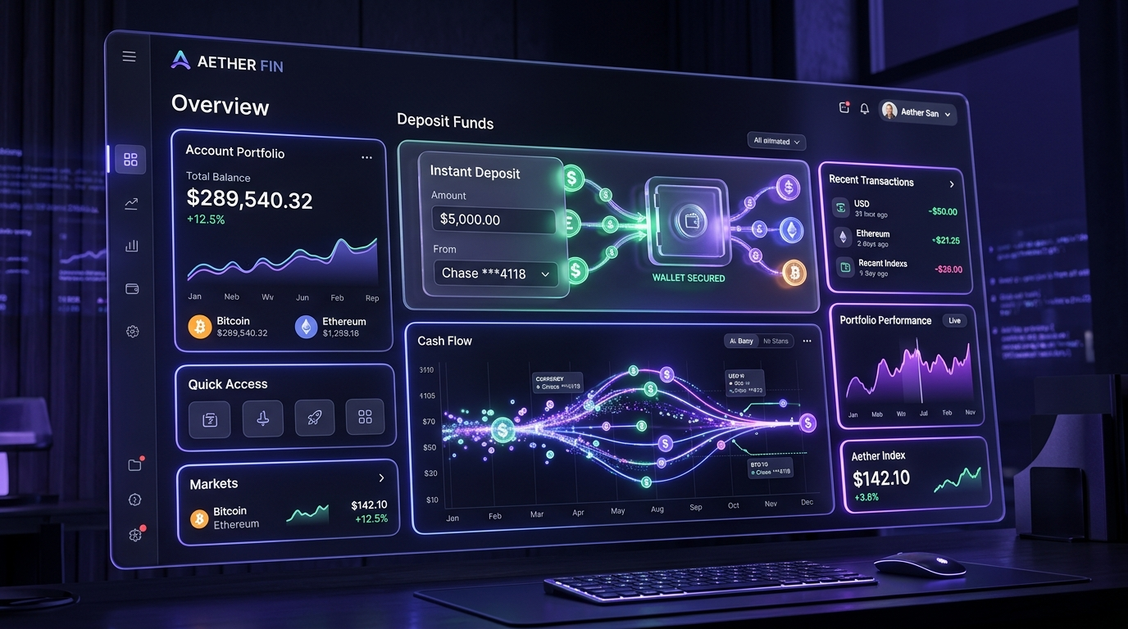
Modern Web Dashboard & User Experience
React 19 + Vite 8 UI Engineering
• Initial 6-Account Display: Renders only first 6 accounts on load for visual cleanliness.
• Show More / Show Less: Interactive toggle expanding to show remaining accounts.
• Money Studio: Deposit and withdraw cards with quick preset amount pills.
• Live Audit History: Instant transaction ledger search with real-time feedback.

Slide 12

Cloud Persistence & Dual-Sync Engine
MongoDB Atlas & Local Fallback
• MongoDB Atlas Cloud: Primary cloud storage for accounts and audit ledger.
• Zero-Downtime Fallback: Auto-switches to local `data.json` if cloud connection drops.
• Integer Currency Accuracy: Calculates in integer paise to eliminate floating-point errors.
• One-Click Reconnect: Instant cloud re-sync from web dashboard status indicator.

Slide 13
Algorithm Complexity Summary
Theoretical & Practical Benchmarks
Operation / Algorithm | Time Complexity | Space Complexity | Application
Linear Search (Phone) | O(n) | O(1) | Checking duplicate phone numbers
Binary Search (Acc No) | O(log n) | O(1) | Instant account lookup & transactions
Insertion Sort (Balance) | O(n^2) | O(1) | Sorting customer accounts by balance
Matrix Operations (2x2) | O(N^3) / O(N^2) | O(N^2) | Branch liquidity & cash flow
Stack Push / Pop | O(1) | O(N) | Parentheses formula validation
Queue Enqueue / Dequeue | O(1) | O(N) | Bank teller token line

Slide 14
Conclusion & Q&A
Summary & Evaluation
• Complete Syllabus Coverage: All 10 CS207 Data Structures modules implemented in C++.
• Modular Team Execution: Divided seamlessly among Manikanta, Lokesh, Anil, Shishira, Chathwik.
• Full-Stack Integration: Production-ready web dashboard with MongoDB cloud persistence.
• Repository: github.com/manikantareddemoni-glitch/bank-management-system
• Thank You: Open for Faculty Evaluation & Questions!

