Slide 1
Steganography
CAPSTONE PROJECT
Presented By: Gunta Manikanteswar Reddy
Student Name : Gunta Manikanteswar Reddy
College Name & Department : Sagi Rama Krishnam Raju Engineering College(CSE Specialization in Cybersecurity , IOT and Cryptography)

Slide 2
OUTLINE
Problem Statement
Technology used
Wow factor
End users
Result
Conclusion
Git-hub Link
Future scope

Slide 3
Problem Statement
Develop a method to securely hide and retrieve messages within images using Least Significant Bit (LSB) steganography. The solution must ensure that the hidden information is invisible to human eyes and protected with a password. This technique aims to provide a simple and effective way for secure communication.

Slide 4
Technology used
Python: The primary programming language used to write the code.
OpenCV: A library for computer vision and image processing tasks, used for reading and writing images.
VS Code (Visual Studio Code): An integrated development environment (IDE) used to write, debug, and manage the Python code.
OS Module: A standard Python library used for interacting with the operating system to handle files and execute system commands.
Command Line Interface (CLI): Used to run the Python script and interact with the user for input and output operations.

Slide 5
Wow factors
Stealth Communication: Hide messages in images without visible changes.
Password Protection: Secure decoding with a password.
Unnoticeable Changes: Embedded messages don't alter the image's appearance.
User-Friendly: Easy to use with minimal setup.
Versatile Applications: Useful for secure communication, digital watermarking, and data protection.

Slide 6
End users
Cybersecurity Enthusiasts: People interested in learning and applying data hiding techniques.
Secret Communicators: Users who need to send confidential messages discreetly.
Digital Forensics Experts: Professionals analyzing digital media for hidden information.
Software Developers: Developers looking to implement steganography in their applications.
Educational Institutions: Schools and universities teaching students about cryptography and information security.

Slide 7

Results

Slide 8
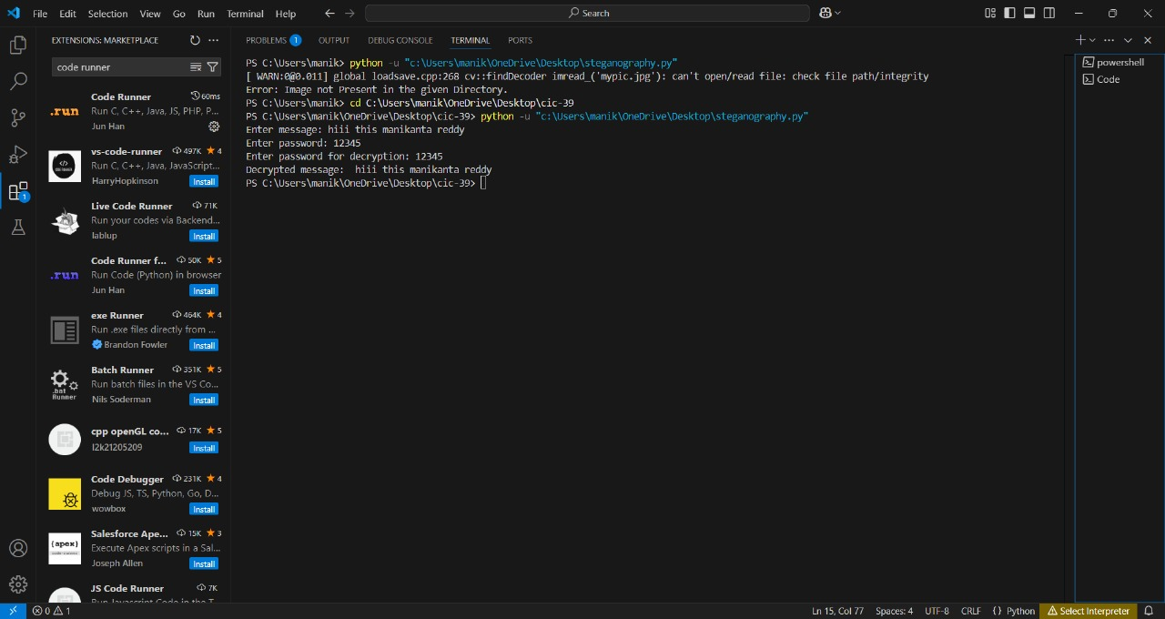

Slide 9


Slide 10
Conclusion
steganography project effectively demonstrates the ability to securely hide and retrieve messages within images using LSB techniques. It combines simplicity and functionality with features like password protection, ensuring the hidden information remains confidential. This project not only provides a practical solution for secure communication but also serves as an excellent learning tool for data hiding and cybersecurity concepts.

Slide 11
GitHub Link
https://github.com/manikantareddy15/steganography.git

Slide 12
THANK YOU

