Slide 1
Data Structures and Algorithms -3 (25CS2103E) Public-Transit Planner
T Venkata Siddarth (2520090187
D Sanjay (2520090133)
R Hema Manikanta (2520090228)
Under the Esteemed Guidance of
Dr. Dyuti Banerjee
Asst. Prof, AI&DS

Slide 2
Abstract
Purpose: Develop a data-structures-based system for planning efficient public transport routes
and timetables.
Data Processing: Cleans and organizes stop, route, and passenger-demand data.
Important Stops: Identifies major stops and high-demand connections.
Route Planning: Constructs feasible transport routes based on passenger demand and available resources.
Frequency Assignment: Assigns suitable service frequencies and departure times.
Fleet Management: Plans routes while considering the available number of buses and fleet capacity.
Budget Management: Keeps the transport plan within the fixed operating budget.
Performance Measures: Calculates demand coverage, average passenger travel time, and total
operating cost.
Objective: Provides an efficient and practical transport plan while satisfying real-world constraints.

Slide 3
Introduction
Transportation Challenge: Public transport agencies need to serve many passenger demand points with limited buses, drivers, time, and budget.
Problems with Traditional Planning: Manual planning and static schedules may result in low passenger coverage, high operating costs, longer travel times, and poor vehicle utilization.
Demand Variation: Passenger demand changes between different stops, making efficient route planning more difficult.
Graph Representation: The transport network is represented as a graph, where stops are vertices and travel connections are edges.
Travel Information: Edges contain information such as distance and travel time between stops.
Data Preparation: Stop, route, and passenger-demand data are cleaned and organized before planning.
Priority Identification: High-demand stops and important connections are identified and given higher priority.

Slide 4
Literature Survey
Guihaireand Hao (2008) reviewed transit network design and scheduling approaches. Their study covered route design, frequency setting, timetabling, and combinations of these planning stages. The research highlighted that network structure directly affects service coverage, passenger convenience, and operating costs.
Schöbel (2012) studied line planning in public transportation and reviewed different mathematical models and algorithms for selecting suitable transit lines. The work emphasized the importance of designing routes that satisfy passenger demand while considering operational requirements.
López-Ramos (2014) surveyed approaches that integrate network design and frequency setting. The study found that these two decisions strongly influence passenger service quality and operator costs. It also discussed constraints such as demand satisfaction and available resources.
Durán-Micco and Vansteenwegen (2022) provided an extensive survey of the Transit Network Design Problem (TNDP) and Transit Network Design and Frequency Setting Problem (TNDFSP). They examined objectives, constraints, solution methods, and passenger-assignment techniques, while noting the gap between theoretical models and practical implementation.

Slide 5
Problem Statement and Objectives
Public transportation agencies must serve high passenger demand using limited buses, drivers, time, and budget.
Traditional manual planning and static schedules may cause low demand coverage, long travel times, high operating costs, and poor fleet utilization.
Passenger demand can vary between different stops, making it difficult to select the most suitable routes and service frequencies.
Represent the transport network using graphs, with stops as vertices and connections as edges.
Clean and organize stop, route, travel-time, and passenger-demand data.
Identify high-demand stops and important transport connections.

Slide 6
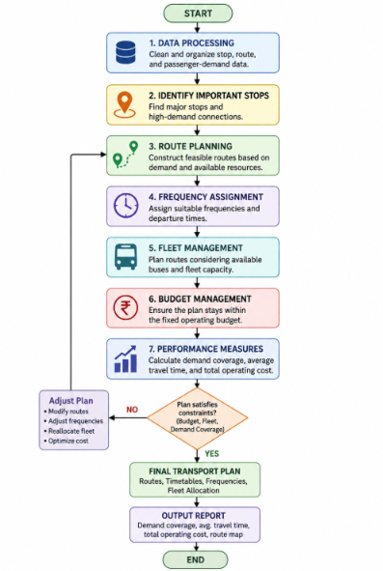
Flow Chart

Slide 7
Hardware and Software requirements
Software Requirements: • Operating System:Windows 10/11, Linux, or macOS • Programming Language: Java • IDE: Visual Studio Code / IntelliJ IDEA / Eclipse • Java Development Kit (JDK): JDK 17 or later • Data Storage: CSV/text files for stop and passenger-demand data • Libraries: Java standard libraries such as Collections, I/O, and utility packages Hardware Requirements: • Processor: Intel Core i3 or equivalent and above • RAM: Minimum 4 GB (8 GB recommended) • Storage: Minimum 500 MB free space for the project and datasets

Slide 8
Results
Successfully represented the public transport network using graphs.
Identified high-demand stops and important connections from passenger-demand data.
Generated feasible routes based on demand, connectivity, fleet availability, and budget.
Created suitable service frequencies and departure timetables.
Improved the ability to measure demand coverage across important stops.
Calculated average passenger travel time for the generated routes.

Slide 9
Conclusion
The Public-Transit Planner provides an efficient approach for designing public transport routes and timetables.
Data structures such as graphs, priority queues, arrays/lists, and hash maps help manage transport data effectively.
The system considers important factors such as passenger demand, route coverage, travel time, fleet availability, and operating cost.
The proposed approach can support better utilization of limited transport resources.

Slide 10
Future Scope
Integrate real-time GPS and traffic data for dynamic route planning.
Add real-time passenger-demand updates to adjust service frequency.
Use AI and machine learning to predict future passenger demand.
Apply advanced optimization techniques to further reduce travel time and operating costs.
Support multiple transport modes, such as buses, trains, and metro services.

Slide 11
Thank you

