Slide 1
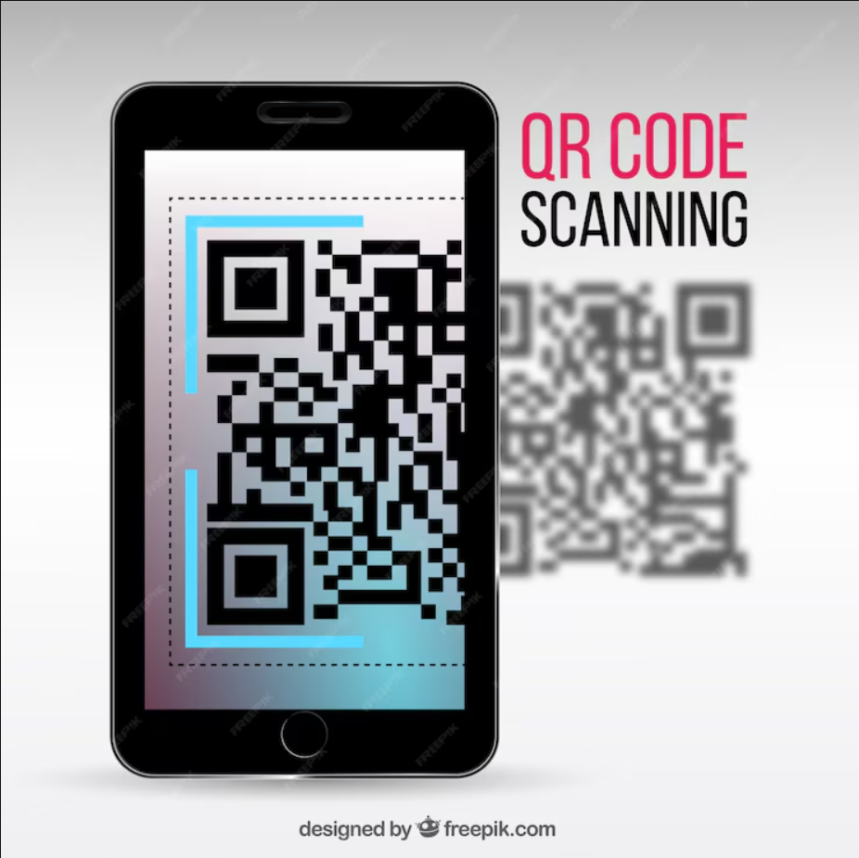
QR Code Generator and Detector
This comprehensive desktop application allows users to easily generate and detect QR codes, empowering efficient information sharing and data retrieval. Designed with a user-friendly Tkinter interface, it seamlessly integrates cutting-edge libraries for a feature-rich experience.

Slide 2




QR Code Generation
Customizable Input
Flexible Styling
Users can enter any desired text, URL, or other data to be encoded into a QR code.
The application allows for adjusting the QR code's color, size, and other visual elements to match the user's preferences.
Seamless Saving
Instant Display
Generated QR codes can be saved as PNG files for easy sharing or printing.
The application displays the generated QR code within the GUI, providing immediate visual feedback.

Slide 3



QR Code Detection
Image Browse
Real-Time Scanning
Detailed Analysis
Users can upload and browse local images, enabling QR code detection within those files.
The application utilizes OpenCV to scan the user's camera feed for any QR codes in real-time.
Detected QR codes are displayed along with their encoded data, providing valuable insights.

Slide 4
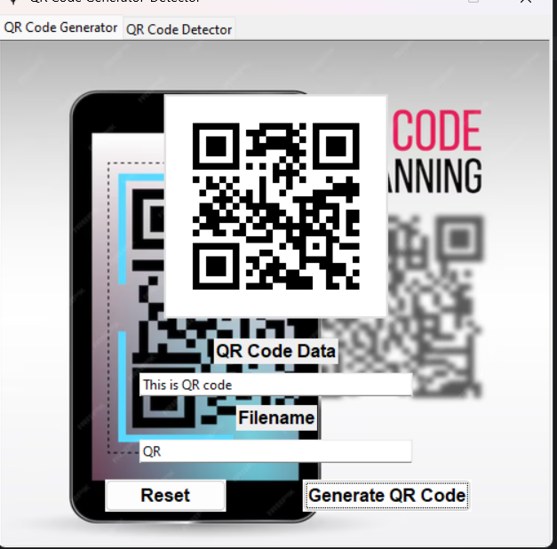
Accepting User Input
1
Text Input
2
Filename Input
Users can enter any desired text, URL, or other data to be encoded into a QR code.
The application prompts users to provide a filename for the generated QR code image.
3
Intuitive Interface
The Tkinter-based GUI ensures a smooth and user-friendly experience throughout the process.

Slide 5
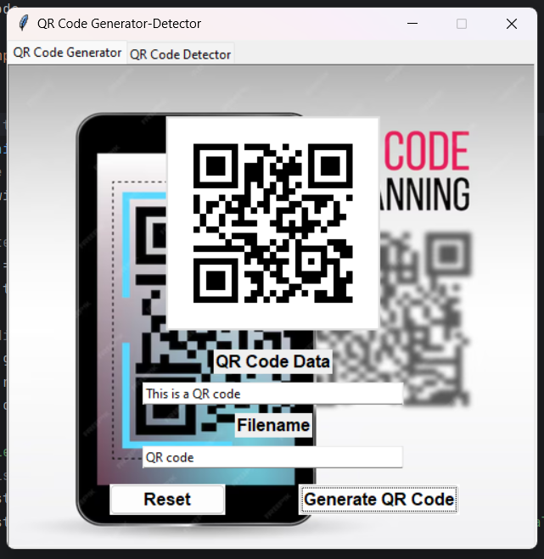



Generating Customizable QR Codes
Color Customization
Users can choose the color scheme of the generated QR code to match their needs.
Adjustable Size
The application allows users to control the size of the generated QR code.
Seamless Saving
The generated QR code can be saved as a high-quality PNG file for later use.

Slide 6




Saving and Displaying QR Codes
Save
Generate
Users can save the QR code as a high-quality PNG file for future use or sharing.
The application generates the QR code based on the user's input.
1
2
3
Preview
The generated QR code is displayed within the GUI for immediate visual feedback.

Slide 7
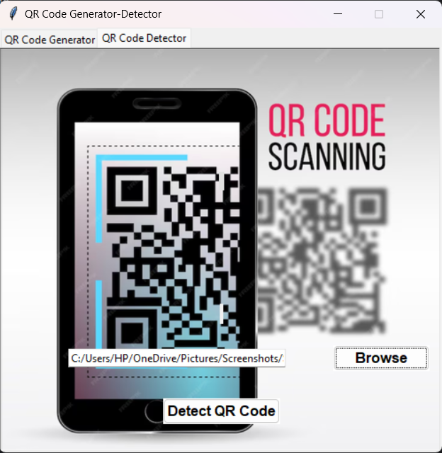





QR Code Detection
Browse Images
Users can upload local images to the application for QR code detection.
Real-Time Scanning
The application utilizes OpenCV to continuously scan the user's camera feed for QR codes.
Detailed Analysis
Detected QR codes are displayed with their encoded data, providing valuable insights.

Slide 8
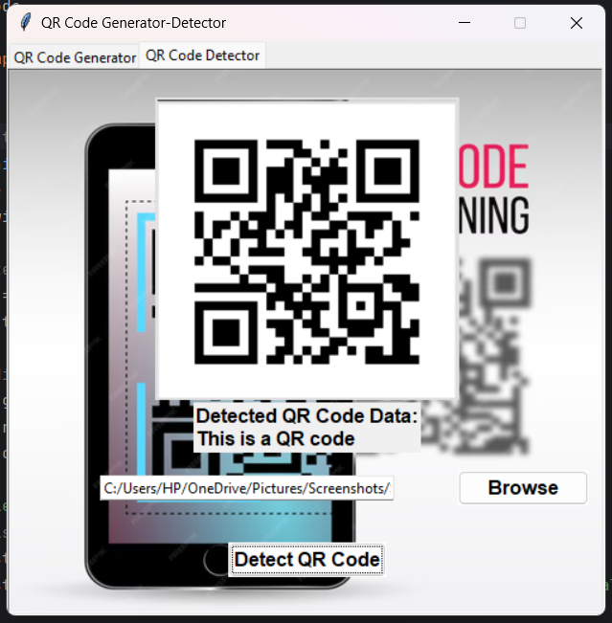


Browsing and Analyzing Images
Image Upload
Users can easily upload local images to the application for QR code detection.
Real-Time Scanning
The application utilizes OpenCV to continuously scan the user's camera feed for QR codes.
Detailed Analysis
Detected QR codes are displayed with their encoded data, providing valuable insights.

Slide 9
Conclusion and Next Steps
1
Powerful Features
2
Future Enhancements
The QR Code Generator and Detector application offers a comprehensive suite of tools to streamline QR code creation and analysis.
Planned improvements include integration with cloud storage, advanced image processing, and support for additional file formats.
3
Empowering Users
This application aims to empower users by providing a user-friendly platform for efficient information sharing and data retrieval.

