Slide 1



Sales Insights Data Analysis Power BI Project
View in Power BI
Last data refresh:
6/2/2024 8:04:30 PM UTC
Downloaded at:
6/2/2024 8:08:06 PM UTC

Slide 2
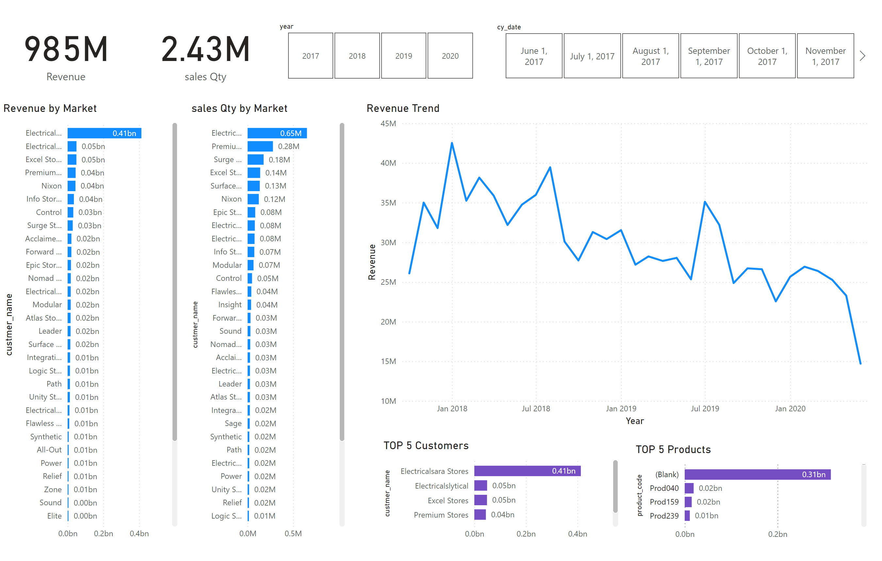
Page 1
Notes:
card
No alt text provided
card
No alt text provided
Revenue by Market
No alt text provided
sales Qty by Market
No alt text provided
slicer
No alt text provided
slicer
No alt text provided
TOP 5 Customers
No alt text provided
TOP 5 Products
No alt text provided
Revenue Trend
No alt text provided

