Slide 1

Efficient Task Allocation and Failure Detection in Crowdsourcing Platforms
Team Number: D6
Sindhu Sahithi - AM.EN.U4CSE20326
Manikanta - AM.EN.U4CSE20370
Surya Teja - AM.EN.U4CSE20371
Anushree - AM.EN.U4CSE20375
Guide - Ms. Lekshmi S Nair
Amrita School of Computing | Amrita Vishwa Vidyapeetham | Amritapuri

Slide 2
Introduction
This project aims to tackle the challenges of task allocation in crowdsourcing platforms, ensuring efficient assignment of tasks to workers based on their skills and task difficulty. Efficient task assignment is paramount for productivity and growth.
The problem is significant due to the increasing popularity of crowdsourcing platforms. We will be delivering a fostering mentorship mapping. Our approach will match tasks with the right individuals, ensuring optimal workforce utilization and task completion.

Slide 3
Motivation
The motivation lies in enhancing platform efficiency, client satisfaction, and freelancer success. Persisting challenges include designing an accurate task allocation algorithm. And the need to improve efficiency and quality by reducing task allocation errors and preventing task failures.

Slide 4
Background Study/Related Work
Title &year | Problem | Contributions | Limitations | Open problems/Future work
Task Personalization for In expertise Workers in Incentive Based Crowdsourcing Platforms (Ayswarya R Kurup,G P Sajeev; Dept of Computer Science 2023) | The paper presents a task recommendation model for inexpert workers in crowdsourcing, but it needs further exploration to handle multiple skills and enhance the recommendation accuracy. | The paper proposes a task recommendation model for inexpert and new workers in crowdsourcing systems, using skill taxonomy and participation probability of expert workers. | This Model's limitation: Assessing workers and tasks with single skills may overlook real-world complexity. | Future work includes extending the model to handle multiple skills, improving the recommendation accuracy, and exploring more complex recommendation algorithms.

Slide 5
Background Study/Related Work
Title &year | Problem | Contributions | Limitations | Open problems/Future work
Aggregating Reliable Submissions in Crowdsourcing Systems [Ayswarya R Kurup; G P Sajeev; J. Swaminathan, (2021)] | In crowdsourcing systems, the quality of submissions from workers can vary due to differences in expertise and knowledge background. Existing task aggregation methods mainly focus on structured submissions and do not consider the cost incurred for completing tasks. | Estimating submission quality based on worker reliability, task difficulty, and similarity. EM approach is used to improve results. The method effectively estimates submission quality and addresses the cold-start problem by leveraging submission similarity. | Adaptive threshold for cost minimization and improved expertness estimation using diverse similarity approaches. Future research could explore generalizing our approach to different crowdsourcing tasks. | Explore adaptive cost minimization, refine worker expertness estimation with diverse similarity metrics. Extend the approach to diverse task types, validate on real platforms, and improve user interface for better engagement and task completion rates.

Slide 6
Background Study/Related Work
Title &year | Problem | Contributions | Limitations | Open problems/Future work
Task Recommendation in Reward Based [Ayswarya R Kurup ,G P Sajeev(2023)] | Addressing task recommendation challenges in dynamic crowdsourcing environments. Exploring hybrid models combining implicit and explicit feedback for improved accuracy. Investigating user interface and user experience enhancements to encourage worker engagement. | Introduces a task recommendation model for reward-based crowdsourcing, combining implicit feedback and explicit features. The model outperforms matrix factorization and reward based models, reducing data sparsity. | Limited evaluation on larger datasets and comparison with state-of the-art methods. Generalization to diverse crowdsourcing platforms and investigation of the model's scalability remain unexplored. | Some of the Future work and problems for Task Recommendation in Reward-Based are Extending evaluation on larger datasets and comparing with state-of-the-art methods.

Slide 7
Background Study/Related Work
Title &year | Problem | Contributions | Limitations | Open problems/Future work
Outlier Detection for Streaming Task Assignment in Crowdsourcing [Yan Zhao; Xuanhao Chen; Liwei Deng et al.(2022)] | The problem is the lack of validation in real-world crowdsourcing platforms, limiting its practical applicability under diverse and dynamic crowdsourcing environments. | The paper proposes an efficient outlier detection framework for streaming task assignment in crowdsourcing, considering both malicious workers and invalid tasks. It introduces a SA Generative Adversarial Network (GAN) outlier detector to identify outliers. | The proposed outlier detection framework's limitations include the lack of real-world deployment, limited exploration of anomalies beyond malicious workers and invalid tasks. Scalability concerns for large crowdsourcing platforms, adaptability to evolving dynamics, impact on tasks. | Real-world deployment and validation, using semi-supervised, evaluating under various streaming scenarios, integrating contextual information to enhance outlier detection, and improving task assignment efficiency

Slide 8
Background Study/Related Work
Title &year | Problem | Contributions | Limitations | Open problems/Future work
Failure Prediction in Crowdsourced Software Development [Abdullah Khanfor, Ye Yang, Gregg Vesonder, Dave Messinger | This paper highlights the need to address non competitive crowdsourcing tasks and explore additional metrics for failure prediction, while considering potential internal threats in the evaluation process. | This paper proposes a failure prediction framework for software crowdsourcing, achieving high accuracy using machine learning. It identifies influencing factors for failure prediction and presents practical recommendations for managing task failure risks. | The study focuses only on competitive tasks on the Top Coder platform, overlooking non competitive or collaborative tasks. Some competition factors and metrics need further investigation, and internal threats should be considered. | Future work includes studying supply and demand for technologies and workers, exploring social network analysis, Text mining and gathering broader data for evaluation.

Slide 9
Persisting Challenges
Dynamic Worker Skills:
Worker skills can change over time, and new workers with unique expertise join the platform. The challenge lies in continuously updating the task allocation algorithm to accommodate these dynamic changes and ensure accurate matching of tasks with suitable workers.
Complex Task Dependencies:
Some tasks may have dependencies on others, making it crucial to consider task sequences and interdependencies during allocation. Handling complex task structures requires advanced algorithms and efficient data management to avoid task bottlenecks and ensure smooth workflow distribution.

Slide 10
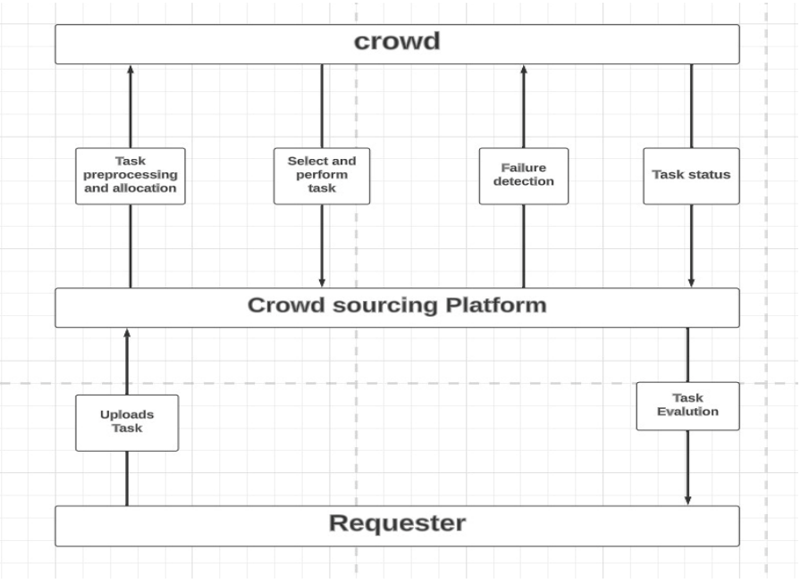
High Level Design

Slide 11
Project Contributions
Mapping In Expert Workers to the Expert Workers
The primary objective is to establish a structured mentorship program where experienced workers are paired with less experienced counterparts. This mentorship arrangement aims to harness the expertise of the seasoned workers, who will assume the role of mentors, guiding and delegating tasks to their less experienced counterparts.
The intended outcome of this initiative is twofold: firstly, it aims to optimize the utilization of the workforce by efficiently channeling their skills and knowledge, and secondly, it strives to enhance task completion rates by streamlining the workflow through the introduction of this mentorship-based approach.

Slide 12
Project Contributions
2. Allocation of the New Tasks
Tasks that arise will be meticulously assigned to workers based on a comprehensive evaluation of several key factors. These factors include the specific skill sets possessed by the workers, the precise requirements of the tasks at hand, the historical approval ratings of the workers, and the expected completion timeframe.
Subsequently, a judicious matching process will ensue, ensuring that the forthcoming tasks are allocated to workers in a manner that aligns seamlessly with these aforementioned criteria.

Slide 13
Algorithms
Expert matching model
Let Wie be the set of inexpert workers and We be the set of expert workers.
A new worker Wie should map to another participant We who has exact or very similar skills.
At first, we compute the distance between the skill set of an inexpert worker and the available expert workers.
And then according to their matching score we will map them.

Slide 14
Algorithms
Task matching model
In this model we compute the matching between workers and tasks.
Then we compute the similarity between the workers and tasks using the similarity measures.
Tasks with higher similarity in skills are recommended to the worker.

Slide 15
Current status
Identifying the Attributes of the dataset
Creating the dataset

Slide 16
References
A. R. Kurup and G. P. Sajeev, “Task recommendation in Reward-Based crowdsourcing systems,” in Fifth International Symposium on Women in Computing and Informatics (WCI-2017), Manipal, Mangalore, India, Sep. 2017, pp. 1511–1518.
Ayswarya R Kurup and G P Sajeev, “Task Personalization for In expertise Workers in Incentive Based Crowdsourcing Platforms, ” in 2018 International Conference on Advances in Computing, Communications and Informatics (ICACCI), Bangalore, India, Sep. 2018.
K. Li, J. Xiao, Y. Wang, and Q. Wang, “Analysis of the key factors for software quality in crowdsourcing development: An empirical study on top coder. com,” in Computer Software and Applications Conference (COMPSAC), 2013 IEEE 37th Annual. IEEE, 2013, pp. 812–817.
A. R. Kurup and G. P. Sajeev, “Task recommendation in Reward-Based crowdsourcing systems,” in Fifth International Symposium on Women in Computing and Informatics (WCI-2017), Manipal, Mangalore, India, Sep. 2017, pp. 1511–1518.

Slide 17
Thank You

