Slide 1
AutoHealOps
A plain-language introduction
What it does, how it works and why it is needed
Manikant Kumar
25 October 2026
Notes:
AutoHealOps is an educational operations platform for understanding application health and reviewing controlled recovery. Explain the name as automated assistance for keeping services healthy. The public website is a browser simulation. The repository also includes a local backend and an optional Kubernetes integration.
Source: https://github.com/manikantbindass/AutoHealOps-Self-Healing-Kubernetes-Cluster-with-AI-Fault-Detection/blob/e9864e01c7f6ac71f4f144feaa9d39b14912d0a9/README.md
Source snapshot: e9864e01c7f6ac71f4f144feaa9d39b14912d0a9
Prepared 25 October 2026. Screenshots show labelled demo data.

Slide 2
Project abstract
AutoHealOps explains service problems and can run supported recovery actions automatically.
It collects health measurements, explains unusual behavior and records decisions. Opted-in live workloads can use confirmed CPU scale-up and restart runbooks without per-action approval.
The public demo simulates recovery. Real infrastructure needs the separately configured backend.
02 / 25
Notes:
Autonomy means the configured controller observes, chooses, executes and checks a supported runbook. It does not mean arbitrary problems are automatically solved. The default remains manual, paused and dry-run. The public site is a simulation; real-cluster acceptance is pending in this development environment.
Source: https://github.com/manikantbindass/AutoHealOps-Self-Healing-Kubernetes-Cluster-with-AI-Fault-Detection/blob/e9864e01c7f6ac71f4f144feaa9d39b14912d0a9/README.md
Source snapshot: e9864e01c7f6ac71f4f144feaa9d39b14912d0a9
Prepared 25 October 2026. Screenshots show labelled demo data.

Slide 3
Why service problems matter
A slow checkout
A customer waits because the application is busy or unhealthy.
Scattered evidence
One tool shows resource use while another records restarts or alerts.
Pressure on the operator
Someone must identify a safe action and check what happened next.
03 / 25
Notes:
Use an illustrative shopping application, not a claim about an actual incident. An overloaded processor, rising memory use or repeated container restarts can be symptoms of a problem. They do not automatically identify the root cause. AutoHealOps organizes the evidence and the recovery workflow.
Source: https://github.com/manikantbindass/AutoHealOps-Self-Healing-Kubernetes-Cluster-with-AI-Fault-Detection/blob/e9864e01c7f6ac71f4f144feaa9d39b14912d0a9/docs/architecture.md
Source snapshot: e9864e01c7f6ac71f4f144feaa9d39b14912d0a9
Prepared 25 October 2026. Screenshots show labelled demo data.

Slide 4
Why this project is useful
A clearer investigation
A controlled response
Measurements, anomaly explanations and incident context appear in one interface. An operator can review the reason for an alert before acting.
Approval, pause, cooldown and audit records make the decision visible. Kubernetes already handles some basic recovery; this project adds evidence and policy around supported actions.
04 / 25
Notes:
Kubernetes already restarts certain failed containers and replaces missing replicas according to its configuration. Do not describe AutoHealOps as inventing those capabilities. Its contribution is the observation, explanation, policy and review layer. This helps students demonstrate reliability concepts and engineers explore a controlled workflow.
Source: https://github.com/manikantbindass/AutoHealOps-Self-Healing-Kubernetes-Cluster-with-AI-Fault-Detection/blob/e9864e01c7f6ac71f4f144feaa9d39b14912d0a9/docs/architecture.md
Source snapshot: e9864e01c7f6ac71f4f144feaa9d39b14912d0a9
Prepared 25 October 2026. Screenshots show labelled demo data.

Slide 5
Kubernetes in everyday language
Container
An application packaged with what it needs to run.
Pod
A small running unit that holds one or more containers.
Deployment
Instructions for keeping a chosen number of application copies running.
Cluster and namespace
The machines that run the applications, and a named area that groups resources.
05 / 25
Notes:
A useful analogy is a building manager. The cluster is the building, the namespace is a named area, deployments describe how many workers should be present, and pods are the running work units. The analogy is only a memory aid. A pod is a Kubernetes scheduling unit, not a physical room or a permanent machine.
Source: https://github.com/manikantbindass/AutoHealOps-Self-Healing-Kubernetes-Cluster-with-AI-Fault-Detection/blob/e9864e01c7f6ac71f4f144feaa9d39b14912d0a9/docs/setup-guide.md
Source snapshot: e9864e01c7f6ac71f4f144feaa9d39b14912d0a9
Prepared 25 October 2026. Screenshots show labelled demo data.

Slide 6
Purpose and audience
Students and evaluators
Understand monitoring, fault detection and safe remediation through a visible demonstration.
Developers
Explore how application symptoms connect to incidents and recovery decisions.
Operations engineers
Inspect the implementation and test a limited namespace integration in a deliberate test environment.
06 / 25
Notes:
The public showcase requires no account. It is useful for explaining the idea without installing a cluster. The native or Compose path offers the actual backend and storage. Experienced operators still need to review security, workload suitability and failure handling before connecting real infrastructure.
Source: https://github.com/manikantbindass/AutoHealOps-Self-Healing-Kubernetes-Cluster-with-AI-Fault-Detection/blob/e9864e01c7f6ac71f4f144feaa9d39b14912d0a9/README.md
Source snapshot: e9864e01c7f6ac71f4f144feaa9d39b14912d0a9
Prepared 25 October 2026. Screenshots show labelled demo data.

Slide 7
The main building blocks
Dashboard
The React interface where people inspect resources, incidents and decisions.
Backend and storage
FastAPI coordinates the workflow. SQLite or MongoDB keeps records in the local system.
Detection service
A trained Isolation Forest can inspect complete metric inputs. Transparent rules provide guards and fallback.
Kubernetes adapter
A restricted adapter and opt-in controller attribute evidence to exact workloads, then apply bounded runbooks.
07 / 25
Notes:
The browser-only public build has its own session simulation and calls none of these backend services. The local backend collects telemetry or uses an explicit demo generator. Prometheus and Grafana are optional monitoring components. The implementation deliberately avoids adding a broker that the local scale does not require.
Source: https://github.com/manikantbindass/AutoHealOps-Self-Healing-Kubernetes-Cluster-with-AI-Fault-Detection/blob/e9864e01c7f6ac71f4f144feaa9d39b14912d0a9/docs/architecture.md
Source snapshot: e9864e01c7f6ac71f4f144feaa9d39b14912d0a9
Prepared 25 October 2026. Screenshots show labelled demo data.

Slide 8
The response workflow
01
Observe
Collect processor use, memory, restart counts and latency where available.
02
Detect and explain
Apply a trained detector or labelled rules and show the supporting measurements.
03
Apply the chosen policy
An operator approves a manual action, or confirmed workload evidence authorizes an enabled runbook.
04
Act and verify
Enforce policy checks, execute the permitted action and record the result and health observations.
08 / 25
Notes:
An alert is evidence of a symptom, not proof of a particular root cause. The system keeps related anomaly, alert, action and audit records connected by a correlation ID. Live namespace-wide measurements cannot justify choosing a particular workload automatically. The operator selects an eligible Deployment.
Source: https://github.com/manikantbindass/AutoHealOps-Self-Healing-Kubernetes-Cluster-with-AI-Fault-Detection/blob/e9864e01c7f6ac71f4f144feaa9d39b14912d0a9/docs/api-contract.md
Source snapshot: e9864e01c7f6ac71f4f144feaa9d39b14912d0a9
Prepared 25 October 2026. Screenshots show labelled demo data.

Slide 9
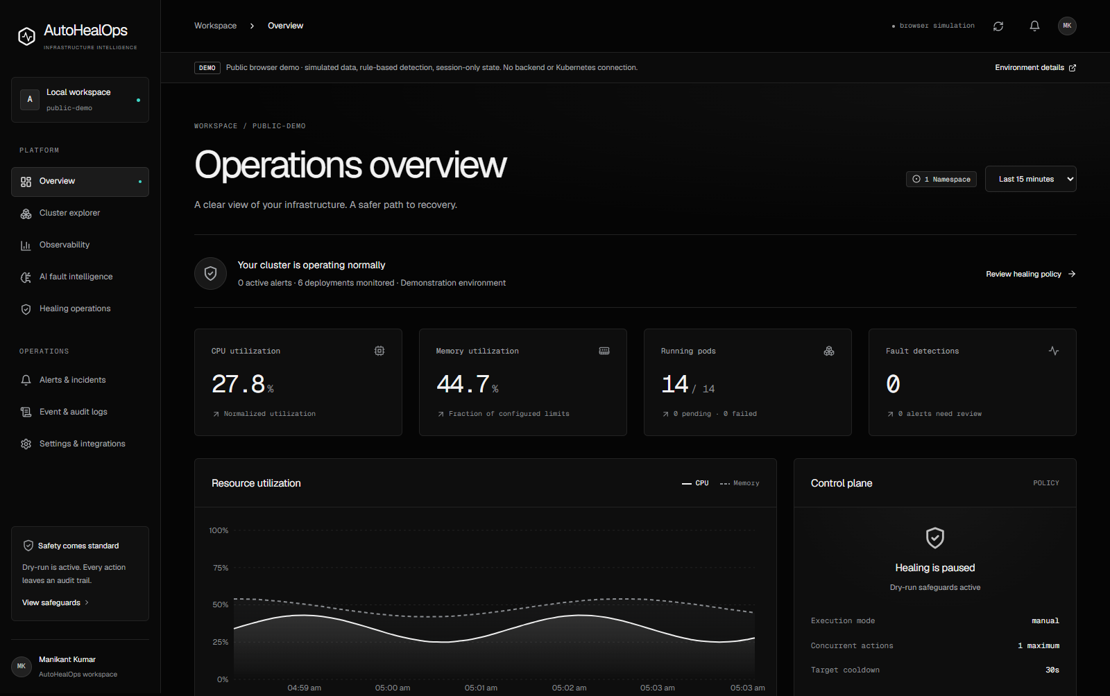
A shared view of application health
Actual project interface showing simulated telemetry. The demo label identifies the data source.
The source banner identifies simulated data. The interface keeps measurements and the recovery policy visible.
09 / 25
Notes:
Point to the data-source banner first. Then explain CPU and memory, pod status, active alerts, recovery policy and recent events. A number on this screenshot belongs to a demonstration dataset. It is not evidence of a real production cluster or a measured service-level objective.
Source: https://github.com/manikantbindass/AutoHealOps-Self-Healing-Kubernetes-Cluster-with-AI-Fault-Detection/blob/e9864e01c7f6ac71f4f144feaa9d39b14912d0a9/docs/vercel-deployment.md
Source snapshot: e9864e01c7f6ac71f4f144feaa9d39b14912d0a9
Prepared 25 October 2026. Screenshots show labelled demo data.

Slide 10
How detection works
Unusual patterns
Explainable thresholds
The local AI service can load a StandardScaler and Isolation Forest trained on synthetic telemetry. The saved preprocessing stays with the model.
Rules identify values above documented limits. Hybrid results show both the actual model decision and the rule that triggered. The public site uses browser rules only.
10 / 25
Notes:
Anomaly means an observation that looks unusual relative to a baseline. It does not necessarily mean the service will fail. The project keeps the learned decision score separate from threshold explanations. A single CPU spike can trigger a rule even when Isolation Forest classifies the full feature combination as within its learned baseline. Synthetic evaluation does not establish accuracy on a real cluster.
Source: https://github.com/manikantbindass/AutoHealOps-Self-Healing-Kubernetes-Cluster-with-AI-Fault-Detection/blob/e9864e01c7f6ac71f4f144feaa9d39b14912d0a9/docs/ai-models.md
Source snapshot: e9864e01c7f6ac71f4f144feaa9d39b14912d0a9
Prepared 25 October 2026. Screenshots show labelled demo data.

Slide 11
Anomaly detection and forecasting
Anomaly detection
Metric forecasting
Question: does this measurement look unusual now?
Output: a decision score or a rule explanation, with severity and observations.
Question: what might CPU or memory look like one sample ahead?
Output: a trend or last-value estimate evaluated in chronological order.
11 / 25
Notes:
The predictor compares a linear trend with a persistence baseline, which simply repeats the most recent measurement. It uses only earlier samples for each holdout prediction. No calibrated failure probability, confidence interval or time-to-failure is available. The public browser demo does not run the forecasting service.
Source: https://github.com/manikantbindass/AutoHealOps-Self-Healing-Kubernetes-Cluster-with-AI-Fault-Detection/blob/e9864e01c7f6ac71f4f144feaa9d39b14912d0a9/docs/ai-models.md
Source snapshot: e9864e01c7f6ac71f4f144feaa9d39b14912d0a9
Prepared 25 October 2026. Screenshots show labelled demo data.

Slide 12
A manual CPU-spike example
01
Inject a demo fault
The scenario sets simulated CPU utilization to 96%.
02
Inspect the evidence
A rule explains why the measurement exceeds its threshold.
03
Approve a recommendation
The operator reviews the target and resumes the paused healing policy.
04
Simulate recovery
The demonstration restores healthy telemetry and records before and after values.
12 / 25
Notes:
The 96% figure is the implemented synthetic CPU scenario, not a measurement from real infrastructure. The post-recovery value varies with the demo generator. The workflow records an explicitly simulated outcome and never touches Kubernetes. An operator can acknowledge or resolve the related incident. Recovery does not silently erase the audit history.
Source: https://github.com/manikantbindass/AutoHealOps-Self-Healing-Kubernetes-Cluster-with-AI-Fault-Detection/blob/e9864e01c7f6ac71f4f144feaa9d39b14912d0a9/backend/services/platform.py
Source snapshot: e9864e01c7f6ac71f4f144feaa9d39b14912d0a9
Prepared 25 October 2026. Screenshots show labelled demo data.

Slide 13
Recovery safeguards
A safe starting point
Local startup uses dry-run mode and pauses new recovery actions until an operator resumes.
A small authorized target
Live actions require the configured namespace and an explicitly managed Deployment.
A bounded action
One operation at a time, one attempt per action, replica limits, cooldown and an hourly budget.
An honest result
An accepted API call alone does not prove recovery. Failed or unverified rollouts remain failures.
13 / 25
Notes:
Manual requests require approval. Autonomous actions require exact startup targets, managed/autonomous Deployment labels, three distinct fresh source samples and stable UID/generation/Pod ownership. One concurrent operation, one attempt, replica limit five, 300-second target cooldown and ten actions/hour apply. No HPA may exist in the autonomous namespace. Emergency pause prevents new operations; it cannot undo an accepted mutation.
Source: https://github.com/manikantbindass/AutoHealOps-Self-Healing-Kubernetes-Cluster-with-AI-Fault-Detection/blob/e9864e01c7f6ac71f4f144feaa9d39b14912d0a9/docs/security-operations.md
Source snapshot: e9864e01c7f6ac71f4f144feaa9d39b14912d0a9
Prepared 25 October 2026. Screenshots show labelled demo data.

Slide 14
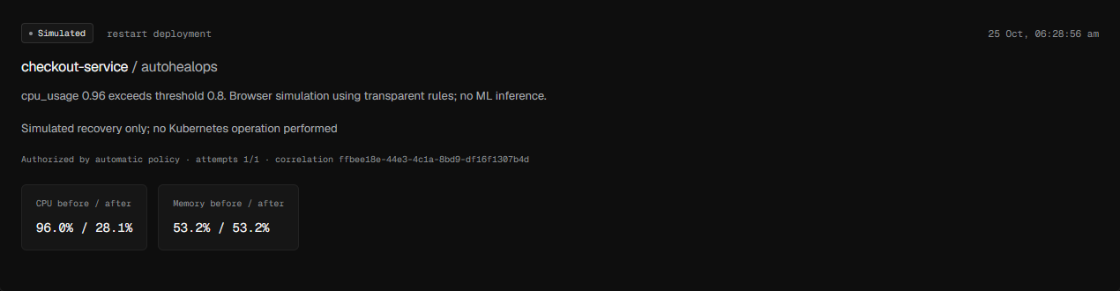
Automatic policy and outcome stay visible
Actual browser simulation: automatic policy, no per-action approval and an explicitly simulated recovery.
The action record names the decision, authorization and outcome. A simulation never represents a real cluster repair.
14 / 25
Notes:
This screenshot comes from the compiled public preview. It shows automatic policy authorization, one attempt and before/after synthetic measurements. No Kubernetes API was used. The live controller uses separate workload evidence and verification; a simulated outcome is never proof of a real repair.
Source: https://github.com/manikantbindass/AutoHealOps-Self-Healing-Kubernetes-Cluster-with-AI-Fault-Detection/blob/e9864e01c7f6ac71f4f144feaa9d39b14912d0a9/docs/api-contract.md
Source snapshot: e9864e01c7f6ac71f4f144feaa9d39b14912d0a9
Prepared 25 October 2026. Screenshots show labelled demo data.

Slide 15
What the eight views cover
Understanding the situation
Reviewing the response
Overview
Cluster explorer
Observability
AI fault intelligence
Healing operations
Alerts and incidents
Event and audit logs
Settings and integrations
15 / 25
Notes:
Overview summarizes health and provenance. Cluster explorer searches and inspects available resources. Observability charts retained telemetry. Fault intelligence separates evidence and model identity from forecasting. Healing operations reviews recommendations and outcomes. Incidents support acknowledgement and resolution. Audit records actor, rationale and result. Settings expose safe policy and service status without revealing secret values.
Source: https://github.com/manikantbindass/AutoHealOps-Self-Healing-Kubernetes-Cluster-with-AI-Fault-Detection/blob/e9864e01c7f6ac71f4f144feaa9d39b14912d0a9/README.md
Source snapshot: e9864e01c7f6ac71f4f144feaa9d39b14912d0a9
Prepared 25 October 2026. Screenshots show labelled demo data.

Slide 16
Three ways to use the project
Public website
Browser simulation, session history, labelled rules and simulated recovery. No account required.
Local demo
React and FastAPI with SQLite or Compose MongoDB. Optional trained AI service. No cluster required.
Configured cluster
Namespace inventory, owned-Pod telemetry and manual or explicitly enabled autonomous Deployment runbooks.
16 / 25
Notes:
Public website: https://autohealops.vercel.app. Native and Compose demos use the same backend contracts, while the public build deliberately isolates its state in the browser. Neither demo path represents a real repair. A live integration needs MongoDB, a reachable Prometheus installation, suitable exporters, strong credentials and scoped Kubernetes identity. Node-wide inventory is not implied by namespace-scoped authorization.
Source: https://github.com/manikantbindass/AutoHealOps-Self-Healing-Kubernetes-Cluster-with-AI-Fault-Detection/blob/e9864e01c7f6ac71f4f144feaa9d39b14912d0a9/docs/vercel-deployment.md
Source snapshot: e9864e01c7f6ac71f4f144feaa9d39b14912d0a9
Prepared 25 October 2026. Screenshots show labelled demo data.

Slide 17
A first visit to the demo
01
Enable automatic policy
In Settings select Autonomous recovery and save. In Healing operations resume healing.
02
Create a visible example
On Overview inject a CPU, memory, restart or latency fault.
03
Watch the simulation
After three fault samples the browser simulates recovery without an approval click.
04
Inspect the result
Check the action, resolved incident and audit. Reloading pauses healing and restores manual policy.
17 / 25
Notes:
Each visitor has an isolated browser session. Refreshing preserves session history and resets healing to paused. Closing the session clears the browser state according to the browser session-storage lifecycle. The site sends no requests to a backend or Kubernetes API. The local README gives installation instructions for the fuller system.
Source: https://github.com/manikantbindass/AutoHealOps-Self-Healing-Kubernetes-Cluster-with-AI-Fault-Detection/blob/e9864e01c7f6ac71f4f144feaa9d39b14912d0a9/docs/vercel-deployment.md
Source snapshot: e9864e01c7f6ac71f4f144feaa9d39b14912d0a9
Prepared 25 October 2026. Screenshots show labelled demo data.

Slide 18
Requirements for a real cluster
A deliberate test environment
Use a selected namespace, a least-privilege service account and an opted-in Deployment.
Actual services and telemetry
Supply MongoDB, Prometheus, exporters and workload measurements. Missing data stays unavailable.
Secure operation
Use strong credentials, private networking, appropriate TLS and reviewed recovery policy.
A verification plan
Test failure paths and backup procedures. Keep the backend at one worker and one replica.
18 / 25
Notes:
The existing local examples do not establish high availability or production safety. The backend has in-process locks and scheduling. Multiple backend replicas would require distributed claims and coordination. HPA needs metrics-server, NetworkPolicy requires a compatible CNI, and ingress TLS needs a controller and valid certificates. These dependencies are separate from simply applying a manifest.
Source: https://github.com/manikantbindass/AutoHealOps-Self-Healing-Kubernetes-Cluster-with-AI-Fault-Detection/blob/e9864e01c7f6ac71f4f144feaa9d39b14912d0a9/docs/setup-guide.md
Source snapshot: e9864e01c7f6ac71f4f144feaa9d39b14912d0a9
Prepared 25 October 2026. Screenshots show labelled demo data.

Slide 19
Current limits and future work
Current boundaries
Future engineering work
Synthetic model training and demonstration data.
No calibrated failure probability or time-to-failure.
Single-process backend and best-effort optional notifications.
Real labelled failure data and separate temporal evaluation.
Distributed action claims and cluster-specific authorization.
Durable delivery, broader recovery testing and production validation.
19 / 25
Notes:
Do not promise a percentage reduction in downtime, automatic root-cause diagnosis or proven production model accuracy. Local tests and CI provide evidence for implemented behavior, not an availability guarantee. Multi-cluster authorization, SSO, durable queues, immutable external audit storage and production-scale load or disaster-recovery verification remain future work.
Source: https://github.com/manikantbindass/AutoHealOps-Self-Healing-Kubernetes-Cluster-with-AI-Fault-Detection/blob/e9864e01c7f6ac71f4f144feaa9d39b14912d0a9/docs/architecture.md
Source snapshot: e9864e01c7f6ac71f4f144feaa9d39b14912d0a9
Prepared 25 October 2026. Screenshots show labelled demo data.

Slide 20
The autonomous recovery loop
01
Attribute the evidence
Follow Deployment and ReplicaSet controller UIDs to exact owned Pods.
02
Confirm the condition
Require three distinct fresh source samples and stable workload identity.
03
Execute one runbook
Use the shared action limits and recheck labels, identity and resource version.
04
Verify and record
Check rollout and healthy telemetry; resolve the incident or pause on failure.
20 / 25
Notes:
The live controller runs after the normal collection pass. Namespace aggregate alerts remain separate and never choose a repair target. Confirmation resets after a pause, changed identity or invalid evidence. Source age must be at most 60 seconds; re-reading one scrape is not another confirmation. The mutation uses the same executor as manual actions.
Source: https://github.com/manikantbindass/AutoHealOps-Self-Healing-Kubernetes-Cluster-with-AI-Fault-Detection/blob/e9864e01c7f6ac71f4f144feaa9d39b14912d0a9/docs/autonomous-recovery.md
Source snapshot: e9864e01c7f6ac71f4f144feaa9d39b14912d0a9
Prepared 25 October 2026. Screenshots show labelled demo data.

Slide 21
The supported live runbooks
CPU pressure
Above 80% of a container CPU limit: add one replica, up to the configured maximum.
Repeated restarts
More than five restarts across owned Pods in one minute: request a rollout restart.
Other symptoms
Memory and latency support investigation; they do not independently select a live repair.
21 / 25
Notes:
Restart conditions take precedence over CPU scale-up. The CPU rule uses the maximum owned-container fraction; the restart rule sums one-minute increases across owned Pods. Rules choose these runbooks. Isolation Forest is a separate detector, not a root-cause or repair planner. Neither scaling nor restarting is guaranteed to fix the problem. There is one autonomous attempt per sustained fault, followed by healthy-evidence re-arming.
Source: https://github.com/manikantbindass/AutoHealOps-Self-Healing-Kubernetes-Cluster-with-AI-Fault-Detection/blob/e9864e01c7f6ac71f4f144feaa9d39b14912d0a9/docs/autonomous-recovery.md
Source snapshot: e9864e01c7f6ac71f4f144feaa9d39b14912d0a9
Prepared 25 October 2026. Screenshots show labelled demo data.

Slide 22
Enabling a live target
Startup policy
Enable automatic mode at startup and name exact targets. Begin with dry-run.
Workload permission
Both managed and autonomous labels must be true. Use a selected namespace without HPAs.
Fresh measurements
Provide owned-Pod CPU, memory, restarts and resource limits through Prometheus.
Operator activation
One backend worker and replica. Test dry-run, configure real execution deliberately, then resume.
22 / 25
Notes:
Use strong live credentials, MongoDB, explicit browser origins and scoped Kubernetes identity. AUTOMATIC_TARGETS is a comma-separated list of at most 20 exact Deployment names. Namespace RBAC also needs ReplicaSet and HPA reads. Paused and zero-replica Deployments are excluded. Do not opt in the control plane itself. Startup always pauses healing, including after changing DRY_RUN. The optional HPA example conflicts with this conservative first autonomous implementation.
Source: https://github.com/manikantbindass/AutoHealOps-Self-Healing-Kubernetes-Cluster-with-AI-Fault-Detection/blob/e9864e01c7f6ac71f4f144feaa9d39b14912d0a9/docs/autonomous-recovery.md
Source snapshot: e9864e01c7f6ac71f4f144feaa9d39b14912d0a9
Prepared 25 October 2026. Screenshots show labelled demo data.

Slide 23
Verification and the failure circuit
A recorded success
A recorded failure
First check rollout availability.
Then require two distinct healthy source observations after execution.
Resolve the related incident only after verification.
Missing evidence, an unverified rollout or unhealthy telemetry cannot become success.
Pause healing and keep the incident open. A retained target latch prevents repeated attempts.
23 / 25
Notes:
The rollout polling window is 45 seconds with five-second API request timeouts. Subsequent telemetry verification defaults to a 120-second polling window plus bounded in-flight calls. Healthy means CPU at most 80%, memory at most 85% and restarts at most five per minute. Two distinct healthy observations re-arm a target. The latch follows record retention. API acceptance and workload telemetry do not establish every customer request is healthy. Pause cannot undo an accepted mutation; restart marks interrupted actions failed.
Source: https://github.com/manikantbindass/AutoHealOps-Self-Healing-Kubernetes-Cluster-with-AI-Fault-Detection/blob/e9864e01c7f6ac71f4f144feaa9d39b14912d0a9/docs/autonomous-recovery.md
Source snapshot: e9864e01c7f6ac71f4f144feaa9d39b14912d0a9
Prepared 25 October 2026. Screenshots show labelled demo data.

Slide 24
Evidence and remaining validation
Backend contracts
38 tests passed, including controller confirmation, authorization and failure outcomes.
Public workflow
12 frontend tests and actual Edge checks cover automatic simulated recovery, pause and mobile layout.
Real cluster acceptance
No Kubernetes context or Docker engine is configured here. Run the documented disposable-namespace checks.
24 / 25
Notes:
The backend suite uses controlled adapters and Prometheus HTTP responses. Real Edge checks use the compiled application and its explicitly synthetic browser data, with zero API traffic. This is implementation evidence, not a deployed Kubernetes acceptance result. Test real exporter labels, RBAC, replica ownership, limits, cooldown, rollback handling by an operator, rollout failure and persistently unhealthy metrics before connecting an important workload. No production uptime or calibrated failure prediction is claimed.
Source: https://github.com/manikantbindass/AutoHealOps-Self-Healing-Kubernetes-Cluster-with-AI-Fault-Detection/blob/e9864e01c7f6ac71f4f144feaa9d39b14912d0a9/docs/validation.md
Source snapshot: e9864e01c7f6ac71f4f144feaa9d39b14912d0a9
Prepared 25 October 2026. Screenshots show labelled demo data.

Slide 25
Further reading and project access
The public demo explains the idea. The repository shows the implementation.
Live demo
autohealops.vercel.app
GitHub
manikantbindass / AutoHealOps
Detailed setup, architecture, AI limitations and security notes are linked in the repository README.
25 / 25
Notes:
Full repository: https://github.com/manikantbindass/AutoHealOps-Self-Healing-Kubernetes-Cluster-with-AI-Fault-Detection. Sources used in this deck: README.md, docs/architecture.md, docs/ai-models.md, docs/api-contract.md, docs/setup-guide.md, docs/security-operations.md and docs/vercel-deployment.md at source snapshot e9864e01c7f6ac71f4f144feaa9d39b14912d0a9. Author: Manikant Kumar. Prepared 25 October 2026. The companion PDF provides a more detailed explanation and glossary.
Source: https://github.com/manikantbindass/AutoHealOps-Self-Healing-Kubernetes-Cluster-with-AI-Fault-Detection/blob/e9864e01c7f6ac71f4f144feaa9d39b14912d0a9/README.md
Source snapshot: e9864e01c7f6ac71f4f144feaa9d39b14912d0a9
Prepared 25 October 2026. Screenshots show labelled demo data.

