Slide 1
CITYPULSE
AI-Powered Urban Intelligence
& Blockchain Analytics
Predict Demand. Optimize Supply.
Build Smarter Cities.
https://github.com/manikantbindass/CityPulse
Notes:
Introduce CityPulse as an engineering project for urban intelligence and blockchain analytics. The repository owner is the verified GitHub account manikantbindass. The project uses synthetic demonstrations and has no claimed municipal deployment or real-data partnership.
Application snapshot: 2385ea7a3c6f9349c9c9ee67a56ace5f279fa992
Evidence date: 2026-10-29
Sources:
README.md
https://github.com/manikantbindass/CityPulse/blob/2385ea7a3c6f9349c9c9ee67a56ace5f279fa992/README.md
docs/reports/source/report.json (companion editable source in this delivery)

Slide 2
One-minute project overview
01
Urban evidence with geography, time and provenance
02
Forecasts and constrained scenarios, with explicit limits
03
A working local/CI platform; no production claim
CITYPULSE | SYNTHETIC DEVELOPMENT / IMPLEMENTATION EVIDENCE
02 / 33
Notes:
The integrated path is Next.js, Spring, PostGIS/Redis and FastAPI, with an operator-driven local blockchain demonstration. Explain that implemented code, demonstrated results and proposed operating targets are separate evidence levels. The companion report contains the full scope and source hashes.
Application snapshot: 2385ea7a3c6f9349c9c9ee67a56ace5f279fa992
Evidence date: 2026-10-29
Sources:
README.md
https://github.com/manikantbindass/CityPulse/blob/2385ea7a3c6f9349c9c9ee67a56ace5f279fa992/README.md
compose.yaml
https://github.com/manikantbindass/CityPulse/blob/2385ea7a3c6f9349c9c9ee67a56ace5f279fa992/compose.yaml

Slide 3
Urban supply and demand problem
01
Different units and time windows distort comparisons
02
Missing observations can look like zero
03
A recommendation can lose its source and assumptions
CITYPULSE | SYNTHETIC DEVELOPMENT / IMPLEMENTATION EVIDENCE
03 / 33
Notes:
Use an example of a supply flow and an inventory stock: they cannot be summed without a period assumption. A business location is not service capacity. These are modeling problems before they are algorithm problems. No real-city outcome improvement has been measured.
Application snapshot: 2385ea7a3c6f9349c9c9ee67a56ace5f279fa992
Evidence date: 2026-10-29
Sources:
docs/data-dictionary.md
https://github.com/manikantbindass/CityPulse/blob/2385ea7a3c6f9349c9c9ee67a56ace5f279fa992/docs/data-dictionary.md
services/api/src/main/java/io/citypulse/workspace/application/AnalyticsService.java
https://github.com/manikantbindass/CityPulse/blob/2385ea7a3c6f9349c9c9ee67a56ace5f279fa992/services/api/src/main/java/io/citypulse/workspace/application/AnalyticsService.java

Slide 4
Limits of disconnected analysis
01
GIS explains where; a notebook predicts what may happen
02
An allocation script needs policy constraints
03
Exports often need a reconstructable evidence trail
CITYPULSE | SYNTHETIC DEVELOPMENT / IMPLEMENTATION EVIDENCE
04 / 33
Notes:
This is a qualitative gap analysis of integration boundaries, not a survey claiming competing tools lack features. Spreadsheets, GIS, notebooks and ledgers remain valid. CityPulse adds explicit transition contracts and provenance around them.
Application snapshot: 2385ea7a3c6f9349c9c9ee67a56ace5f279fa992
Evidence date: 2026-10-29
Sources:
docs/reports/source/narrative.md (companion editable source in this delivery)

Slide 5
CityPulse proposed solution
Observe compatible records
01
02
03
04
Observe
Forecast
Simulate
Verify
Compatible evidence
Named methods
Explicit constraints
Digest and provenance
Human review remains the decision boundary
CITYPULSE | SYNTHETIC DEVELOPMENT / IMPLEMENTATION EVIDENCE
05 / 33
Notes:
The user remains the decision owner. Observation, forecast and optimization are distinct objects. A hash establishes integrity, not truth. The solution diagram is editable and summarizes implemented capabilities without implying a queue worker or automatic resource dispatch.
Application snapshot: 2385ea7a3c6f9349c9c9ee67a56ace5f279fa992
Evidence date: 2026-10-29
Sources:
README.md
https://github.com/manikantbindass/CityPulse/blob/2385ea7a3c6f9349c9c9ee67a56ace5f279fa992/README.md
docs/decision-engine.md
https://github.com/manikantbindass/CityPulse/blob/2385ea7a3c6f9349c9c9ee67a56ace5f279fa992/docs/decision-engine.md

Slide 6
Product vision and objectives
01
Reconstruct a result from source records and fingerprints
02
Keep authorization independent of UI and model instructions
03
Measure methods against transparent baselines
CITYPULSE | SYNTHETIC DEVELOPMENT / IMPLEMENTATION EVIDENCE
06 / 33
Notes:
Vision should be framed as a testable engineering objective. Field effectiveness, real source completeness and production SLOs require separate pilot evaluation. Avoid claims of guaranteed profit, autonomous city management or certified security.
Application snapshot: 2385ea7a3c6f9349c9c9ee67a56ace5f279fa992
Evidence date: 2026-10-29
Sources:
docs/PRD.md
https://github.com/manikantbindass/CityPulse/blob/2385ea7a3c6f9349c9c9ee67a56ace5f279fa992/docs/PRD.md
docs/reports/source/narrative.md (companion editable source in this delivery)

Slide 7
Users and business applications
01
Analysts and planners: compare evidence and coverage
02
Businesses and providers: inspect and publish permitted data
03
Administrators and citizens: role-appropriate access
CITYPULSE | SYNTHETIC DEVELOPMENT / IMPLEMENTATION EVIDENCE
07 / 33
Notes:
Current general business data is tenant-scoped, not individually owner-scoped. That is a deployment gate for mixed-owner tenants. Demo persona settings change navigation only; the server evaluates real membership and scopes on every protected request.
Application snapshot: 2385ea7a3c6f9349c9c9ee67a56ace5f279fa992
Evidence date: 2026-10-29
Sources:
docs/api/backend.md
https://github.com/manikantbindass/CityPulse/blob/2385ea7a3c6f9349c9c9ee67a56ace5f279fa992/docs/api/backend.md
docs/security/architecture.md
https://github.com/manikantbindass/CityPulse/blob/2385ea7a3c6f9349c9c9ee67a56ace5f279fa992/docs/security/architecture.md

Slide 8
Core features
01
Geospatial registry, ingestion and historical analytics
02
Forecast jobs, opportunity scores and saved scenarios
03
PulseAI evidence and local content attestations
CITYPULSE | SYNTHETIC DEVELOPMENT / IMPLEMENTATION EVIDENCE
08 / 33
Notes:
The application is modular. Admin/reporting folders do not imply separate deployed services. Licensed live connectors, durable queue consumers, Kubernetes and a public-chain deployment are future work. Each capability should be demonstrated at its actual evidence boundary.
Application snapshot: 2385ea7a3c6f9349c9c9ee67a56ace5f279fa992
Evidence date: 2026-10-29
Sources:
README.md
https://github.com/manikantbindass/CityPulse/blob/2385ea7a3c6f9349c9c9ee67a56ace5f279fa992/README.md
docs/decision-engine.md
https://github.com/manikantbindass/CityPulse/blob/2385ea7a3c6f9349c9c9ee67a56ace5f279fa992/docs/decision-engine.md

Slide 9
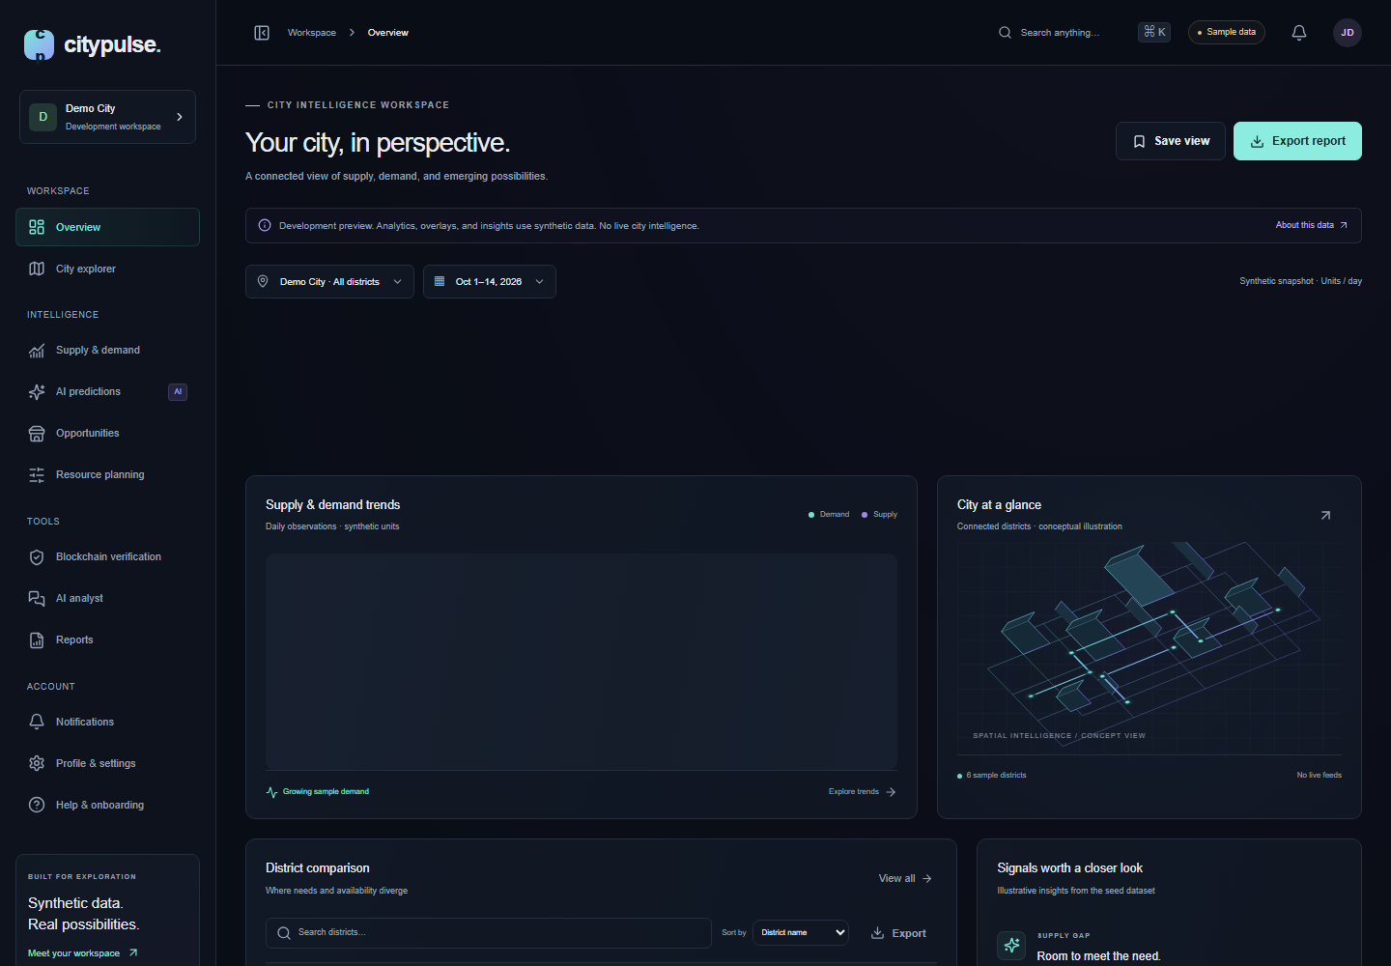
Working product demonstration
01
Actual local application
02
Clearly labeled synthetic data
CITYPULSE | SYNTHETIC DEVELOPMENT / IMPLEMENTATION EVIDENCE
09 / 33
Notes:
This is a real Chromium capture from the running local app, not a design mockup. KPI values are sample data. Local Docker was unavailable; Linux CI supplies full-stack evidence. Do not point at a sample KPI as real city intelligence.
Application snapshot: 2385ea7a3c6f9349c9c9ee67a56ace5f279fa992
Evidence date: 2026-10-29
Sources:
docs/assets/readme-provenance.json
https://github.com/manikantbindass/CityPulse/blob/2385ea7a3c6f9349c9c9ee67a56ace5f279fa992/docs/assets/readme-provenance.json

Slide 10
Technology stack
01
Next.js + TypeScript for the web workspace
02
Java 21 / Spring Boot 4 for canonical business operations
03
FastAPI / SciPy / scikit-learn for numerical isolation
CITYPULSE | SYNTHETIC DEVELOPMENT / IMPLEMENTATION EVIDENCE
10 / 33
Notes:
PostgreSQL/PostGIS is authoritative; Redis supports sessions, limits and caching. Solidity uses OpenZeppelin/Ethers and Hardhat. Compose precedes the unprovisioned AWS ECS path. A temporary Jackson-2 compatibility bridge remains a documented migration obligation.
Application snapshot: 2385ea7a3c6f9349c9c9ee67a56ace5f279fa992
Evidence date: 2026-10-29
Sources:
apps/web/package.json
https://github.com/manikantbindass/CityPulse/blob/2385ea7a3c6f9349c9c9ee67a56ace5f279fa992/apps/web/package.json
services/api/pom.xml
https://github.com/manikantbindass/CityPulse/blob/2385ea7a3c6f9349c9c9ee67a56ace5f279fa992/services/api/pom.xml
services/ai-engine/pyproject.toml
https://github.com/manikantbindass/CityPulse/blob/2385ea7a3c6f9349c9c9ee67a56ace5f279fa992/services/ai-engine/pyproject.toml

Slide 11
System architecture
01
Browser identity resolves at the Next server boundary
Browser
Next.js BFF
OIDC provider
Spring API
PostgreSQL / PostGIS
Redis
02
Spring authorizes and persists; Python computes
FastAPI / SciPy
AI state and models
Local EVM
CITYPULSE | SYNTHETIC DEVELOPMENT / IMPLEMENTATION EVIDENCE
11 / 33
Notes:
Labels match the report C4 container view. Use private service identity and server-derived tenant context. An explicitly enabled local synthetic adapter is a narrower exception, unsaved and unsuitable as proof of production authorization. No asynchronous worker is implied.
Application snapshot: 2385ea7a3c6f9349c9c9ee67a56ace5f279fa992
Evidence date: 2026-10-29
Sources:
docs/reports/source/diagrams.json (companion editable source in this delivery)
compose.yaml
https://github.com/manikantbindass/CityPulse/blob/2385ea7a3c6f9349c9c9ee67a56ace5f279fa992/compose.yaml

Slide 12
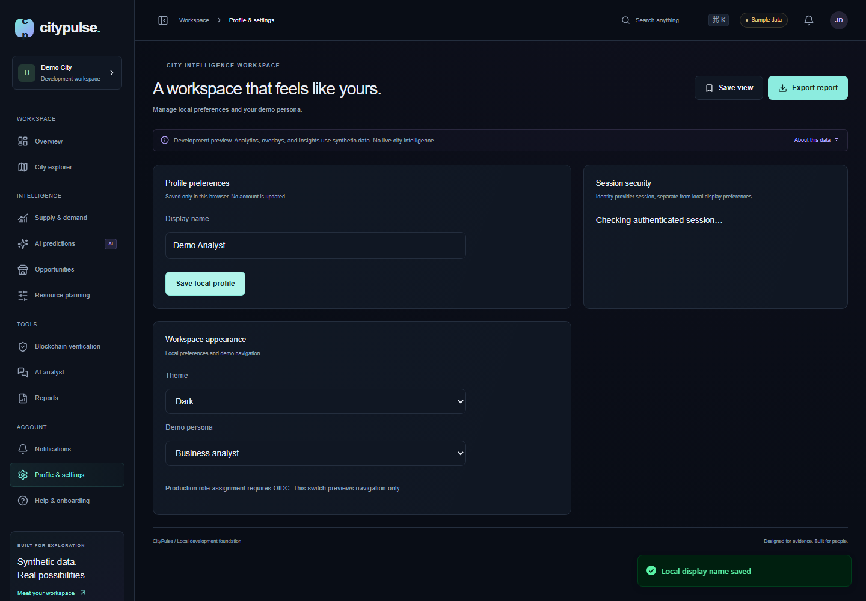
Frontend architecture and design
01
Typed routes, query state and local preferences
02
Charts/maps with table and keyboard alternatives
03
One theme for workspace, portals and notifications
CITYPULSE | SYNTHETIC DEVELOPMENT / IMPLEMENTATION EVIDENCE
12 / 33
Notes:
Issue #22 exposed shell-only theme inheritance and Sonner defaults. PR #23 moved theme to the document root, explicitly themed notifications, gated selection on hydration and corrected light success-toast contrast. Eighteen desktop/mobile tests include this regression. This screenshot is actual local UI.
Application snapshot: 2385ea7a3c6f9349c9c9ee67a56ace5f279fa992
Evidence date: 2026-10-29
Sources:
apps/web/components/providers.tsx
https://github.com/manikantbindass/CityPulse/blob/2385ea7a3c6f9349c9c9ee67a56ace5f279fa992/apps/web/components/providers.tsx
apps/web/e2e/theme.spec.ts
https://github.com/manikantbindass/CityPulse/blob/2385ea7a3c6f9349c9c9ee67a56ace5f279fa992/apps/web/e2e/theme.spec.ts

Slide 13
Java Spring Boot backend
Controllers validate; services enforce policy and transactions
01
02
03
04
Authenticate
Authorize
Transact
Explain
Token and membership
Tenant and scopes
Validate and persist
Safe typed response
Human review remains the decision boundary
CITYPULSE | SYNTHETIC DEVELOPMENT / IMPLEMENTATION EVIDENCE
13 / 33
Notes:
Do not imply every endpoint is individually owner-scoped. General operational data is tenant-scoped; conversations/scenarios narrow by subject ownership. JWT acceptance alone cannot expand database role permissions. Current enabled membership narrows signed scopes.
Application snapshot: 2385ea7a3c6f9349c9c9ee67a56ace5f279fa992
Evidence date: 2026-10-29
Sources:
services/api/src/main/java/io/citypulse/identity/MembershipFilter.java
https://github.com/manikantbindass/CityPulse/blob/2385ea7a3c6f9349c9c9ee67a56ace5f279fa992/services/api/src/main/java/io/citypulse/identity/MembershipFilter.java
docs/api/backend.md
https://github.com/manikantbindass/CityPulse/blob/2385ea7a3c6f9349c9c9ee67a56ace5f279fa992/docs/api/backend.md

Slide 14
Database and PostGIS architecture
01
WGS84 boundaries and longitude-first points
tenant / user_account
tenant_city / city
zone /
geographic_area
business
source_metadata
observation /
inventory
02
Separate flow observations, stock snapshots and provenance
operation_receipt
forecast_result
audit_event
03
Composite references protect sensitive tenant relationships
pulseai_session /
message
decision_snapshot /
scenario
verification_request
CITYPULSE | SYNTHETIC DEVELOPMENT / IMPLEMENTATION EVIDENCE
14 / 33
Notes:
The physical report appendix is definitive. tenant_city assigns shared city definitions rather than making every city directly tenant-owned. GiST supports spatial queries; tenant/time indexes support protected history. Parent-boundary edits need controlled revalidation.
Application snapshot: 2385ea7a3c6f9349c9c9ee67a56ace5f279fa992
Evidence date: 2026-10-29
Sources:
services/api/src/main/resources/db/migration/V1__canonical_geospatial_schema.sql
https://github.com/manikantbindass/CityPulse/blob/2385ea7a3c6f9349c9c9ee67a56ace5f279fa992/services/api/src/main/resources/db/migration/V1__canonical_geospatial_schema.sql
services/api/src/main/resources/db/migration/V2__tenant_operations.sql
https://github.com/manikantbindass/CityPulse/blob/2385ea7a3c6f9349c9c9ee67a56ace5f279fa992/services/api/src/main/resources/db/migration/V2__tenant_operations.sql

Slide 15
Data ingestion and processing
01
CSV, JSON and Point GeoJSON
CSV / JSON /
GeoJSON
Parse and validate
Clean and normalize
Deduplicate / quality
Durable local output
API publication
02
Validate, normalize, deduplicate and score quality
PostGIS
Reject / dead letter
Analytical queries
03
Checkpoint locally; publish with scoped replay receipts
CITYPULSE | SYNTHETIC DEVELOPMENT / IMPLEMENTATION EVIDENCE
15 / 33
Notes:
Input size, headers, units, timestamps and geography are bounded. Quality is a rule-based diagnostic, not proof of source truth or model confidence. A local checkpoint is not evidence that all remote publication completed. Live provider access requires licensing and configuration.
Application snapshot: 2385ea7a3c6f9349c9c9ee67a56ace5f279fa992
Evidence date: 2026-10-29
Sources:
services/ingestion/citypulse_ingestion/pipeline.py
https://github.com/manikantbindass/CityPulse/blob/2385ea7a3c6f9349c9c9ee67a56ace5f279fa992/services/ingestion/citypulse_ingestion/pipeline.py
scripts/data_pipeline.py
https://github.com/manikantbindass/CityPulse/blob/2385ea7a3c6f9349c9c9ee67a56ace5f279fa992/scripts/data_pipeline.py

Slide 16
AI/ML forecasting workflow
01
Past-only lag and weekday features
Synthetic daily rows
Chronological split
Past-only features
Four candidates
Validation selection
Held-out one-step test
02
Chronological train / validation / test
Versioned JSON artifact
Bounded inference
Diagnostics / review
03
Versioned JSON artifacts, fallback and rollback
CITYPULSE | SYNTHETIC DEVELOPMENT / IMPLEMENTATION EVIDENCE
16 / 33
Notes:
Eight synthetic city/district/category scopes contain 182 daily observations each. Train/validation/test is chronological 60/20/20. Validation MAE selects among seasonal-naive, moving average, Ridge and XGBoost. Rolling one-step performance is not recursive multi-horizon or unseen-city performance.
Application snapshot: 2385ea7a3c6f9349c9c9ee67a56ace5f279fa992
Evidence date: 2026-10-29
Sources:
services/ai-engine/citypulse_ai/modeling.py
https://github.com/manikantbindass/CityPulse/blob/2385ea7a3c6f9349c9c9ee67a56ace5f279fa992/services/ai-engine/citypulse_ai/modeling.py
docs/reports/model-evaluation.json
https://github.com/manikantbindass/CityPulse/blob/2385ea7a3c6f9349c9c9ee67a56ace5f279fa992/docs/reports/model-evaluation.json

Slide 17
Actual model evaluation
Synthetic
held-out
one-step MAE
Compare within segment.
No real-city accuracy claim.
AMS/BLR = Amsterdam/Bengaluru; C/N = central/north; G/M = groceries/mobility
CITYPULSE | SYNTHETIC DEVELOPMENT / IMPLEMENTATION EVIDENCE
17 / 33
Notes:
The chart reads selected-model test MAE from committed evaluation JSON. Compare within synthetic segment. Validation-selected candidates are not always best on the test period. Empirical interval coverage varies materially; a 90th-percentile residual method is not guaranteed 90% future coverage. The report retains all candidate metrics.
Application snapshot: 2385ea7a3c6f9349c9c9ee67a56ace5f279fa992
Evidence date: 2026-10-29
Sources:
docs/reports/model-evaluation.json
https://github.com/manikantbindass/CityPulse/blob/2385ea7a3c6f9349c9c9ee67a56ace5f279fa992/docs/reports/model-evaluation.json
docs/model-card.md
https://github.com/manikantbindass/CityPulse/blob/2385ea7a3c6f9349c9c9ee67a56ace5f279fa992/docs/model-card.md

Slide 18
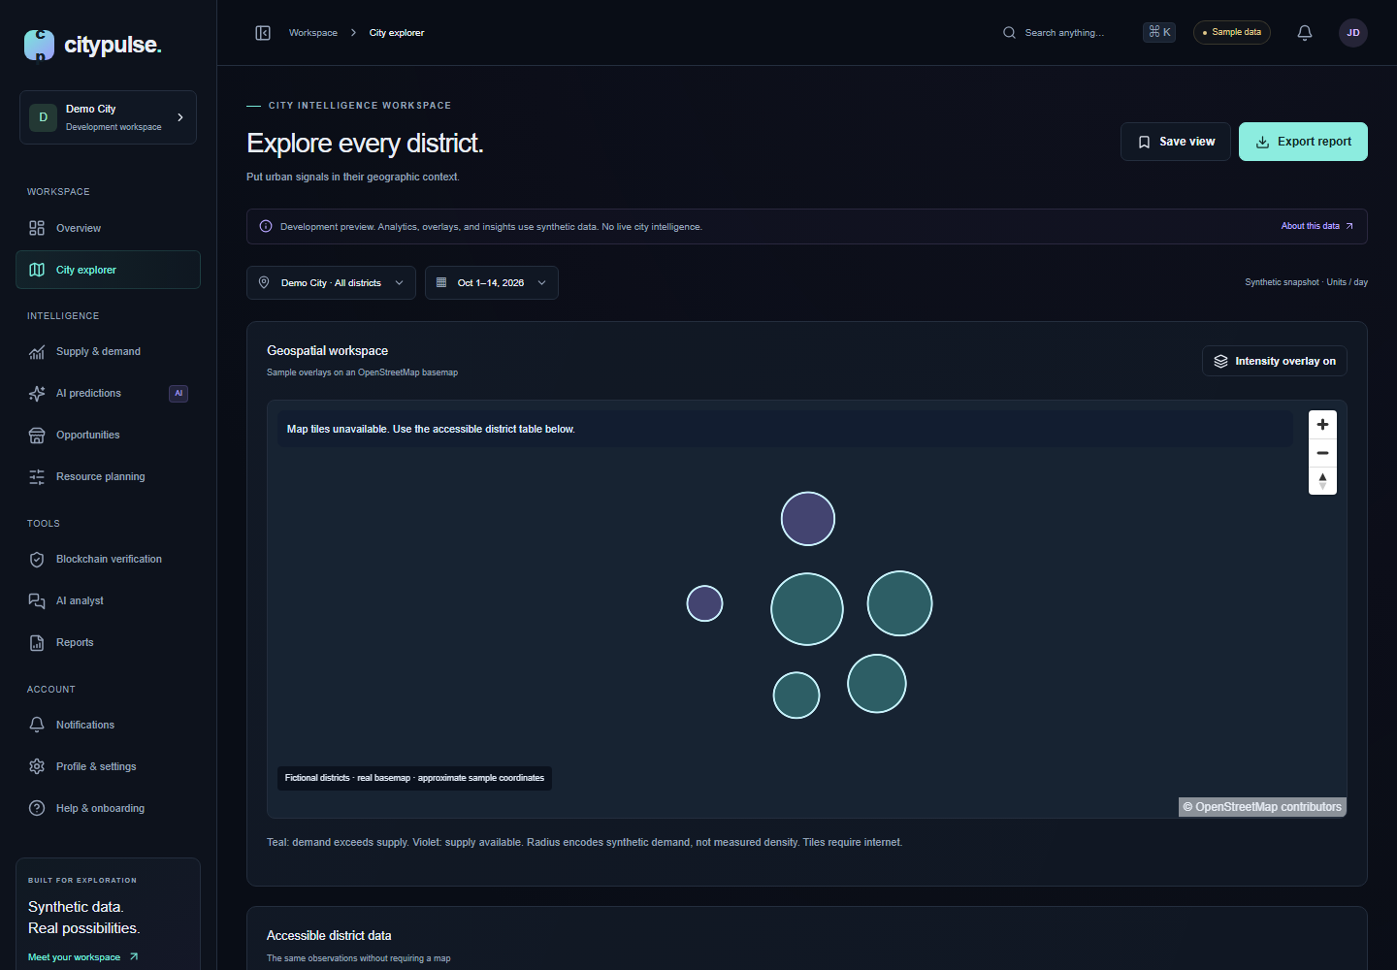
City maps and demand forecasts
Synthetic daily demand units, Jul–Aug 2025; residual intervals are diagnostic
CITYPULSE | SYNTHETIC DEVELOPMENT / IMPLEMENTATION EVIDENCE
18 / 33
Notes:
The map is an actual local screenshot and remains labeled synthetic. The forecast chart is derived from an actual local FastAPI response saved with its input/provenance and no credentials. A forecast response is a demonstration, not measured future accuracy. Intervals and fallback status must be read from that response.
Application snapshot: 2385ea7a3c6f9349c9c9ee67a56ace5f279fa992
Evidence date: 2026-10-29
Sources:
docs/presentations/source/evidence/forecast-demo.json (companion editable source in this delivery)
docs/model-card.md
https://github.com/manikantbindass/CityPulse/blob/2385ea7a3c6f9349c9c9ee67a56ace5f279fa992/docs/model-card.md

Slide 19
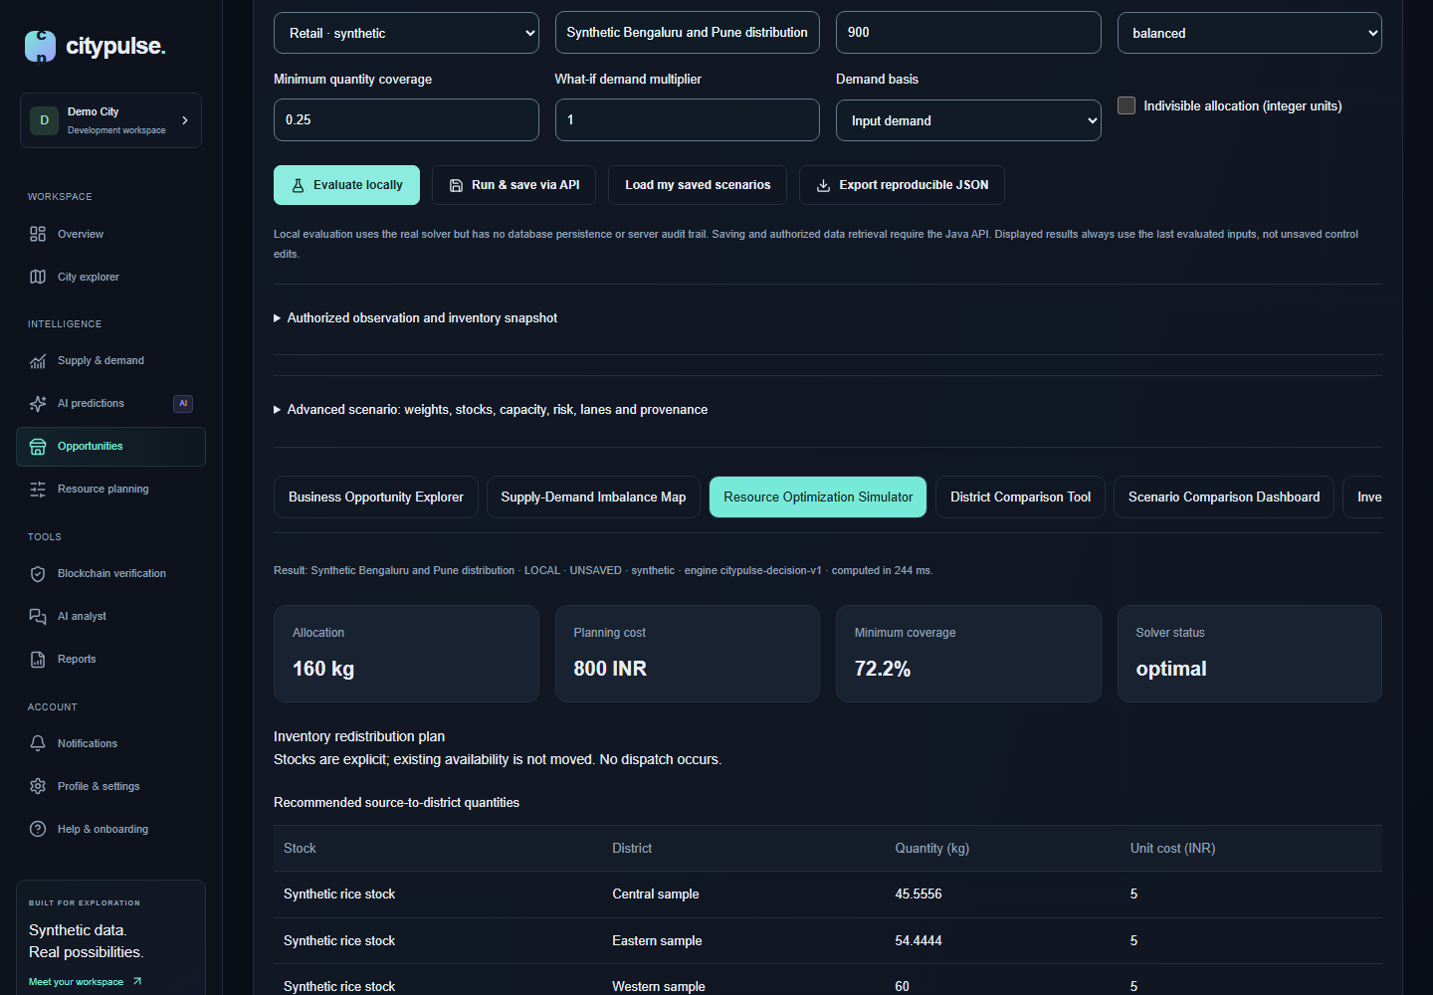
Business opportunity engine
01
Configurable scores expose assumptions
02
Budget, stock, capacity, lanes and coverage are explicit
03
Infeasibility is a result; no plan dispatch occurs
CITYPULSE | SYNTHETIC DEVELOPMENT / IMPLEMENTATION EVIDENCE
19 / 33
Notes:
The screenshot follows an actual local SciPy calculation with synthetic data. Scores are indicators, not investment-success probabilities. A local result is unsaved; the Java path supports owned snapshots, saved/exported scenarios and reproduction. Cost minimization may validly allocate zero without a hard positive floor.
Application snapshot: 2385ea7a3c6f9349c9c9ee67a56ace5f279fa992
Evidence date: 2026-10-29
Sources:
docs/reports/decision-evaluation.json
https://github.com/manikantbindass/CityPulse/blob/2385ea7a3c6f9349c9c9ee67a56ace5f279fa992/docs/reports/decision-evaluation.json
services/ai-engine/citypulse_ai/decisions.py
https://github.com/manikantbindass/CityPulse/blob/2385ea7a3c6f9349c9c9ee67a56ace5f279fa992/services/ai-engine/citypulse_ai/decisions.py

Slide 20
PulseAI conversational analyst
01
Read-only tools retrieve permitted records
Bounded question +
filters
Spring policy
Fixed read-only tools
Verified statements
Optional provider
Validate ID selection
02
An optional model selects allowed statement IDs
Construct answer
Evidence fallback
Owned conversation
03
Java constructs factual prose and citations
CITYPULSE | SYNTHETIC DEVELOPMENT / IMPLEMENTATION EVIDENCE
20 / 33
Notes:
Neither retrieved text nor provider output can choose arbitrary SQL or introduce free-form factual claims. Missing records remain absent. The default disabled provider makes no paid external request. Stored forecasts require tenant checks and are not silently attributed to an unrelated city UUID.
Application snapshot: 2385ea7a3c6f9349c9c9ee67a56ace5f279fa992
Evidence date: 2026-10-29
Sources:
services/api/src/main/java/io/citypulse/pulseai/PulseAiService.java
https://github.com/manikantbindass/CityPulse/blob/2385ea7a3c6f9349c9c9ee67a56ace5f279fa992/services/api/src/main/java/io/citypulse/pulseai/PulseAiService.java
services/ai-engine/citypulse_ai/pulseai.py
https://github.com/manikantbindass/CityPulse/blob/2385ea7a3c6f9349c9c9ee67a56ace5f279fa992/services/ai-engine/citypulse_ai/pulseai.py

Slide 21
Why attest selected content?
01
Exports and audit evidence need integrity checks
02
A digest can be compared independently
03
Integrity does not establish observation truth
CITYPULSE | SYNTHETIC DEVELOPMENT / IMPLEMENTATION EVIDENCE
21 / 33
Notes:
Blockchain is justified narrowly for selected attestations, not as the primary database or a guarantee of honest providers. References must exclude secrets and private personal data. Public immutability complicates deletion; local EVM behavior does not establish a deployed public system.
Application snapshot: 2385ea7a3c6f9349c9c9ee67a56ace5f279fa992
Evidence date: 2026-10-29
Sources:
docs/blockchain.md
https://github.com/manikantbindass/CityPulse/blob/2385ea7a3c6f9349c9c9ee67a56ace5f279fa992/docs/blockchain.md
blockchain/contracts/DatasetAttestationRegistry.sol
https://github.com/manikantbindass/CityPulse/blob/2385ea7a3c6f9349c9c9ee67a56ace5f279fa992/blockchain/contracts/DatasetAttestationRegistry.sol

Slide 22
Smart contracts and verification
01
Authorize source and attester role
Exported bytes
Off-chain digest
AuthorizedSource
Registry
DatasetAttestation
Registry
Receipt / event
VerificationRecord
02
Record a unique event digest and receipt
Java confirmation
Tampered bytes
03
Compare the original and tampered bytes
CITYPULSE | SYNTHETIC DEVELOPMENT / IMPLEMENTATION EVIDENCE
22 / 33
Notes:
AuthorizedSourceRegistry, DatasetAttestationRegistry and VerificationRecord match report labels. IDs include chain/contract/submitter/event. The recorded local demo uses chain 31337 and 150,788 gas for one sample. This is not a public-network fee quote. Java separately distinguishes DIGEST_RECORDED from validated CHAIN_CONFIRMED.
Application snapshot: 2385ea7a3c6f9349c9c9ee67a56ace5f279fa992
Evidence date: 2026-10-29
Sources:
docs/reports/blockchain-local-demo.json
https://github.com/manikantbindass/CityPulse/blob/2385ea7a3c6f9349c9c9ee67a56ace5f279fa992/docs/reports/blockchain-local-demo.json
services/api/src/main/java/io/citypulse/workspace/application/ChainReceiptService.java
https://github.com/manikantbindass/CityPulse/blob/2385ea7a3c6f9349c9c9ee67a56ace5f279fa992/services/api/src/main/java/io/citypulse/workspace/application/ChainReceiptService.java

Slide 23
Security, authentication and privacy
01
OIDC/PKCE, encrypted sessions and current membership
02
Tenant/owner predicates, bounded inputs and safe exports
03
Real IdP/MFA rollout and external assurance remain pending
CITYPULSE | SYNTHETIC DEVELOPMENT / IMPLEMENTATION EVIDENCE
23 / 33
Notes:
CSRF is retained except for explicit bearer API requests; invalid credentials still fail authorization. Session tokens are not in browser storage. Nonce CSP, strict parsing, minimized logs, runtime DB grants and dependency scans provide layers. No penetration test, professional contract audit or certification is claimed.
Application snapshot: 2385ea7a3c6f9349c9c9ee67a56ace5f279fa992
Evidence date: 2026-10-29
Sources:
docs/security/architecture.md
https://github.com/manikantbindass/CityPulse/blob/2385ea7a3c6f9349c9c9ee67a56ace5f279fa992/docs/security/architecture.md
docs/security/threat-model.md
https://github.com/manikantbindass/CityPulse/blob/2385ea7a3c6f9349c9c9ee67a56ace5f279fa992/docs/security/threat-model.md

Slide 24
Cloud infrastructure and deployment
01
Compose is executable and verified in Linux CI
Local / CI host
Web / API / AI
PostGIS / Redis
Optional telemetry /
chain
AWS HTTPS ALB
Private ECS / Fargate
02
AWS private ECS/data modules are validated code
Managed data
EFS and private S3
Isolated migration task
03
No cloud apply or paid resource provisioning occurred
CITYPULSE | SYNTHETIC DEVELOPMENT / IMPLEMENTATION EVIDENCE
24 / 33
Notes:
Fargate workloads, HTTPS ALB, managed data, EFS and private S3 are code-level designs. Counts default to zero pending bootstrap, but data/network resources would still cost money after apply. Internal HTTP, broad NAT egress and writable ephemeral cloud roots are documented hardening gaps. SQS has no connected consumer.
Application snapshot: 2385ea7a3c6f9349c9c9ee67a56ace5f279fa992
Evidence date: 2026-10-29
Sources:
infrastructure/terraform/main.tf.json
https://github.com/manikantbindass/CityPulse/blob/2385ea7a3c6f9349c9c9ee67a56ace5f279fa992/infrastructure/terraform/main.tf.json
docs/operations/deployment.md
https://github.com/manikantbindass/CityPulse/blob/2385ea7a3c6f9349c9c9ee67a56ace5f279fa992/docs/operations/deployment.md

Slide 25
Scalability and reliability
01
Web/API scale within pool and DB budgets
02
SQLite-backed AI remains one writer
03
Recovery objectives require an actual restore rehearsal
CITYPULSE | SYNTHETIC DEVELOPMENT / IMPLEMENTATION EVIDENCE
25 / 33
Notes:
At four API tasks with ten connections each, budget up to forty runtime connections plus operational headroom. EFS is persistence, not concurrent SQLite safety. Durable job metadata/leases/outbox and queue consumers precede horizontal AI scaling. RPO/RTO are targets, not measured recovery guarantees.
Application snapshot: 2385ea7a3c6f9349c9c9ee67a56ace5f279fa992
Evidence date: 2026-10-29
Sources:
docs/operations/scaling.md
https://github.com/manikantbindass/CityPulse/blob/2385ea7a3c6f9349c9c9ee67a56ace5f279fa992/docs/operations/scaling.md
docs/operations/recovery.md
https://github.com/manikantbindass/CityPulse/blob/2385ea7a3c6f9349c9c9ee67a56ace5f279fa992/docs/operations/recovery.md

Slide 26
CI/CD and monitoring
01
Build, test, scan and produce CycloneDX inventories
Next instrumentation
Spring / Micrometer
FastAPI middleware
OTLP collector
Tempo
Prometheus
02
Private metrics and redacted OpenTelemetry traces
Grafana dashboard
Alert rules
ECS CloudWatch path
03
Alert rules exist; pager delivery is not configured
CITYPULSE | SYNTHETIC DEVELOPMENT / IMPLEMENTATION EVIDENCE
26 / 33
Notes:
Main requires nine application/security/platform jobs. Manual packaging is separate from automatic provisioning. Compose verifies actual API/AI scrapes and spans stored in Tempo. CloudWatch is a configured ECS path, not a deployed logging service. Proposed SLOs are not attained service levels.
Application snapshot: 2385ea7a3c6f9349c9c9ee67a56ace5f279fa992
Evidence date: 2026-10-29
Sources:
.github/workflows/ci.yml
https://github.com/manikantbindass/CityPulse/blob/2385ea7a3c6f9349c9c9ee67a56ace5f279fa992/.github/workflows/ci.yml
.github/workflows/security.yml
https://github.com/manikantbindass/CityPulse/blob/2385ea7a3c6f9349c9c9ee67a56ace5f279fa992/.github/workflows/security.yml
scripts/monitoring_smoke.py
https://github.com/manikantbindass/CityPulse/blob/2385ea7a3c6f9349c9c9ee67a56ace5f279fa992/scripts/monitoring_smoke.py

Slide 27
Testing and quality assurance
29
48
13
Java
AI
Web unit
18
6
4
Desktop/mobile
Ingestion
Solidity
Revision-linked CI evidence; two mocked Terraform plans; no coverage percentage invented
CITYPULSE | SYNTHETIC DEVELOPMENT / IMPLEMENTATION EVIDENCE
27 / 33
Notes:
These counts have revision-linked CI evidence in the report. Linux Java has zero skips; local Docker tests skip because the engine was unavailable. Browser tests include accessibility and theme persistence. Zero fixable HIGH/CRITICAL findings is a scoped scan gate, not a clean bill of security.
Application snapshot: 2385ea7a3c6f9349c9c9ee67a56ace5f279fa992
Evidence date: 2026-10-29
Sources:
docs/reports/source/evidence.json (companion editable source in this delivery)
apps/web/e2e/theme.spec.ts
https://github.com/manikantbindass/CityPulse/blob/2385ea7a3c6f9349c9c9ee67a56ace5f279fa992/apps/web/e2e/theme.spec.ts

Slide 28
End-to-end user journey
Load licensed or synthetic records
01
02
03
04
Ingest
Investigate
Decide
Preserve
Validate and replay
Compare and forecast
Human-reviewed scenario
Save, export, verify
Human review remains the decision boundary
CITYPULSE | SYNTHETIC DEVELOPMENT / IMPLEMENTATION EVIDENCE
28 / 33
Notes:
Walk through ingestion/replay, an owned evidence session, a forecast job, a constrained scenario and an independent digest comparison. Keep failure paths visible: absent counterpart, invalid authorization, solver infeasibility and unmatched receipt. Human review remains the decision boundary.
Application snapshot: 2385ea7a3c6f9349c9c9ee67a56ace5f279fa992
Evidence date: 2026-10-29
Sources:
scripts/smoke.py
https://github.com/manikantbindass/CityPulse/blob/2385ea7a3c6f9349c9c9ee67a56ace5f279fa992/scripts/smoke.py
docs/decision-engine.md
https://github.com/manikantbindass/CityPulse/blob/2385ea7a3c6f9349c9c9ee67a56ace5f279fa992/docs/decision-engine.md
docs/pulseai.md
https://github.com/manikantbindass/CityPulse/blob/2385ea7a3c6f9349c9c9ee67a56ace5f279fa992/docs/pulseai.md

Slide 29
Real results and key learnings
21 requests
0% HTTP failures
20 seconds
1 arrival/second
Direct loopback AI
Synthetic smoke workload; excludes web/API/DB latency and is not production capacity evidence
CITYPULSE | SYNTHETIC DEVELOPMENT / IMPLEMENTATION EVIDENCE
29 / 33
Notes:
The k6 run is twenty seconds at one arrival per second, with twenty-one observed requests. It excludes Next, Java, DB and external network. It is not saturation or production SLO evidence. Local solver benchmarks cover three sizes with three repeats each; raw data is retained. Interval coverage and portal-theme tests exposed useful limitations rather than just confirming expected behavior.
Application snapshot: 2385ea7a3c6f9349c9c9ee67a56ace5f279fa992
Evidence date: 2026-10-29
Sources:
docs/reports/operations/k6-local-ai.json
https://github.com/manikantbindass/CityPulse/blob/2385ea7a3c6f9349c9c9ee67a56ace5f279fa992/docs/reports/operations/k6-local-ai.json
docs/reports/decision-evaluation.json
https://github.com/manikantbindass/CityPulse/blob/2385ea7a3c6f9349c9c9ee67a56ace5f279fa992/docs/reports/decision-evaluation.json

Slide 30
Challenges, tradeoffs and limitations
01
Synthetic data and incomplete coverage limit conclusions
02
Local AI persistence limits distributed deployment
03
Licensing, identity, security review and DR need pilot evidence
CITYPULSE | SYNTHETIC DEVELOPMENT / IMPLEMENTATION EVIDENCE
30 / 33
Notes:
General business rows require owner policy for mixed-owner tenants. Historical documents lagged implementation, so this report/deck use a code-first hierarchy. A Hardhat development advisory and deprecated Jackson bridge remain disclosed. Avoid promising profit, real-time intelligence, mainnet operation or certification.
Application snapshot: 2385ea7a3c6f9349c9c9ee67a56ace5f279fa992
Evidence date: 2026-10-29
Sources:
docs/api/backend.md
https://github.com/manikantbindass/CityPulse/blob/2385ea7a3c6f9349c9c9ee67a56ace5f279fa992/docs/api/backend.md
docs/security/verification.md
https://github.com/manikantbindass/CityPulse/blob/2385ea7a3c6f9349c9c9ee67a56ace5f279fa992/docs/security/verification.md
docs/operations/scaling.md
https://github.com/manikantbindass/CityPulse/blob/2385ea7a3c6f9349c9c9ee67a56ace5f279fa992/docs/operations/scaling.md

Slide 31
Future roadmap
01
Licensed, assessed sources and real IdP acceptance
02
Durable job metadata, workers and artifact storage
03
Measured capacity, recovery drills and independent review
PLANNED / NOT DEPLOYED
CITYPULSE | SYNTHETIC DEVELOPMENT / IMPLEMENTATION EVIDENCE
31 / 33
Notes:
All three groups are future work, not deployed modules. Queue consumers and Kubernetes require measured need. Add multi-horizon calibration and field evaluation before expanding model complexity. Real provider cadence/completeness and a responsible decision owner are essential acceptance inputs.
Application snapshot: 2385ea7a3c6f9349c9c9ee67a56ace5f279fa992
Evidence date: 2026-10-29
Sources:
README.md
https://github.com/manikantbindass/CityPulse/blob/2385ea7a3c6f9349c9c9ee67a56ace5f279fa992/README.md
docs/operations/scaling.md
https://github.com/manikantbindass/CityPulse/blob/2385ea7a3c6f9349c9c9ee67a56ace5f279fa992/docs/operations/scaling.md
docs/model-card.md
https://github.com/manikantbindass/CityPulse/blob/2385ea7a3c6f9349c9c9ee67a56ace5f279fa992/docs/model-card.md

Slide 32
Final summary
01
A working platform for reconstructable urban analysis
02
Explicit evidence, uncertainty and policy constraints
03
The next milestone is a controlled real-data pilot
CITYPULSE | SYNTHETIC DEVELOPMENT / IMPLEMENTATION EVIDENCE
32 / 33
Notes:
Summarize implemented integration, not a list of technologies alone. The value is that an analyst can inspect sources and assumptions and reproduce a scenario. The project does not claim operational city adoption, production uptime, independent audit or guaranteed outcomes.
Application snapshot: 2385ea7a3c6f9349c9c9ee67a56ace5f279fa992
Evidence date: 2026-10-29
Sources:
docs/reports/source/report.json (companion editable source in this delivery)
README.md
https://github.com/manikantbindass/CityPulse/blob/2385ea7a3c6f9349c9c9ee67a56ace5f279fa992/README.md

Slide 33

Questions and discussion
Questions?
Data • models • security • deployment
https://github.com/manikantbindass/CityPulse
Repository and reproducible evidence
CITYPULSE | SYNTHETIC DEVELOPMENT / IMPLEMENTATION EVIDENCE
33 / 33
Notes:
Invite questions about data compatibility, uncertainty, tenant/owner policy, optimization objectives, source-truth limits and the next pilot. The QR and text URL point to the actual GitHub repository. Speaker notes and the companion PDF provide implementation sources and verification limitations.
Application snapshot: 2385ea7a3c6f9349c9c9ee67a56ace5f279fa992
Evidence date: 2026-10-29
Sources:
README.md
https://github.com/manikantbindass/CityPulse/blob/2385ea7a3c6f9349c9c9ee67a56ace5f279fa992/README.md

