Slide 1
FlowNova AI
Visual workflows. Real execution.
Product, architecture, operation, and the path toward a scalable platform
26 October 2026 · github.com/manikantbindass/FlowNovaAI
Notes:
FlowNova AI is a visual workflow workbench. The Vercel-native demo supports protected sessions, private Blob-backed workspace data, immutable versions, and durable workflow execution. A separate Java/Spring Boot relational runtime supports local development and an enterprise deployment direction. This presentation explains what is implemented and separates proposed capabilities from verified behavior.

Slide 2
What FlowNova does
Draw
Configure
Publish
Run
Connect nodes
Map JSON data
Freeze a version
Inspect results
A workflow is a reviewable definition. An execution is a recorded instance of one version.
02
Notes:
Users describe a process through nodes and connections, configure data, publish a version, and inspect persisted results. It serves developers, operators, and teams evaluating auditable automation. External integrations and unsupervised agents are not assumed to exist.
Source: FlowNovaAI repository source, architecture.md, docs/*.md; edition 26 October 2026. Implemented behavior is distinct from proposed roadmap.

Slide 3
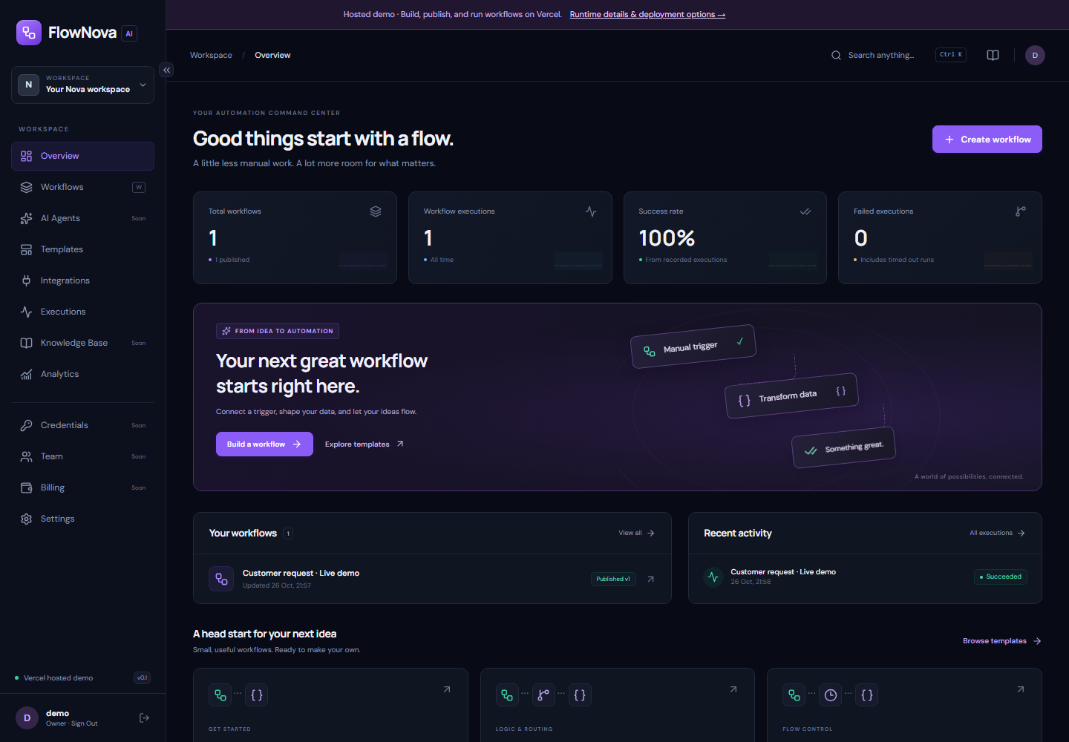
The automation workspace
Workflows
Create a draft or start with a supported template.
Activity
Inspect recorded executions and real metrics.
Status
Planned capabilities are labeled explicitly.
Actual application capture · real records and execution
03
Notes:
The workspace overview uses actual records. Screenshots come from a real authenticated session created for documentation. It does not fabricate usage trends or provider connectivity.
Source: FlowNovaAI repository source, architecture.md, docs/*.md; edition 26 October 2026. Implemented behavior is distinct from proposed roadmap.

Slide 4
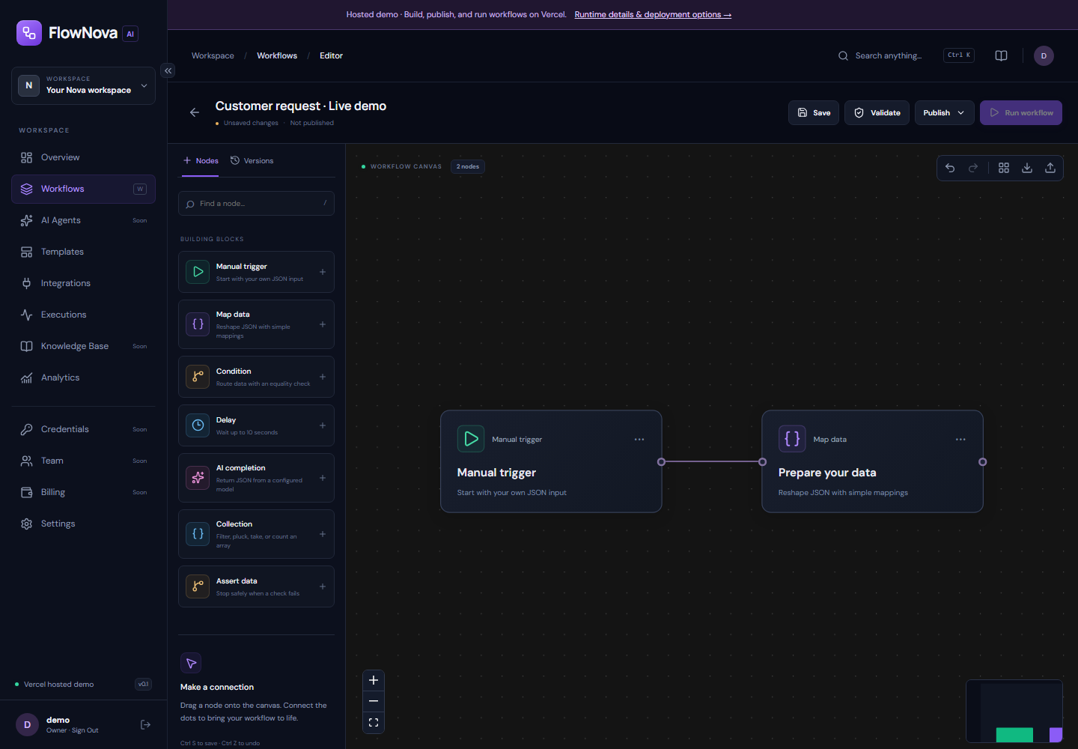
A canvas you can execute
Build visually
Add, move, connect, and configure nodes.
Keep control
Save explicitly, validate, undo, and export.
Publish safely
Confirm a version before running it.
Actual application capture · real records and execution
04
Notes:
The XYFlow canvas supports configuration, copy/paste, undo/redo, grid snapping, layout, minimap, import/export, and server validation. Drafts use revisions. Real-time collaborative editing and autosave merging are not implemented.
Source: FlowNovaAI repository source, architecture.md, docs/*.md; edition 26 October 2026. Implemented behavior is distinct from proposed roadmap.

Slide 5
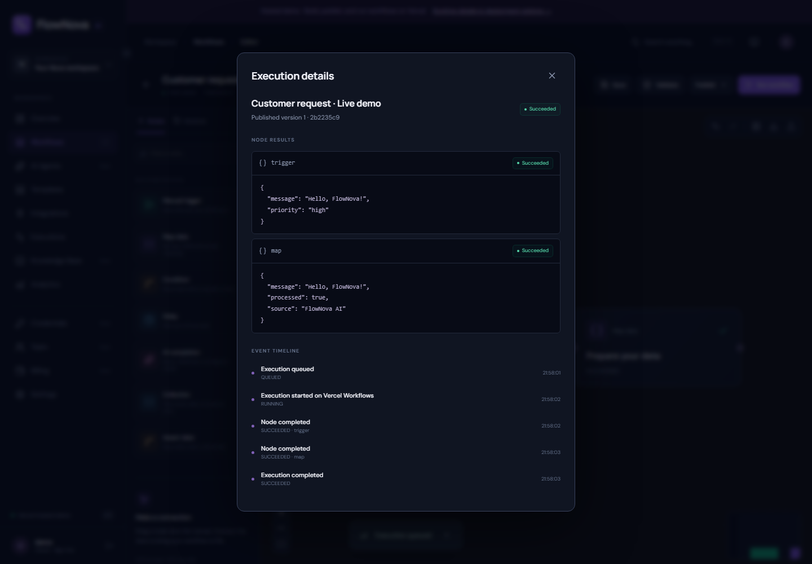
Inspect a real completed run
Exact version
Each run references a published snapshot.
Node results
Outputs and skipped branches are persisted.
Trace
Events show what happened and when.
Actual application capture · real records and execution
05
Notes:
The execution screenshot shows real deterministic node outputs. Inputs use field-name redaction. An optional AI adapter can be configured, but no fake model reply is presented.
Source: FlowNovaAI repository source, architecture.md, docs/*.md; edition 26 October 2026. Implemented behavior is distinct from proposed roadmap.

Slide 6
Definitions and executions stay separate
Draft r1
Version 1
Run A
Editable graph
Immutable snapshot
Exact version reference
Draft r2
Version 2
Run B
Later edits
Explicit new publish
Independent history
06
Notes:
Saving a draft increments its revision. Publishing locks or conditionally updates the stored definition and copies its graph into a new immutable version. Runs refer to that snapshot. Restoring a version creates a new draft revision; it does not rewrite history.
Source: FlowNovaAI repository source, architecture.md, docs/*.md; edition 26 October 2026. Implemented behavior is distinct from proposed roadmap.

Slide 7
Two deployment paths, one product contract
Next.js UI
Hosted API
Vercel Workflows
Visual editor
Sealed sessions
Durable steps and delays
Private Blob storage · conditional writes · browser-scoped demo workspace
Next.js UI
Spring Boot
PostgreSQL
Same API client
Identity and services
Durable SQL queue
07
Notes:
The owner requested a complete hosted core on Vercel without requiring visitor backend setup. The TypeScript hosted adapter preserves the UI API contracts while the Java relational runtime remains available. This is a deliberate architecture tradeoff and needs parity tests, not hidden duplication.
Source: FlowNovaAI repository source, architecture.md, docs/*.md; edition 26 October 2026. Implemented behavior is distinct from proposed roadmap.

Slide 8
The data model
Definition records
Workspace → workflow → immutable workflow version
Execution records
Execution → node checkpoints → persistent events
Governance records
Membership/role checks and append-oriented audit entries
08
Notes:
Workspace ownership scopes definitions, versions, executions, events, and audits. PostgreSQL uses foreign keys and indexes. The hosted demo stores a bounded workspace document with immutable versions and run checkpoints; it is not an unlimited relational database replacement.
Source: FlowNovaAI repository source, architecture.md, docs/*.md; edition 26 October 2026. Implemented behavior is distinct from proposed roadmap.

Slide 9
Identity and workspace isolation
Server-side checks
Every workspace operation verifies the authenticated workspace and role.
Public demo, private records
demo/demo opens the browser’s workspace; the storage token never reaches the browser.
Production identity is separate
Verified organizations, invitations, MFA, and browser OIDC onboarding remain planned.
09
Notes:
Local Java mode uses Spring Security sessions and CSRF. Production Java mode uses an external OIDC JWT issuer and audience. Hosted mode uses iron-session sealed cookies, public demo credentials, and browser-scoped private workspaces. Public credentials are not verified organizational identity. Clearing cookies loses access to that demo workspace.
Source: FlowNovaAI repository source, architecture.md, docs/*.md; edition 26 October 2026. Implemented behavior is distinct from proposed roadmap.

Slide 10
Execution on Vercel
Queue
Durable step
Checkpoint
Finish
Run accepted
Execute a node
Record output/event
Terminal status
Cancellation fences later checkpoints. A 120-second deadline bounds the demo run.
10
Notes:
Vercel Workflows persists orchestration; each I/O operation is a step. Durable sleep handles delay nodes. Blob records hold node checkpoints and events, while conditional writes prevent silently lost concurrent mutations. Provider side effects remain at-least-once if a request repeats after a crash.
Source: FlowNovaAI repository source, architecture.md, docs/*.md; edition 26 October 2026. Implemented behavior is distinct from proposed roadmap.

Slide 11
Execution in the relational runtime
Atomic creation
Execution and queued event are inserted in one database transaction.
Lease and checkpoint
A worker checks claim ownership before persisting each result.
Bounded recovery
Expired leases requeue eligible work; repeated stale attempts fail rather than run forever.
11
Notes:
The Java worker uses the database as its durable queue. Compare-and-set claims assign a lease token, checkpoints persist progress, and stale leases recover with bounded attempts. Current processing is sequential per Java process; multi-worker throughput is not benchmarked.
Source: FlowNovaAI repository source, architecture.md, docs/*.md; edition 26 October 2026. Implemented behavior is distinct from proposed roadmap.

Slide 12
Seven supported node types
Start and shape
Control and intelligence
Manual trigger
JSON mapping
Collection: filter / pluck / take / count
Condition: true / false
Delay: up to 10 seconds
Assert: enforce data requirements
AI completion: configured provider
No arbitrary code execution or generic HTTP side effects are exposed.
12
Notes:
The node contract uses kind, schemaVersion, configuration, and graph edges. Unsupported types are rejected. Graphs have one manual trigger, at most 50 nodes/100 edges, no cycles, and no ambiguous joins.
Source: FlowNovaAI repository source, architecture.md, docs/*.md; edition 26 October 2026. Implemented behavior is distinct from proposed roadmap.

Slide 13
Data moves through explicit contracts
Input
Mapping
{ "message": "Hello",
"priority": "high" }
{ "message": "$.message",
"processed": true }
Condition → { matched, data } → read $.data.message on the next branch
13
Notes:
Mapping strings beginning with $. read a path from prior node output. Other values are literals; missing paths become null. Conditions return matched and data, and downstream nodes access the original input under data. Collections inspect at most 1000 elements and return at most 100.
Source: FlowNovaAI repository source, architecture.md, docs/*.md; edition 26 October 2026. Implemented behavior is distinct from proposed roadmap.

Slide 14
AI is bounded and optional
Configured by the owner
Without a provider key, the AI node reports a clear configuration failure.
Time and output limits
25-second request timeout, at most 512 output tokens, JSON object output.
No hidden autonomy
No tools, credential discovery, external actions, or delegated agents.
14
Notes:
The current OpenAI adapter uses a server key, fixed provider URL, server-configured model, JSON object mode, and input redaction by field name. JSON mode guarantees format rather than semantic correctness. No tool calls or autonomous permission discovery occur. No live provider success is assumed. Source: https://developers.openai.com/api/docs/guides/structured-outputs
Source: FlowNovaAI repository source, architecture.md, docs/*.md; edition 26 October 2026. Implemented behavior is distinct from proposed roadmap.

Slide 15
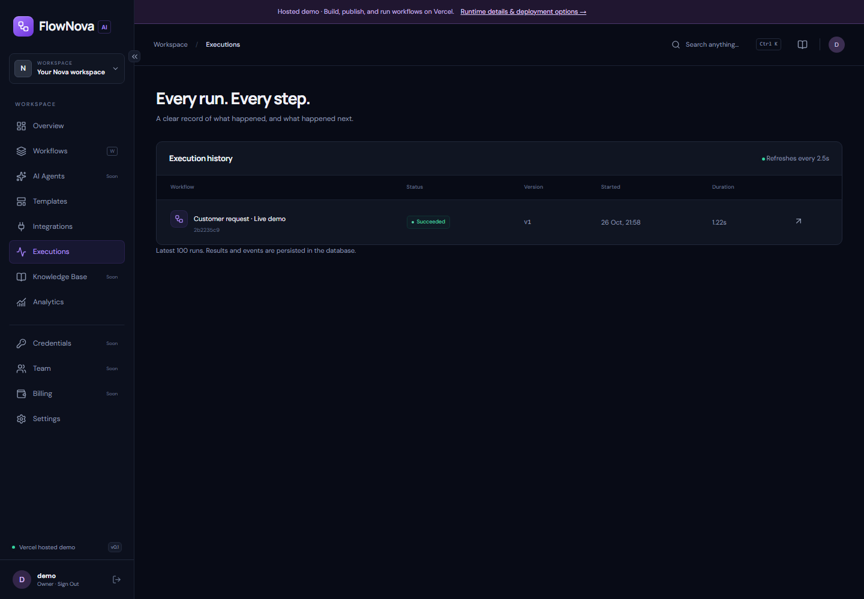
History survives the browser view
Persistence
Runs and node checkpoints are stored server-side.
Inspection
Open an execution and inspect outputs and errors.
Cancellation
Stop eligible queued or active runs.
Actual application capture · real records and execution
15
Notes:
History contains actual stored runs. The current client polls persisted state; SSE and cursor-based reconnect are roadmap items.
Source: FlowNovaAI repository source, architecture.md, docs/*.md; edition 26 October 2026. Implemented behavior is distinct from proposed roadmap.

Slide 16
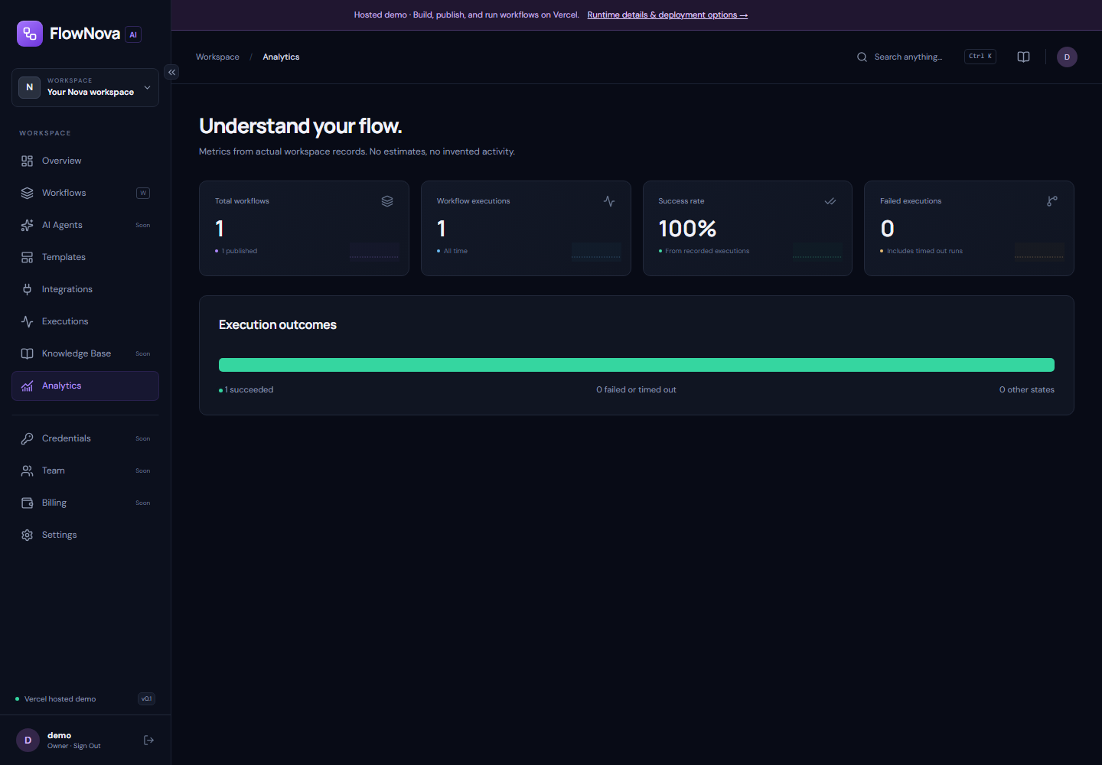
Metrics come from actual records
Counts
Workflows, published flows, and executions.
Outcomes
Succeeded and failed/timed-out runs.
Scope
Only the authenticated workspace contributes.
Actual application capture · real records and execution
16
Notes:
No fabricated analytics time series is shown. The success percentage uses all retained execution records as its denominator. Hosted demo retention is bounded by explicit workspace limits.
Source: FlowNovaAI repository source, architecture.md, docs/*.md; edition 26 October 2026. Implemented behavior is distinct from proposed roadmap.

Slide 17
Hosted limits are visible
25 workflows
20 versions per workflow
50 execution records
2 active runs
2 MB workspace data
120-second run deadline
Optional AI credentials and future third-party connectors still require configuration.
17
Notes:
The hosted demo is an evaluation environment on Vercel Hobby. It uses a bounded private workspace document rather than claiming enterprise throughput. Provider usage limits can stop availability. Local/relational deployment is a separate path.
Source: FlowNovaAI repository source, architecture.md, docs/*.md; edition 26 October 2026. Implemented behavior is distinct from proposed roadmap.

Slide 18
Run the relational platform locally
Install
npm ci · select an installed JDK for JAVA_HOME
Start the API
SERVER_PORT=8181 · apps/api/mvnw spring-boot:run
Start the web app
API_ORIGIN=http://127.0.0.1:8181 · npm run dev --workspace apps/web -- --port 3210
18
Notes:
Node 22+ and JDK 21+ are prerequisites. The included Maven wrapper starts Spring Boot. H2 is the file-backed development alternative; Docker Compose targets PostgreSQL but was not locally verified while the original Docker daemon was stopped. Ports 3210/8181 avoid existing services on the inspected machine.
Source: FlowNovaAI repository source, architecture.md, docs/*.md; edition 26 October 2026. Implemented behavior is distinct from proposed roadmap.

Slide 19
Security controls and open work
Implemented boundaries
Before production use
Authorization and tenant checks
CSRF and protected sessions
Request and execution limits
Immutable publication
No arbitrary code / unsafe HTTP
Verified organizational identity
Credential lifecycle and encryption
Retention and deletion policy
Backup restore and load evidence
Independent security assessment
19
Notes:
Implemented controls include role checks, workspace scoping, CSRF, protected cookies, request/input/output bounds, immutable versions, revision conflicts, secret field redaction, and no arbitrary scripts or generic HTTP node. Redaction is not DLP. Production identity, shared infrastructure, retention, and security review remain work.
Source: FlowNovaAI repository source, architecture.md, docs/*.md; edition 26 October 2026. Implemented behavior is distinct from proposed roadmap.

Slide 20
Scale by measuring the bottleneck
Separate API and worker roles
Add bounded worker pools and protect noisy tenants.
Measure queue age and DB load
Report throughput, latency percentiles, errors, hardware and payload size.
Prove recovery
Kill workers, restore backups, test schema rollout and provider failures.
20
Notes:
The hosted document store is deliberately bounded. Relational scaling requires tested PostgreSQL claims, tenant fairness, worker pools, backpressure, and shared rate/session infrastructure. Proposed load targets are test objectives, not guarantees.
Source: FlowNovaAI repository source, architecture.md, docs/*.md; edition 26 October 2026. Implemented behavior is distinct from proposed roadmap.

Slide 21
2027 proposals: controlled tools and agents
Hosted core and connectors
Verified identity, signed events, schedules, safe egress, GitHub and Slack.
Bounded agents
Explicit tool scopes, approvals, iteration/time/token budgets, and evaluation datasets.
Knowledge and governance
Safe uploads, tenant retrieval, citations, deletion, audit retention, usage and billing.
21
Notes:
Roadmap proposals include signed webhooks, schedules, encrypted credentials, approved MCP tools, A2A delegation, schema-constrained generation, human approvals, retrieval with citations, usage budgets and evaluations. MCP and A2A are not integrated in this release. Sources: https://modelcontextprotocol.io/specification/2026-07-28/architecture ; https://a2a-protocol.org/latest/specification/
Source: FlowNovaAI repository source, architecture.md, docs/*.md; edition 26 October 2026. Implemented behavior is distinct from proposed roadmap.

Slide 22
A short live demonstration
Sign in
Create
Publish
Execute
demo / demo
Manual + mapping
Confirm version 1
Inspect JSON output
https://flownova-ai.vercel.app
The repository contains architecture, startup, security, testing, and deployment references.
22
Notes:
Open the hosted site, sign in with public credentials, create a workflow, save/validate/publish, run an object input, and inspect the persisted result. Do not claim external provider connectivity unless it is actually configured and tested.
Source: FlowNovaAI repository source, architecture.md, docs/*.md; edition 26 October 2026. Implemented behavior is distinct from proposed roadmap.

Slide 23
Source and further reading
github.com/manikantbindass/FlowNovaAI
architecture.md
docs/DEPLOYMENT.md
docs/SECURITY.md
docs/TESTING.md
docs/ROADMAP_2027.md
Build something that gives you time back.
23
Notes:
The source repository is the authority for implemented behavior. architecture.md provides the system explanation; docs/PROGRESS.md records actual verification; docs/ROADMAP_2027.md separates proposals from shipped behavior. This file is editable. It was rendered and package-validated, not claimed to have been checked in PowerPoint.
Source: FlowNovaAI repository source, architecture.md, docs/*.md; edition 26 October 2026. Implemented behavior is distinct from proposed roadmap.

