Slide 1
BRICS NATIONS OLYMPIC MEDAL ANALYSIS
Presented By
Manikantha Dandi
234161017

Slide 2
Motivation
BRICS is an intergovernmental organization comprising Brazil, Russia, India, China, and South Africa.
Understanding Performance Trends : can help identify patterns, improvements, or challenges over the years
Promoting Sports Culture within the BRICS nations : engage communities in sports

Slide 3
Overview
Python based analysis using pandas, matplotlib
Columns in Data set : Year, Host city, Total Athletics, Gold, Silver, Bronze, Total Medals, Rank, Country
Data range : 1984 to 2020
Note that During 1984 and 1988 Russia is part of Soviet union nation.
1992 part of unified team
In 2020 represented as Russian Olympic Committee

Slide 4
Block Diagram
START
MAIN FUNCTION
Functions
Load_data()
line_plot_participation_over_years()
comparison_of_medals_across_years()
scatter_plot_rank_vs_total_medals()
get_top_countries()
pie_chart_category_wise_medals_all_years()

Slide 5
Pseudo code
# call main function
if __name__ == "__main__":
main()
#functions to be called in main function
def main():
olympic_data = load_data()
display_data_head(olympic_data)
# Plotting using Matplotlib
# Call your analysis functions
line_plot_participation_over_years(olympic_data)
bar_plot_total_medals_by_country(olympic_data)
comparison_of_medals_across_years(olympic_data)
bar_plot_medals_distribution_in_year(olympic_data, 2020)
scatter_plot_rank_vs_total_medals(olympic_data)
stacked_bar_plot_total_medals_distribution(olympic_data)

Slide 6
pseudocode
#load data
def load_data():
return pd.read_csv('F:\\python_pro\\olympic_statistics_modified.csv’)
#some other function
plot_medals_over_years(olympic_data)
pie_chart_category_wise_medals_all_years(olympic_data, 'India’)
get_top_countries(olympic_data, 2008, 4)

Slide 7
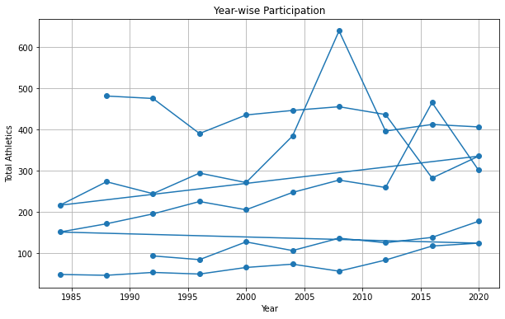
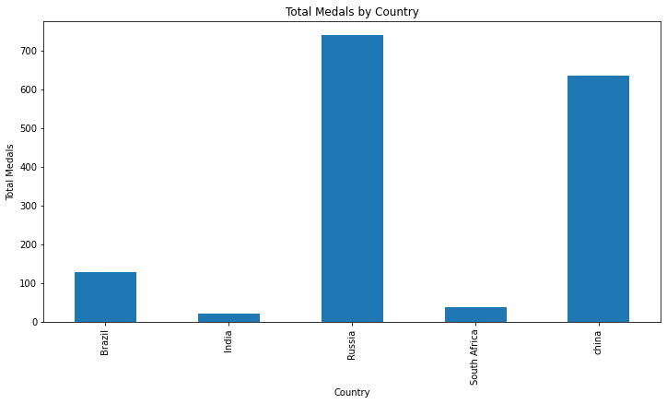
Results

Slide 8
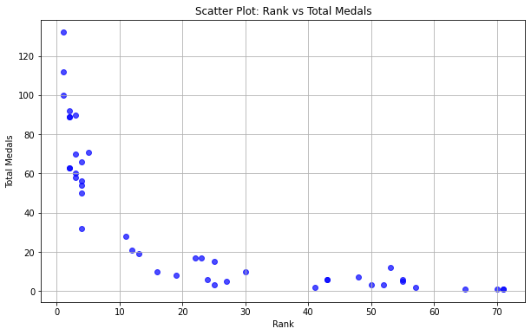
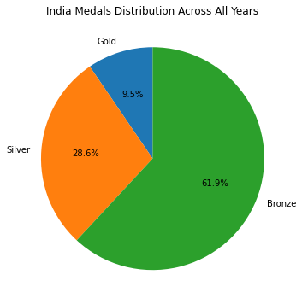
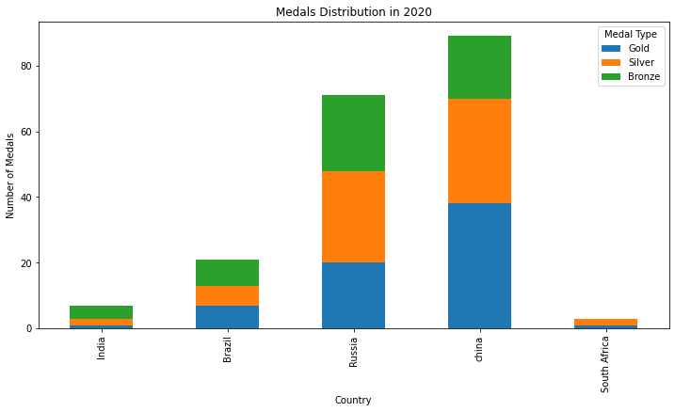
Results

Slide 9
Executing the Python code
Observations after executing the code:
-Both Russia and China appears to be a consistently strong performers across multiple years
-India’s medal count is comparatively lower

Slide 10
Thank you

