Slide 1

Sales Data Analysis & MIS Reporting Dashboard
Multi-Year Car Sales Performance Analysis (2020–2026)
Presented by: Manikant Sharma

Slide 2
Business Background
Car dealership requires effective sales performance tracking.
  Manual reporting limits real-time visibility.
  Need for automated MIS reporting.
  Importance of KPI monitoring for strategic decisions.

Slide 3
Project Objective
Build dynamic Power BI dashboard.
  Track YTD, MTD, and YoY KPIs.
  Enable data-driven decision making.
  Improve reporting efficiency.

Slide 4
Dataset Overview
5,000+ transaction records.
  Multi-year data (2020–2026).
  Attributes: Date, Region, Company, Body Style, Price, Dealer.
  Structured and optimized for analytics.

Slide 5

KPI Framework
YTD Total Sales
  MTD Total Sales
  YOY Growth
  YTD Average Price
  YTD Cars Sold
  YTD vs Previous Year Difference

Slide 6
Technical Implementation
Star Schema Data Model
  Calendar Table for time intelligence
  DAX Functions: TOTALYTD(), TOTALMTD(), SAMEPERIODLASTYEAR()
  Interactive filters and drilldowns

Slide 7
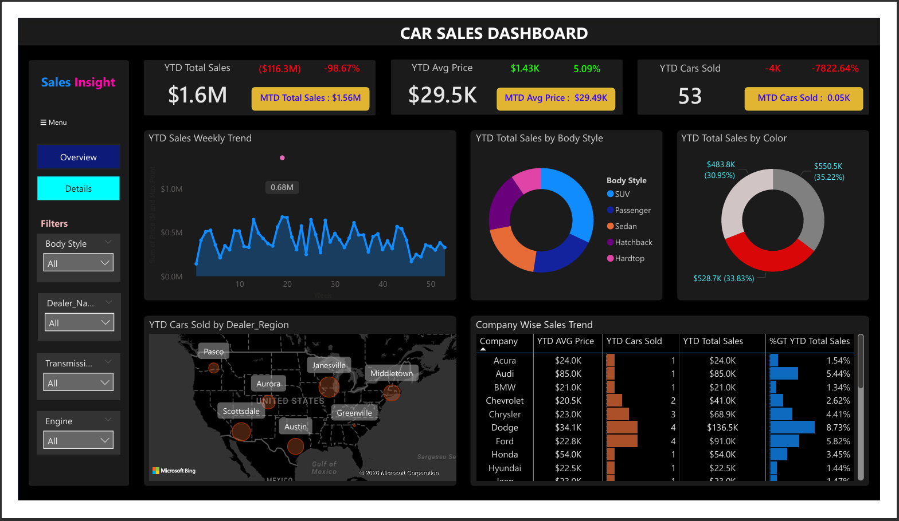
Dashboard Overview
Interactive KPI Summary & Weekly Trend

Slide 8
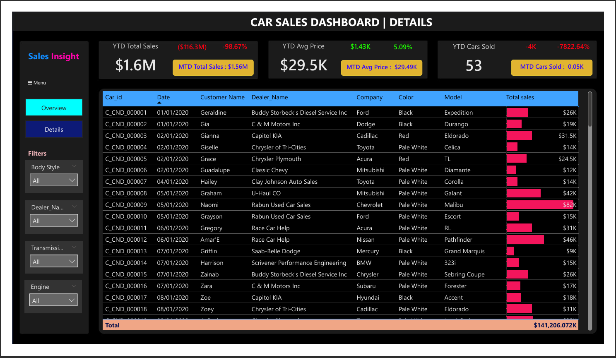
Detailed Transaction Analysis
Dashboard Details Page

Slide 9
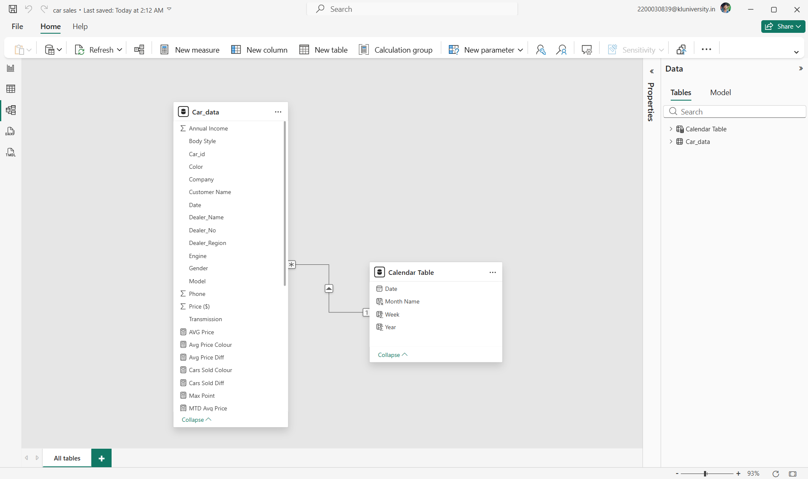
Data Model – Star Schema Structure
Model View

Slide 10
Business Insights
Revenue concentration up to 40% in top categories.
  Regional performance differences identified.
  Seasonal weekly sales trends observed.
  Improved executive-level KPI visibility.

Slide 11

Business Impact
Reduced manual reporting effort by ~30%.
  Enabled 6-year performance comparison.
  Automated MIS reporting.
  Improved strategic decision-making.

Slide 12
Conclusion
Transformed raw sales data into actionable insights.
  Built scalable and dynamic BI solution.
  Demonstrated Power BI & DAX expertise.

