Slide 1
Intelligent Shelves
Project Report

Slide 2
Introduction
The goal of this project was to use advanced inventory management to change the retail environment. Our objectives were to guarantee constant availability, offer real-time product updates, and create a seamless shopping experience.
This report covers technical accomplishments, project milestones, and the effective deployment of the Intelligent Shelves system.

Slide 3
Requirements
Real-Time Inventory Updates:
Accurate and real-time updates on product availability.
Display of product availability on digital screens instantly.
Assurance that intended purchases are in stock.
Ease of Use:
User-friendly interface on digital screens.
Quick and easy product availability checks.
Intuitive and straightforward design, requiring minimal guidance.

Slide 4
Requirements (Contd.)
Consistent Availability:
Assurance of consistent product availability.
Reduction of instances with empty shelves.
Ensuring the store has the items customers need.
Efficient Shopping:
Efficient and pleasant shopping experience.
Quick and easy product discovery.
Minimization of frustration in searching for out-of-stock items.

Slide 5
System Requirements
Real-Time Data Processing:
Capable of processing data in real time.
Immediate reflection of inventory changes on digital screens.
Simulated Software:
Inclusion of simulated software for accurate external environment mimicry.
Realistic representation of inventory movements and updates for testing and optimization.

Slide 6
System Requirements (contd.)
Backend Functionality:
Development to handle data processing, inventory tracking, and communication with simulated software.
Frontend User Interface:
Intuitive user interface for digital screens.
Real-time inventory status display.
Seamless integration with backend for data retrieval and display.

Slide 7
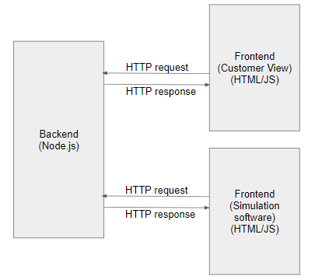
System Architecture

Slide 8
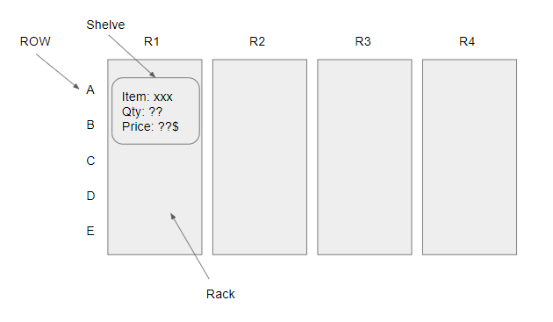
System Design
Frontend Customer View:
It will display the complete store view to the customer. Along with the shelves, it will also display the quantity (/stock) of the items in that rack.

Slide 9
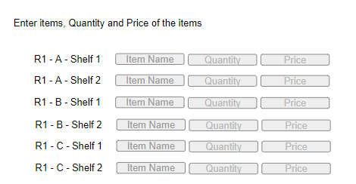
System Design (contd.)
Frontend Simulation Software:
This simulation software will simulate the physical events like removing or adding items from or to the rack (which will actually be detected by RFID technology in real world)

Slide 10
System Design (contd.)
Backend:
Event Handling:
Backend will process events from both simulation software and customer view.
Immediate database updates when items are added or removed in the simulation software.
APIs in Backend:
GET/store_structure:
Purpose: Obtain store structure information.
Usage: Both front-ends (simulation and customer views).
Details: Provides data on the number of racks, rows, and shelf details.

Slide 11
System Design (contd.)
APIs in Backend:
GET/shelf_data:
Purpose: Retrieve shelf details.
Usage: Both front-ends.
Details: Fetches information about items on the shelf, including quantity and price.
PUT/shelf_item:
Purpose: Update item information in shelfs.
Usage: Both front-ends.
Details: Used to modify items, quantity, or price on the shelf.

Slide 12
Technical Results
We have achieved the all phases mentioned in the initial project plan, including the successful implementation of software (frontend and backend) components, testing and deployment.
Testing has shown that the core functionality, including real-time inventory updates, is operational.
Some technical issues, such as data synchronization and minor performance bottlenecks, have been identified and are addressed.

Slide 13
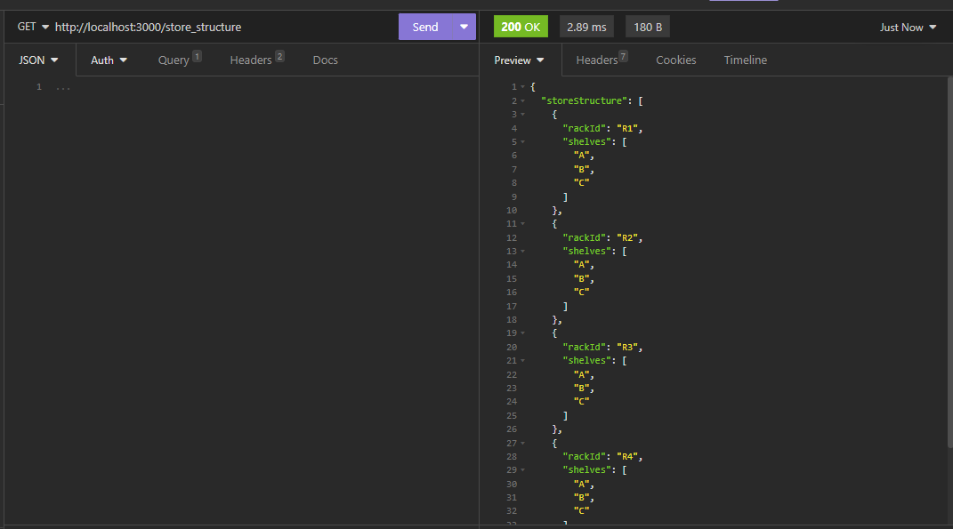
Technical Results
Backend Testing: (GET store_structure API)

Slide 14
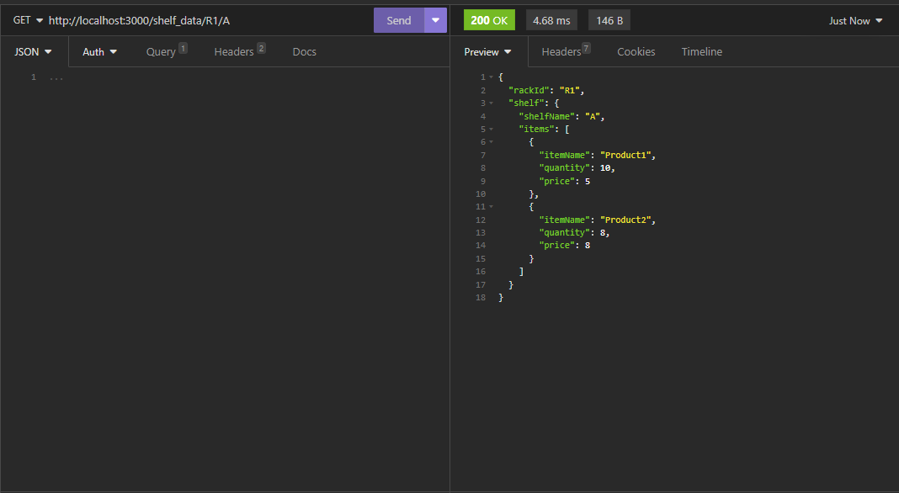
Technical Results
Backend Testing: (GET shelf_data API)

Slide 15
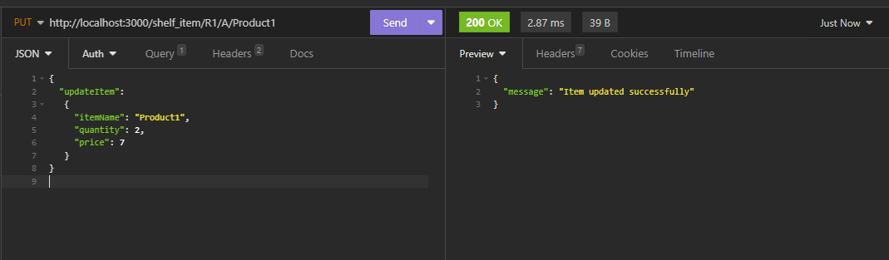
Technical Results
Backend Testing: (PUT shelf_item API)

Slide 16
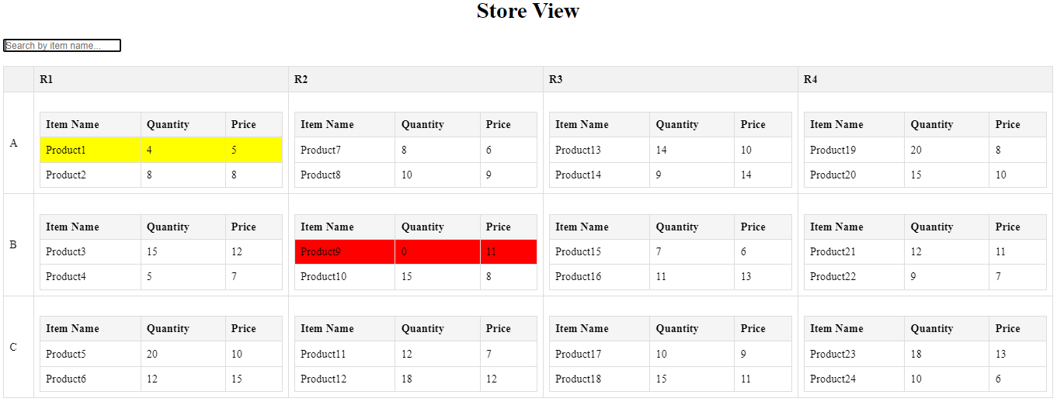
Technical Results
Front end Testing: (Store View)

Slide 17
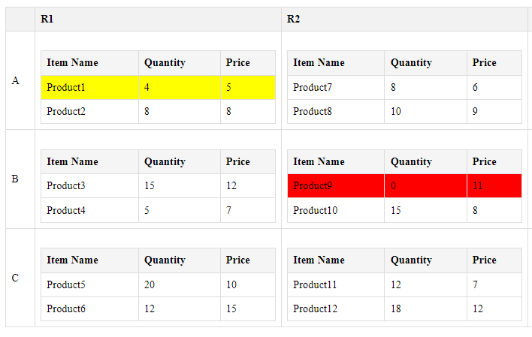
Technical Results
Front end Testing: Displays warning sign in realtime when stock is low and becomes zero

Slide 18
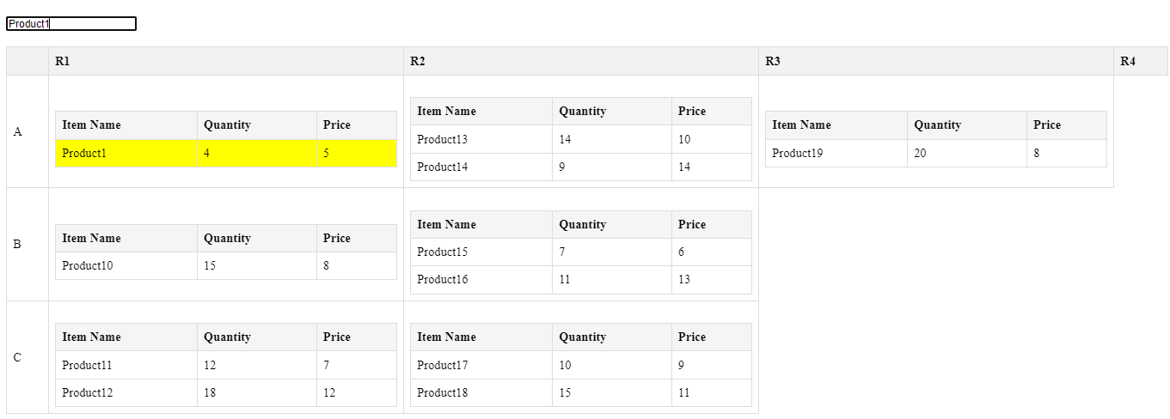
Technical Results
Front end Testing: Search option to quickly search for the desired item

Slide 19
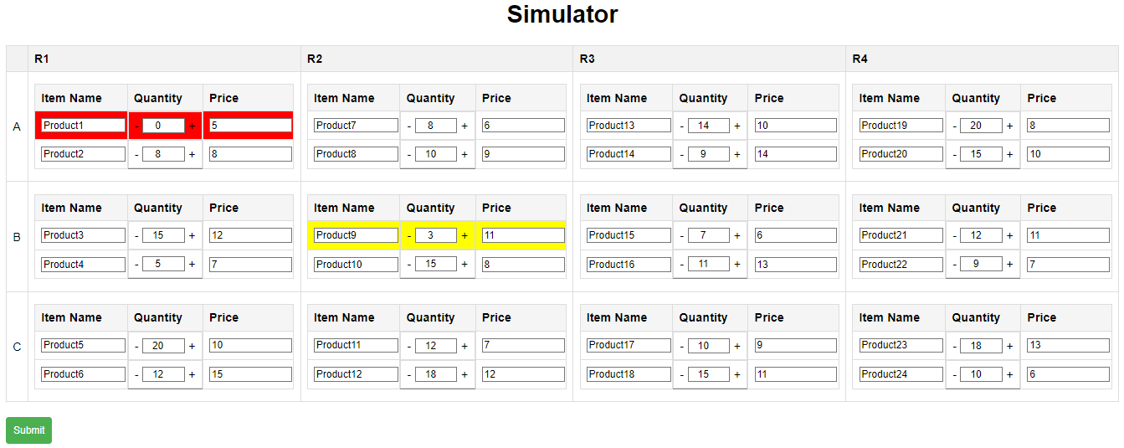
Technical Results
Front end Testing: (Simulator)

Slide 20
Summary
With its sophisticated simulation software that emulates user shopping behavior and lets items be removed from virtual shelves with dynamic quantity value adjustments in line, the project has successfully met all of its planned requirements.
An improved and immersive user experience is ensured by the store view's frequent refreshes and real-time updates.
A centralized, responsive system that allows for precise tracking and fast reaction to stock changes is made possible by the smooth synchronization between simulation actions and store view updates.

