Slide 1

Spend Analytics forecasting
Krionics Devize (Tanvir Islam/Manik Bali)

Slide 2
Contents
How does the data look like
What influences margin/loss
What are dominant variables that caused the drop in 2017 Q3
Moving forward

Slide 3
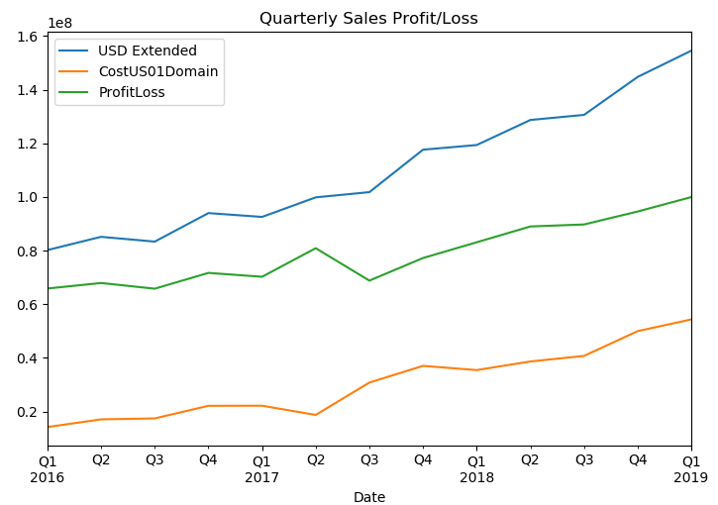
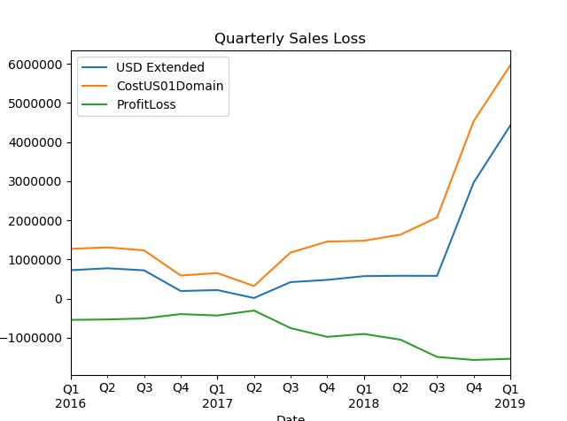
Margin/Loss Variation over time
Correlation Matrix | Cost Price | Selling Price
Margin(SP-CP) | 0.85, 3.4 e-12 | 0.9, 2.7 e-20
Loss (SP-CP) | -0.9, 5.0 e-15 | -0.64, 9.7e-06
Margin curve
Margin calculated as SP-CP
Margin is over 100 time the loss.
Margin grows steadily over the period of study
Loss is steady but increases after Q3 2017
Margin ties ( Corr= 0.9 )more with Selling price
Loss ties (Corr-0.9) more with Cost Price
Essentially implying that margin

Slide 4

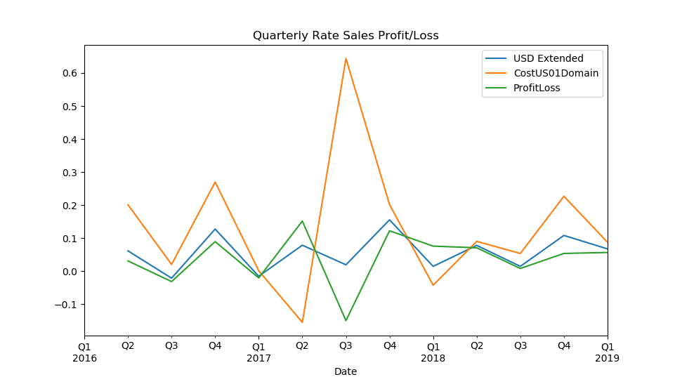
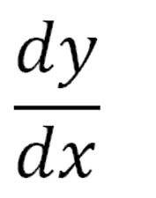
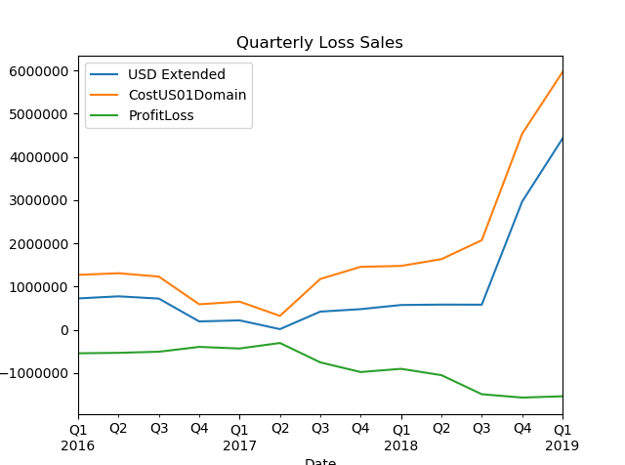
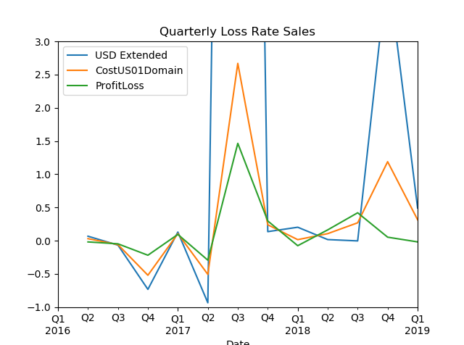
PROFIT/Loss CHANGE
Profit and Loss get negatively impacted in the same quarter

Slide 5
Moving forward
Separate Quarters with +ive and –ve Rates of Change and analyze the differences.
This would give us an idea of what changes from rise in profits to loss in profits

Slide 6
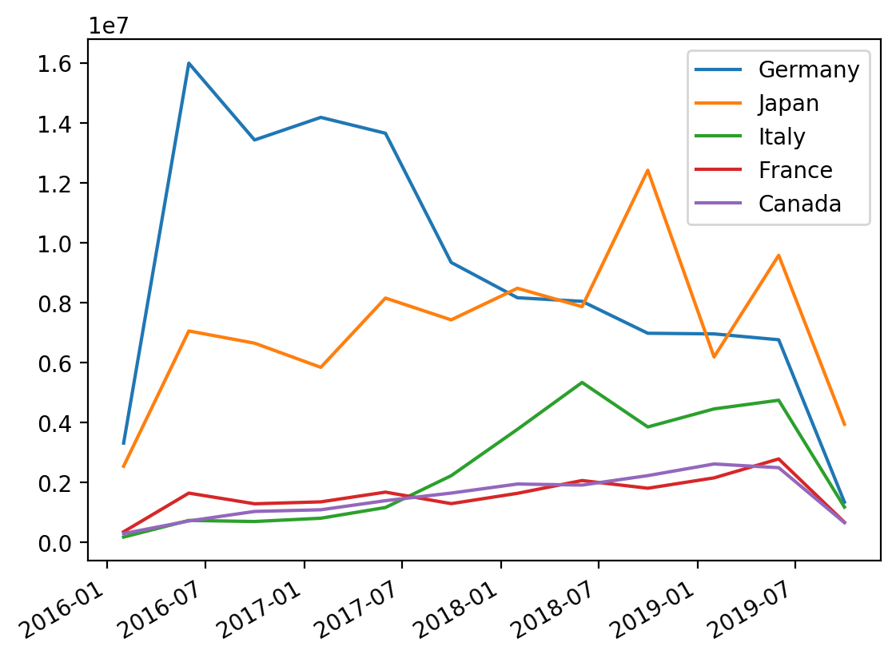
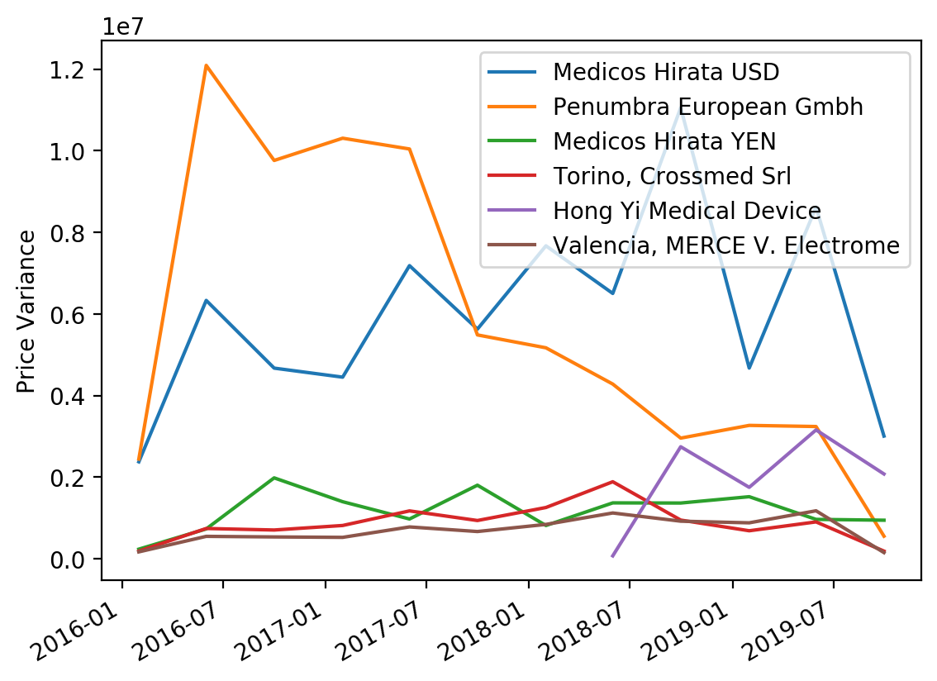
Profit reduction
Due to:
Reduced growth in Germany
and
Less revenue from Penumbra European Gmbh

Slide 7
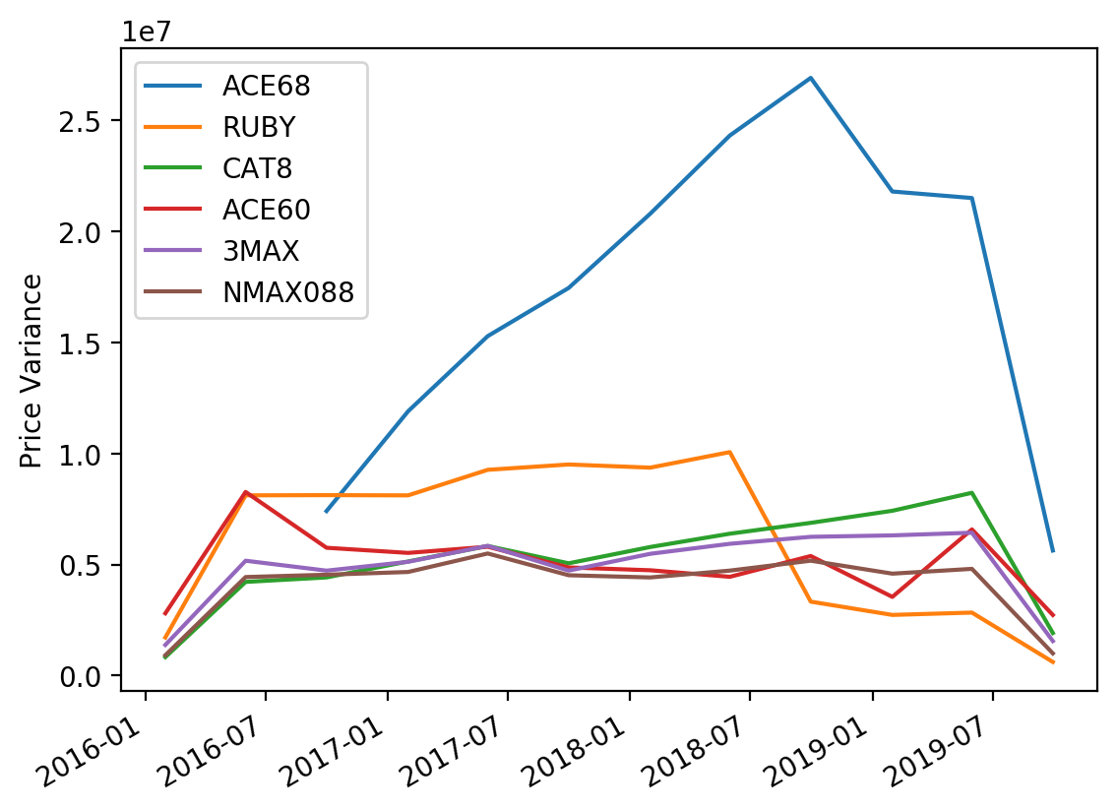
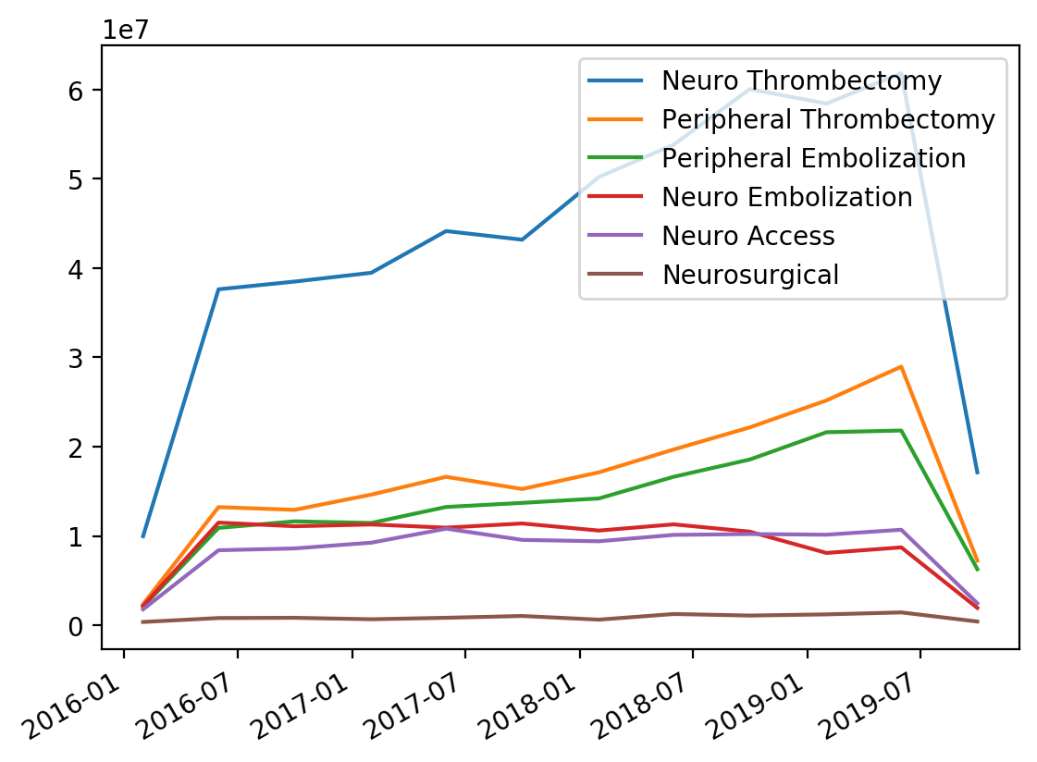
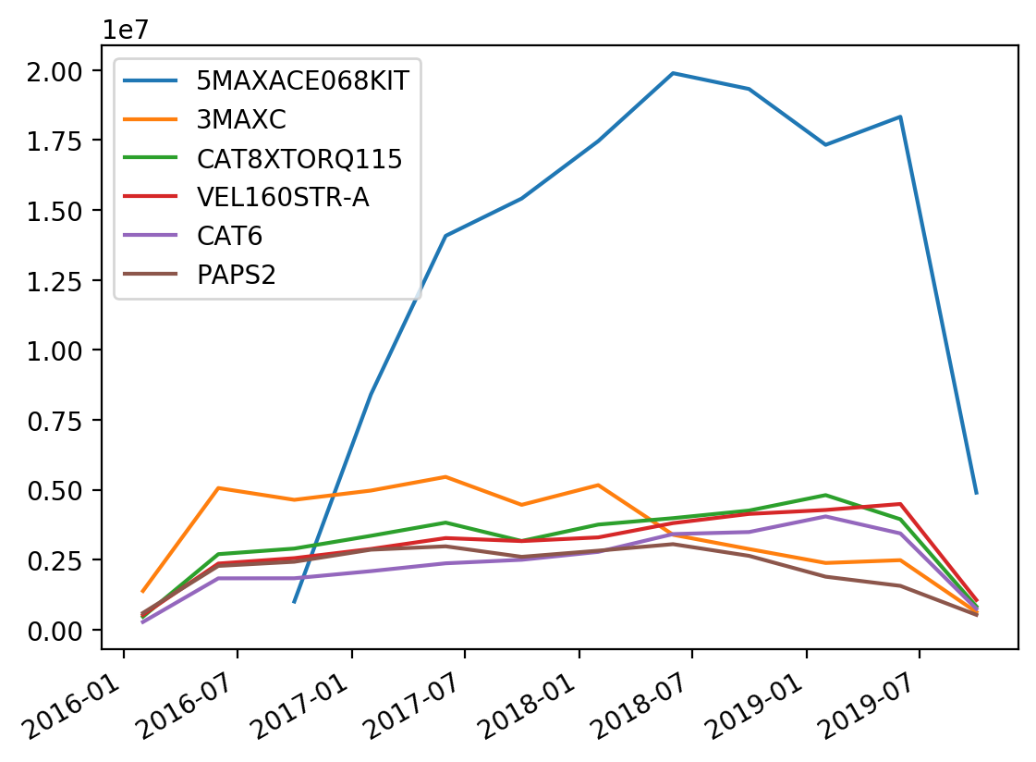
Dominant growth signals
Neuro Thrombecomy and Peripheral Thrombectomy, ACE68, and 5MAXACE are contributing to the growth
Underlying reason is cost increase

Slide 8
Strategy for Analysis
Separate +ive from –ive Quarters and analyze data and see what has changed.
Starting point could be the analyziz that we done and know potentially which partnumbers/countries/dates are profit and loss making.

Slide 9
Future work
Preliminary analysis of loss curve does not show a certain reason of the loss upto 2017 Q3.
From Q3 till 2019 the loss increases with rising costs.

Slide 10
ML/AI Framework
How much Profit/Loss and What is the reason ?
Split Data Profit and Loss
Profit
Loss
Examine Loss making Products
Examine Loss making Countries
Examine Loss making Time
Examine Profit making Products
Examine Profits' making Countries
Examine Profit making Time
Model takes into account, 1.overlaps between loss and profit
2.Trends
3.Variations and correlations
Profit/Loss = M/L Model( Time/Market/Product)

