Slide 1
Coursera Capstone Project for Data Science
Manik Baliyan

Slide 2
Problem Statement
Predict the Road Accident/Collisions Severity to help, support and augment concerned authorities
Analysis Approach
Exploratory data analysis- Data cleaning and variable manipulation for best results
Model Building- Train and test, selection through RFE and handling Multicollinearity through VIF.
Evaluation- Accuracy score, Precision and ROC AUC score are checked. ROC curve is plot for the final model.

Slide 3
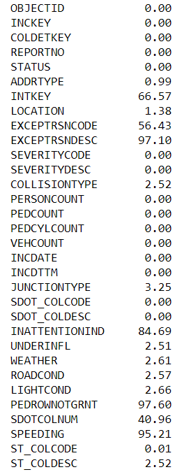
Null Percentages Column Wise
High Null percentages-
INTKEY
EXCEPTRSNCODE
EXCEPTRSNCODE
PEDROWNOTGRNT
SPEEDING

Slide 4
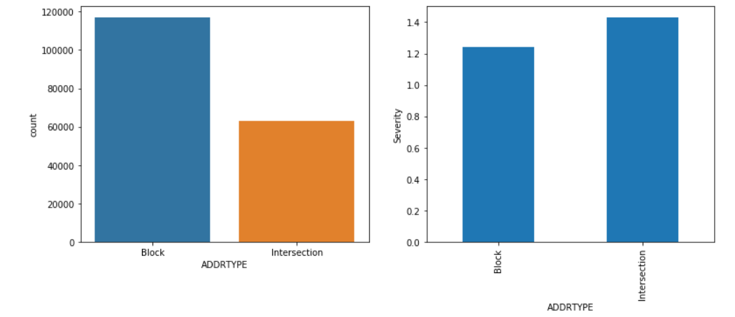
SEVERITY MEASURE

Slide 5
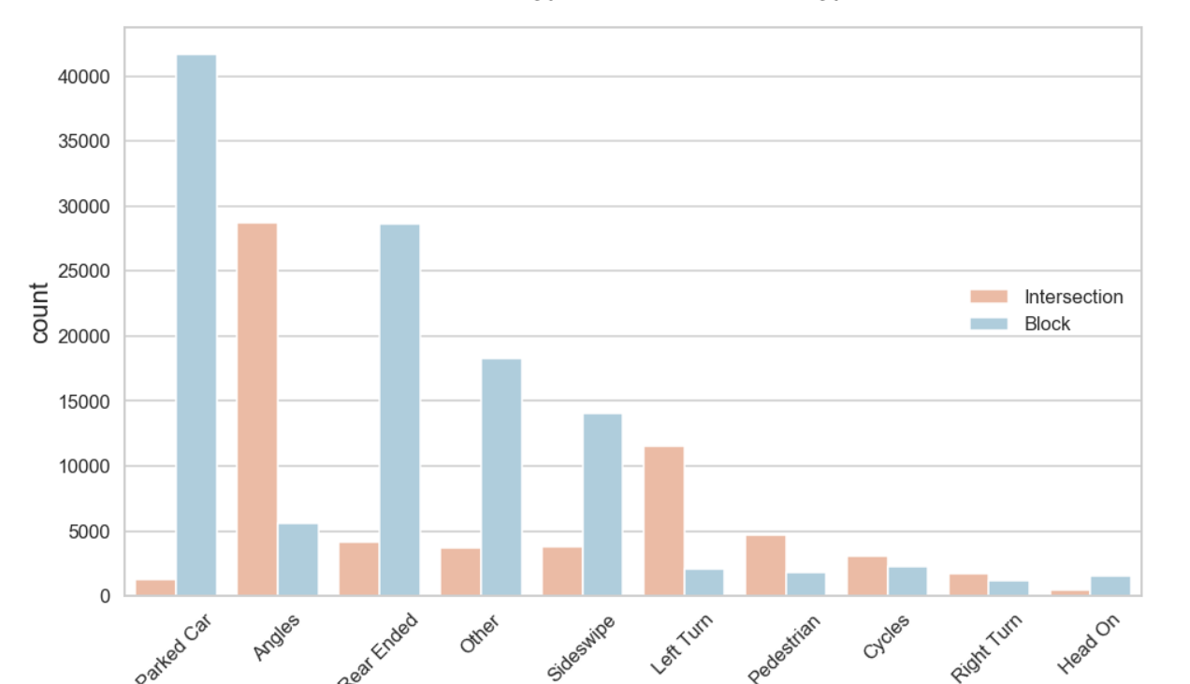
COLLISION TYPES

Slide 6
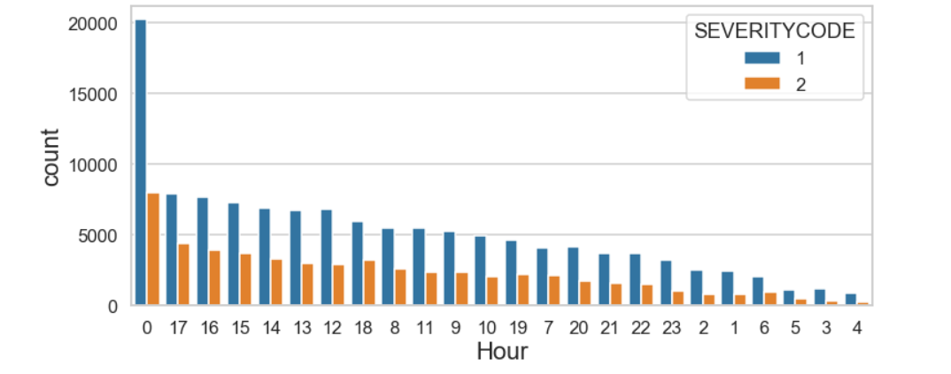
HOUR-WISE

Slide 7
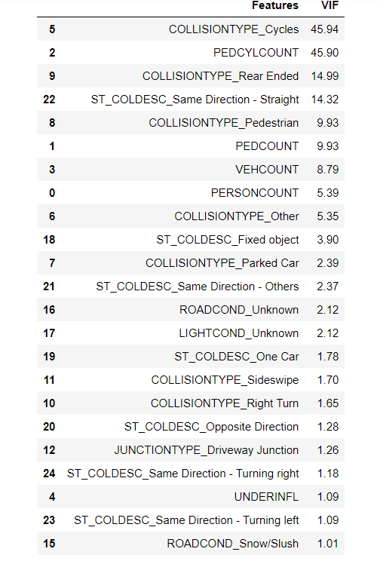
VIF

Slide 8
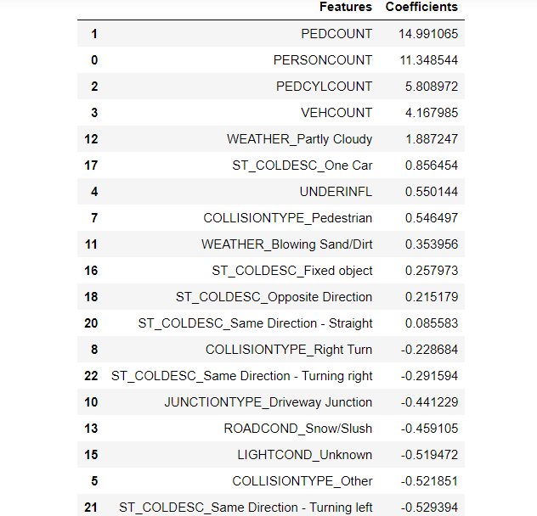
Feature Importance from Logistic Regression

Slide 9
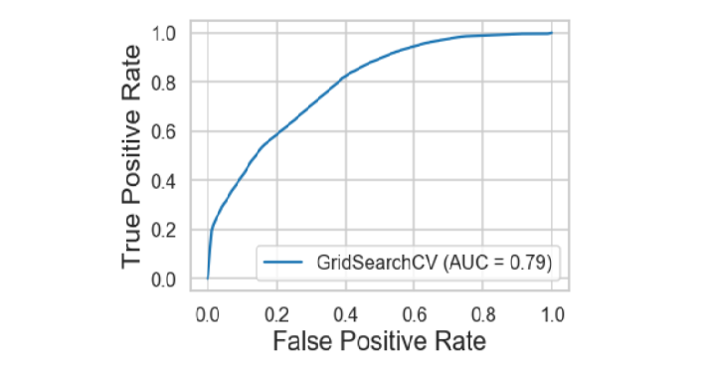
ROC Curve
We get a good curve with area under the curve being 0.79

