Slide 1
Project Topic Implementation of van Emde Boas tree with application to Kruskal and compare wrt Union Find and AVL
Team members:
Manik Gupta(2019202007)
Akash Kumar(2019201046)

Slide 2
Van Emde Boas Tree
An extremely fast data structure for ordered dictionaries
An ordered dictionary is a data structure that maintains a set S of elements drawn from an ordered universe U and supports these operations:
Insert(x),lookup(x),delete(x), successor(x)

Slide 3
Approach 1(Direct addressing using bit vector):
Bit vectors: array of bits of length u
To insert x, set the bit for x to 1
To delete x, set the bit for x to 0
Insert, Delete, Member functions in O(1)
However, Min, Max, Predecessor, Successor in O(n)
Space usage is Θ(u)

Slide 4
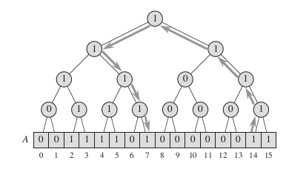
Approach 2(Superimposing binary tree structure):
The entries of the bit vector form the leaves of the binary tree, and each internal node contains a 1 if and only if any leaf in its subtree contains a 1. In other words, the bit stored in an internal node is the logical-or of its two children.
To find the minimum value in the set, start at the root and head down toward the leaves, always taking the leftmost node containing a 1
To find the successor of x, start at the leaf indexed by x, and head up toward the root until we enter a node from the left and this node has a 1 in its right child .Then head down through node ́, always taking the leftmost node containing a 1

Slide 5
Approach 2(Superimposing binary tree structure):
Operations:
● Member operation in O(1)
● Insert, Delete, Min. Max, predecessor, Successor in O(log u)

Slide 6
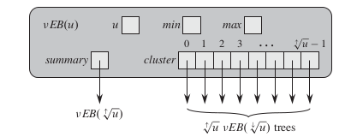
Approach 3(Using summary vector):
Superimpose a tree of degree sqrt(u) on top of bit vector
Each veb node consists of universe_size, min, max, summary, cluster vector
Summary vector of size sqrt(u)
sqrt(u) clusters of size sqrt(u)
ith bit of summary vector contains bitwise or of ith cluster
Cluster no.for x = high(x) = floor( x / sqrt(u) )
Cluster index for x = low(x) = x % sqrt(u)

Slide 7
Approach 3(Using summary vector):
Recurrence relation:
T(u) = T( sqrt(u) ) + O(1)
T(u) = O( log log u )
Operations:
Insert, Delete, Member, Min, Max, predecessor, Successor in O( log log u )
Where u=2^n is the max no. of elements that can be stored in a tree. Elements can have values from {0, 1,... ,u−1},

Slide 8
Application of vEB Tree:
van Emde Boas trees can be used anywhere in place of a normal binary search tree so long as the keys in the search tree are integers in some fixed range.
Graph algorithms
Forwarding of packets on the internet

Slide 9
Kruskal Algorithm
Kruskal’s algorithm is a minimum-spanning-tree algorithm which finds an edge of the least possible weight that connects any two trees in the forest
It is a greedy algorithm in graph theory as it finds a minimum spanning tree for a connected weighted graph adding non decreasing cost edges at each step
This means it finds a subset of the edges that forms a tree that includes every vertex, where the total weight of all the edges in the tree is minimized

Slide 10
Kruskal using van Emde Boas Tree
Instead of sorting all the edges or extracting minimum weight edge using minheap, we used vEB Tree to extract extract edge with minimum weight
First insert all the unique edge weights in the van Emde Boas tree
Then one by one find the minimum edge weight using minimum() operation of veb tree, include that in MST if it doesn’t form a cycle and then delete that edge weight
FindMin() is O(1) operation in veb tree and deletion takes O( log log u ) time

Slide 11
Methods to handle duplicates in vEB Tree
Used map to handle duplicates in vEB Tree.
In map , we use edge weight as key and list of all the edges as values.
Before inserting into the vEB Tree , we first check in the map whether that edge weight is already present or not
If the edge is not present in the map , then we inserted that edge weight in both vEB Tree and map.
If the edge is already present in the map , then we don’t insert that edge weight into the vEB Tree, we simply insert the edge in the list of that edge weight
Followed similar process for deletion

Slide 12
Kruskal using AVL Tree
Approach is similar to vEB Tree implementaion
Only difference is that in vEB tree implementation , we were able to extract minimum in O( log log u) time but in AVL Tree it takes O( log n ) time
The method which was used in vEB Tree , same method is used here also to handle duplicates .

Slide 13
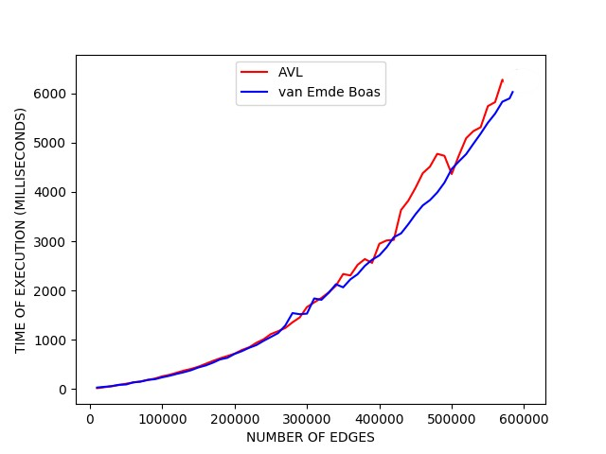
Analysis of implementation of Kruskal using vEB Tree and AVL Tree

Slide 14
Analysis of implementation of Kruskal using vEB Tree and AVL Tree
Since vEB tree extracts min element in O(log log u) time while AVL Tree does it in O(log n) time , so vEB should perform better than AVL Tree
However the difference is not significant for small no of edges
It becomes apparent only when number of edges is quite large

Slide 15
Thank You

