Slide 1
GLOBAL FINANCE & SALES PERFORMANCE DASHBOARD
Task 3 – Dashboard Design
Power BI | Data Analytics Internship
Prepared by: Manik Patil

Slide 2
KEY PERFORMANCE INDICATORS
Total Revenue: 318M
Total COGS: 149M
Total Profit: 169M
Profit Margin: 53.23%

Slide 3
REVENUE & SALES TRENDS
• Revenue shows noticeable month-to-month fluctuations.
• Highest revenue levels were observed around March and July.
• Revenue dropped significantly in April and October.
• Partner and Online channels generated the highest revenue, while Direct was slightly lower.
• The dashboard allows users to explore these trends using Region, Product Category and Date filters.

Slide 4
PRODUCT CATEGORY PERFORMANCE
• Enterprise Software has the highest profit among the product categories.
• Consulting and Cloud Services show similar profit levels.
• Hardware has the lowest profit among the four categories.
• The category comparison helps identify which product areas contribute most to overall profitability.
• Product Category can be filtered interactively in the Power BI dashboard.AA

Slide 5
KEY INSIGHTS & BUSINESS RECOMMENDATIONS
KEY INSIGHTS
• Total Revenue is 318M with Total Profit of 169M.
• Profit Margin is 53.23%, indicating strong overall profitability.
• Enterprise Software contributes the highest profit among the product categories.
• Revenue varies considerably across the months.
• Partner and Online channels have slightly higher revenue than Direct.
RECOMMENDATIONS
• Focus on high-performing Enterprise Software products.
• Investigate the months with significant revenue declines.
• Continue strengthening Partner and Online sales channels.
• Use Region, Product Category and Date filters to identify performance opportunities.

Slide 6
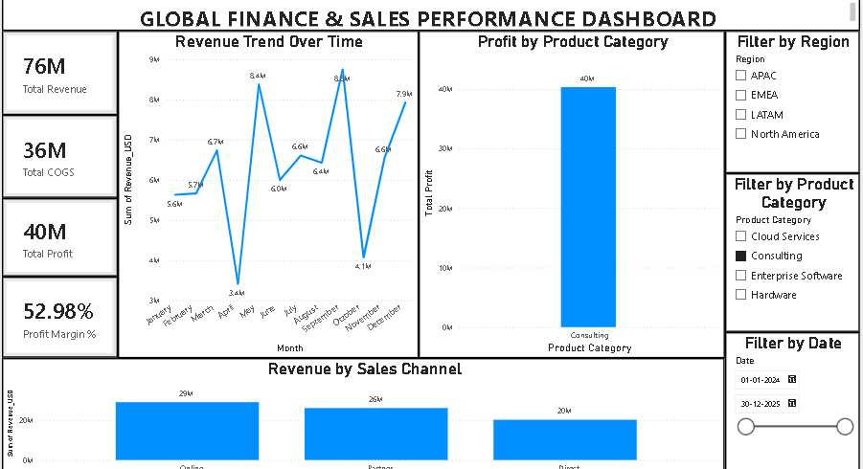
POWER BI DASHBOARD PREVIEW

