Slide 1
Customer, Order and Return Performance Dashboard
-Objective: To analyze customer behavior, order performance and return patterns.
- Manik

Slide 2


Tools used :
- Power Bi - DAX - Power Point
Dataset Overview
Total 3 Datasets : 1. Customer data 2. Order data 3. Return data
- Customer Data
8 columns.
500 rows.
3 years of data[2020, 21, 22].
500 Unique customer id’s.
Only 1 country data i.e., India.
3 segments.
      Consumer, Corporate, Home office.
7 cities.
      Ben, Chen, Delhi, Hyd, Kol, Mum, Pune.
- Order Data
15 columns.
1000 rows.
1 year of data[2023].
1000 Unique order id’s.
Only 1 country data i.e., India.
3 segments.
7 cities.
4 regions.
3 category.
5 sub-category.
- Return Data
4 columns.
100 rows.
2 years of data[2023, 24].
97 Unique order id’s.
4 return reasons.
3 return status.

Slide 3
KPI’s :
Total Customers.
Repeat Customers.
New Customers.
Total Orders.
Total Profit.
Total Sales.
Repeat Orders Percentage.
Discount Impact Percentage.
Discount Impact
Total Return Orders.
Percentage of Return Orders.

Slide 4
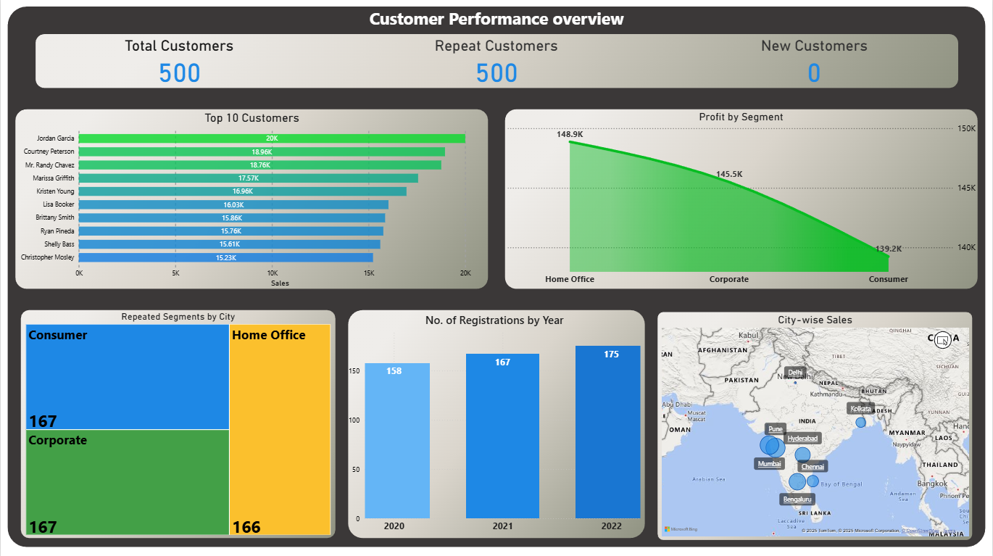

Slide 5

Insights
Total customers are 500, and all are repeat customers. There are no new customers, this tells that the business is not growing, which resulted in no new customer.
Jordan Garcia is the top customer of our business with 20k sales.
Home office segment is generating the highest profits but consumer and corporate has dropdown, so we should focus more on the consumer segment to increase profits.
Most cities lie in the consumer & corporate segment because they both have same city counts while home office segment has only small gap, which tells that the segments are mostly even distributed in the cities, which is a good sign.
Registrations have steadily increased every year; this shows that we had a growth in new customers in those years.
City-wise sales show that most of revenue is generated from the southern most part of India and we have the least sale from Delhi.

Slide 6
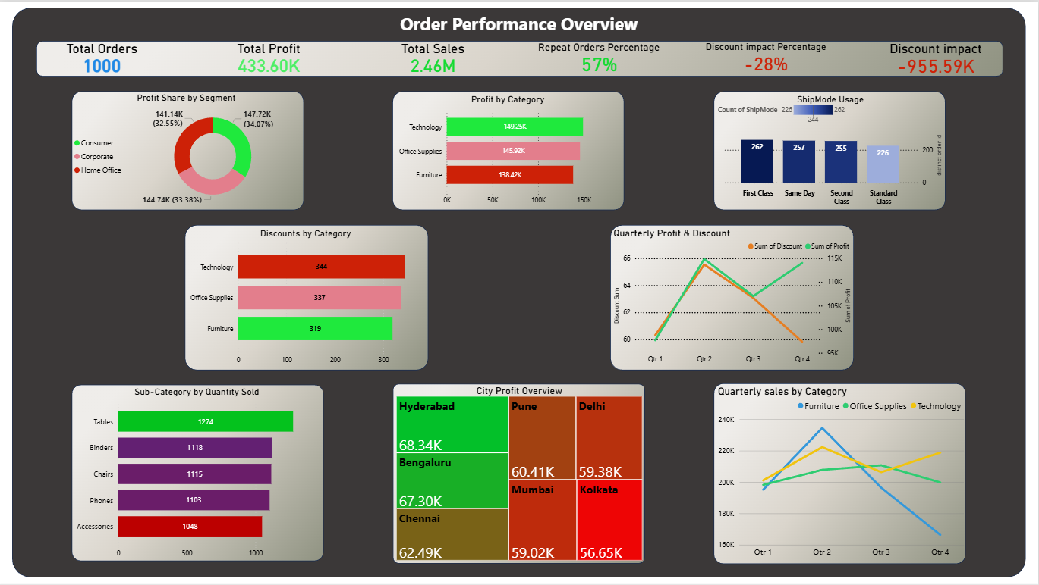

Slide 7
Insights
There are 1000 total orders, & the total sales was 2.46M in which the total profit was 433.60k, which says the profit percent was 17.63%, which means the business is not in good conditions.
57% of orders are repeat orders, which is a good sign.
Discount impact is very high, which says a big part of revenue is being lost in discounts.
Technology category has the highest profits & furniture’s is lowest.
Most customers are using First class & Same day shipping, & if there were return orders among these, then we had a loss over there, because of shipping costs.
The Quarterly profits are fluctuating where Q2 & Q4 had most profits then Q1 & Q3. The discounts had a spike in the Q2 but later got dropped, which is a good sign.
Tables is the top selling sub category.
Hyderabad has the highest sales & Kolkata has the lowest. Hyd has more furniture and office accessories outlets so due to that we sold highest.
The Q2 had the most of our sales because the climatical reason, financial year for most companies, this means Q2 is a good period for the business.

Slide 8
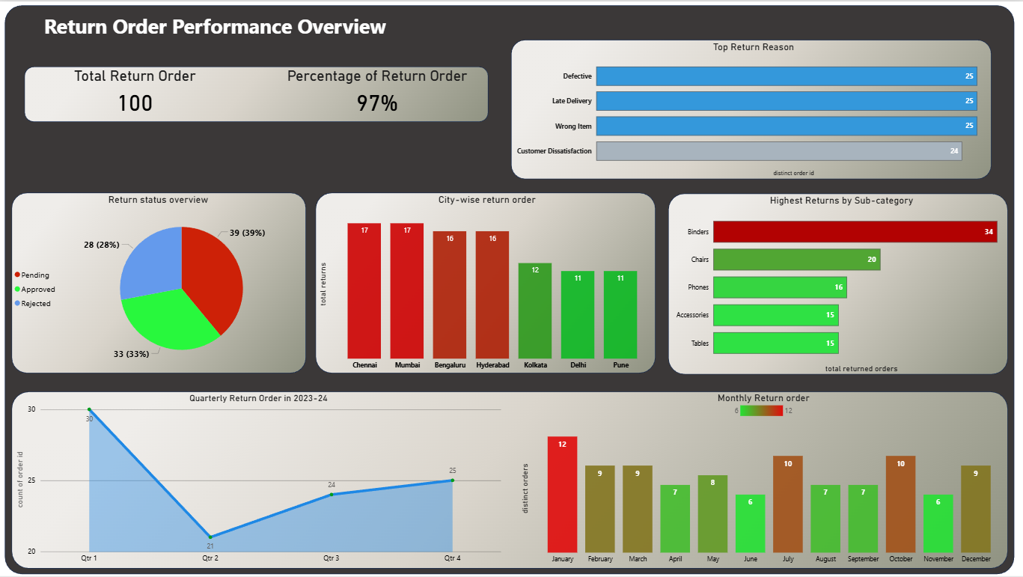

Slide 9
Insights
There are 100 returned orders & percentage of return orders is 97%, which is way high, this tells that there is a major problem in products.
Most of the return reasons are top 3 i.e., defective, late delivery, wrong product & customer dissatisfaction had slight difference but this shows the product quality is not good.
There is 39% of pending return order status, which needs to be approved or rejected ASAP.
Chennai & Mumbai has the highest return orders, where as Pune & Delhi have fewer returns.
Binders were the most returned sub category which means, the quality of binders needs to be improved & also followed by chairs.
Q2 had the lowest orders returned where as Q1 had the highest.
Specifically, Jan had the highest return orders followed by July and October, and June and Nov had the lowest return orders.

Slide 10
Measures created in DAX
Total Customers=DISTINCTCOUNT(customer_data[CustomerId]).
Repeat_Customers=CALCULATE([Total_customer],order_data[orderId]>1).
New_Customers=[Total_Customers]-[Repeat_Customers].
Total sales=SUM(order_data[sales])
Total orders=DISTINCTCOUNT(order_data[orderId])
Total potential sales=SUMX(order_data,order_data[sales]/(1-order_data[Discount]))
Discount impact=[Total sales]-[Total potential sales]
Discount impact percentage=DIVIDE([discount impact],[Total potential sales])
Distinct customers=DISTINCTCOUNT(order_data[customersId])
Count of repeat orders=[Total orders]-[Distinct customers]
Percentage of repeat orders=DIVIDE([count of repeat orders],[Total orders])
Total_orders2=DISTINCTCOUNT(order_data[orderId])
Total_returned_orders=COUNT(return_data[orderId])
Total_distinct_orders_returned=DISTINCTCOUNT(return_data[order_Id])
Percentage of returned orders=DIVIDE([total_distinct_orders_returned],[total_returned_orders])

Slide 11

Thank You..

