Slide 1

Insurance Claim Risk Prediction
Mani Mandepudi
Machine Learning Engineer

Slide 2
Business Objective
Build a robust, production-ready pipeline to predict the likelihood of insurance claims for approximately 1,200 new insurance applications received daily.
Key Requirements
Deliver claim predictions within the 2-week cooling-off period to support timely decision-making.
Retrain the model monthly using fresh data to maintain performance and adapt to evolving patterns.
Business Impact
Improves risk assessment, helping reduce losses and ensuring fair underwriting.

Slide 3

Key Functionalities
Daily Predictions
Monthly Model Retraining
On-Demand Prediction API

Slide 4
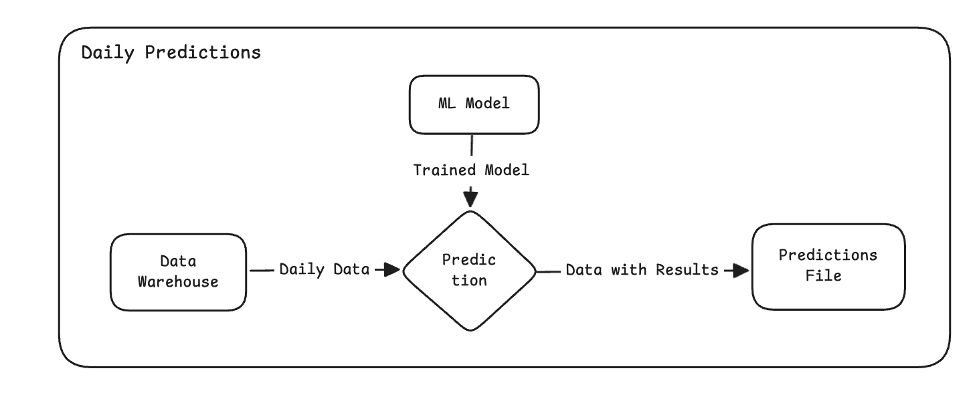
Architecture: Daily Predictions

Slide 5
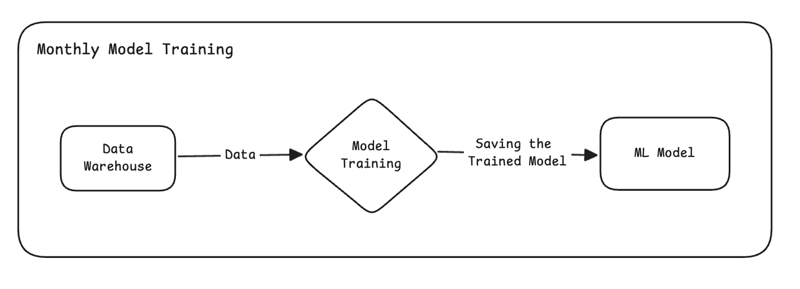
Architecture: Monthly Model Training

Slide 6
Tools & Technologies
Programming Language: Python
API Framework: FastAPI
Containerization: Docker
Version Control: Git
CI/CD Pipeline: GitHub Actions
Orchestration & Deployment: Kubernetes
Cloud Platform: Google Cloud Platform (GCP)
Testing Framework: Pytest

Slide 7
Code Walkthrough
Now, let's go through the code to understand the implementation: GitHub

Slide 8
Improvements
Replace CronJobs with Airflow
Use MLflow for model registry
Add model monitoring and data drift detection
Store predictions in cloud DB/table instead of flat files

Slide 9
Thank You

