Slide 1

CHATBOT DEPLOYMENT WITH IBM CLOUD WATTSON ASSISTANT PHASE-5

Slide 2
TEAM LEADER –DHANALAKSHMI C-731221205006
TEAM MEMBERS
AHALYA.JC-731221205301
MANILA.K-731221205020
MAHADEVAMMA.S-731221205017
RATHNA.R-731221205033

Slide 3
How to build a better chatbot
Chatbots powered by IBM watsonx Assistant can do much more than just chat – they offer quick, accurate answers across digital and voice channels, and are able to complete complex transactions by leveraging robotic process automation and backend integrations with business systems.
watsonx Assistant is underpinned by Large Language Models (LLMs) and comes with out-of-the-box natural language processing, which can address the messy nature of human communication and prevent conversations from reaching a frustrating dead-end.

Slide 4
Build bots faster
Create your first virtual assistant using IBM watsonx Assistant ActionsActions are a new way to build conversational flows in watsonx Assistant to help your customers accomplish their goals. They make the build experience dramatically easier by consolidating elements such as intents, entities and slots into a single, intuitive build process within the user interface.

Slide 5
How to get started
Take the first stepsUnderstand the key constructs used by watsonx Assistant.
Prepare to build your first virtual assistant.
Get familiar with the in-product navigation and user interface.
Use templates to build conversation flows faster.

Slide 6
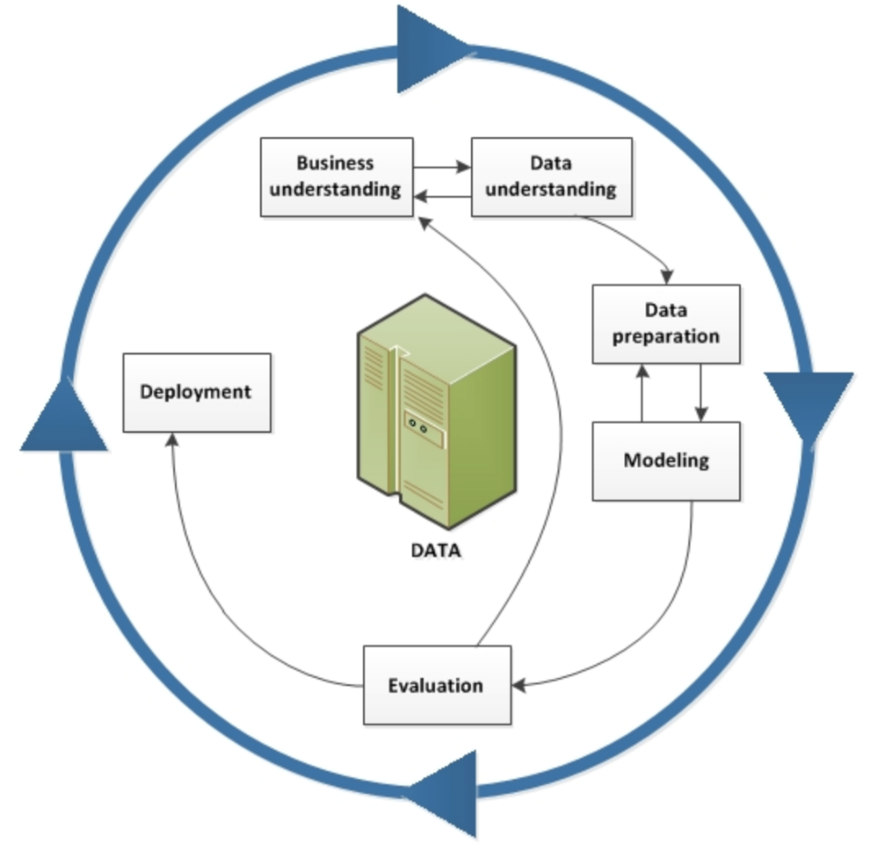
DATA MINING

Slide 7
IBM Watson Studio
IBM Watson Studio gives you the environment and tools to solve business problems by collaboratively working with data. You can choose the tools needed to analyze and visualize data; to cleanse and shape the data; to ingest streaming data; or to create, train, and deploy machine learning models.

Slide 8
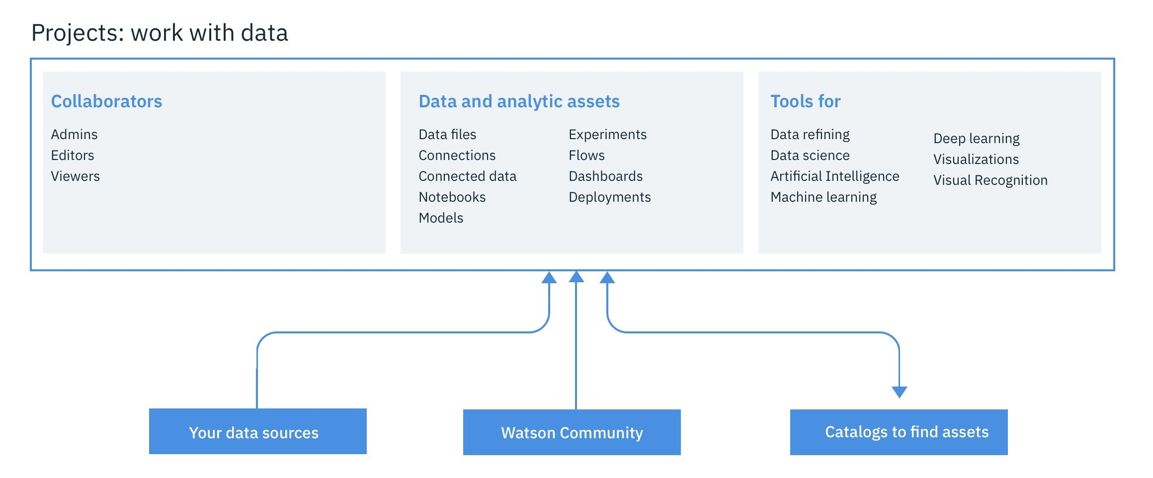

Slide 9
Summary
One objective of this learning path is to show how IBM Watson Studio offers, in addition to Jupyter Notebooks for Python, Scala, or R, alternative ways of going through a similar process that might be faster and can be achieved without programming skills.

Slide 10
In essence, these mechanisms are SPSS Modeler Flow, which allows a data scientist to create a model purely graphically by defining a flow, and the IBM AutoAI graphical tool inside IBM Watson Studio, which goes one step beyond SPSS by providing a semi-automatic approach to creation, evaluation, deployment, and testing of a machine learning model. At the same time, the learning path shows how IBM Watson Studio provides capabilities out of the box for profiling, visualizing, and transforming the data, again without any programming required.

Slide 11
IBM Watson Assistant is a powerful platform that enables developers to build natural language processing (NLP) chatbots to interact with users and provide accurate responses. By the end of this guide, you will have a functional chatbot that can answer questions, engage users, and improve with additional training data.

Slide 12
EVALUATOR SIGNATURE: MENTOR SIGNATURE: SPOC SIGNATURE: HOD SIGNATURE:

