Slide 1
Flight Delays Prediction
Manile Srun (u3273786)

Slide 2
Contents
Introduction
  The business problem
  Dataset
Summary of On-Premises vs On-Cloud Workflows
Key findings, Model Performance, Comparisons
Conclusion
  reflect on challenges and lessons

Slide 3
Introduction: Business Problem
Business Problem:
  Travel booking website wants to alert customers about potential weather-related flight delays BEFORE booking.
Business Goal:
  Improve the customer booking experience by predicting potential delays early.
Business Impact:
  Improved customer satisfaction
  Reduced complaints about unexpected delays

Slide 4
Introduction: Dataset
Source: US Bureau of Transportation Statistics (BTS)
Time Period: 2014-2018 (U.S airports)
Size: 60 compressed files
Target: ArrDel15 (arrival delay 15 mins) -> is_delay (0=no delay, 1=delay)
Features: 110
  Simplify features: Year, Quarter, Month, DayofMonth, DayOfWeek, FlightDate, Reporting_Airline, Origin, OriginState, Dest, DestState, CRSDepTime, DepDelayMinutes, DepartureDelayGroups, Cancelled, Diverted, Distance, DistanceGroup, ArrDelay, ArrDelayMinutes, ArrDel15, AirTime

Slide 5
On-Premises
Data Handling
Data exploration
Data Preprocessing
Model
Feature Engineering
Re-Model
a. Combining all CSV files
b. Filtering the usable columns (20)
c. Handling missing values
d. Defining the target
a. Class imbalance (80% no delay, 20% delay) -> biased models
b. Explore different variables (i.e. Which airline has the most delays?, Which months have the most delays?)
a. Filtering the required columns again (10)
b. numerical vs categorical (one-hot encoding and BUCKETIZE i.e DepHourofDay)
c. produced combined_csv_v1
a. Split train-test
b. Base Model: Logistic Regression
c. Evaluation
Not good
a. Adding new features: holidays, weather
b. combined_csv_v2
a. Split train-test
b. Model: Logistic Regression
c. Evaluation
Better

Slide 6
On-cloud workflows
Uploading Data
Training Model
Model Deployment
Batch Transform (Testing)
Evaluation
Repeat Again
a. Using combined_csv_v1 and Uploading to bucket S3
b. Splitting into train/validate/test (70-15-15)
- Organized in S3 folders
a. Model 1: Linear Learner (Baseline)
b. Hyperparameters (binary_classifier, 10 epochs)
a. Host the model on another instance
a. Processing the entire test dataset through the trained model at once to generate predictions for evaluation
a. Evaluation: Not good
a. Repeat the previous steps again but with combined_csv_v2 + XGBoost Model
b. Evaluation: Better

Slide 7
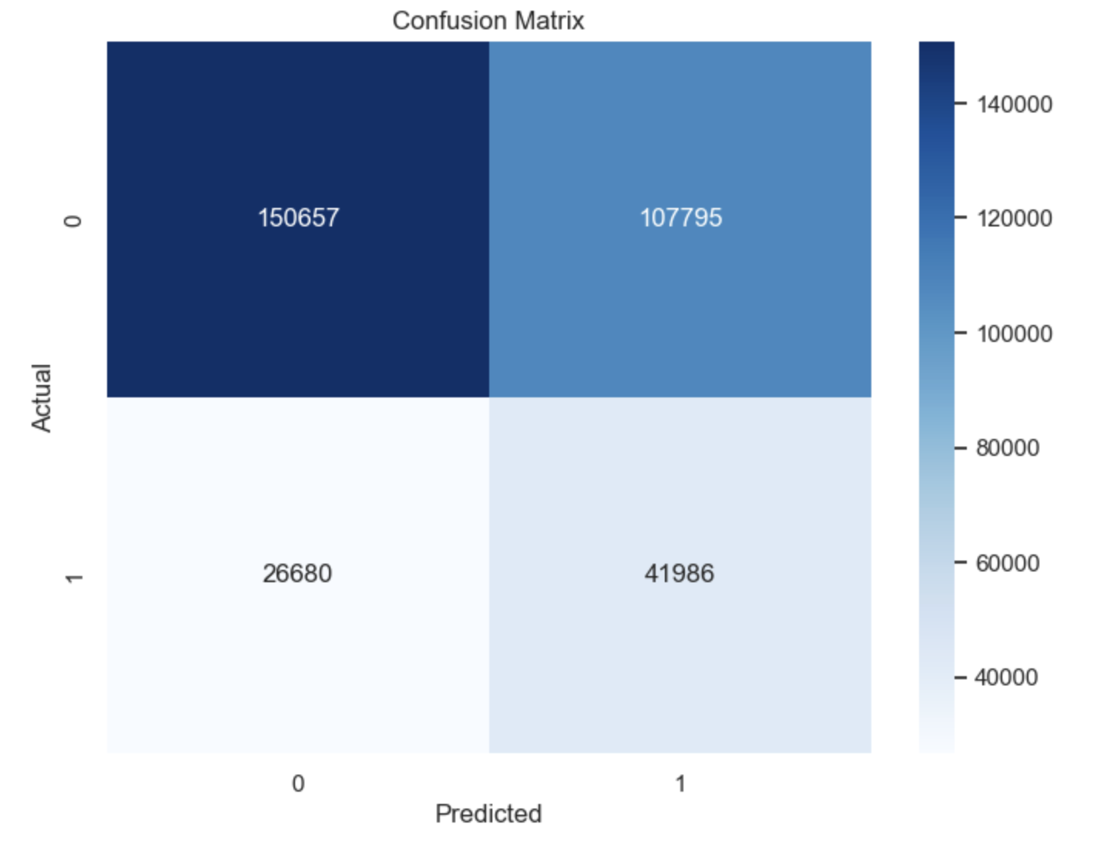
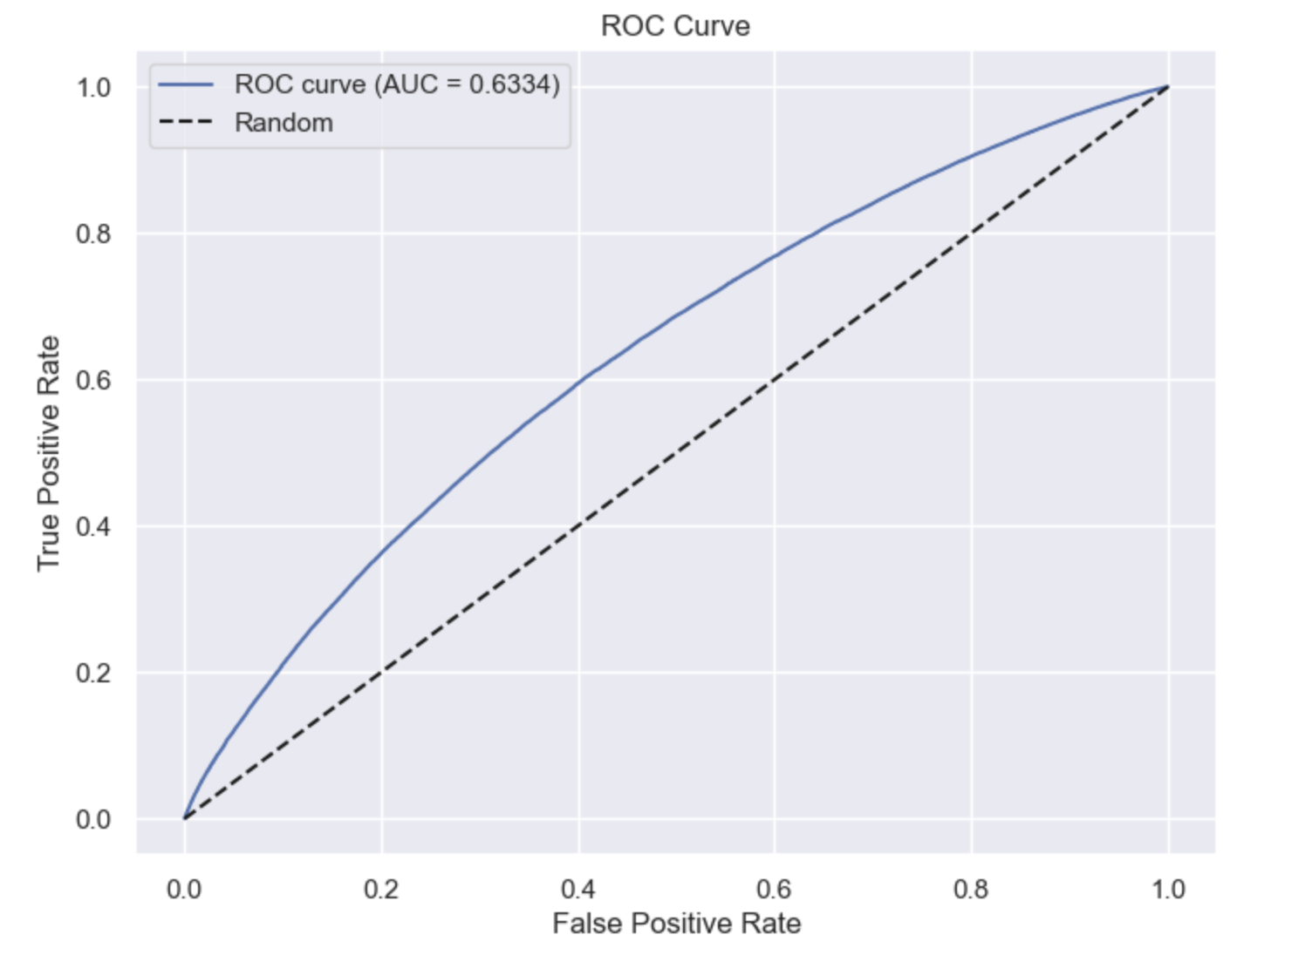
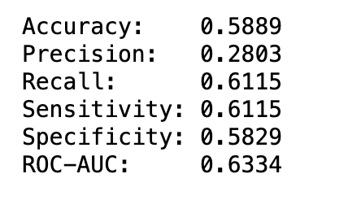
Key findings, Model Performance, Comparisons: On-Premises

Slide 8
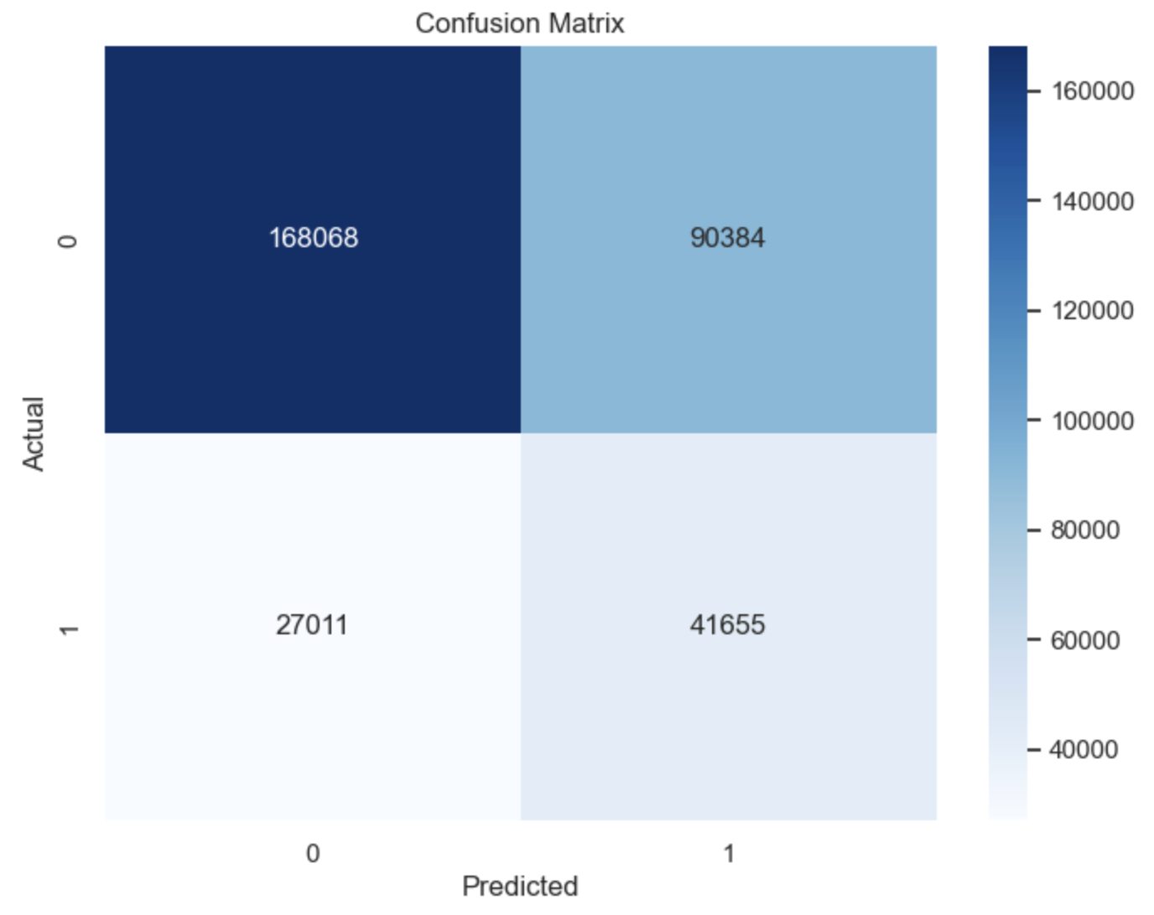
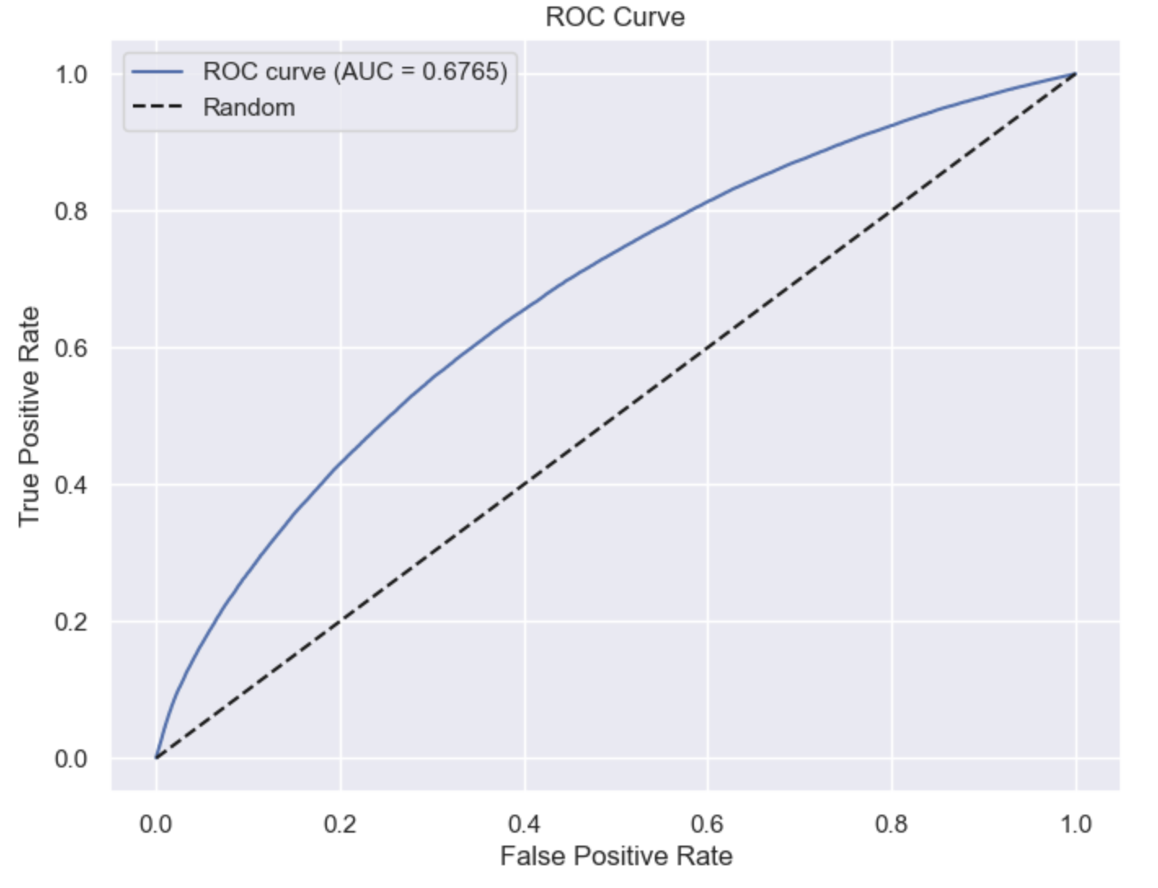
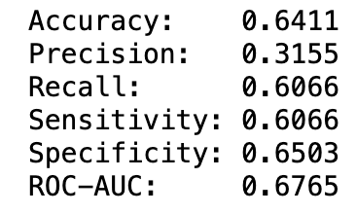
Key findings, Model Performance, Comparisons: On-Premises (Iteration)

Slide 9
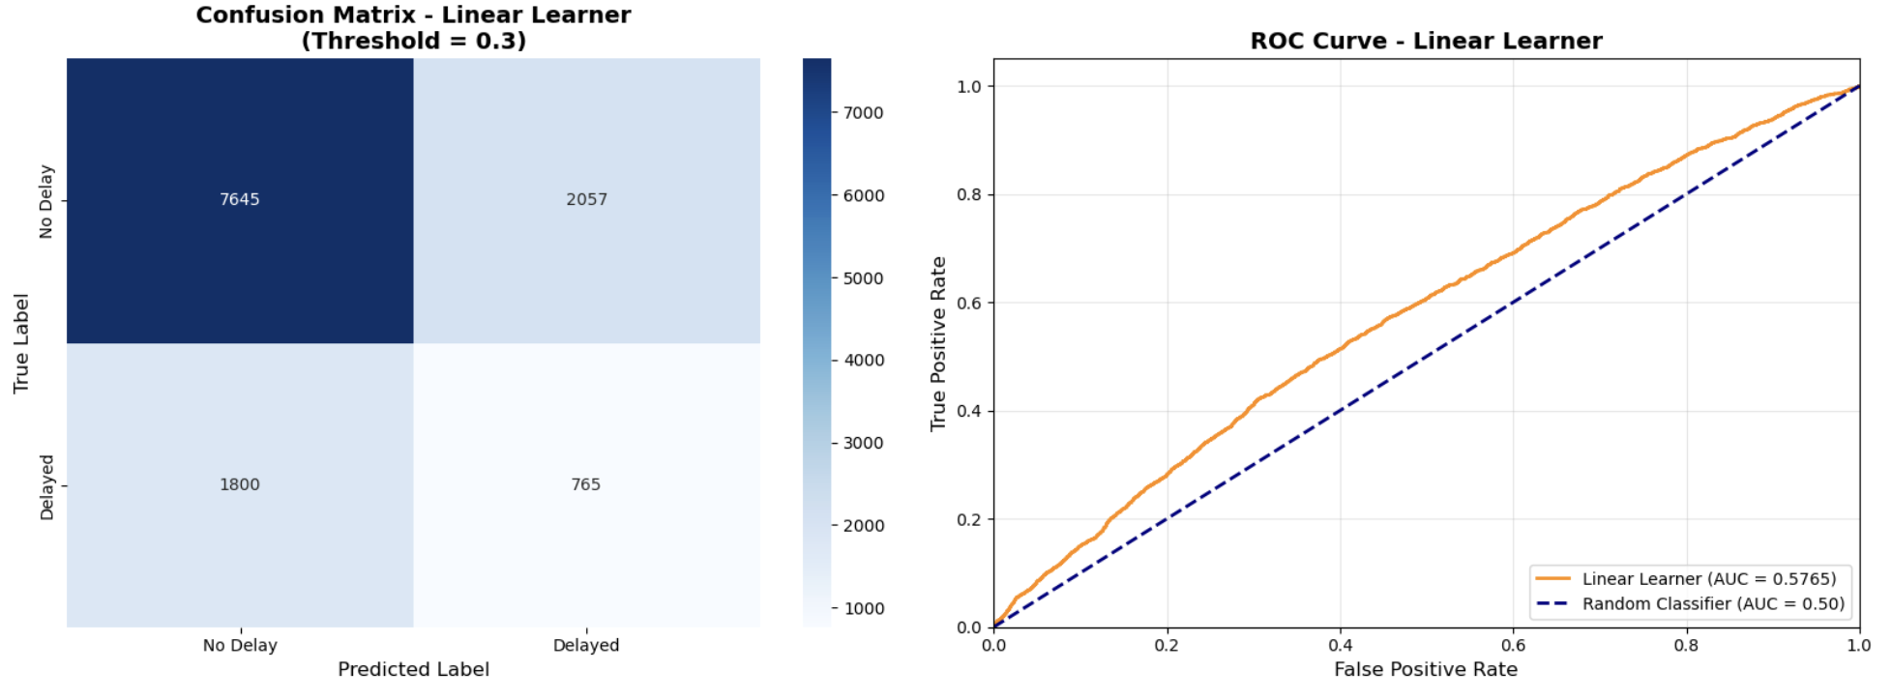
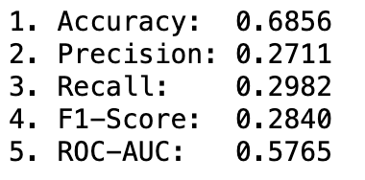
Key findings, Model Performance, Comparisons: On-cloud

Slide 10
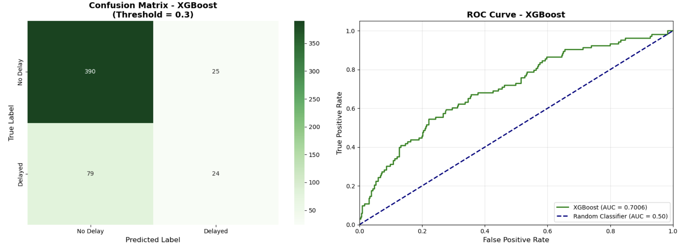
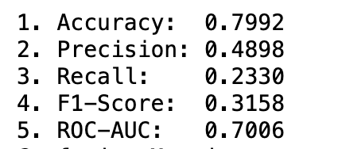
Key findings, Model Performance, Comparisons: On-cloud (iteration)

Slide 11
Conclusion: Challenges + Lessons Learnt
Challenges:
  Large Dataset -> slow to process locally and difficult to upload to AWS
  AWS setup complexity -> configuring S3 buckets
Lessons:
  Learned how to clean and preprocess large datasets efficiently using Pandas and sampling strategies
  Gained hands-on experience with AWS SageMaker, including training, deployment, and batch inference.

Slide 12
Thank you

