Slide 1
How Does the Islamic Calendar Really Work in Different Parts of the World?
Helmer Aslaksen
Dept. of Mathematics
National Univ. of Singapore
www.math.nus.edu.sg
aslaksen@math.nus.edu.sg

Slide 2
Challenges when talking about calendars
Most historians of science are not interested in calendars
Many Western scholars don’t realize how important non-Western calendars still are in many cultures
Many non-Western scholars feel that non-Western calendars are old-fashioned

Slide 3
Challenges when talking about the Islamic calendar
Is the Islamic calendar computational or observational?

Slide 4
The arithmetical calendar 1
Some sources describe an arithmetical (tabular) Islamic calendar. It is sometimes used for approximate conversions for civil purposes, but is not used for religious purposes by Sunnis or Twelver (Ithna Asharia) Shi`ites.

Slide 5
The arithmetical calendar 2
However, it is common among Sevener (Isma`ili) Shi`ites, including the Bohras (Musta'lis) and Nizaris (Isma`ili Khojas, Aga Khanis).

Slide 6
The arithmetical calendar 3
It seems to have been designed to be closer to new Moon than to the first visibility of the lunar crescent, so it often runs a day or two ahead of the regular Islamic calendars.

Slide 7
The arithmetical calendar 4
There are currently about one million Bohras and possibly up 20 millions Nizaris, compared to over a billion Sunnis and close to a hundred million Twelver Shi`ites.
Both of these groups are today primarily Indian Muslim groups, but they trace their history from the Fatimid Caliphate that ruled Egypt from about 970 to 1171.
The calendar is therefore sometimes referred to as the Fatimid or misr (Egyptian) calendar.

Slide 8
The arithmetical calendar 5
The calendar is sometimes attributed to the famous astronomer Al-Battani (850-929) and an alternative version to Ulugh Beg (1393-1449).
It is also sometimes referred to as hisabi.
It is possibly also used by the Qadianis (Ahmadiyyas), but they are not considered to be Muslims by other Muslims.

Slide 9
Rules for the Islamic calendar
If the sky is clear, the testimony of at least two upright Muslim men, or one man and two women, is sufficient to establish the start of Ramadan, but if the sky is cloudy then the testimony of a single, upright person will be accepted.

Slide 10
Are the rules followed?
The Islamic is in principle observational, but what is the practical reality?

Slide 11
The problem of crescent visibility
We know perfectly well where the Moon and the Sun are at any given time, but how light must the Moon be and how dark must the sky be before we can see the crescent?
And what if the weather is bad?

Slide 12
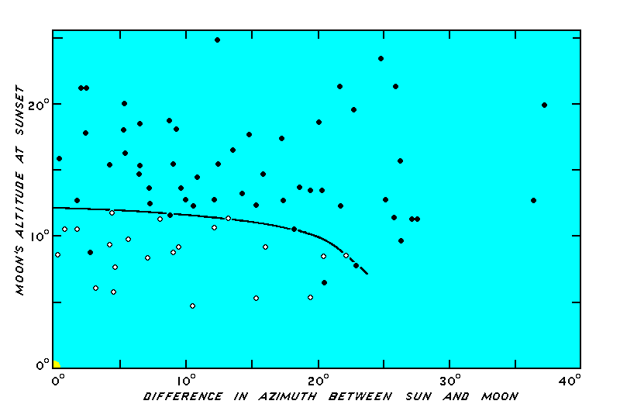
Lunar visibility theory

Slide 13
MoonCalc by Monzur Ahmed
Prediction software, using various criteria

Slide 14
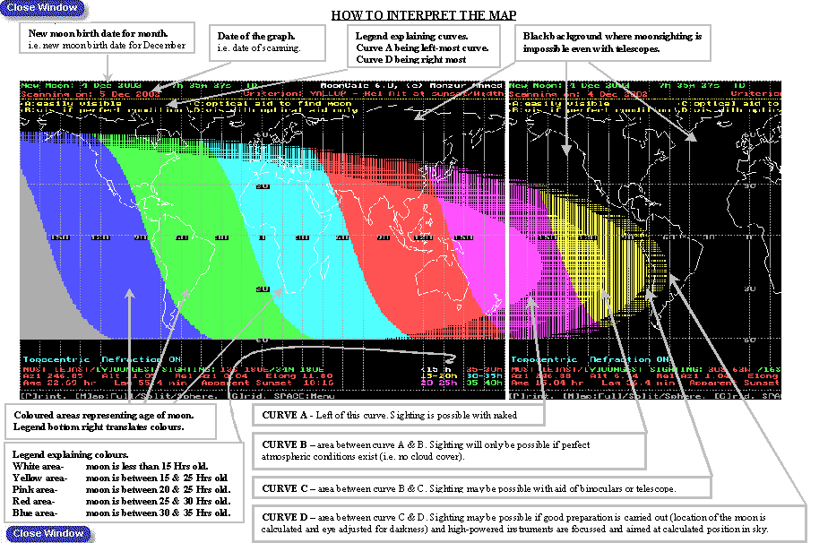

Slide 15
January 2005
Eid ul-Adha: The moon's conjunction is on January 10, 2005, at 12:04 Universal Time, i.e. 7:04am Eastern Standard Time - 4:04am Pacific Standard Time. On January 10, the moon is going to be 13 hours old on West coast of USA and cannot be seen anywhere in the world with the exception of Polynesian Islands. On January 11, it will be seen in most of the world, as shown by the visibility curves. Therefore, first day of Zul-Hijja is going to be on January 12 in most of the world, and accordingly, 10th Zul-Hijja is going to be on Friday, January 21, 2005.

Slide 16
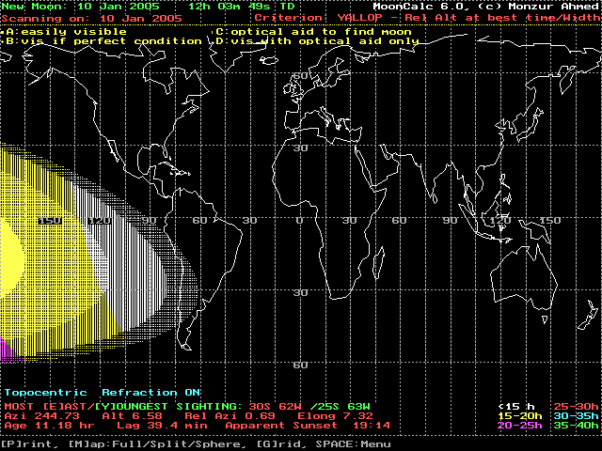
January 10, 2005

Slide 17
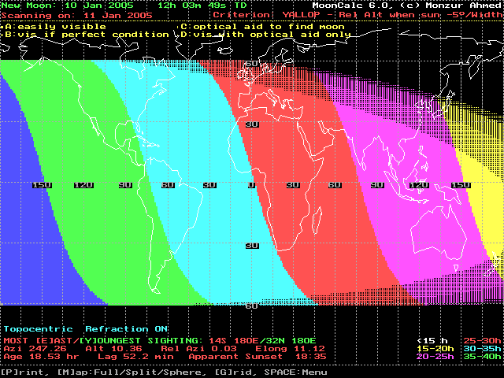
January 11, 2005

Slide 18
Methods of Beginning Islamic Months in Different Countries (Khalid Shaukat, moonsighting.com)
Actual Sighting judged by Qadi, or Review Panel. (Bangladesh, India, Pakistan, Oman, Morocco)
Moon born & moonset after sunset. (Saudi Arabia, sometimes deviates for Ramadan, Shawwal, Zul-Hijja)
Follow Saudi Arabia. (Qatar, Kuwait, UAE, Bahrain, Yemen, Turkey)
Moon born & moon sets at least 5 minutes after sunset. (Egypt)
News from neighboring countries. (New Zealand gets from Australia, and Suriname gets from Guyana)
Follow first Muslim country that announces it. (Europe, Some Caribbean Islands)
Criteria, of age, or altitude, or sunset-moonset lag. (Algeria, and Tunisia)
Age > 8 hours, altitude > 2°, elongation > 3°. (Singapore, Malaysia, Brunei and Indonesia)
Pre-calculated calendar. Bohra, Ismaiili, and Qadiani community in the world.
No specific criterion! Decision varies year by year. (Nigeria)
Actual sighting confirmed by astronomical calculations. (USA, Canada).

Slide 19
The Muslim calendar in Singapore
MUIS (Majlis Ugama Islam Singapura), the Islamic Religious Council of Singapore determines the calendar
Before 1974, the Muslim calendar in Singapore was based on sightings from Sultan Shoal, the southernmost part of Singapore.
After 1974, decided that the new month starts if at sunset on the eve of the 29th day the Moon is above the horizon. (The Muslim calendar in Singapore is based on latitude 1 20' 34'' N and longitude 103 51' 08'' E.)

Slide 20
Singapore after 1980
In the 80s they decided to follow a variation of the 1978 Istanbul criterion and require that the altitude of the Moon should be more than 5 degrees at sunset. In the 90s they switched to 2 degrees.

Slide 21
Regional cooperation
Attempt to coordinate the major holidays with Malaysia, Brunei and Indonesia (MABIMS).
The altitude of the Moon at sunset is more than 2 degrees.
The arc of light (elongation of the Moon from the Sun or the apparent angular distance) is more than 3 degrees.
The age of the moon is more than 8 hours.
In practice, however, MUIS only looks at the first part of the criterion.

Slide 22
How good are the MABIS criteria?
The minimum possible values of the three variables are approximately:
Altitude > 6
Arc of light > 7
Age > 16

Slide 23
The Saudi calendar
For many years, the Saudi calendar was consistently early

Slide 24
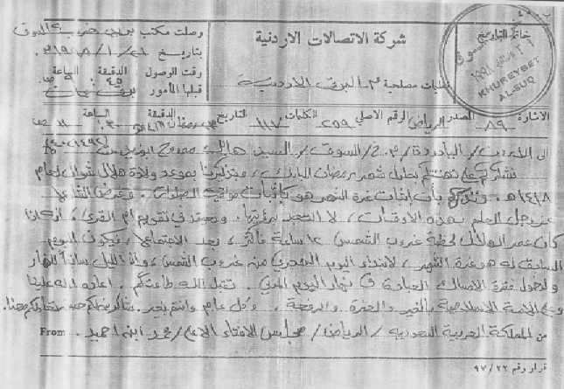
Telegram to the Jordanian Astronomical Society
It is adopted in Umm-ul-Qura Calendar that if the Moon's age at Sunset is 12 hours or more after the New Moon then the PREVIOUS day is the first day of the Islamic month

