Slide 1


Automated Presentation Creating Process
How to Create PowerPoint Presentations with Python

Slide 2
How to Add a Chart

Slide 3
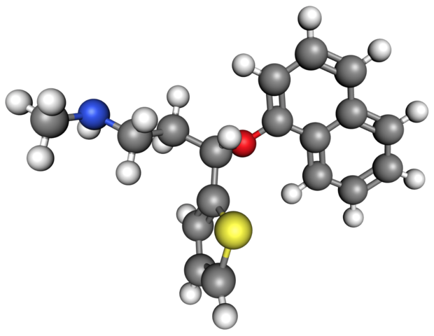
How to Add an Image

Slide 4
How to Add an Image
Do you know how the Orcs first came into being? They were elves once,
taken by the dark powers, tortured and mutilated. A ruined and terrible form of life.
Now... perfected. My fighting Uruk-Hai. Whom do you serve?
They will find the Ring, and kill the one who carries it.

Slide 5
Thank You

