Slide 1
Clustering Algorithms in Machine Learning
Overview of Clustering: Key Methods, Visualizations, and Mathematical Formulas
Presented by: Mani Maran . R

Slide 2
What is Clustering in ML?
Clustering is an unsupervised learning technique.
It groups data points into clusters so that:
Points in the same cluster are more similar to each other.
Points in different clusters are more dissimilar.
Used when we don’t have labels in the dataset.
Applications: customer segmentation, anomaly detection, image compression, document grouping, etc.

Slide 3
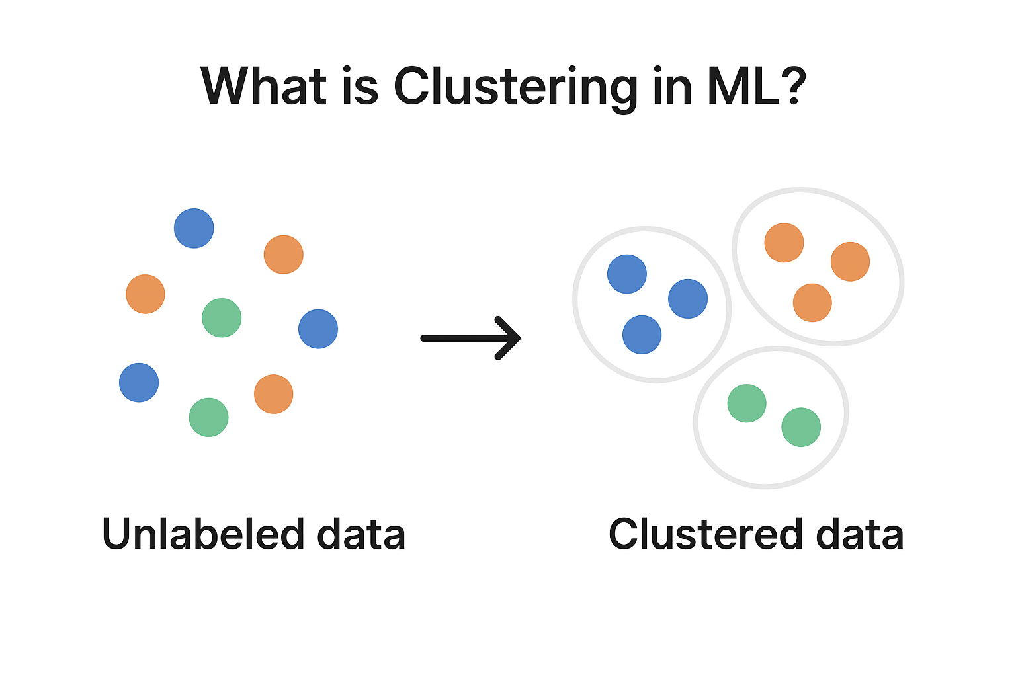

Slide 4
K-Means Clustering
Groups data into k clusters by minimizing distance to cluster centroids. Works well for spherical and evenly sized clusters.
from sklearn.cluster import Kmeans
kmeans = KMeans(n_clusters = i, init = 'k-means++’, random_state = 42)
y_kmeans = kmeans.fit_predict(x)
Advantages:
- Simple, fast, scalable for large datasets.
Disadvantages:
- Must predefine k, sensitive to outliers and initialization.

Slide 5
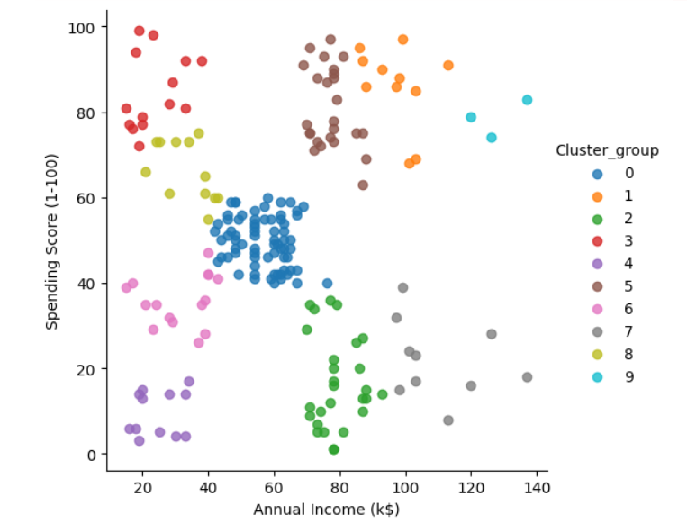
Visualization of K-Means Clustering

Slide 6
Agglomerative Clustering
A hierarchical, bottom-up clustering method that merges clusters step by step. Produces a dendrogram for visualization.
from sklearn.cluster import AgglomerativeClusteringclusmodel = AgglomerativeClustering(n_clusters = 5)
label = clusmodel.fit_predict(x)
Advantages:
- No need to predefine number of clusters, captures hierarchy.
Disadvantages:
- Computationally expensive (O(n²)), sensitive to noise.

Slide 7
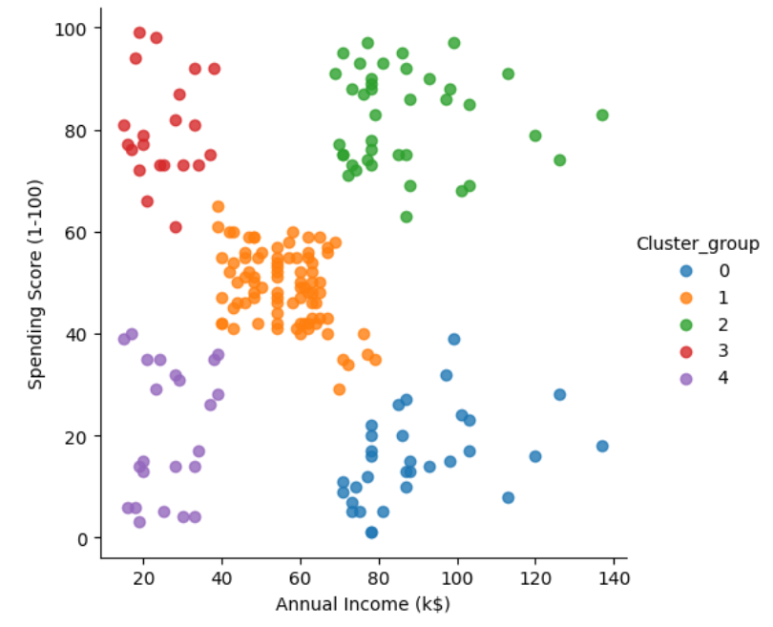
Visualization of Agglomerative Clustering

Slide 8
Affinity Propagation Clustering
Identifies exemplar points as cluster centers using message-passing between data points. Does not require k.
from sklearn.cluster import AffinityPropagationaff = AffinityPropagation(random_state=5)
y_aff=aff.fit_predict(x)
Advantages:
- Automatically finds number of clusters, flexible.
Disadvantages:
- High memory and CPU cost, may form many small clusters.

Slide 9
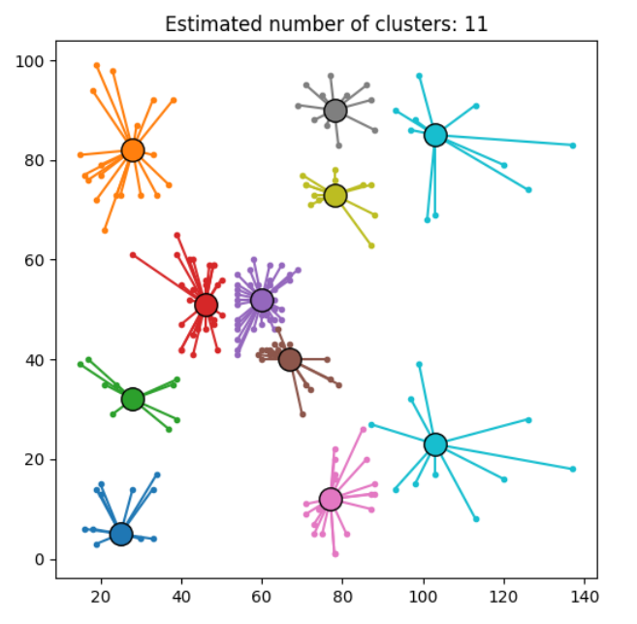
Visualization of Affinity Propagation

Slide 10
Mean-Shift Clustering
Finds clusters by shifting points towards regions of high data density. Works well for non-spherical clusters.
from sklearn.cluster import MeanShift
MS = MeanShift(bandwidth=25).fit(x)
y_MS = MS.fit_predict(x)
Advantages:
- No need for number of clusters, detects arbitrary shapes.
Disadvantages:
- Computationally expensive, sensitive to bandwidth choice.

Slide 11
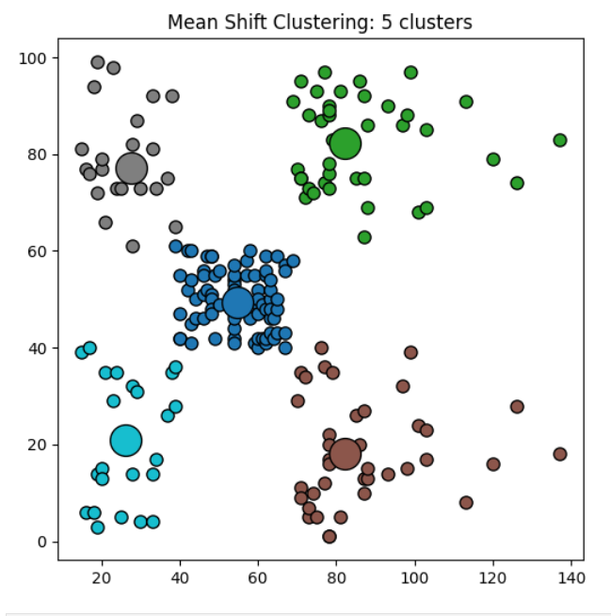
Visualization of Mean Shift

Slide 12
Spectral Clustering
Uses graph Laplacian and eigenvalues to transform data before clustering. Captures complex structures.
from sklearn.cluster import SpectralClustering
SC = SpectralClustering(n_clusters = 5, assign_labels = 'discretize', eigen_solver = 'arpack', random_state = 0)
y_SC = SC.fit_predict(x)
Advantages:
- Works for non-linear cluster boundaries, flexible.
Disadvantages:
- Needs predefined k, computationally heavy for large data.

Slide 13
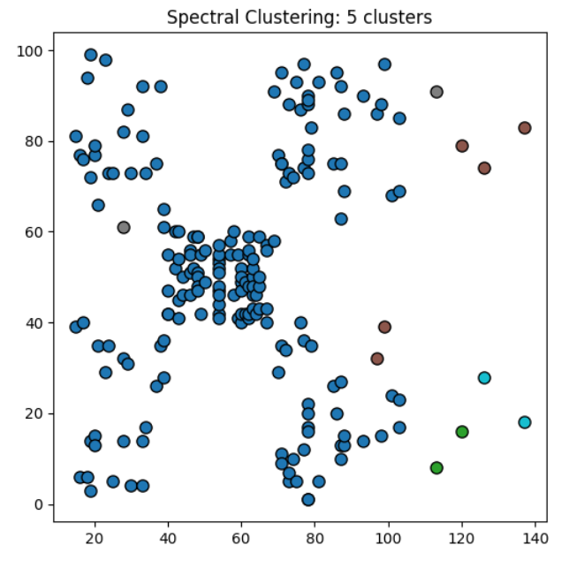
Visualization of Spectral Clustering

Slide 14
DBSCAN density-based clustering
Groups dense regions together and labels sparse points as noise. Suitable for irregularly shaped clusters.
from sklearn.cluster import DBSCAN
DB = DBSCAN(eps=6, min_samples=5)
y_DB = DB.fit_predict(x)
Advantages:
- No need to specify clusters, handles noise, arbitrary shapes.
Disadvantages:
- Struggles with varying density, needs careful parameter tuning.

Slide 15
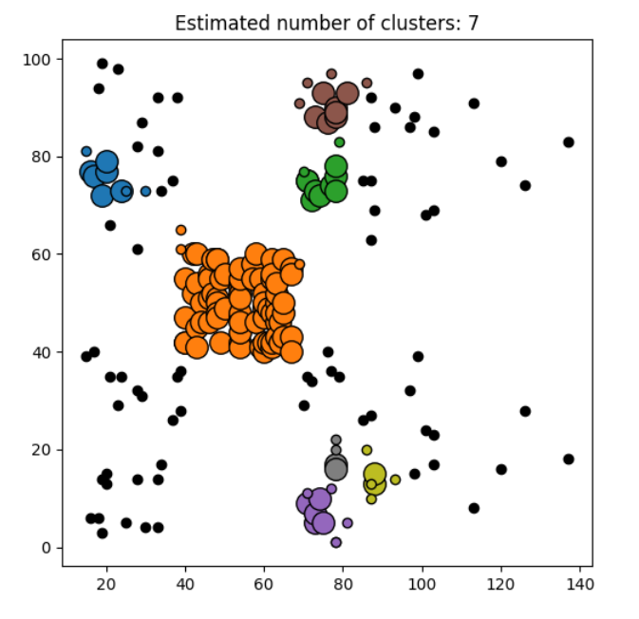
Visualization of DBSCAN

Slide 16
OPTICS - ordering points to identify the clustering structure
Extension of DBSCAN that orders points by reachability to detect clusters at varying densities.
from sklearn.cluster import OPTICS
OP = OPTICS(min_samples=5, xi = 0.05, min_cluster_size = 0.05).fit(X)
y_OP = OP.fit_predict(X)
Advantages:
- Handles variable density clusters, no fixed k.
Disadvantages:
- More complex and computationally intensive, harder to interpret.

Slide 17
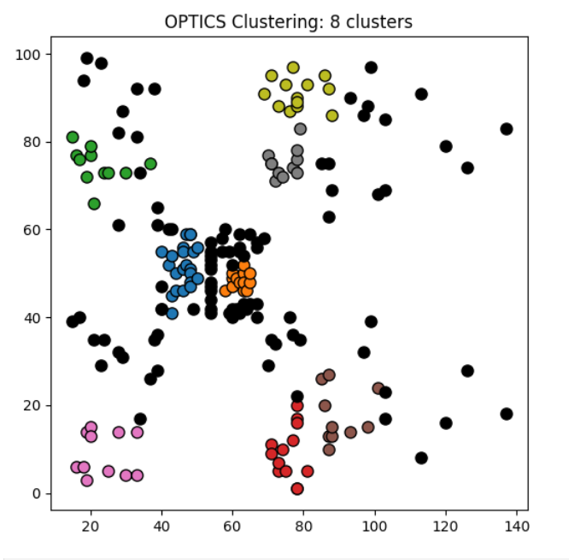
Visualization of OPTICS

Slide 18
BIRCH - (Balanced Iterative Reducing and Clustering Using Hierarchies)
Uses a CF tree to incrementally cluster very large datasets efficiently. Summarizes data for clustering.
from sklearn.cluster import Birch
brc = Birch(threshold = 5.0, n_clusters = 5)
y_brc = brc.fit_predict(X)
Advantages:
- Scales well to massive data, memory efficient.
Disadvantages:
- Best for spherical clusters, sensitive to threshold parameters.

Slide 19
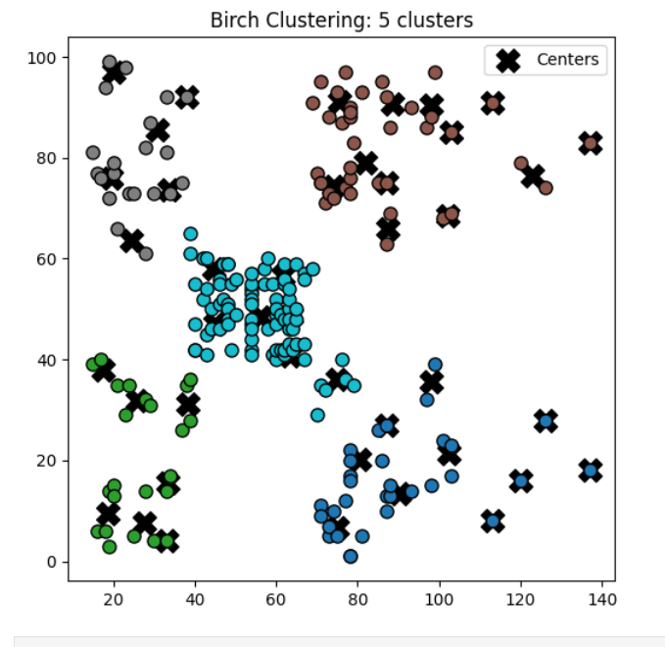
Visualization of BIRCH

