Slide 1
Boosting Algorithms in Machine Learning
A Powerful Ensemble Learning Technique
Presented by: Mani Maran . R

Slide 2
What is Boosting?
Boosting is an ensemble learning technique that combines multiple weak learners to form a strong learner.
Purpose: Reduce bias and variance, improving overall model accuracy.
Key Idea: Sequentially apply weak learners, focusing on misclassified examples from previous iterations.

Slide 3
Why Use Boosting?
Converts weak models into strong models
Reduces both bias and variance
Works well for structured/tabular data
Improves performance compared to a single model

Slide 4
How Does Boosting Work?
Start with a simple model (weak learner)
Train it on the dataset
Evaluate errors and assign weights
Next model focuses on hard-to-classify samples
Combine models sequentially to improve accuracy

Slide 5
Common Boosting Algorithms
AdaBoost: Adjusts weights of misclassified samples
Gradient Boosting: Optimizes loss function using gradient descent
XGBoost: Regularization + Parallel computation for speed
LightGBM: Faster, handles large data, histogram-based learning
CatBoost: Categorical feature support with minimal preprocessing

Slide 6
AdaBoost Workflow
1. Initialize sample weights equally
2. Train first weak learner (e.g., decision stump)
3. Calculate error and update sample weights
4. Train next weak learner focusing on misclassified samples
5. Repeat for a predefined number of iterations
6. Final model = Weighted sum of weak learners

Slide 7
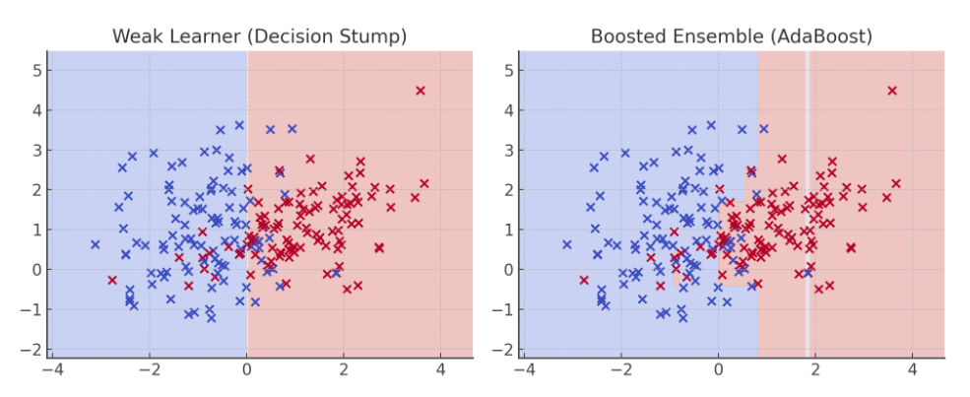
It shows the decision boundary:
Left: a weak learner (decision stump)
Right: the AdaBoost ensemble with much better separation

Slide 8
Gradient Boosting Intuition
Models correct residuals of previous learners
Minimizes a loss function (e.g., MSE for regression)
Each new tree tries to reduce error from previous step
Formula:
F(x) = F(x) + learning_rate * new_model(x)

Slide 9
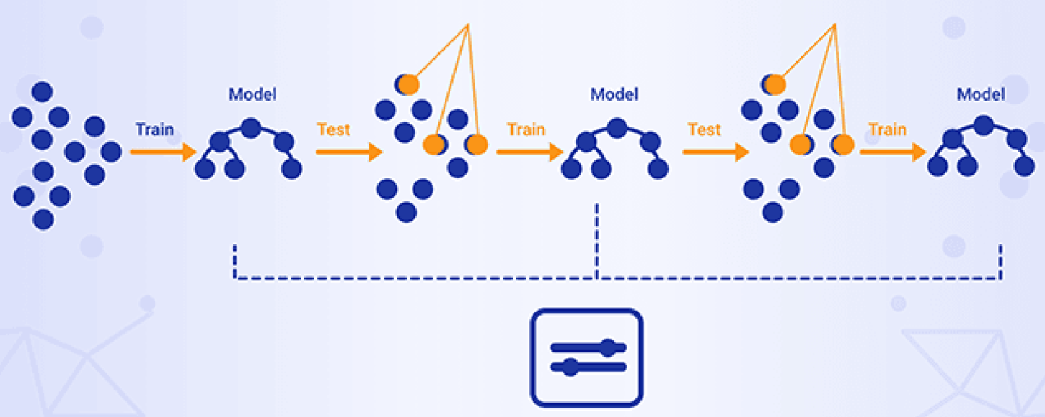
It shows how each new learner progressively corrects residuals over iterations.

Slide 10
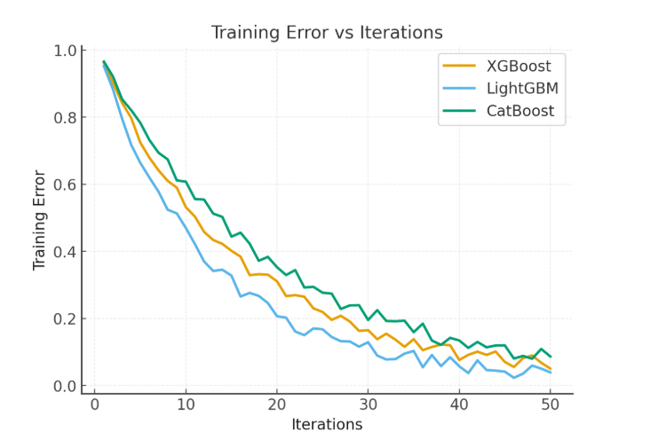
Comparing XGBoost, LightGBM, and CatBoost (all simulated to show efficiency differences).

Slide 11
Advantages of Boosting
High predictive accuracy
Reduces overfitting (especially with regularization)
Handles complex relationships
Flexibility: Different loss functions

Slide 12
Disadvantages of Boosting
Computationally expensive
Sensitive to noisy data and outliers
Difficult to interpret compared to simple models
Risk of overfitting if not properly regularized

Slide 13
Real-World Applications
Fraud detection
Customer churn prediction
Credit scoring
Image classification
Predictive maintenance

Slide 14
Popular Libraries
scikit-learn: AdaBoost & GradientBoosting implementations
XGBoost: Highly optimized, efficient boosting framework
LightGBM: Fast and scalable boosting algorithm
CatBoost: Handles categorical features automatically

Slide 15
Histogram-based Gradient Boosting (HistGB)
What is Hist Gradient Boosting?
- Optimized Gradient Boosting using feature binning
- Bins continuous features into discrete histograms
Why Use It?
- Faster training than traditional Gradient Boosting
- Low memory usage
- Scales well with large datasets
- Comparable accuracy
Example Use Case:
from sklearn.ensemble import HistGradientBoostingClassifier
model = HistGradientBoostingClassifier()
model.fit(X_train, y_train)

Slide 16
Summary
Boosting is a powerful ensemble technique
Combines weak learners sequentially
Reduces bias and variance for better performance
Widely used in real-world ML problems

