Slide 1
Applied Data Science

Slide 2
Problem Statement:
The problem is to develop a future sales prediction system that can accurately forecast sales for a given product or set of products in a business. Accurate sales predictions are essential for inventory management, financial planning, and overall business strategy. The system should take into account various factors, such as historical sales data, market trends, seasonality, and external influences, to provide reliable forecasts.

Slide 3
Design Thinking Process
Empathize
Define
Ideate
Prototype
Test
Implement
Monitor and Iterate

Slide 4
Empathize:
Understand the needs and pain points of the stakeholders, including business leaders, sales teams, and inventory managers.
Collect and analyze historical sales data, including product sales, seasonal variations, and any external factors that may impact sales.

Slide 5
Define
Clearly define the scope of the project, the specific products or product categories to be predicted, and the time frame (e.g., monthly, quarterly, or annually).
Identify the key performance indicators (KPIs) that will be used to measure the accuracy of sales predictions.

Slide 6
Ideate:
Brainstorm potential solutions and approaches to sales prediction, considering both traditional statistical methods and advanced machine learning techniques.
Explore the use of data sources such as social media, customer reviews, and economic indicators to enhance predictions.

Slide 7
Prototype:
Develop a proof-of-concept model or a Minimum Viable Product (MVP) for sales prediction. This may involve selecting a machine learning algorithm, creating a database for data storage, and developing a user interface for input and output.

Slide 8
Test:
Evaluate the prototype's performance using historical data and relevant evaluation metrics (e.g., Mean Absolute Error or Root Mean Squared Error).
Gather feedback from users and stakeholders to refine the model and the system's user experience.

Slide 9
Implement:
Develop a production-ready version of the sales prediction system that can handle real-time or batch predictions.
Ensure scalability and robustness of the system for use in a production environment.

Slide 10
Monitor and Iterate:
Continuously monitor the performance of the sales prediction system in a real-world setting.
Implement regular updates and improvements based on new data, user feedback, and changing business conditions.

Slide 11
Phases of Development for Future Sales Predicti
Data Collection:
Data Preprocessing:
Feature Engineering:
Model Selection
Model Training:
Validation and Testing
Deployment:
Monitoring and Maintenance:
Feedback Loop:

Slide 12
Data Collection:
Gather historical sales data, including product-specific sales, pricing, promotions, and external variables like economic indicators or weather data.

Slide 13
Data Preprocessing:
Clean, transform, and preprocess the data to handle missing values, outliers, and prepare it for modeling.

Slide 14
Feature Engineering:
Create relevant features that can enhance the predictive power of the model. This may include lag features, seasonality, and external data integration.

Slide 15
Model Selection:
Choose an appropriate forecasting model, which can range from traditional time series methods (e.g., ARIMA) to more advanced machine learning techniques (e.g., neural networks)

Slide 16
Model Training:
Train the selected model on historical data, optimizing its parameters to achieve the best possible accuracy.

Slide 17
Validation and Testing:
Validate the model's performance on a separate validation dataset and fine-tune as necessary.
Test the model's accuracy against a hold-out test dataset.

Slide 18
Deployment:
Deploy the trained model into the production environment for generating real-time or batch predictions.

Slide 19
Monitoring and Maintenance:
Continuously monitor the model's performance, retraining it as new data becomes available.
Address any issues or discrepancies that may arise in the production system.

Slide 20
Feedback Loop:
Maintain an iterative feedback loop with stakeholders to incorporate their insights and adapt the system to changing business needs and market conditions.

Slide 21
Dataset Used
The dataset should include historical sales data for the products or product categories you want to predict.
Key data points in the dataset might include:
Date or timestamp: Recording the time of sale.
Product ID or SKU: Identifying the specific product.
Sales quantity: The number of units sold for each product.
Price: The price at which the product was sold.
Promotions or discounts: Any special offers or discounts during the sale.
External factors: Data on external variables like economic indicators, weather conditions, holidays, or special events that may impact sales.

Slide 22
Data Preprocessing Steps
Data preprocessing is crucial to ensure the dataset is clean and suitable for modeling. Common steps include:
Handling missing values: Decide whether to impute missing data or remove incomplete records.
Outlier detection and treatment: Identify and handle outliers that can distort predictions.
Data transformation: Apply transformations like log scaling or normalization to make the data more suitable for modeling.
Encoding categorical variables: Convert categorical variables like product IDs into numerical values.
Date and time processing: Extract relevant features from date/timestamps, such as day of the week, month, or year, to capture seasonality.
Aggregation: Aggregate data at the desired granularity (e.g., daily, monthly) to match the prediction frequency.

Slide 23
Feature Extraction Techniques
Effective feature extraction is critical for accurate sales prediction. Here are some techniques to consider:
a. Lag Features:
Create lag features to capture historical sales patterns. For example, include the sales from the previous day, week, or month as features.
Lag features help the model capture dependencies on past sales

Slide 24
b. Rolling Statistics:
Calculate rolling statistics like moving averages and rolling standard deviations for various time windows.
These features can reveal trends and seasonality in the data.
c. Seasonal Features:
Create binary or categorical features to represent seasons or holidays.
For example, a "holiday" feature can indicate whether a particular day is a holiday, which can impact sales.

Slide 25
D.External Data Integration:
Integrate external data sources relevant to your business, such as:
Economic indicators like GDP, inflation rates, or consumer sentiment indices.
Weather data, including temperature, precipitation, and weather conditions.
Events and promotions that might influence sales.
e. Time-Based Features:
Generate time-based features like day of the week, month, or quarter, which can capture recurring patterns.

Slide 26
F.Price and Promotion Features:
Incorporate pricing and promotion information, such as discounts, special offers, and advertising campaigns, as features.
Changes in price or promotional activities can have a significant impact on sales.
g. Market Trends:
Include features related to broader market trends, industry developments, or competitive factors that could affect sales.

Slide 27
H.Customer Behavior:
If relevant, create features related to customer behavior, such as customer reviews, ratings, or social media sentiment, as these can influence sales.
i. Geographical Data:
If your business operates in multiple locations, consider features related to the geographical context, such as regional differences in demand.

Slide 28
Choice of Machine Learning Algorithm:
The choice of the machine learning algorithm depends on the characteristics of your sales prediction problem and the dataset. Here are some commonly used algorithms for sales prediction:

Slide 29
a. Time Series Models:
ARIMA (AutoRegressive Integrated Moving Average): Suitable for univariate time series data with clear trends and seasonality.
Exponential Smoothing (Holt-Winters): Effective for time series data with seasonality and trend components.

Slide 30
b. Regression Models:
Linear Regression: Appropriate for modeling simple relationships between sales and predictor variables like price, promotions, or external factors.
Random Forest Regression: Useful for capturing non-linear relationships and interactions between features.
Gradient Boosting (e.g., XGBoost or LightGBM): Powerful for modeling complex relationships and capturing feature importance

Slide 31
c. Neural Networks:
Recurrent Neural Networks (RNNs): Effective for sequential data like time series, capable of capturing dependencies over time.
Long Short-Term Memory (LSTM) and Gated Recurrent Unit (GRU): Specialized RNN architectures that perform well on time series data.

Slide 32
d. Prophet:
Developed by Facebook, Prophet is designed for forecasting time series data with daily observations that may contain missing data points and outliers.
The choice of algorithm should be based on the dataset's characteristics, problem complexity, and the interpretability of the model. It's often a good practice to experiment with multiple algorithms to find the one that provides the best predictive performance.

Slide 33
Model Training: After selecting an algorithm, you need to train your model. The training process involves the following steps:
a. Data Split:
Divide your dataset into training, validation, and test sets. The training set is used to train the model, the validation set helps tune hyperparameters, and the test set is used to evaluate the model's performance.

Slide 34
b. Feature Scaling:
Normalize or standardize your features to ensure that they are on the same scale, which helps the model converge faster and improve performance.
c. Hyperparameter Tuning:
Experiment with different hyperparameters of your chosen algorithm to optimize its performance. Techniques like grid search or random search can be used.
d. Model Training:
Train the model on the training dataset using the chosen algorithm and hyperparameters.
e. Validation:
Evaluate the model's performance on the validation dataset and make adjustments as necessary.

Slide 35
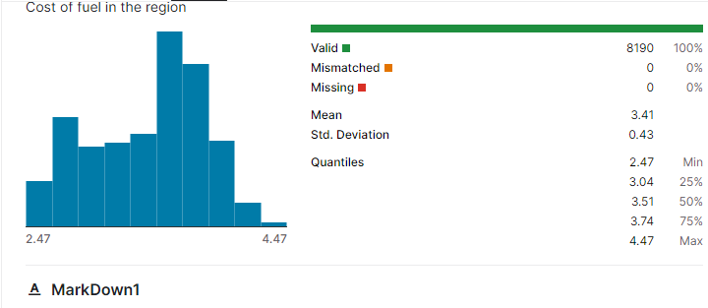

Slide 36
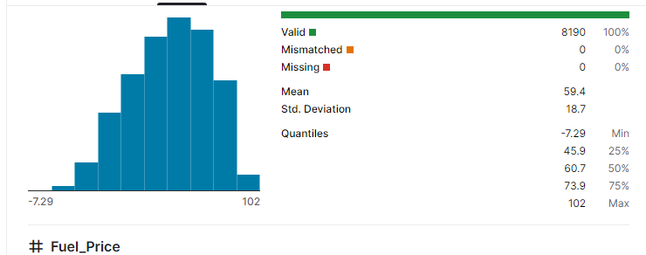

Slide 37
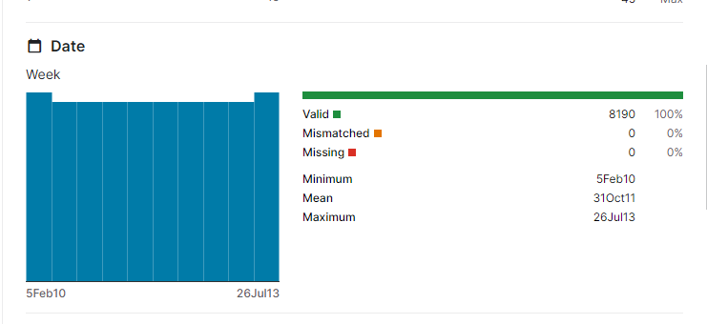

Slide 38
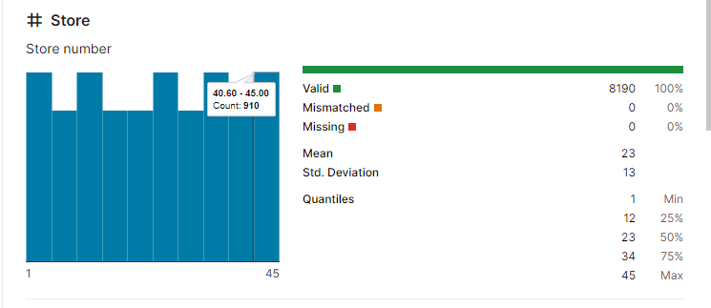

Slide 39
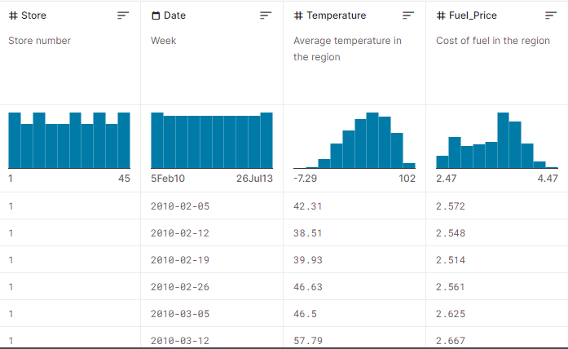

Slide 40
Evaluation Metrics:
Evaluation Metrics: To assess the performance of your future sales prediction model, you should use appropriate evaluation metrics. The choice of metrics can depend on the specific requirements and characteristics of your business, but some common metrics for sales prediction include:
a. Mean Absolute Error (MAE):
MAE measures the average absolute difference between the predicted and actual values. It is easy to interpret but sensitive to outliers.

Slide 41
b. Mean Squared Error (MSE) and Root Mean Squared Error (RMSE):
MSE is the average of the squared differences between predictions and actual values. RMSE is the square root of MSE. These metrics penalize large errors more heavily.
c. Mean Absolute Percentage Error (MAPE):
MAPE calculates the percentage difference between predicted and actual values. It is useful for understanding prediction accuracy in terms of percentages.
d. R-squared (R^2) or Coefficient of Determination:
R-squared measures the proportion of the variance in the dependent variable (sales) that is predictable from the independent variables (features). A higher R-squared indicates a better fit.

Slide 42
e. Forecast Bias:
Evaluate whether the model consistently overestimates or underestimates sales. This helps in understanding the direction of prediction errors.
The choice of evaluation metric should align with your business goals and priorities. For instance, if minimizing overestimation is critical, you may focus on forecast bias. If you need a comprehensive metric, MAE, RMSE, or MAPE are often preferred.

Slide 43
coding
# Import necessary libraries
import pandas as pd
import numpy as np
from sklearn.model_selection import train_test_split
from sklearn.linear_model import LinearRegression
import matplotlib.pyplot as plt
# Load your historical sales data (make sure you have a CSV or other data file)
# Replace 'your_data.csv' with the actual filename
data = pd.read_csv('your_data.csv')

Slide 44
# Explore the data (view the first few rows)
print(data.head())
# Assuming your data has two columns: 'date' and 'sales'
# You might want to add more features like marketing spend, seasonality, etc.
# Data preprocessing
X = data[['date']] # Your features (e.g., date)
y = data['sales'] # Your target variable (sales)

Slide 45
# Split the data into training and testing sets
X_train, X_test, y_train, y_test = train_test_split(X, y, test_size=0.2, random_state=0)
# Create a linear regression model
model = LinearRegression()
# Train the model
model.fit(X_train, y_train)
# Make predictions on the testing data
y_pred = model.predict(X_test)

Slide 46
# Make predictions on the testing data
y_pred = model.predict(X_test)
# Visualize the results
plt.scatter(X_test, y_test, color='blue')
plt.plot(X_test, y_pred, color='red', linewidth=2)
plt.title('Sales Prediction')
plt.xlabel('Date')
plt.ylabel('Sales')
plt.show()

Slide 47
# Predict future sales
# Replace 'future_date' with the date you want to predict sales for
future_date = pd.to_datetime('2023-01-01') # Example future date
future_sales = model.predict(np.array([[future_date]]))
print(f"Predicted sales for {future_date}: {future_sales[0]}")

