Slide 1

Advanced Programming Practices Project - Build 3
Team Tejaswini - 40186127
Vignesh - 40171544
Vikram - 40126852
William - 40186129
Manimaran - 40167543

Slide 2




Project Goals
To build a specific “RISK” game.
To be able to build a console java application implements the gameplay of warzone game
To implement java coding standard, programming models, architectural concept design patterns which is a part of curriculum
To deliver a real time working software satisfying the given problem statements.

Slide 3
Build-3 Goals
Map file should be read by the application and to implement Map editor and few Game play modules
The Map editor operations include show map, edit map, save map, validate map.
The first build mainly focuses on reading the map files and creating Continent, Country and borders as the classes in java for performing operations on it and display(Show map).
The Incremental delivery Software development model is used for developing.

Slide 4
Build-3 Goals
To implement Coding Conventions and generate Javadoc for better understandably of the code.
Work as a team for a single project with the common aim with equal responsibilities.
To be able to work with the common repositories(remote repositories) GitHub, with the commits made by every team members.
To Test the quality of the software by performing “JUNIT” testing framework for the application.
To implement all the design patterns mentioned in the Build3 guideline

Slide 5
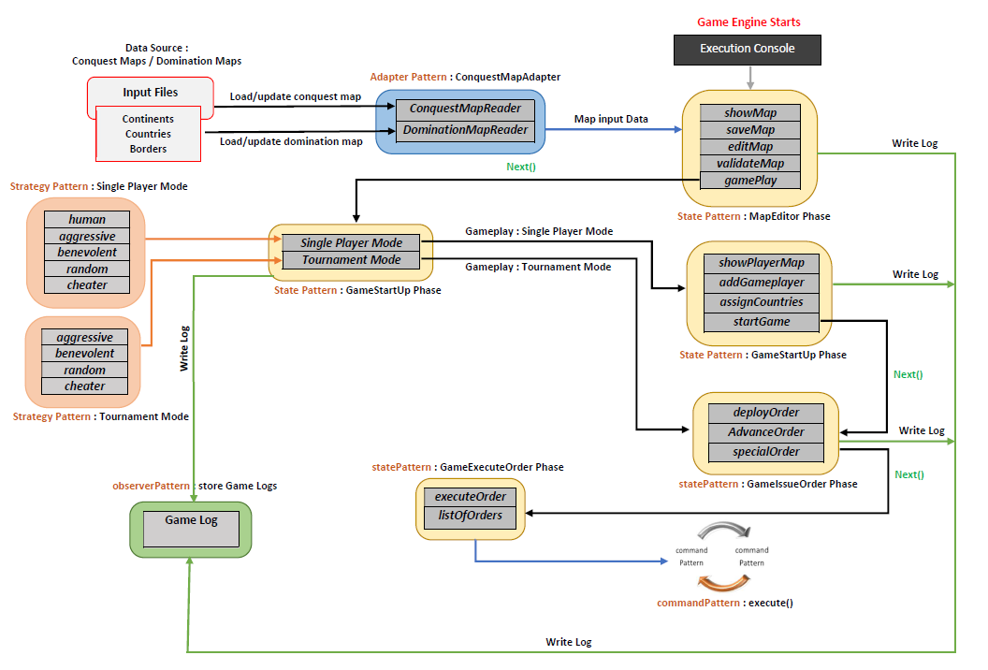
Architectural Design

Slide 6
Architectural Design - Read Phase
Source Map files are read and composed into Java objects using Bean Reader Class
Based on User preference, Map values are loaded
The read text file values are used to create the classes for continent, country and borders as per the map structure.

Slide 7
Architectural Design - Read Phase
The Continent map with their ids and the Country map with their respective continents was created.
The edges between the countries is added and removed from the loaded composite graphs and the values are returned.
The returned values are displayed to the user console.

Slide 8
Architectural Design - Execution Phase
The main game loop is used to assign reinforcements to the players, to issue order, execute order.
The player instances are fetched from player class and the properties of a player are manipulated during game play
Game loop gives control to each player in a round robin fashion.

Slide 9
Game Phases – MapEditor
Map Editor
Editmap
Showmap
Validatemap
Savemap
EditContinent
EditCountry
EditNeighbor
The above commands has a specific use cases to edit the game map

Slide 10
Game Phases – GamePlay
StartUp Phase
LoadMap command is used to select the available maps, the values are asked from the user.
Game Player is used to create and remove the players for the game play.
Every Player is assigned with the countries and through the objects.
The different orders issue-order(), next-order() is used on the different players and removed from the list once used.

Slide 11
Game Phases – GamePlay
Main Game Loop
Assign reinforcement phase is used to assign the armies for the players under the game rules from the game loop.
Issue order phase is used to get the order from the user and issue it to the owned armies like how many armies to deploy, where to deploy etc…with their country ids in round robin fashion.
Execution phase is used to execute the command on deployed order of armies, countries with respective users, by calling object method in that phase.

Slide 12
Refactoring
Refactoring consists of improving the internal structure of an existing program’s source code, while preserving its external behavior.
Refactoring mainly done in implementing design patterns.
State Pattern,
Command Pattern.

Slide 13
Refactoring
The Phases involved in State pattern are
StartUpPhase,
IssueOrdersPhase,
OrderExecution phase.
The classes used in Command pattern are
Command class,
Invoker class,
Client class.

Slide 14
Refactoring
The new Design pattern called “Observer Pattern” is created and it is used to keep record of all the commands.
The classes involved in observer pattern are:
LogEntryBuffer,
LogWriter,
Observer,
Observable.

Slide 15
Refactoring
The Design pattern called “Adapter Pattern” is created to allow the application to choose different reading modes of map
The classes involved in adapter pattern are:
ConquestMapAdapter,
ConquestMapReader,
DominationMapReader.

Slide 16
Refactoring
The new Design pattern called “Strategy Pattern” is created and it is used to define different player behaviors to act upon during gameplay / application
The classes involved in strategy pattern are:
Human,
Aggressive,
Benevolent,
Random,
Cheater.

Slide 17
Software Stack
Java as a programming language
GIT as a repository
Eclipse as an IDE
Project is incorporated in Gradle project

