Slide 1


Status Tracking System

Slide 2
Technologies used in developing STS
Hibernate
Spring MVC
Data tables
MySQL
Java
Bootstrap

Slide 3
About STS
STS helps to assign and track the status of the incident tickets assigned to a resource
Incident is an unplanned event that causes interruption in service or deterioration in service quality
Maintains the history of tickets assigned to a resource
Helps users to prioritize the tickets assigned to them and act accordingly
Consists of many useful functions and features which make handling of tickets easy
A useful tool in Project Management

Slide 4
Why STS?
STS increases productivity by enabling better co-ordination between teams.
STS helps on minimizing time wasted on tracking issues
STS improves quality by ensuring all tickets are recorded down with all the details and are tracked until completion
Gives users the freedom to access from mobiles or PC.

Slide 5
Actors of STS
Target Audience of STS:
1. Administrators
2. Application Developers
3. Testers

Slide 6
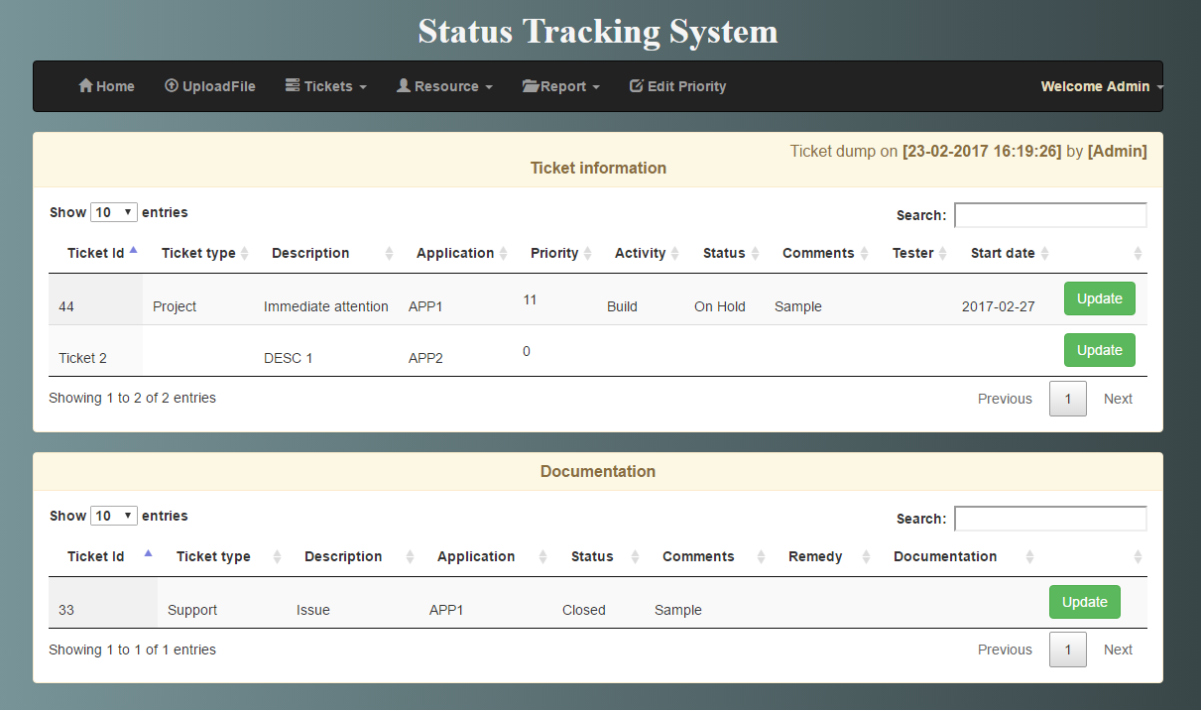
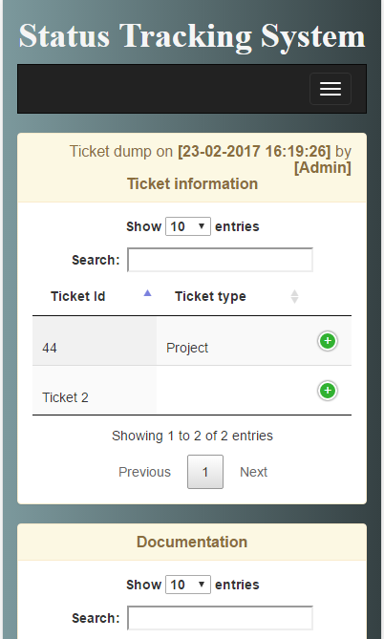
Different views of the application
2.Pc View
1.Mobile View

Slide 7

Functionalities enabled for Administrators
Add/ Modify details of a resource
Upload tickets
Assign/ Reassign tickets
Delete tickets
Release tickets
Various reports on resources and tickets

Slide 8

Login

Slide 9
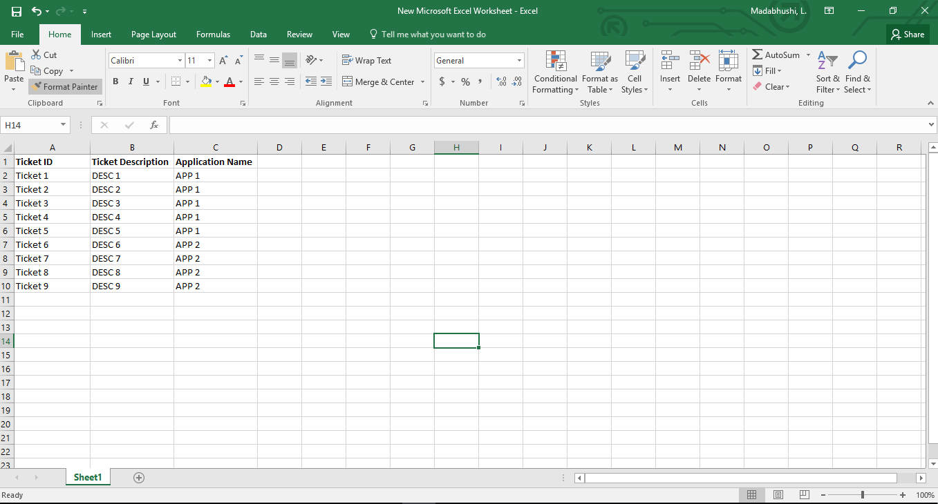
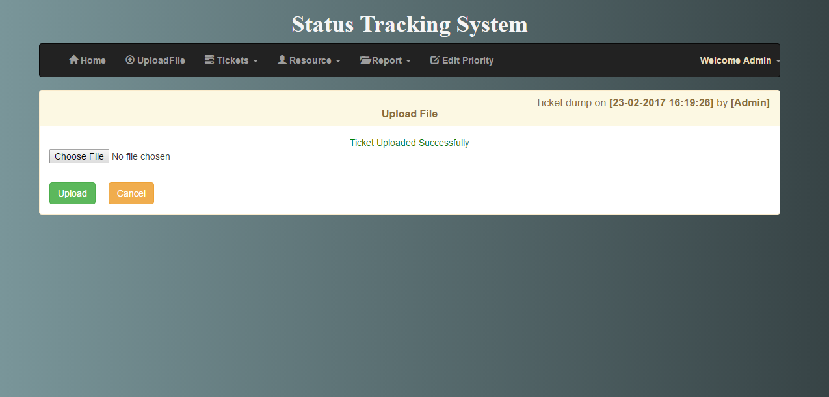
Upload File

Slide 10
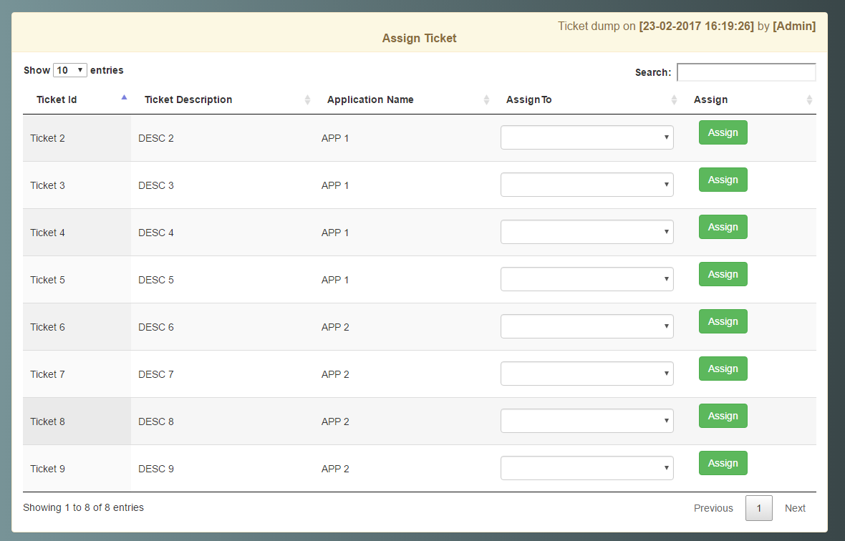
Assign Tickets

Slide 11
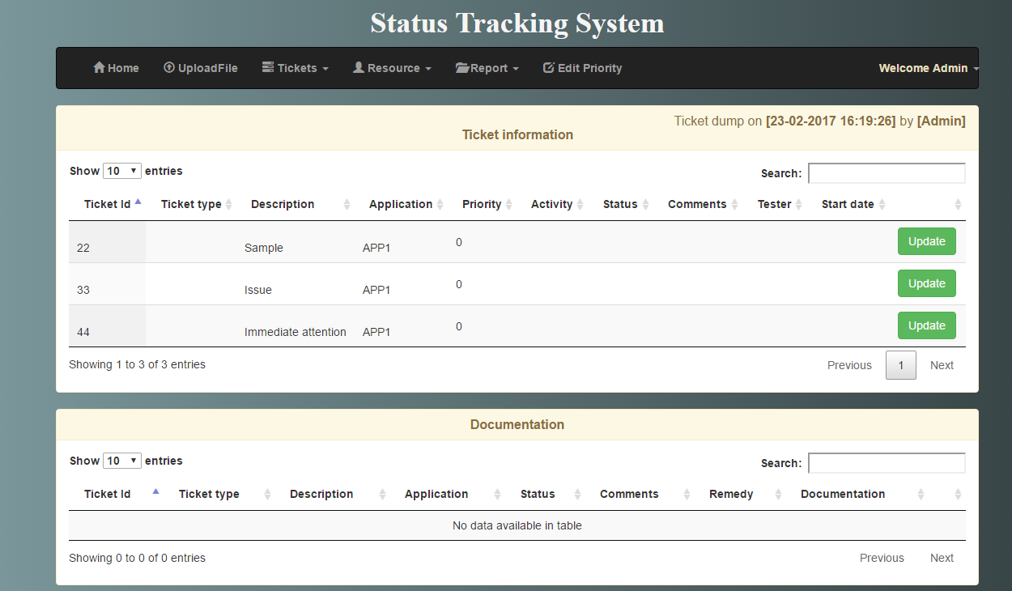
Home Page of an Administrator

Slide 12
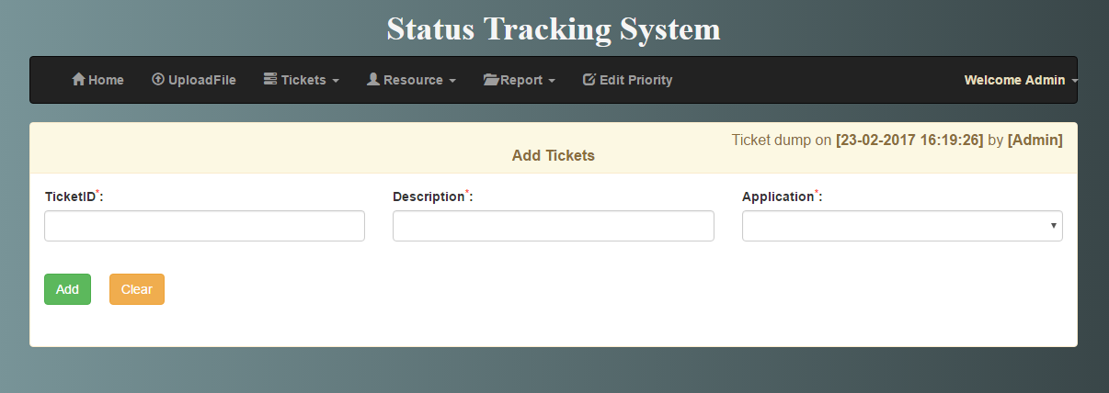
Add Ticket

Slide 13
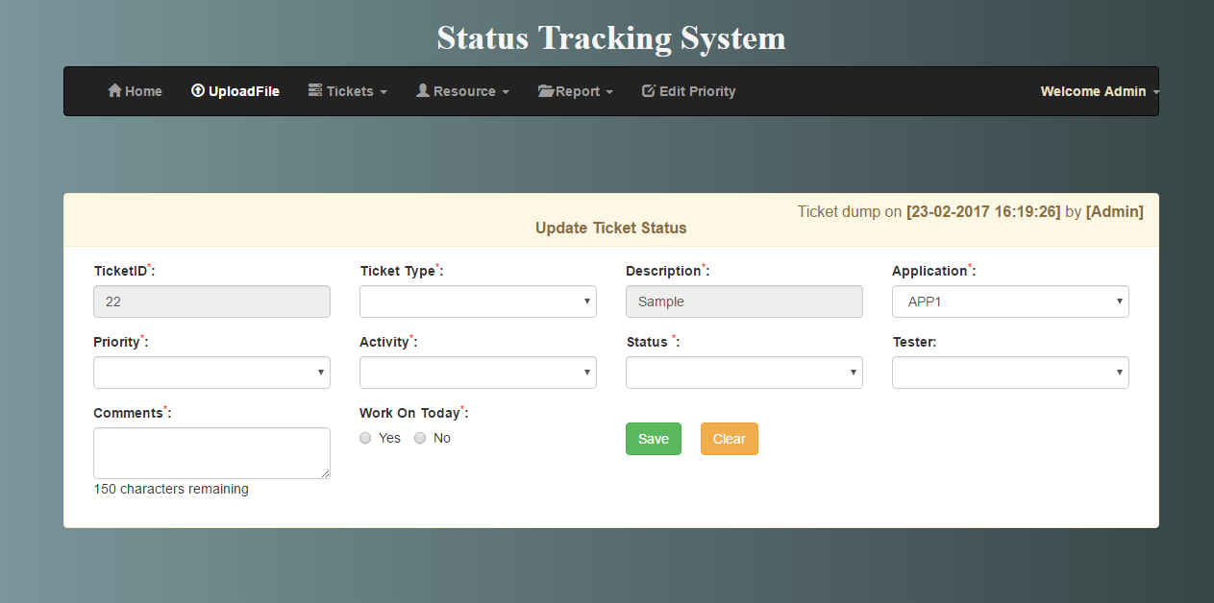
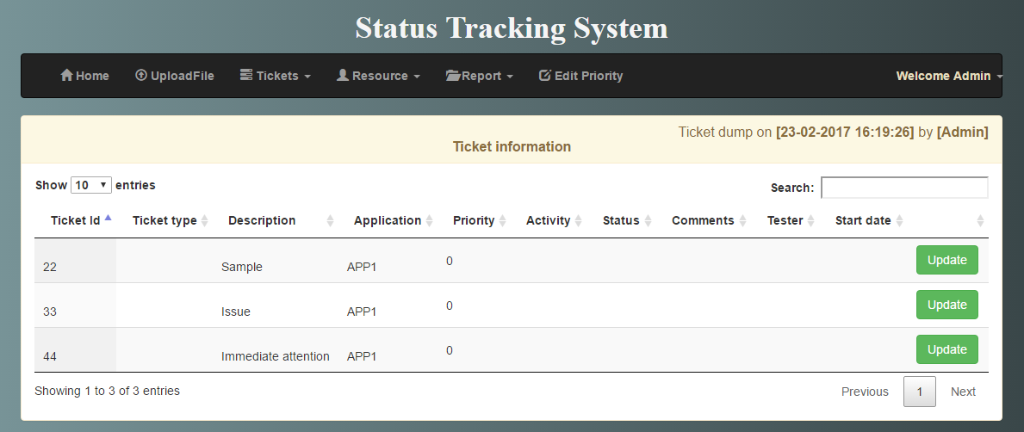
Update Ticket

Slide 14
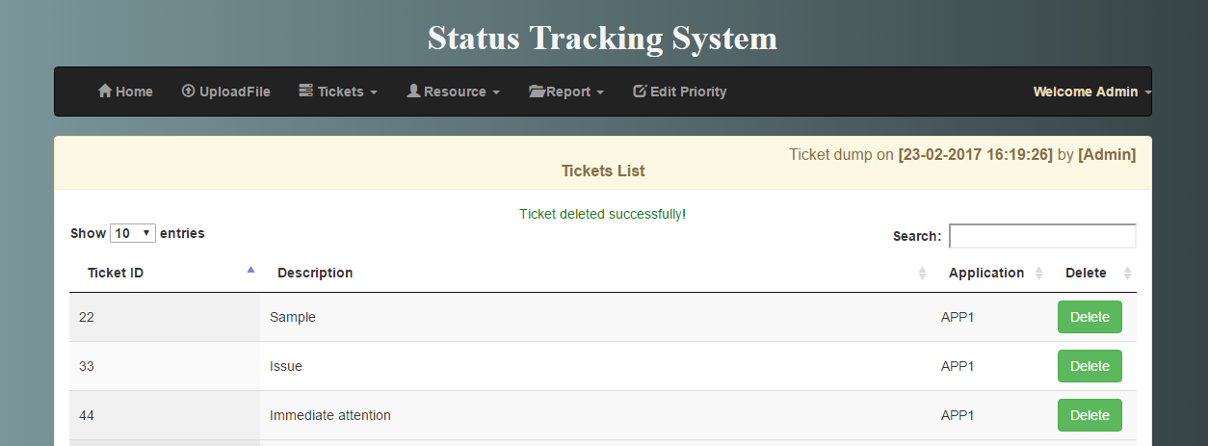
Delete Ticket

Slide 15
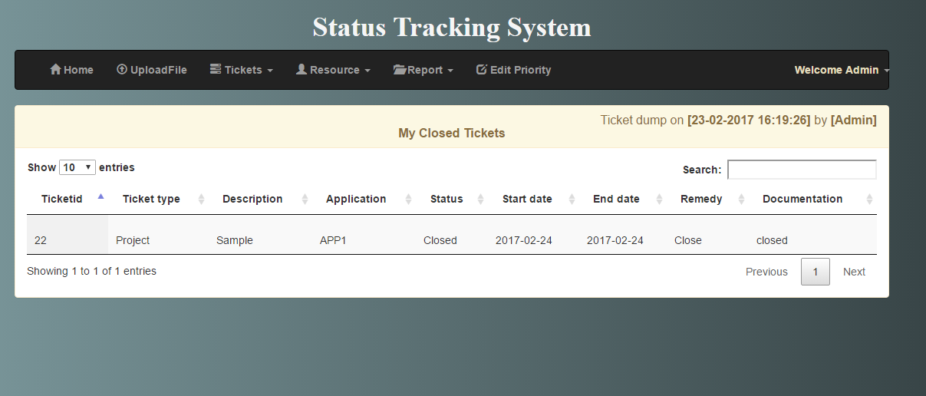
Display Closed Tickets

Slide 16
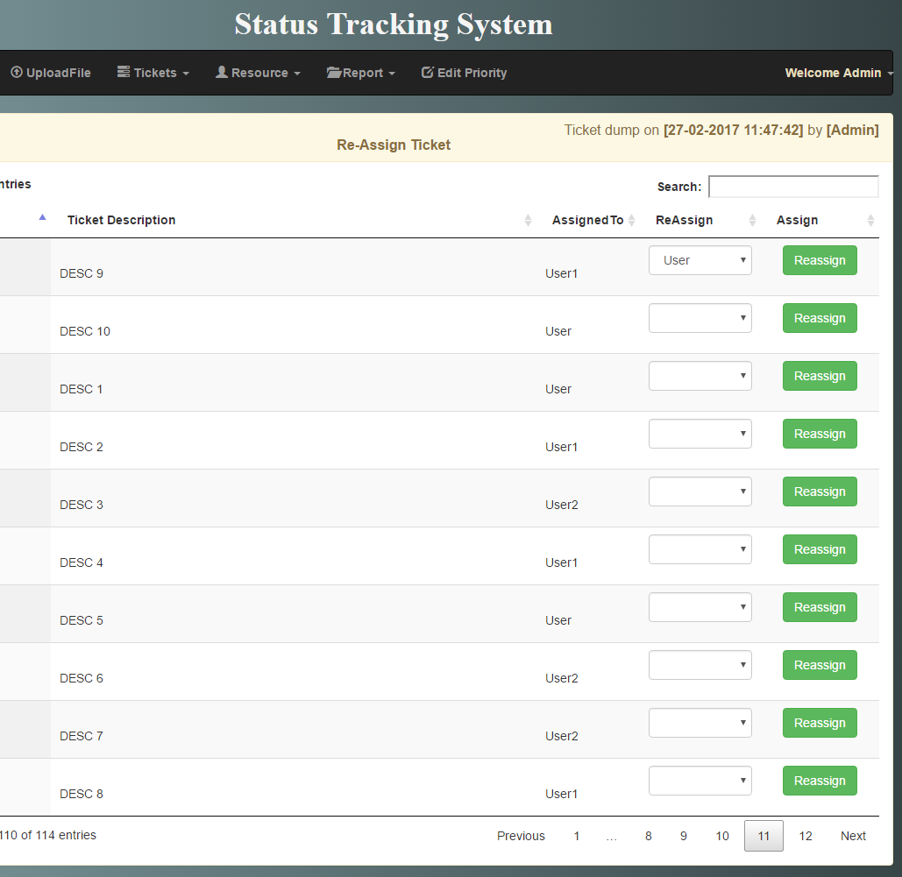
Re-Assign Tickets

Slide 17
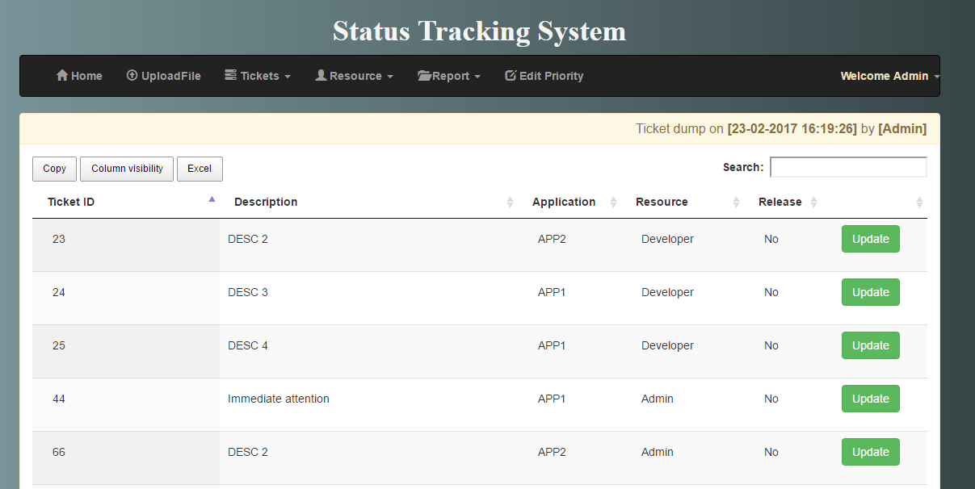
Release Tickets

Slide 18
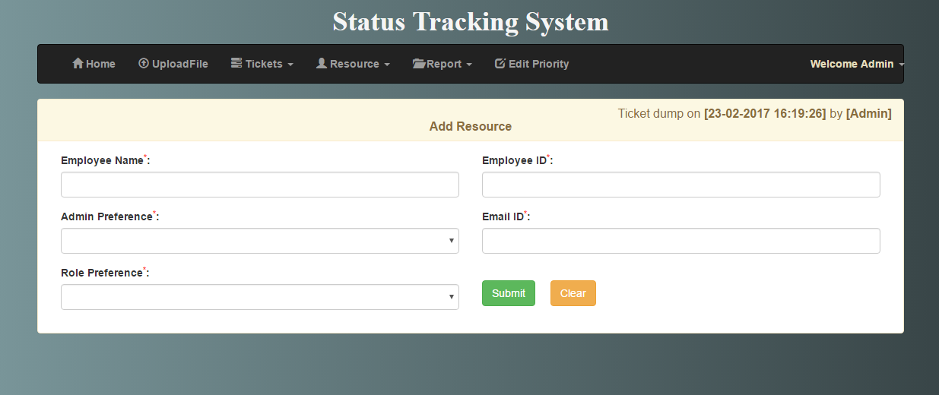
Add Resource

Slide 19
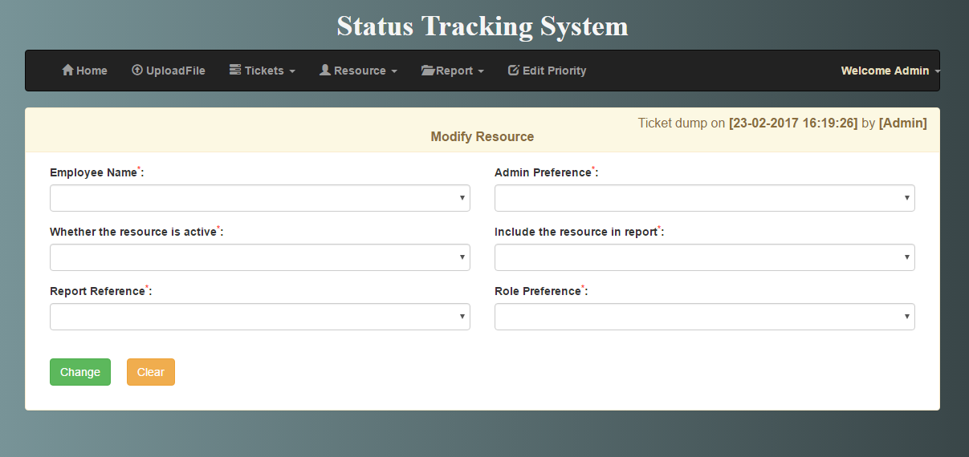
Modify resource

Slide 20
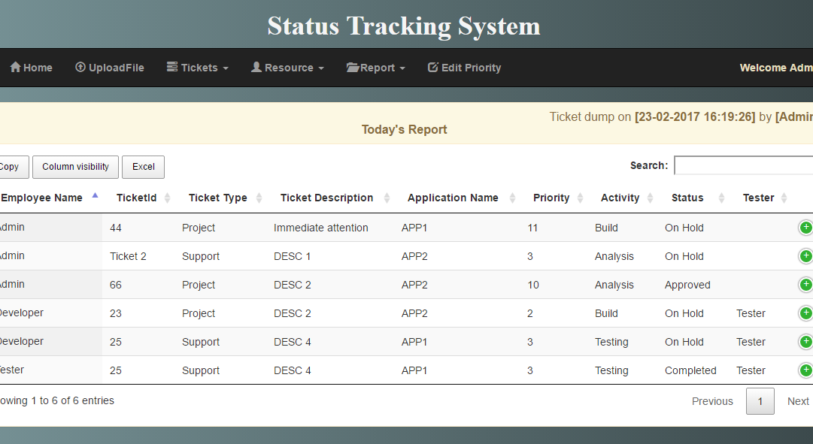
Daily Status Report

Slide 21
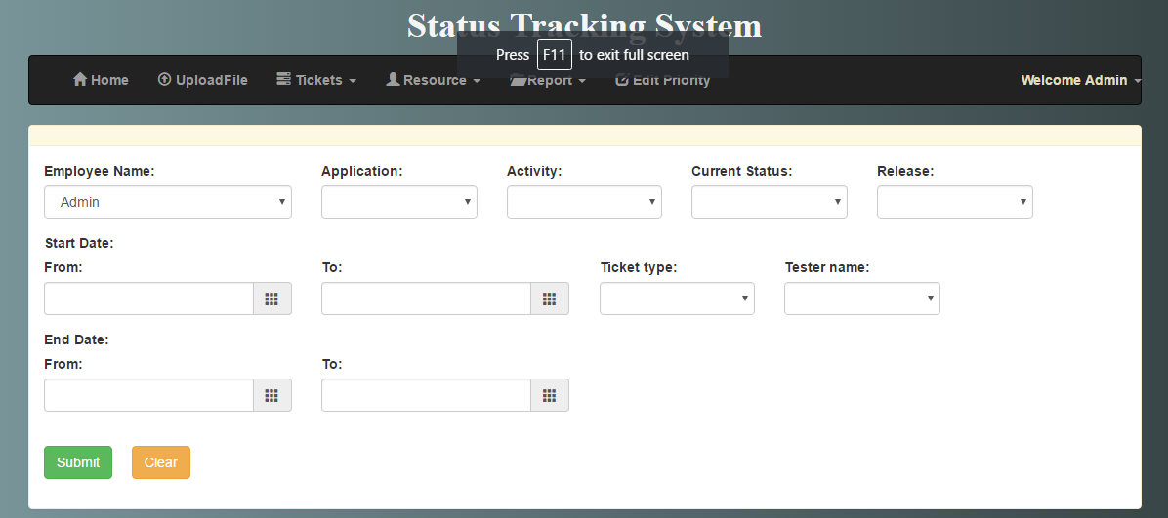
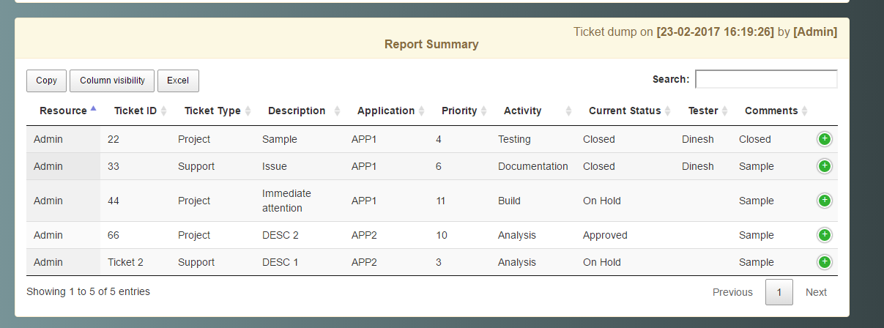
Report Summary

Slide 22
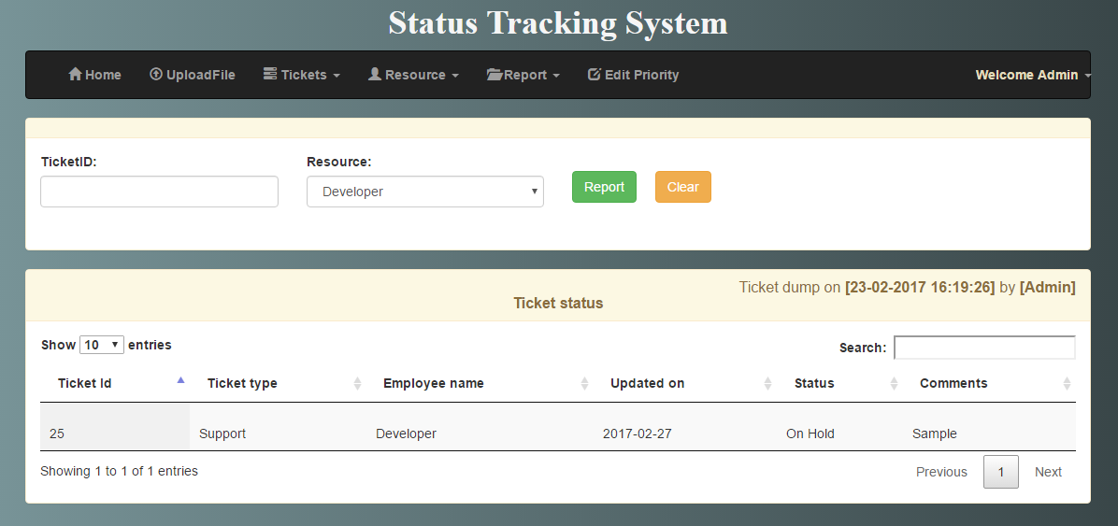
Ticket Status

Slide 23
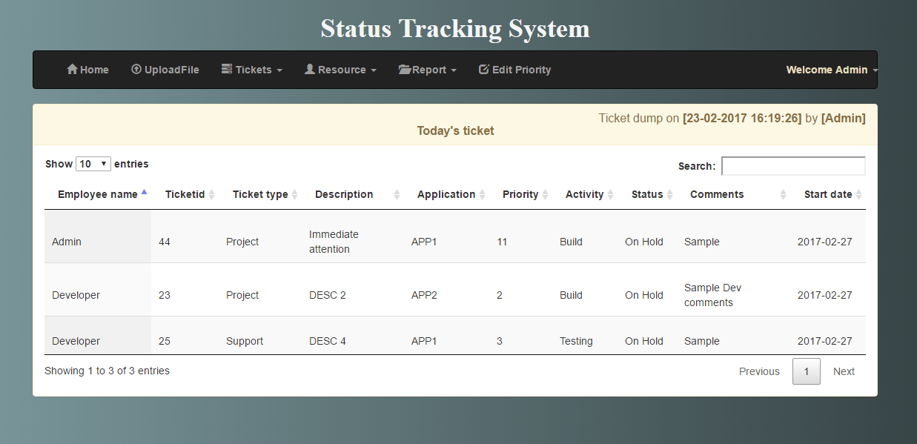
Today’s Ticket

Slide 24
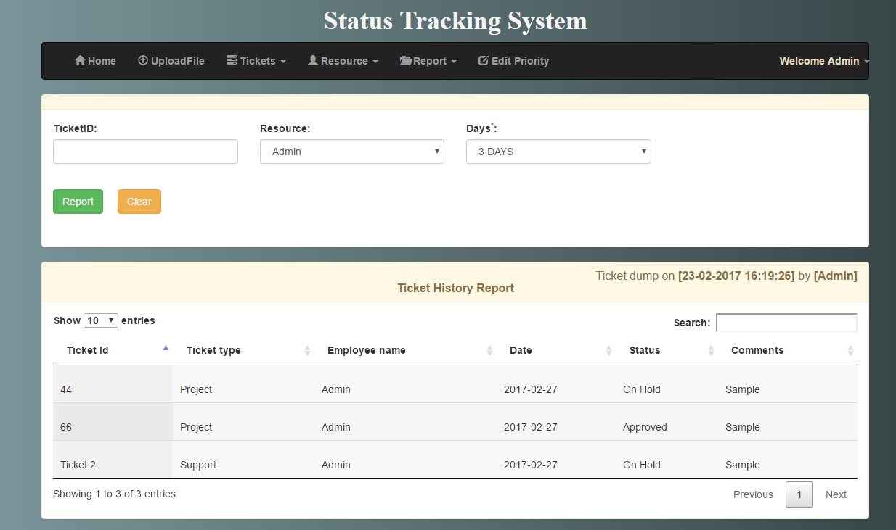
Ticket History Status

Slide 25
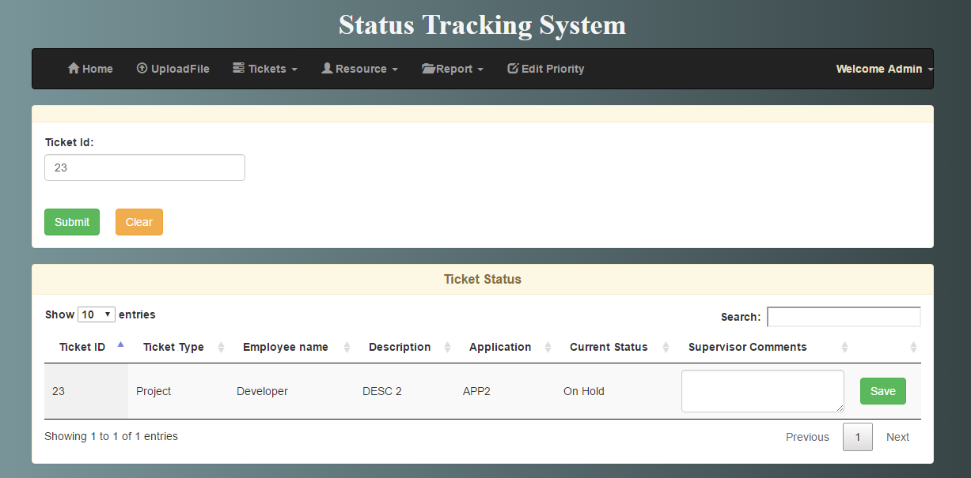
Clarification

Slide 26
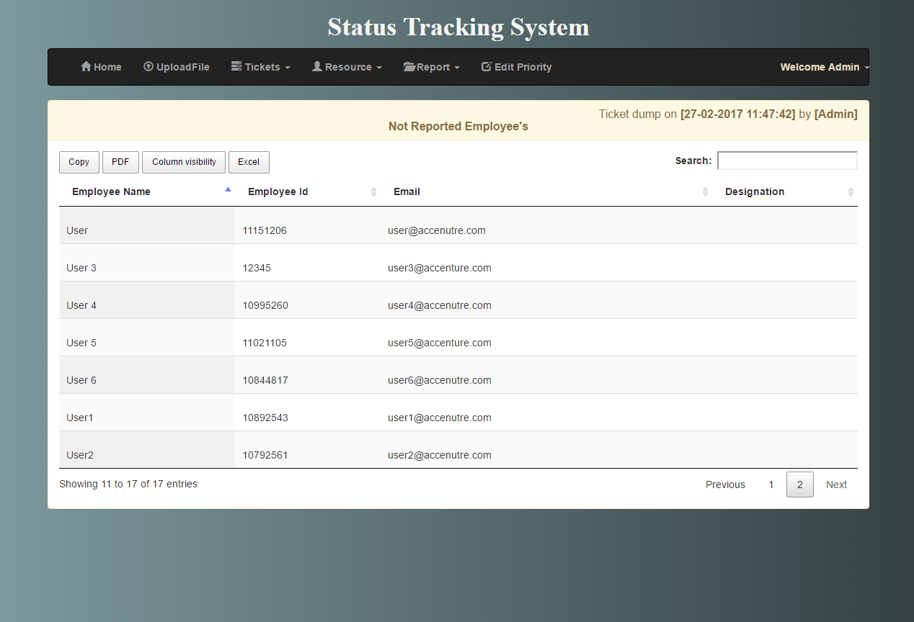
Not Reported Employees

Slide 27
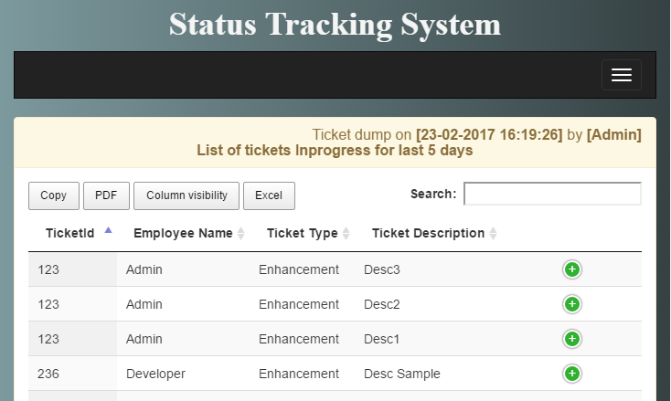
No change in status

Slide 28
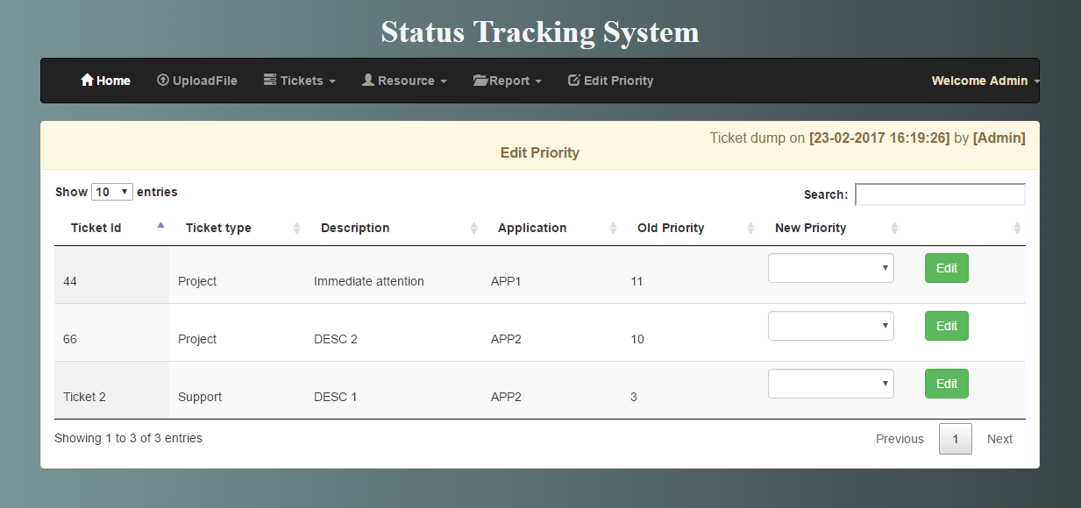
Edit Priority

Slide 29
Functionalities enabled for Developer
Keep track of all the tickets assigned to him
1
Display all the closed tickets
2
Add recently identified tickets
3
Update ticket details
4

Slide 30
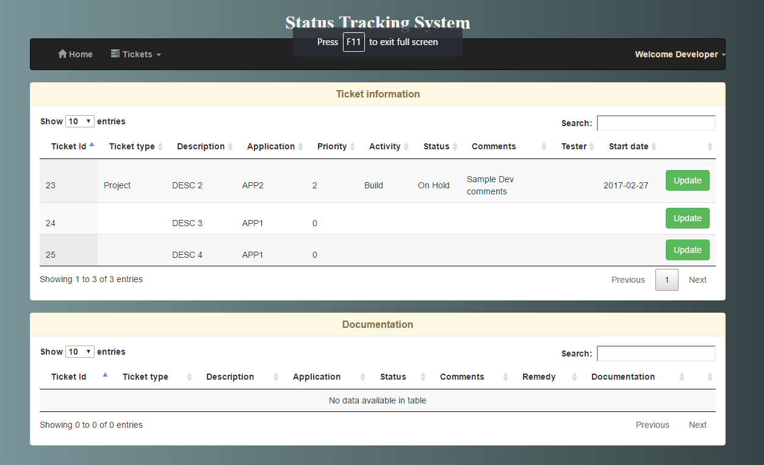
Home page of Developer

Slide 31
Functionalities enabled for Tester
Keep track of all the tickets assigned to him
1
Display all the tickets completed by him
2
Update ticket details
3

Slide 32
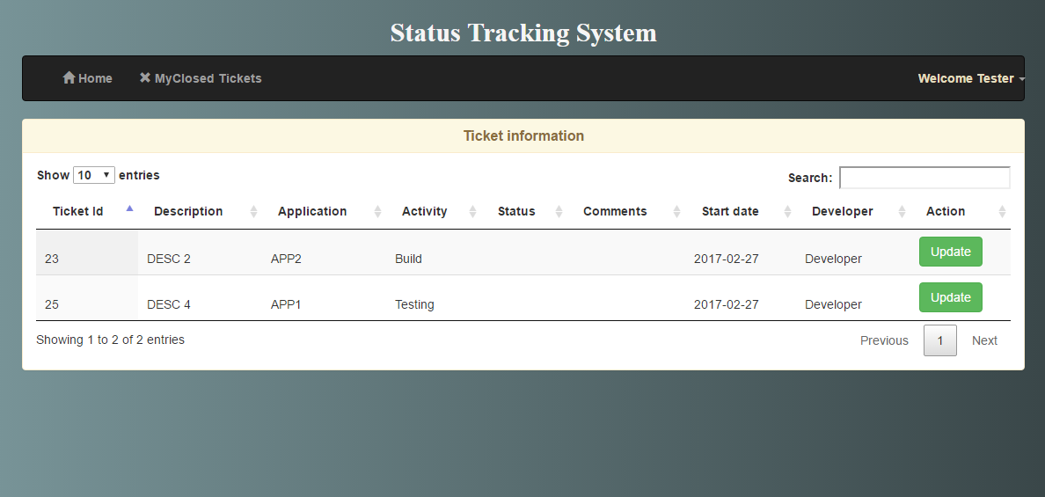
Home page of Tester

