Slide 1
Telecom Customer Management System – Use case Implemented using Angular 18 version
Register New Customer
Manage Existing Customers
Listed the existing customer details
Provided an mock modify customer information by reusing existing register form
Provided Delete feature
Provide a create customer feature from manage user for better user experience
Name
DOB
Email
Adhaar Number
Mobile Number
Choose Plan

Slide 2
Component explanations
Header-component
(To manage the menu items using model file)
Register-Customer Component
(Registration flow)
Manage-Customer Component
(Manage customer data, table, edit, delete)
General-table component
(Shared table component and it’s reusable)
Dynamic-Form component
(This will contain the dynamic form field element and it’s reusable component)
Interceptor – to handle the http request including error handling
Button.scss & Color.scss - Used for generic style and button file

Slide 3
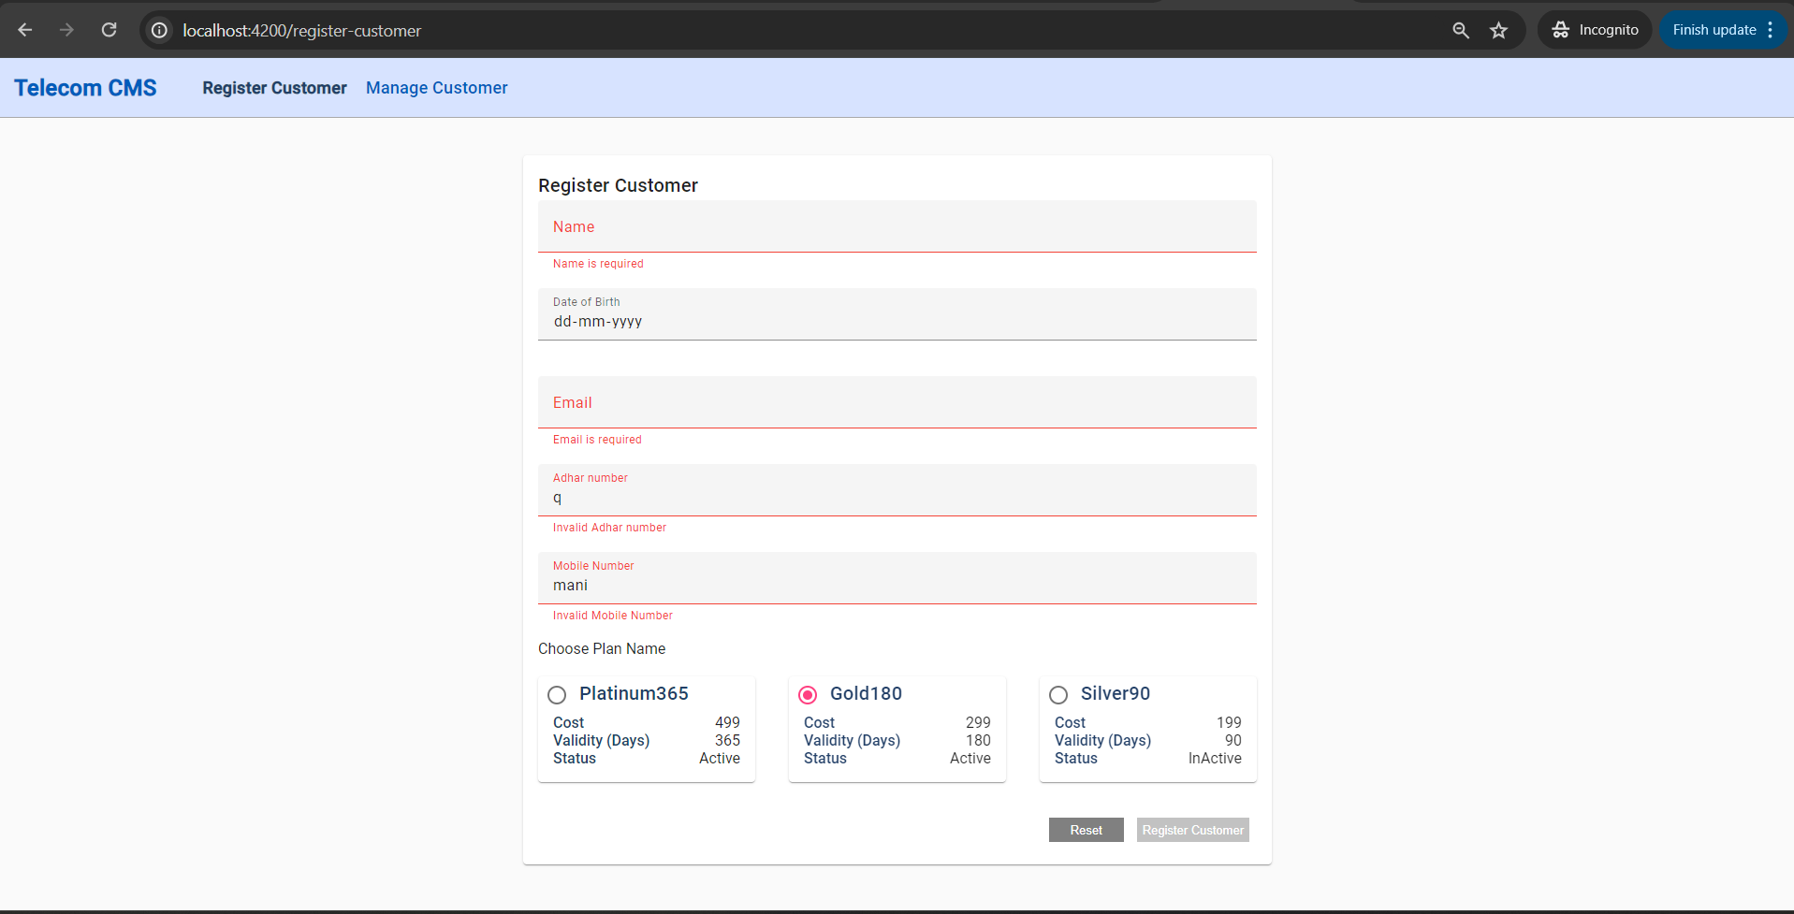
Registration

Slide 4
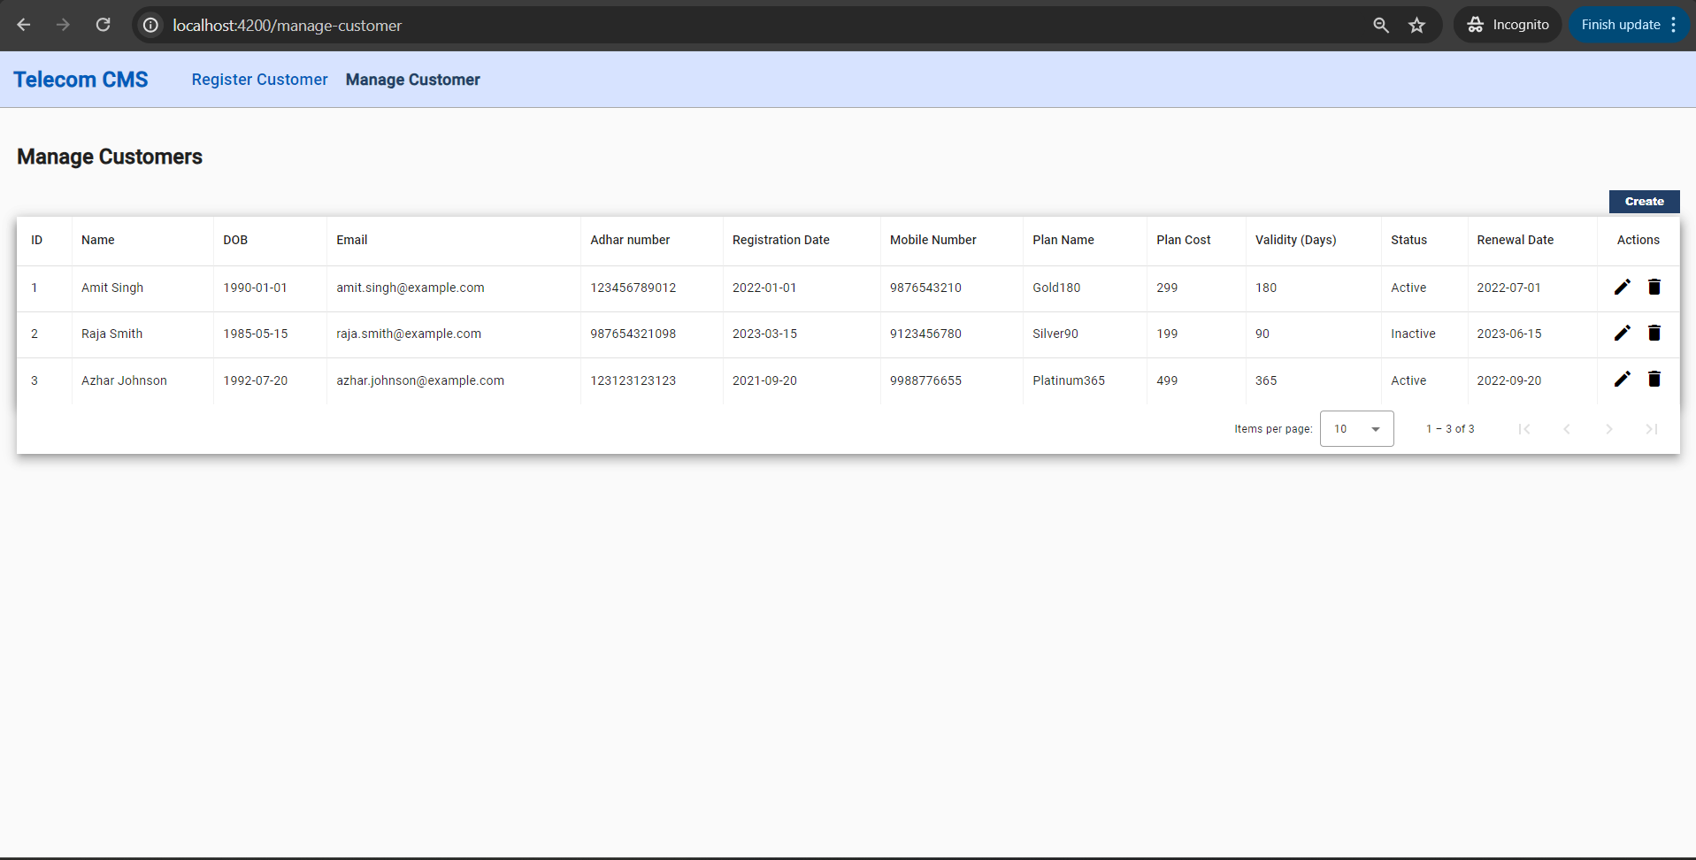
Manage Customers – List View

Slide 5
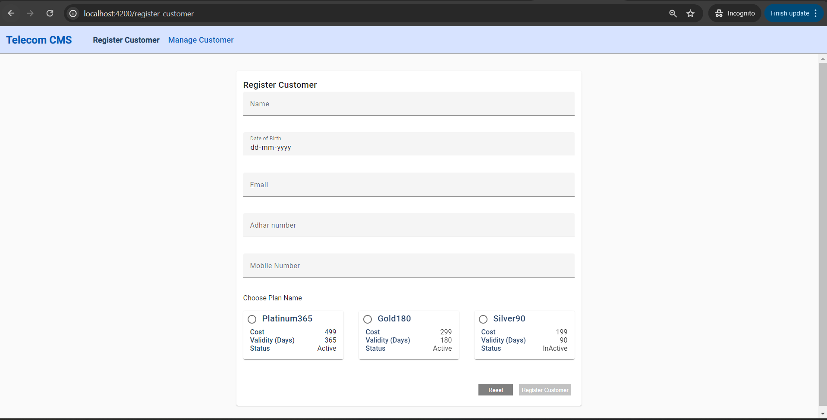
Manage Customers – Create Flow

Slide 6
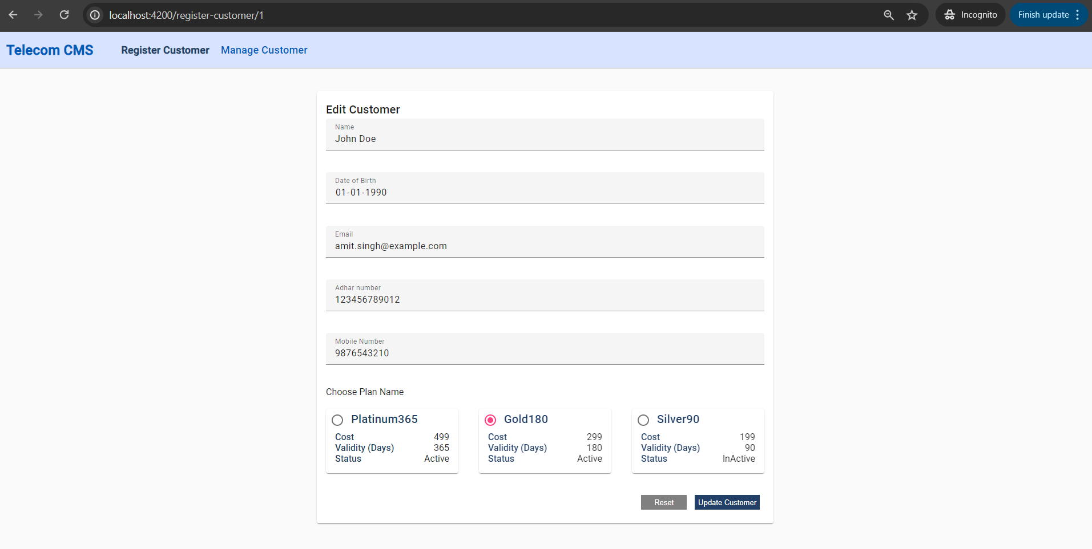
Manage Customers – Edit Flow

Slide 7
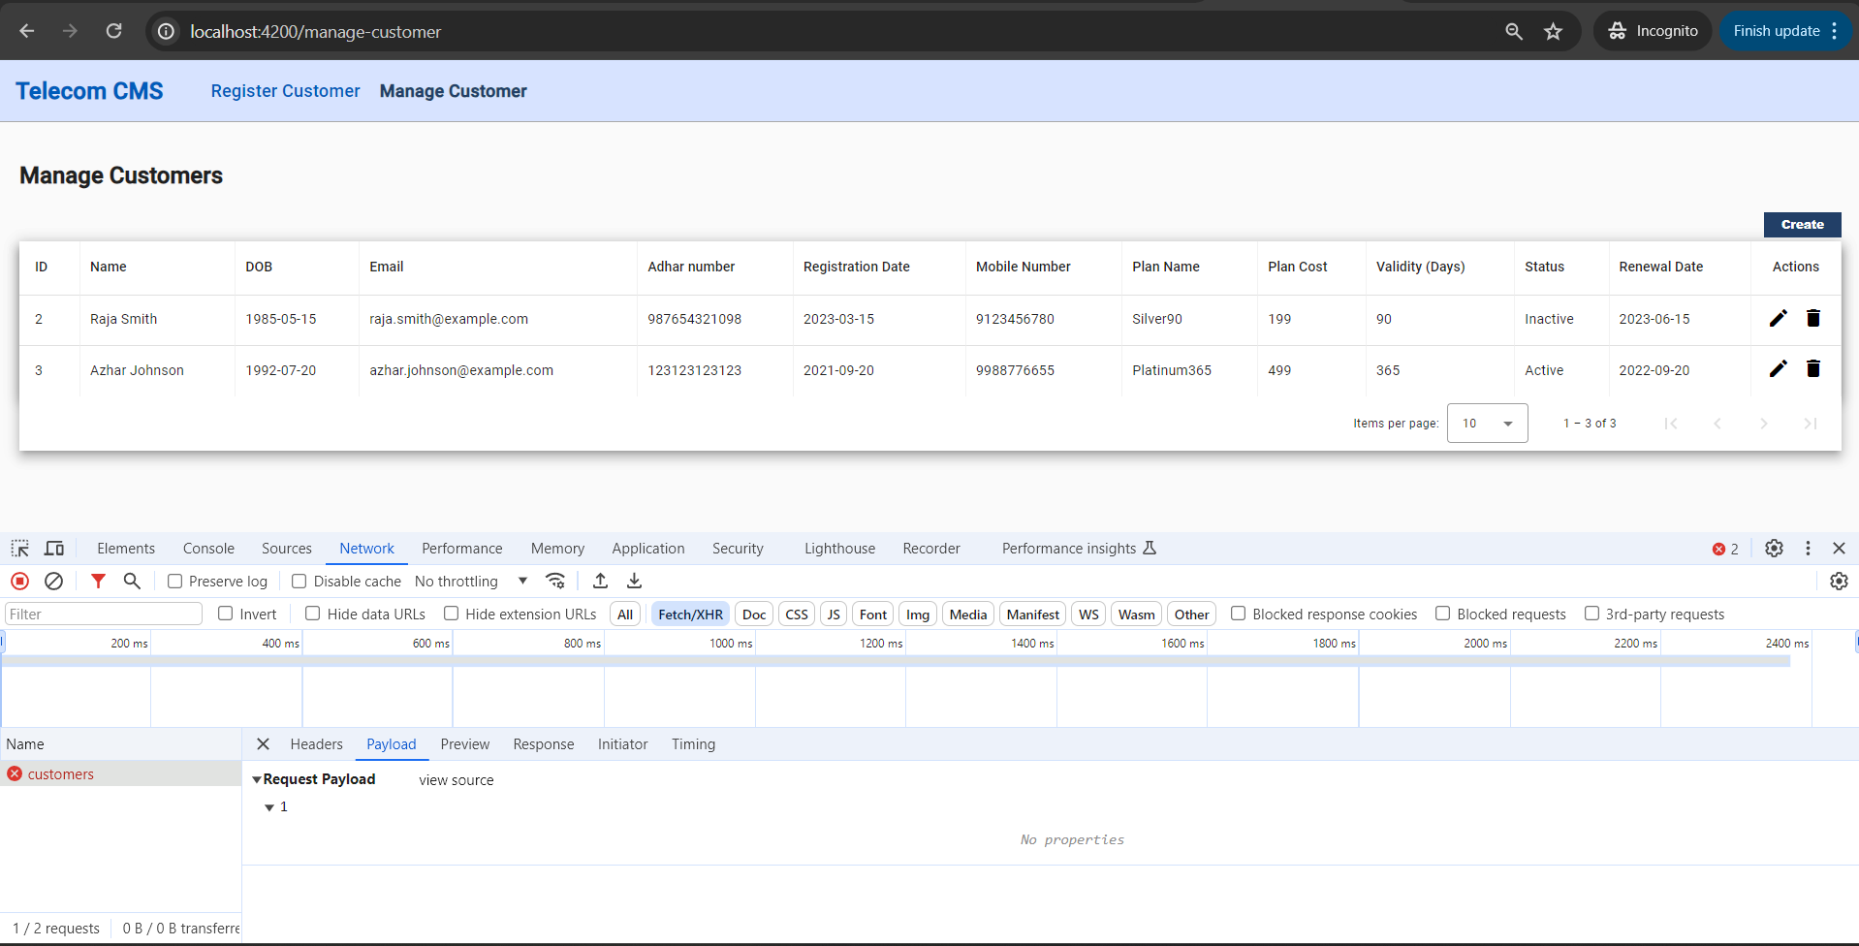
Manage Customers – Delete Flow (Mock)

Slide 8
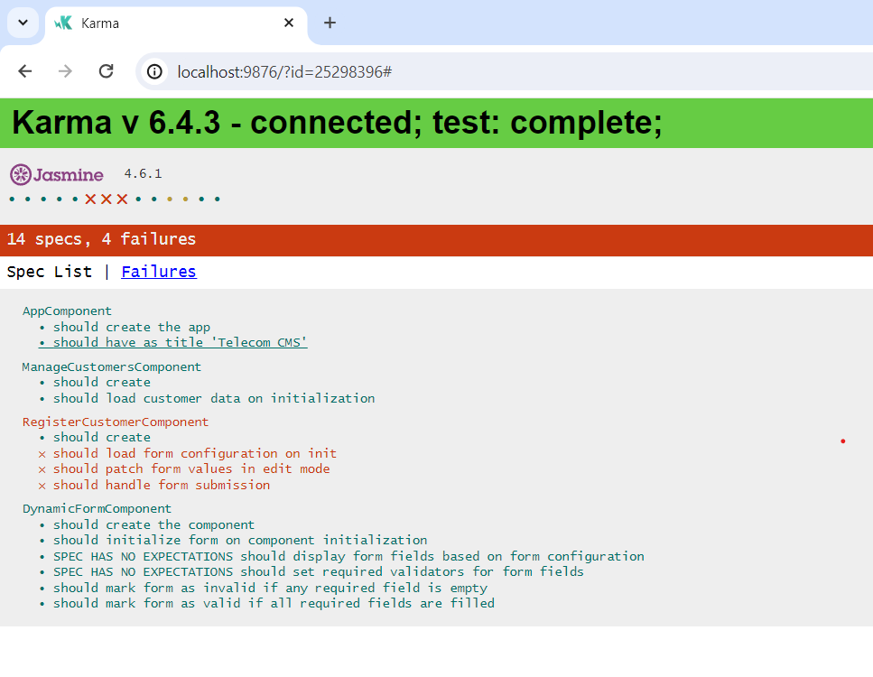
Unit Test Cases – Karma Jasmine used
Due to time constraint fully completed the 10 test cases out of 14.

