Slide 1
Cryptography Programming Assignment 2
Rohan Verma 2018A3PS059H
Prabhav Sharma 2018A3PS0337H
Manish Modwani 2018A3PS0604H

Slide 2
Introduction
A blockchain is simply a series of blocks linked together. Each block in the blockchain will have its own digital fingerprint (hash code), the previous block's digital fingerprint, and some data.
Each block not only contains the hash of the previous block, but its own hash is calculated in part from the previous hash.
Hash function exhibits a huge avalanche effect, because of this it becomes very difficult for unauthorized person to hack it.

Slide 3
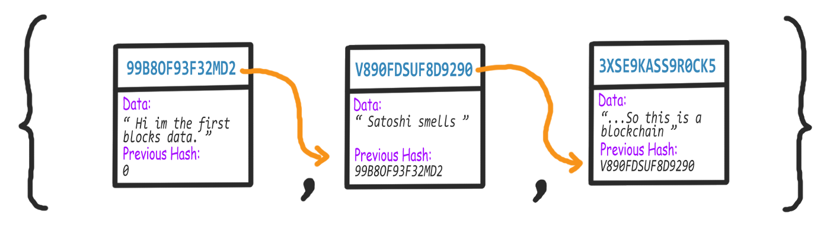

Slide 4
E-Voting Using Blockchain
E-voting systems will benefit everyone who participates in elections. It enables us to vote from anywhere and at any time.
In general, voting is a time-consuming process in which people must gather at a specific location and wait for hours in order to vote, and there will be a significant financial outlay to maintain camps and assign security for offline voting. However, e-voting assists us in overcoming these challenges.
Blockchain technology has the potential to solve the e-voting security problem. (This necessitates a significant amount of computation.)

Slide 5
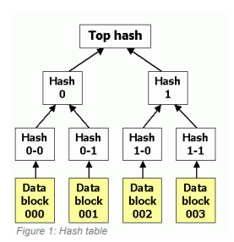

Slide 6
During this process, a voter blockchain is used to keep a record of both transactions taking place at each stage of this process for each voter: 1. Firstly, a transaction is created when a user ‘registers’. 2.
The next transaction is created when a government miner authorizes that user’s right to vote. After the correspondence is received by the user they can then await voting to open to use their credentials to vote.
It is important to note that this voter blockchain will never contain details of the vote cast by the user.

Slide 7
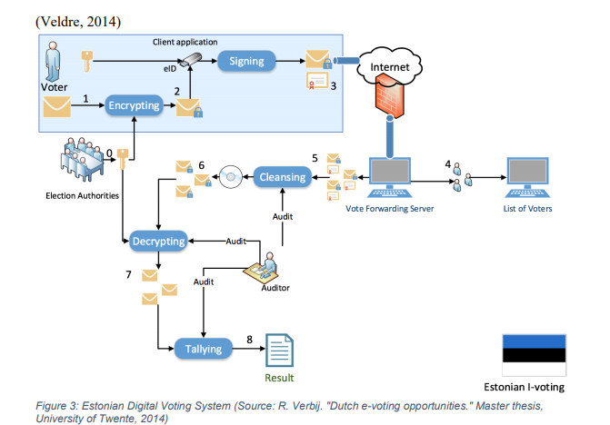

Slide 8
In this section, we create blocks that contain information such as the previous block hash code, the current block hash code, and voting information (i.e. to whom they vote).
These blocks are linked together using an array list.
In order to implement e-voting via blockchain, we will use the following functions:
createBlock()
verifyTransaction()
mineBlock()
.

Slide 9
createBlock()
This function is used to create the blocks and link them together using an array list.
Each block contains 5 variables in them:
string current hash
string previous hash
int nonce
string data
long timestamp
The hash codes are generated by the mineBlock() function and saved in the current hash variable.

Slide 10
With the help of the previous hash, each block is linked to the next, i.e. the previous block will point to the next block.
Data variables store information about voting, for example, in our case, we created four political parties with the names 1,2,3,4. So the voter can select any political party, and his selection is saved in this variable.
Nonce is associated with the invention of hashing. In the hash generation, the once variable is brute forced to get the desired number of zeroes ( here it is 5)
The difficulty variable determines the desired number of zeroes. The higher the difficulty value, the more difficult it is to mine a block.
In the mineBlock() function, we will go over nonce in greater detail.

Slide 11
mineBlock()
The hash codes are generated using this function.
This function is implemented using the SHA-256 algorithm.
SHA is an abbreviation for Secure Hash Algorithm, which is used in cryptography to generate hash codes.
This algorithm is present in security.
Message digest library of java
This function takes previous hash, timestamp, data, and nonce as input and always returns a 256 bit hash code as output.

Slide 12
verifyTransaction()
This function is used to validate the voter information using zero knowledge proof.
Zero-Knowledge Proofs (ZKPs) enable data to be validated without revealing the data itself.
We use various algorithms to implement ZKPs. The discrete logarithm algorithm is used in this case.
The function verifies the voter's x value. The function, on the other hand, only has the y value, which is equal to (g^x)mod p.

Slide 13
In this manner, the function can verify without having access to the data.
The user first chooses a random number ‘r' and sends a ‘h' value to the verifier. The verifier then sends a random bit 0/1, and the user finally sends a calculated value, which is then verified.
In our code, this happens for 5 rounds.
However, the same ‘h' values cannot be used because there is no point in running 5 rounds if all ‘h' values are the same.

Slide 14
veiwUser()
We are not using the viewUser() function here for the sake of privacy. That is, others should not know who we voted for.

Slide 15
END.

