Slide 1

Disease prediction system based on symptoms
-------------------TOPIC----------------------
PRESENTED BY- maninder singh
SECTION - a
Roll_no- 2018464
B.TECH CSE Vi SEM

Slide 2
TABLE OF CONTENTS 1. INTRODUCTION 1.1. About Disease Prediction system 1.2. About Project 2. REQURIMETS OF PROJECT 2.1. Hardware Requirement 2.2. Software Requirement 2.3. Libraries ALGORITHM/MODEL USED FOR DETECTION OUTPUT CONCLUSION

Slide 3
1.1. Introduction to Disease Prediction system
Machine learning is computer programming to optimize performance using sample data or past data. Machine learning is the study of computer systems that learn from data and experience. Prediction system and recommendation system is used to give us the maximum possible accurate output based on computers data. We are using naïve bayes algorithm and theorem in this project.
The machine-learning algorithm has two parts: training, testing. Predict disease using symptoms and patient history Machine learning technology has been striving for decades. Machine learning technology provides an immeasurable platform in the medical field for health issues to be effectively resolved. We apply machine learning to keep complete hospital data.

Slide 4
1.3. About Project
As the name suggest, Disease prediction System provides us opportunity to check or detect the various diseases based Symptoms given in datasets . It is a Machine Learning project in which we develop an algorithm which takes the different inputs in the form of symptoms and retrieve us the approximate accurate disease.
This project takes place in various steps which are given as follows:
1.Try to find datasets for this machine leaning project (from Kaggle,google dataset search etc) which will have data about various symptoms and diseases.
2.Next step is about import python libraries such as tkinter,numpy,pandas and some GUI based libraries.
3.Applying machine leaning algorithm and built and model.

Slide 5
2.1. Hardware Requirement
Device Specifications:
Processor: Intel(R) Core(TM) i5-1135G7 @ 2.40GHz 2.42 GHz
Installed RAM: 8.00 GB
System type: 64-bit operating system, x64-based processor
Window Specifications:
Edition Windows 10 Home Single Language
Version 20H2
OS build 19042.1469
2.2. Software Requirement
Latest Version of Python installed
Have Py charm installed on your computer
2.3. Libraries
Scikit-Learn (pip install scikit)
numpy
tkinter

Slide 6
Algorithm Medical disease System consists of three main modules: *Dataset searching and fetching * Working on python *Applying naïve bayes algorithm. Naïve Bayes Classifier Algorithm *Naïve Bayes algorithm is a supervised learning algorithm, which is based on Bayes theorem and used for solving classification problems. *It is mainly used in text classification that includes a high-dimensional training dataset. *Naïve Bayes Classifier is one of the simple and most effective Classification algorithms which helps in building the fast machine learning models that can make quick predictions

Slide 7

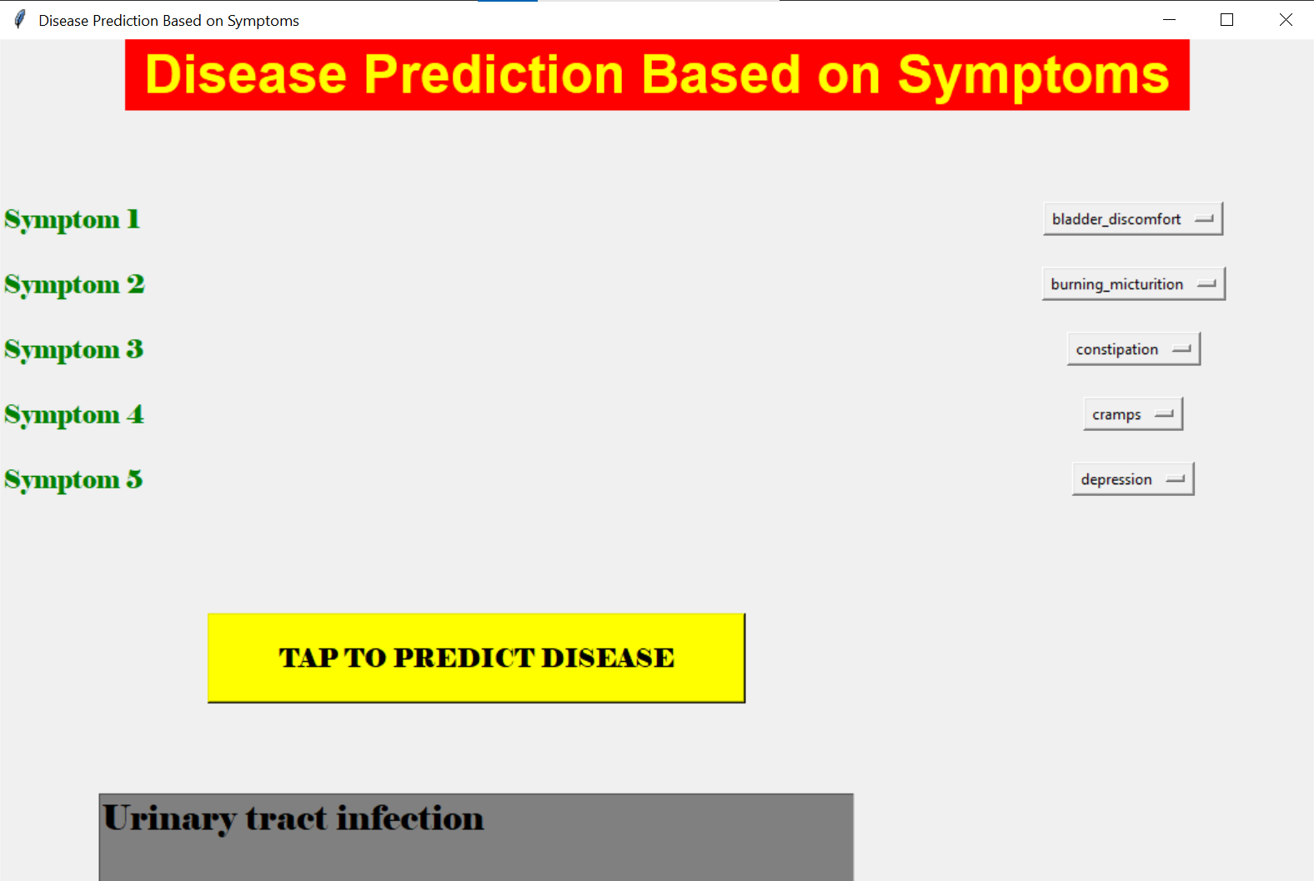
OUTPUT

Slide 8
Conclusion We have now have all the skills required to create a program that detects and recognizes the disease based on symptoms and we have successfully created our Machine Learning project that is Disease Prediction/recommendation system based on symptoms. We have successfully developed an algorithm which is working accurately and effectively in recognising a disease. Under this project we learn various aspects such as: 1]How to work on datasets for machine learning projects. 2]Model Building and use of various libraries in python. 3]Expansion in knowledge about machine leaning. 4]Knowledge of various algorithms like naïve bayes algorithm. 5]First time working on python GUI part

Slide 9
Thank you

