Slide 1


NEIL GOGTE INSTITUTE OF TECHNOLOGY
Kachavanisingaram Village, Hyderabad, Telangana 500058.
RECIPE APPLICATION USING REACT JS
DEPARTMENT OF CSE(AIML)
PRESENTED BY :
AMOGH JOSHI 245321748066
UNDER THE GUIDANCE OF:-
Mrs. M. Deepika
ASSISTANT PROFESSOR

Slide 2
Table of Contents
INTRODUCTION
EXISTING SYSTEM
PROPOSED SYSTEM
OPERATING ENVIRONMENT
FUNCTIONAL REQUIREMENTS
SYSTEM DESIGN
CONCLUSION

Slide 3

Introduction to Recipe Application
It is a ReactJS-based application designed to provide users with a seamless and interactive platform for discovering, sharing, and organizing recipes.
Explore diverse recipes, create a personalized profile, and enjoy an intuitive user experience.
Empowering users to discover, share, and organize recipes effortlessly while providing a delightful user experience.

Slide 4
Existing System
There are several apps and numerous real-time websites specialize in creating recipes and finding ingredients by searching for specific items.
Users can typically filter recipes based on dietary preferences, cuisine types, and other criteria.
Here are some of the well-known examples, ->All Recipes ->Yummly ->Super Cook etc..

Slide 5
Proposed System
Our recipe app is a revolutionary step-by-step cooking guide designed for both beginners and seasoned cooks.
Additionally, it boasts a searchable database of delicious dishes, a scaling tool to adjust servings, and a handy timer.
Whether you're a novice chef or an experienced foodie, our app provides everything you need to cook with confidence and create culinary masterpieces in your own kitchen.

Slide 6
OPERATING ENVIRONMENT
Software Requirements:
Operating System : Windows 7 (Min)
Front End : React Js , Express
Back End : Node Js , MongoDB
Hardware Requirements:
Processor : Intel CORE i5 10th gen
Speed : 2.9 GHz (Min)
RAM : 4 GB (Min)
Hard Disk : 128 GB (Min)

Slide 7
FUNCTIONAL REQUIREMENTS
User Functionality:
The user will be able to upload his own recipes
The user can search for any recipes manually
Admin Functionality:
The admin manages the website.
The admin can make changes to the website such as modifying the UI and making it more interactive than earlier.
The admin can implement a better algorithm if at all a better algorithm is created in near future.

Slide 8
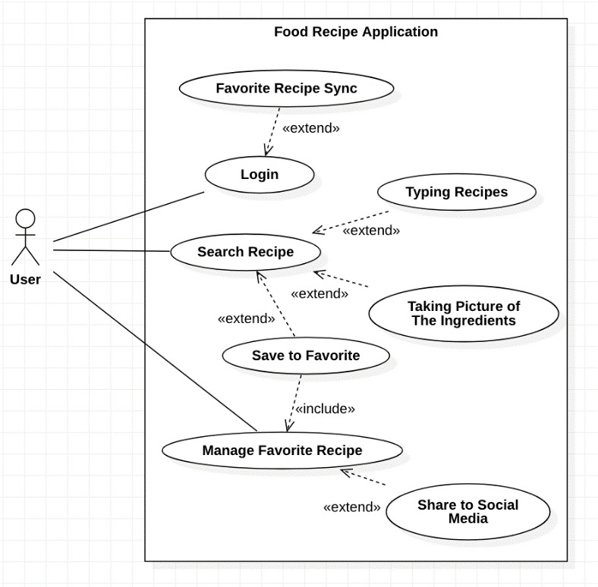
SYSTEM DESIGN
USE CASE DIAGRAM:

Slide 9
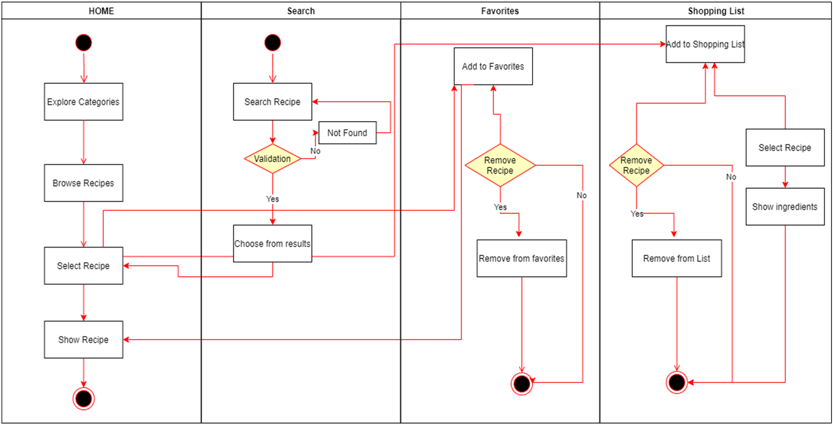
SEQUENCE DIAGRAM:

Slide 10
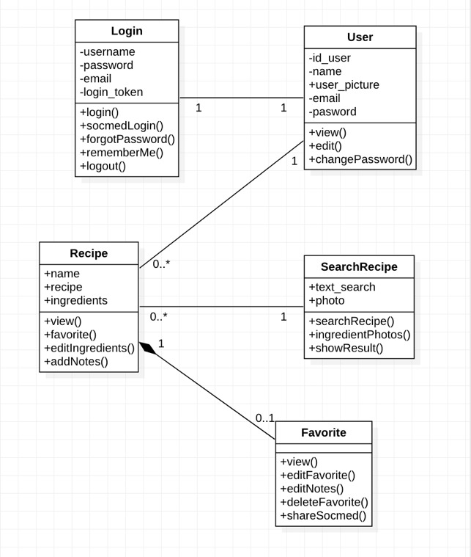
CLASS DIAGRAM:

Slide 11
Conclusion and Future Directions
1
Current Advancements
User can easily upload his own recipes and learn new recipes
User can Short List Interested Recipes
2
Future Innovations
Inclusion of Artificial Intelligence
Integration with Smart Devices
3
Industry Adoption
Increased Digital Engagement
Meal Planning and Grocery Integration

