Slide 1
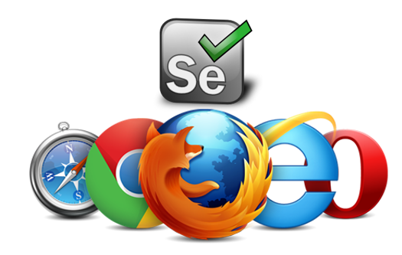
Software Testing (Automation)

Slide 2
Content
Sr. No. | Topics
1 | What is Software Testing ? And Why Automation Testing ?
2 | Software Testing Life cycle
3 | Type of Testing (Manual Testing and Automation Testing)
4 | Automation Tools
5 | Introduction to Selenium
6 | Selenium Frameworks
7 | Selenium Tools
8 | Workflow for Web Automation
9 | Introduction to Appium
10 | Workflow for Mobile Automation
11 | iOS Mobile Automation Requirements

Slide 3
What is Software Testing ?
Software Testing is a process followed after the development phase to verify whether the actual results match the expected results and to decrease the level of defects.
Why Software Testing ?
During the launch event of Windows 98 by Microsoft, the window system got crash due to a software bug.
China Airlines Airbus A300 crashed due to a software bug on April 26, 1994, killing 264 innocent live
In April of 1999, a software bug caused the failure of a $1.2 billion military satellite launch, the costliest accident in history

Slide 4
Software Testing Life Cycle
Software Testing life cycle is a sequential steps to be followed in order to perform a software testing.
Requirement Analysis
Test Planning
Environment Setup
Test Execution
Test Case Development
Test Cycle Closure

Slide 5
Software Testing
Manual Testing
Automation Testing
Software tested by manually by a Quality Analyst. QA test each module manually as per the test cases and log the bugs for the issues found while testing. No Automation tools or scripts are used while manual testing. Reporting and co-ordination with team is done manually.
Software tested by automation tools like selenium, UFT etc. is automation testing. In automation, tester writes code/scripts in different programming languages and execute according to the requirements. All the process takes place by integration different tools. Reporting and bug logging is done automatically.

Slide 6
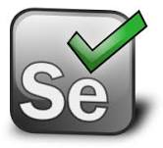






Automation Tools
Selenium
Katalon
Appium
QTP
Ranorex
IBM RFT

Slide 7
Selenium
Selenium
Selenium IDE
WebDriver
Selenium RC
Selenium Grid
Selenium is a open source automation testing suite developed by Jason Huggins in 2004.
Selenium means to automate browsers. It is design to test only web based applications and is similar to HP QTP.
Programming Languages
Java
C#
Python
Ruby
Perl
Javascript
php

Slide 8
Automation Frameworks
Module Based Testing Framework
Library Architecture Testing Framework
Data Driven Testing Framework
Keyword Driven Testing Framework
Hybrid Testing Framework
BDD Framework
- Separate and independent test scripts for each module.
- Useful in Regression of Unit or single module Testing.
- In case of changes only single module is effected.
- Common Modules are separated and used only once all over.
- Modules are dependent on each other.
- Increase the code reusability.
- Data is driven from external sources like EXCEL, TXT, CSV files.
- Useful in Regression of Unit or single module Testing.
- In case of changes only single module is effected.
- Similar to Module Based framework but uses Keywords.
- Keyworks are self guiding as to what action need to be perform.
- Single keyword is use to execute single or multiple modules.
- Combination of more than one framework.
- Separate modules are integrated with Keywords.
- External sources can also be integrated.
- Behavior Driven Development framework allows easy readable
and understandable format to BA, Developers and QA’s.
- Popular BDD framework is Cucumber.

Slide 9
Eclipse
TOOLS -1
Eclipse is an IDE (Integrated Development Environment) for programming purposes. Eclipse provide a variety in adding plugins and integration with 3rd party tools.
Java
Java is a high level programming Language used for software development. Java is a platform independent language and was developed by Sun Microsystems.
GitHub
It is repository hosting service that provides a facility to store code online and can be accessible anywhere anytime.
GitHub provides public and private Repository's.

Slide 10
Appium
TOOLS -2
Appium is an open source mobile automation tool use to test native, hybrid and Mobile web applications. Appium server can be run on iOS, Android and Windows systems.
Extend Reports
Extend report is a HTML report use to record selenium activities while automation being performed on web or on Mobile. It provides pie chart reporting and records time and machine details.
TestNG
TestNG is a testing framework developed upon an existing framework called Junit. TestNG means next generation. TestNG is use to increase the code reusability.

Slide 11
Selenium Workflow
Java
Chrome
- Maven
- TestNG
- Java Libraries
- Selenium Libraries
C#
FireFox
Python
Safari
Automation Script
Selenium WebDriver
Ruby
Opera
Perl
I E
php
Phantom JS

Slide 12
What is Xpath ?
Xpath is use to find elements in a webpage. Webpage contains different attributes for each element like ID, Name, Class etc.
Type of Xpaths?
Absolute Xpath > html/body/div[2]/div/a
Relative Xpath > //tagname[@Attribute = ‘Value’]
Relative Xpaths Type
Basic Xpath
Contains
OR & AND
Startswith & Endswith
Following, Child, Preceding

Slide 13
Selenium Action Commands
Action | Commands
Enter URL | GET
Enter text in text field | SENDKEYS
Click on button or Submit button | CLICK
Select a check box or radio button | CLICK
Select value from a drop down | SELECTBYVISIBLETEXT
Mouse Click | CLICKANDHOLD
Keyboard action | KEYBORADUP/DOWN
Upload and download files | WGET
Handling iFrames | SWITCHTO
Handle different pop-up alerts | ALERT
Generate Reports and PDF | TAKESNAPSHOT

Slide 14
Web Automation Requirements
Java
Eclipse / IntellJ / NetBeans
TestNG
Maven
Browser drivers

Slide 15
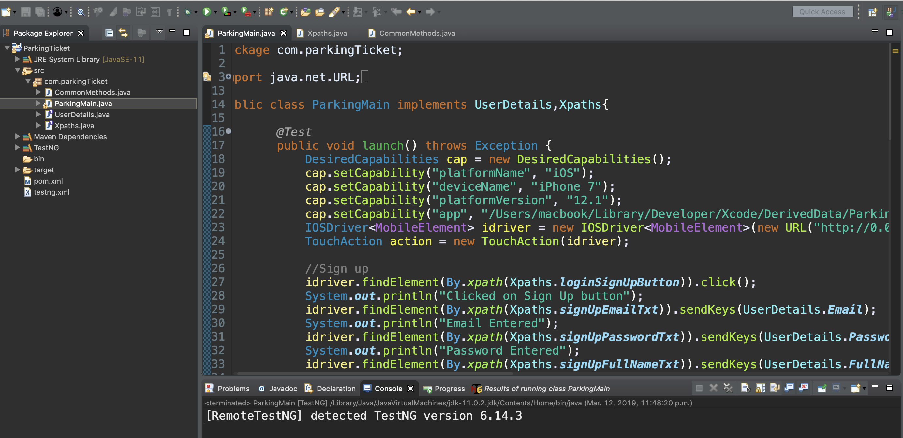
Eclipse– Selenium Framework

Slide 16
References Websites
BASICS SELENIUM
- https://www.guru99.com
- https://www.softwaretestinghelp.com
- https://www.seleniumhq.org
TESTNG INSTALLATION
- https://www.360logica.com/blog/how-to-install-testng-in-eclipse/
BROWAER DRIVERS
Chrome - https://chromedriver.storage.googleapis.com/index.html?path=80.0.3987.16/
Firefox - https://github.com/mozilla/geckodriver/releases
OperaMini - https://github.com/operasoftware/operachromiumdriver/releases
Video Reference
- https://youtu.be/ySglJIrDVMQ

Slide 17
Questions ??

Slide 18
Thank You …

