Slide 1
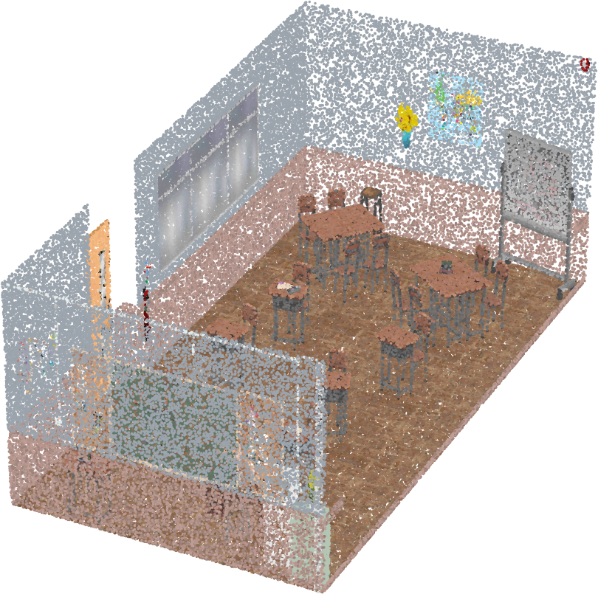
LIDAR WORKSHOP
From laser pulses to understanding
The background, the main techniques, and the algorithms behind them.
Updated 2026/11/01
Notes:
Welcome. This session is about ideas, not buttons: what LiDAR measures, how the data is cleaned, aligned, coloured and understood. Each idea has a matching tab in the LiDAR Learning Lab, so after each topic we can try it.

Slide 2
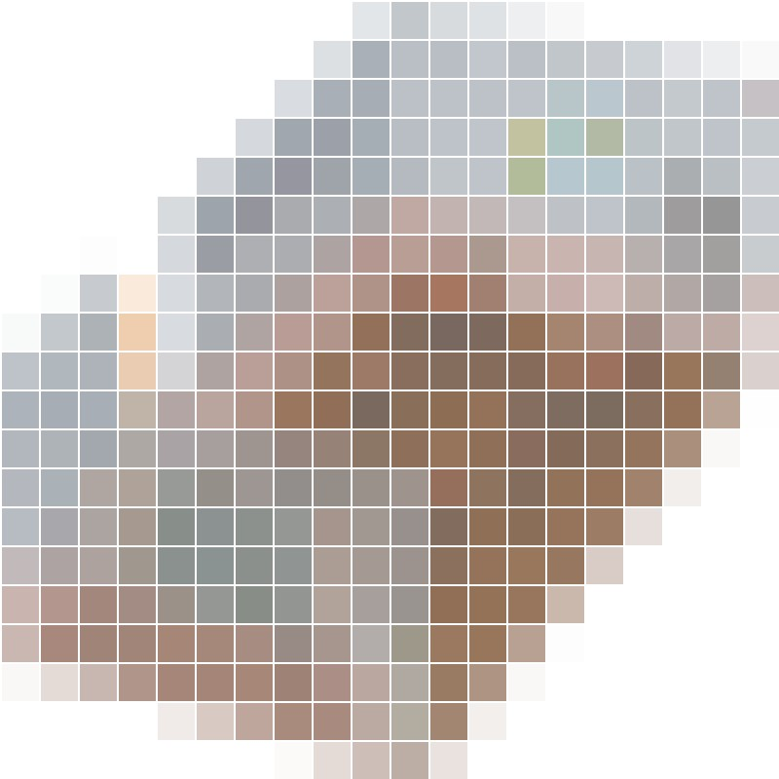
BACKGROUND
From a picture to a point cloud
add depth
Image: a 2D grid
Point cloud: a 3D set
Each cell is a pixel with a colour
Each point has a position in space
Stored as: .jpg .png .tiff
Stored as: .las .laz .e57 .ply .pcd .xyz
Each point carries
x, y, z in metres, the intensity of the return, a colour if a camera is fused
Notes:
Start with the picture: an image is a 2D grid. Every cell is a pixel and holds a colour. Now add depth. A point cloud is a collection of points whose position is represented by x, y, z coordinates. Each point can also carry intensity, colour and a time stamp. Real data is imperfect: noise, uneven density, shadows and stray points. LAS is the survey standard and LAZ is the same data compressed. E57 is an exchange format for scanners, PLY and PCD are common in research and robotics, XYZ is plain text with one point per line. It is the same room: the image only knows colour on a flat grid, the point cloud knows where things really are in space.

Slide 3
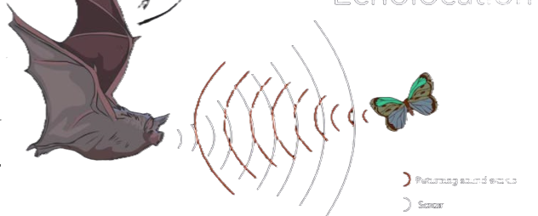
BACKGROUND
What is LiDAR?
Light Detection And Ranging
1 Light
2 Detection
3 Ranging
The laser pulse it sends out.
It catches the signal that bounces back.
From the return it gets the distance.
THE PRINCIPLE
Laser pulse sent
Like a bat's echo, but with light.
Time how long the pulse takes to come back.
LiDAR
Reflection received
Distance = speed × time / 2
67 ns means 10 m. One nanosecond is about 15 cm.
Wall
So LiDAR measures 3D shape directly
Real distances
Works in the dark
Exact positions
Metres from the return time, not a guess.
It brings its own light.
Every point has x, y, z to measure.
Notes:
Light means: the source, the laser it sends. Detection means: it detects the returning signal. Ranging means: from the return it calculates the distance. The principle is time of flight: send a short pulse, time how long it takes to come back, and distance = speed of light × time ÷ 2. The single biggest advantage: LiDAR measures 3D shape directly. A camera guesses depth from a flat picture; LiDAR brings its own light, so it also works at night. The principle is the same as a bat's echolocation: a bat sends a call, the sound bounces off an insect, and the delay of the echo tells it the distance. LiDAR does it with light instead of sound, which travels about a million times faster, so the times are nanoseconds. Diagram: Petteri Aimonen, public domain (Wikimedia Commons). The scanner sends a laser pulse. It hits the wall and some of the light reflects back. Distance equals speed of light times the travel time, divided by two, because the light goes there and back. A return after 67 nanoseconds means a wall 10 metres away; one nanosecond is about 15 cm. This repeats millions of times every second. Warning: a mirror can reflect the laser in a completely different direction, so the LiDAR receives no signal.

Slide 4
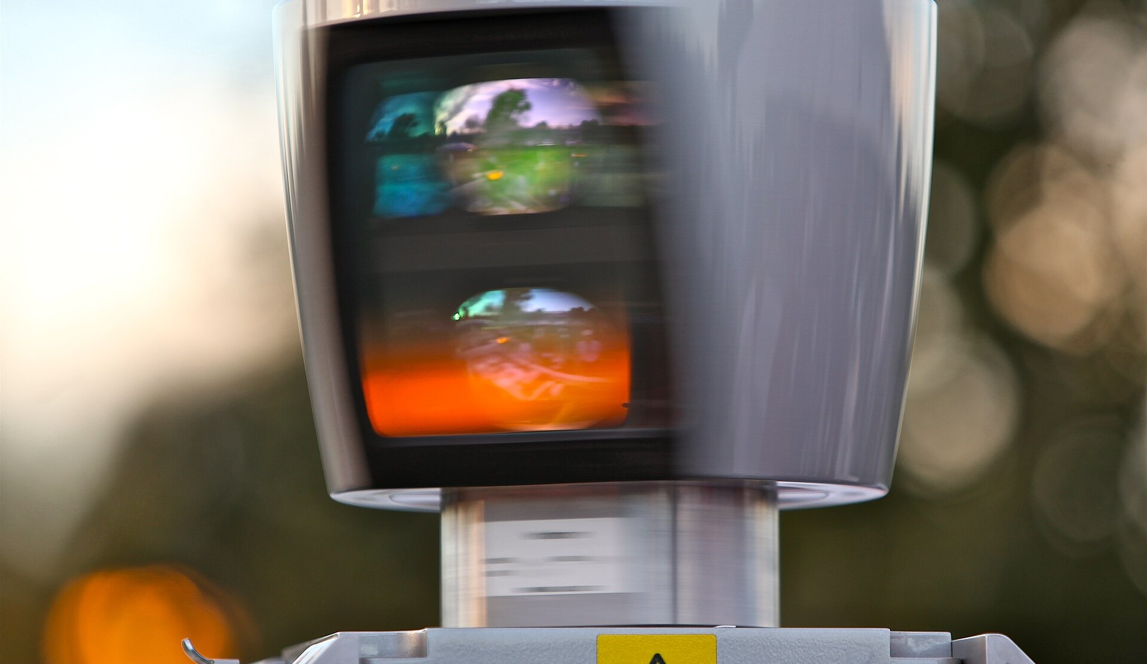
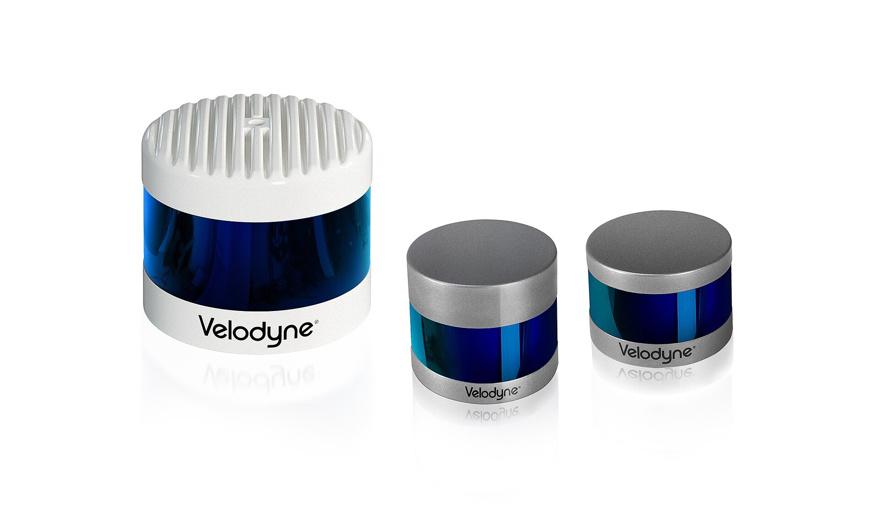
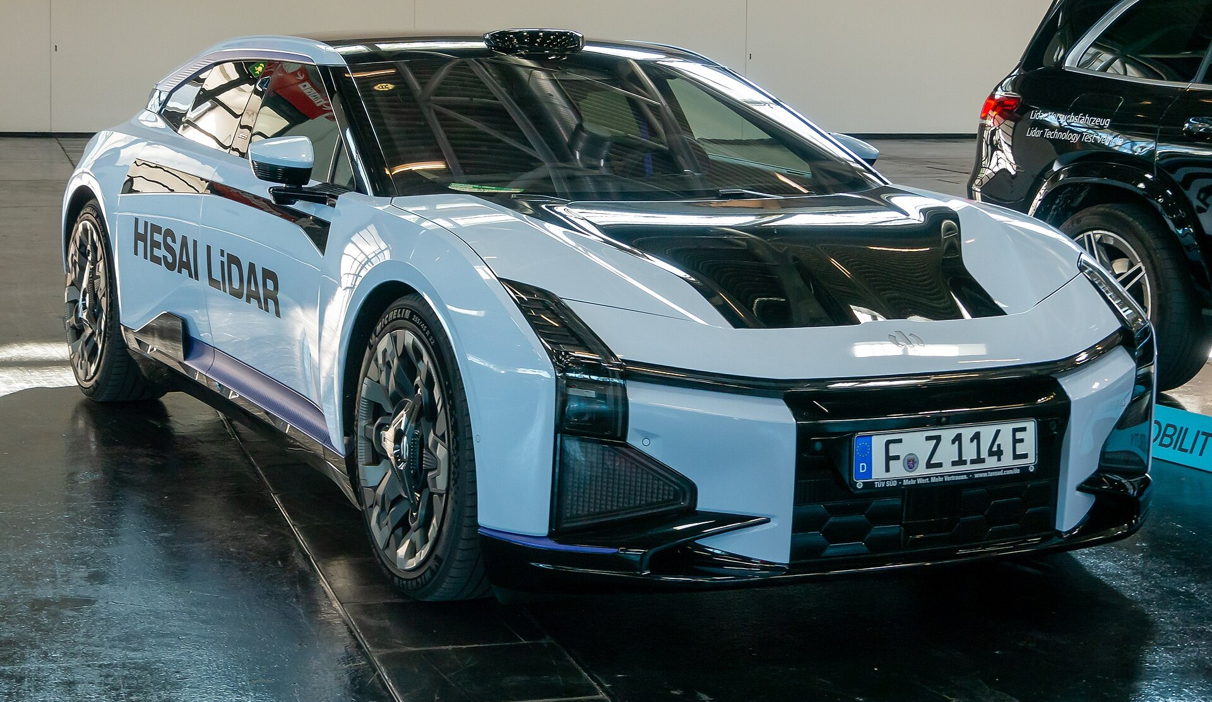
BACKGROUND
LiDAR has become cheap
2007
2018–2021
2025–2026
$75–80k
~$4k
~$200
Velodyne HDL-64E
Velodyne VLP-16 (Puck)
Hesai ATX automotive LiDAR
Photo: Steve Jurvetson, CC BY 2.0
Photo: APJarvis, CC BY-SA 4.0 (Puck family)
Photo: Matti Blume, CC BY-SA 4.0 (Hesai test vehicle)
Cheaper sensors put LiDAR in cars, robots and even phones.
Indicative historical US dollar prices. Different sensor generations and product classes, not identical specifications.
Notes:
Price becomes cheaper and LiDAR becomes mainstream. In 2007 a Velodyne HDL-64E cost about 75 to 80 thousand dollars. By 2018 to 2021 a Velodyne VLP-16 was about 4 thousand. In 2025 to 2026 an automotive LiDAR such as the Hesai ATX is about 200 dollars. These are different sensor generations and product classes, not identical specifications. Apple now puts LiDAR in phones, for example to help portrait images in low light. Photos from Wikimedia Commons: HDL-64E by Steve Jurvetson (CC BY 2.0), Velodyne Puck family by APJarvis (CC BY-SA 4.0), Hesai LiDAR test vehicle by Matti Blume (CC BY-SA 4.0).

Slide 5
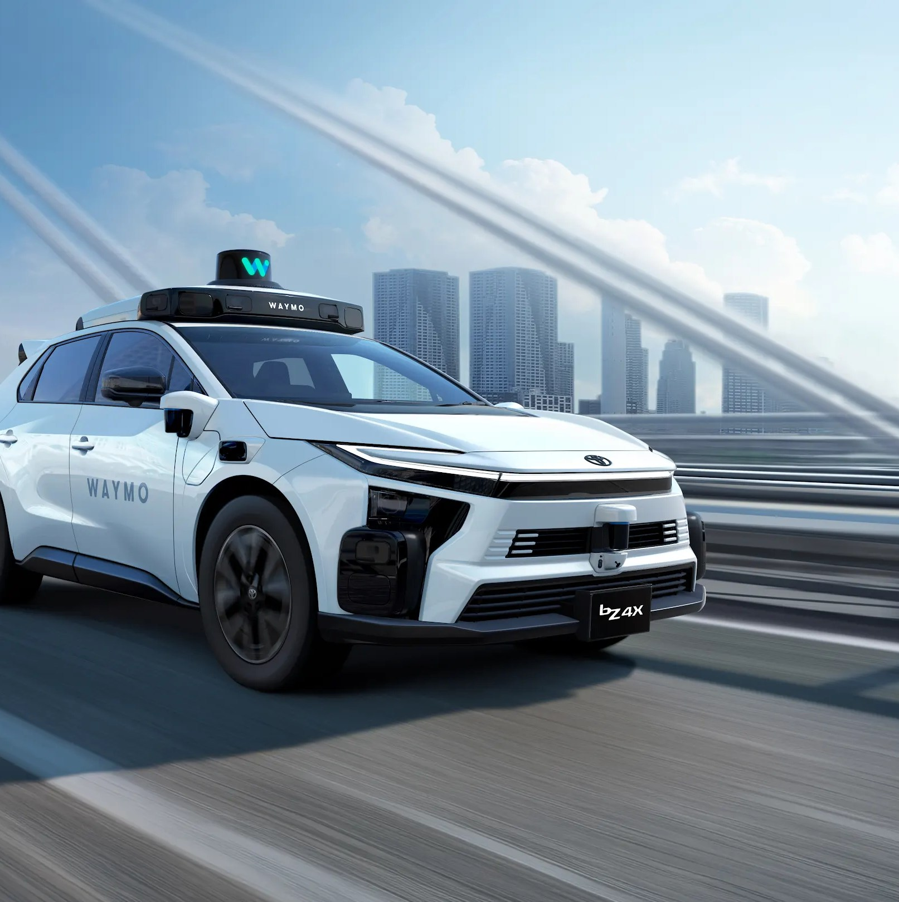
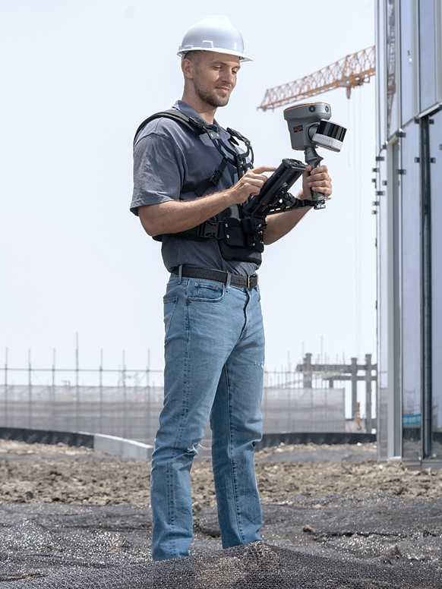
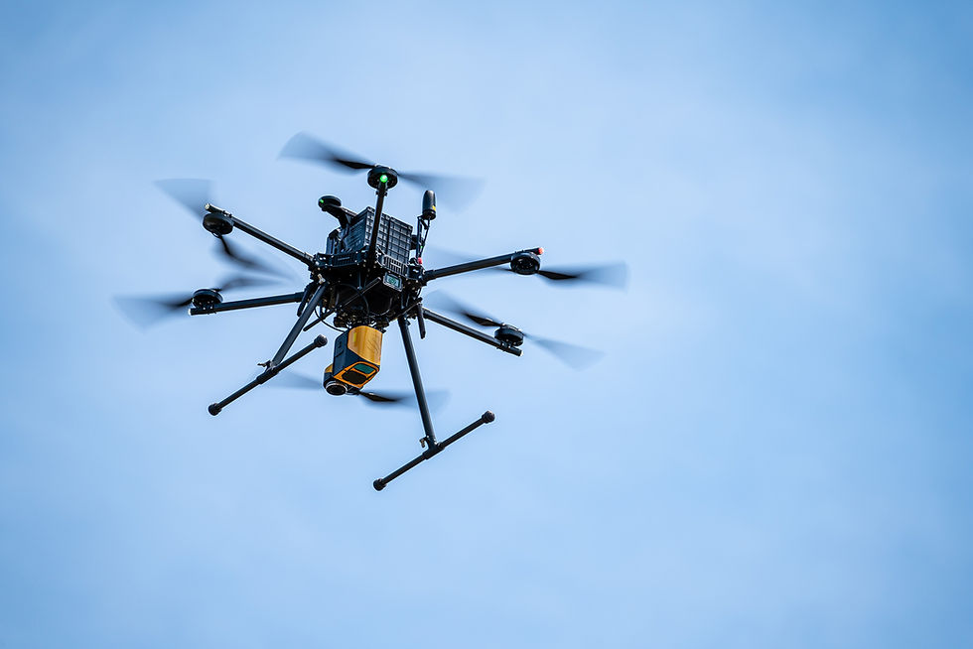
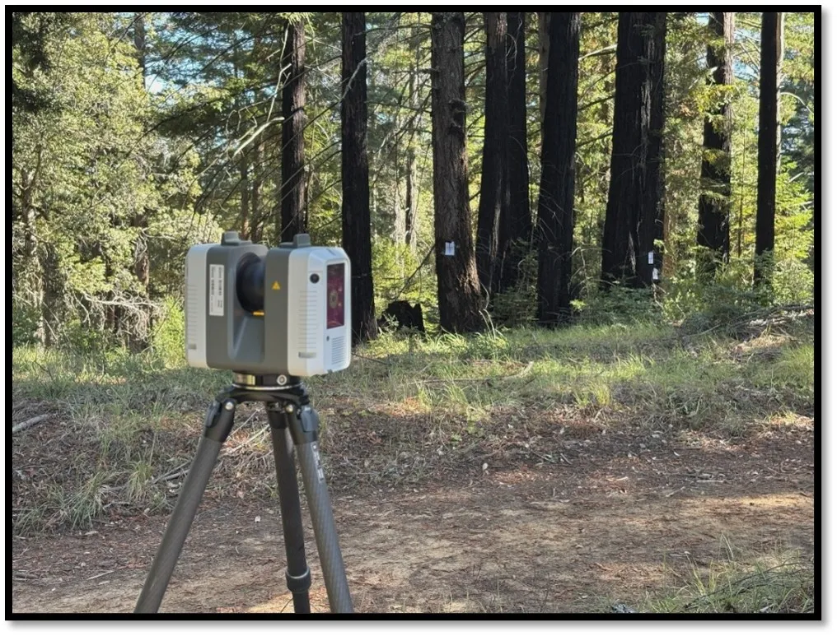
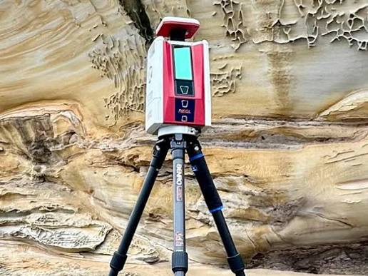
BACKGROUND
Two kinds of LiDAR: mobile and terrestrial
Mobile
Terrestrial
The scanner moves while it scans: on a vehicle, a person, a drone or an aircraft.
Large areas fast. Needs an accurate path.
A scanner on a tripod. It stays still for each scan, then moves to the next station.
Survey-grade accuracy. Slow, with blind spots.
Photo: Cargyrak, CC BY-SA 4.0, Wikimedia Commons
Photo: Ustephan, CC BY-SA 3.0, Wikimedia Commons
Notes:
Two families are enough to start. Mobile: the scanner moves, so the path must be known to place every point. Terrestrial: the scanner is static during a scan, so the data is clean but you must move and register stations. Both families use the same physics.

Slide 6
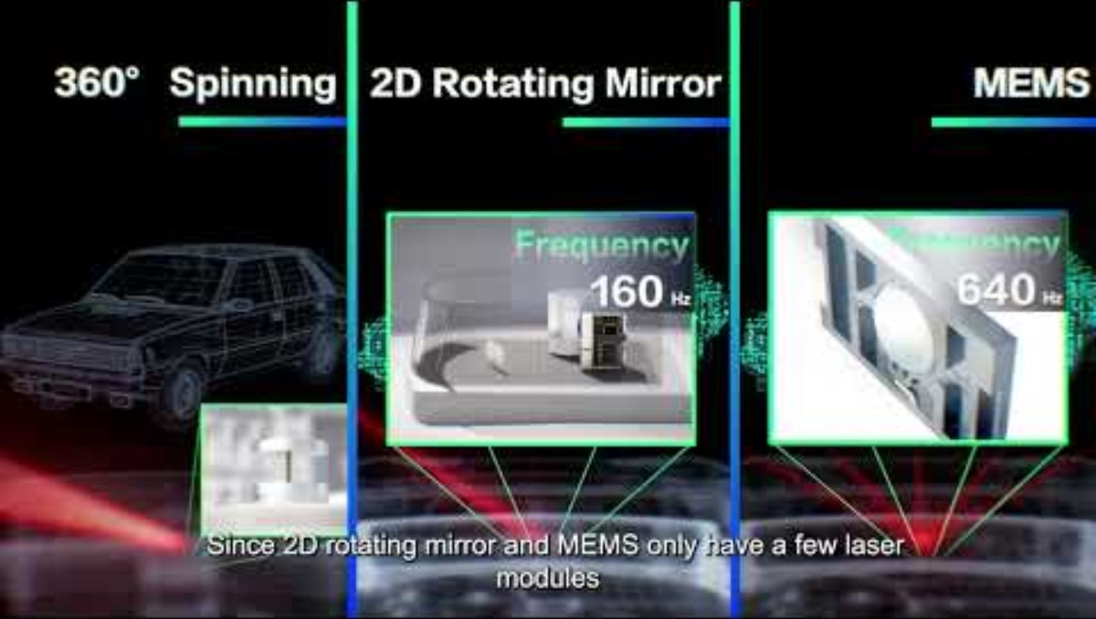
Notes:
Price becomes cheaper and LiDAR becomes mainstream. In 2007 a Velodyne HDL-64E cost about 75 to 80 thousand dollars. By 2018 to 2021 a Velodyne VLP-16 was about 4 thousand. In 2025 to 2026 an automotive LiDAR such as the Hesai ATX is about 200 dollars. These are different sensor generations and product classes, not identical specifications. Apple now puts LiDAR in phones, for example to help portrait images in low light. Photos from Wikimedia Commons: HDL-64E by Steve Jurvetson (CC BY 2.0), Velodyne Puck family by APJarvis (CC BY-SA 4.0), Hesai LiDAR test vehicle by Matti Blume (CC BY-SA 4.0).

Slide 7
SOFTWARE
Tools for working with point clouds
Tool | Good for | Price
Python/C++ | Scripts to process, a viewer to check (CloudCompare) | Free
GreenValley LiDAR360 | Full suite: forestry, terrain, mapping | ≈ US$4,200, modules ≈ US$2,100 each
Leica Cyclone REGISTER 360 | Registers terrestrial scans | ≈ US$2,650 a year
Autodesk ReCap Pro | Scan clean-up for Autodesk workflows | ≈ CA$535 a year
Agisoft Metashape | Photos to 3D (photogrammetry) | US$179 or US$3,499
Prices are what vendor and reseller pages listed in 2026. They change, so confirm before buying.
Notes:
There are many tools. The paid suites are polished and supported, and several are specialised: LiDAR360 for forestry and terrain, Cyclone REGISTER 360 for joining terrestrial scans, ReCap for Autodesk users, Metashape for photogrammetry. Prices come from reseller and vendor pages and vary by licence type, region and module. Open source: CloudCompare, Open3D, PDAL.

Slide 8
SOFTWARE
Why Python and CloudCompare come first
Free
Repeatable
How they split the work
No licence to buy. Everyone can follow along.
A script treats 1 scan or 1,000 the same way.
Python processes: filter, register, segment, batch.
CloudCompare looks: inspect, measure, compare.
Transparent
Joins AI
You see every step, so you learn what it does.
NumPy, PyTorch and the rest work on the same arrays.
Notes:
The argument is not that paid tools are bad. It is that code plus a free viewer teaches you the ideas, scales to any amount of data, and never expires. Open3D handles registration, filtering and meshing in a few lines; CloudCompare is the quickest way to look at a result and measure distances between clouds. Keep a paid suite in mind for formal deliverables.

Slide 9
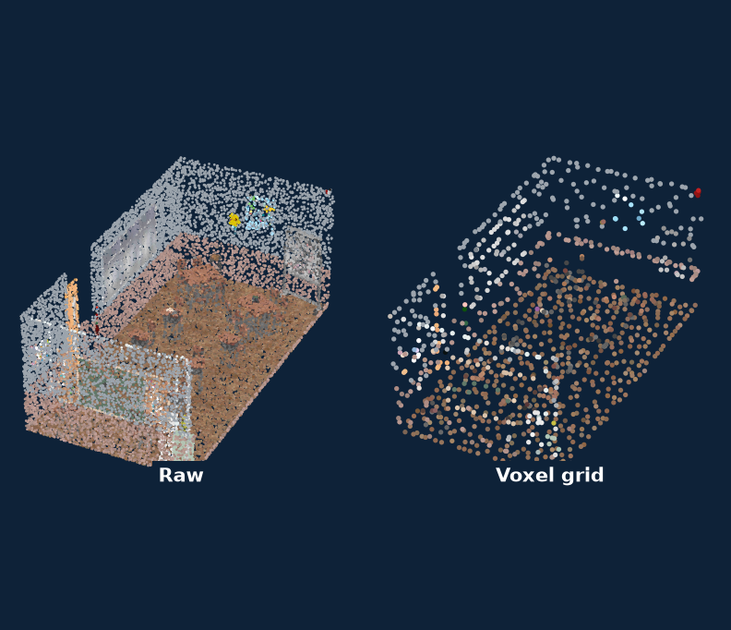
TECHNIQUE · CLEANING
Point cloud processing
Raw scans are huge and noisy. Processing thins and cleans them so every later step is fast and reliable.
Algorithm | What it does | Good for
Voxel grid filter | Keeps one point per cube | Even density, big speed-ups
Statistical outlier removal | Drops points far from neighbours | Stray points, dust and rain
Radius outlier removal | Drops points with few close neighbours | Sparse noise at long range
PCA normal estimation | Fits a plane to each neighbourhood | Surface direction, shading
KD-tree and octree | Find neighbours quickly | Every step that follows
Classroom scan from the Learning Lab
Notes:
These are the standard first steps in Open3D, PCL and CloudCompare. Voxel size and neighbour counts are the two settings that matter most.

Slide 10
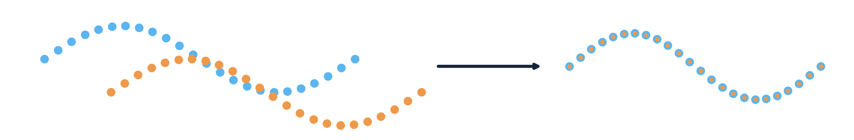
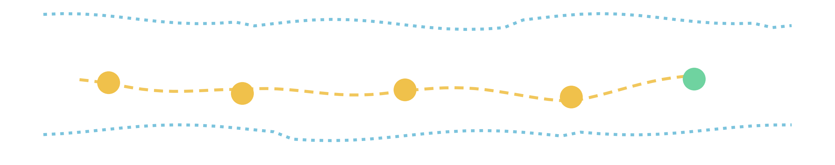
TECHNIQUE · ALIGNMENT
From registration to SLAM
Point cloud registration
Two unaligned scans
Aligned scans
SLAM: continuous registration + position estimation + mapping
Aligned scans + estimated trajectory
Notes:
Registration lines up two scans of the same place. SLAM does it continuously while the scanner moves: every new scan is registered to the map so far, which also gives the position of the scanner (S1 to S5). The result is aligned scans plus the estimated trajectory.

Slide 11
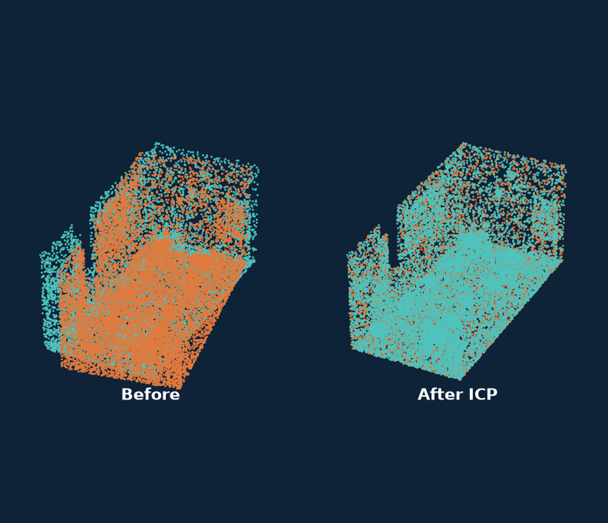
TECHNIQUE · ALIGNMENT
Registration
Registration finds the rotation and shift that places one scan in the frame of another, so several scans become one model.
Algorithm | What it does | Good for
ICP, point-to-point | Match nearest points, solve, repeat | Fine alignment from a rough start
ICP, point-to-plane | Uses surface normals | Walls and floors, converges faster
Generalized ICP (GICP) | Matches small surface patches | Noisy indoor scenes
NDT | Fits the scan to a grid of Gaussians | Large outdoor scans
FPFH + RANSAC | Matches 3D features, no start needed | Coarse alignment of far-apart scans
Classroom scan from the Learning Lab
Notes:
A common recipe is global registration first (FPFH with RANSAC), then ICP to refine. ICP alone gets stuck in a wrong local minimum if the start is poor.

Slide 12
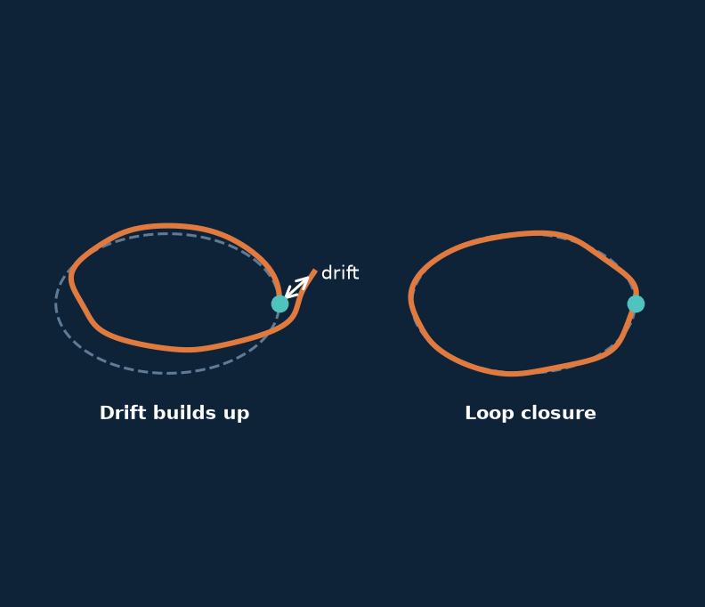
TECHNIQUE · MAPPING
LiDAR SLAM
SLAM estimates the path of a moving scanner and builds the map at the same time, so mobile scans land in one frame.
Algorithm | What it does | Good for
LOAM and LeGO-LOAM | Track edge and plane features | Cars and robots, spinning LiDAR
FAST-LIO2 | Fuses LiDAR and IMU directly | Fast motion, drones, Livox
LIO-SAM | LiDAR, IMU and GNSS in a factor graph | Long routes with little drift
KISS-ICP | Plain ICP with motion prediction | A simple, robust baseline
Cartographer | Submaps with loop closure | Indoor and backpack mapping
Classroom scan from the Learning Lab
Notes:
Drift builds up along a path. Loop closure, recognising a place you have been before, pulls the map back into shape. Pick by sensor and motion: Livox with fast motion suits FAST-LIO2, a car with GNSS suits LIO-SAM.

Slide 13
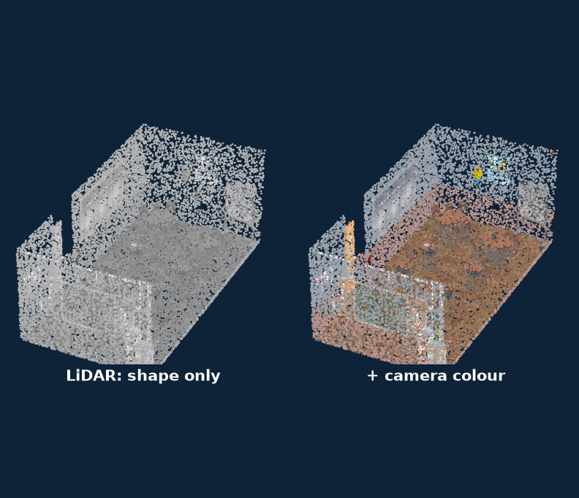
TECHNIQUE · COLOUR
LiDAR and camera fusion
LiDAR gives exact shape and a camera gives colour. Fusion projects each point into the image, after calibrating the two.
Algorithm | What it does | Good for
Zhang’s method | Camera lens model from a checkerboard | Step one: camera intrinsics
PnP with RANSAC | Camera pose from 3D to 2D matches | LiDAR to camera extrinsics
Target-based calibration | A board seen by both sensors | Reliable, done in a workshop
Edge or mutual-information alignment | Matches image and LiDAR edges | Targetless, on-site recalibration
Z-buffer colouring | Keeps the nearest point per pixel | No colour leaking through walls
Classroom scan from the Learning Lab
Notes:
Check the result on sharp edges such as door frames: a few pixels of calibration error show as colour bleeding past the edge.

Slide 14
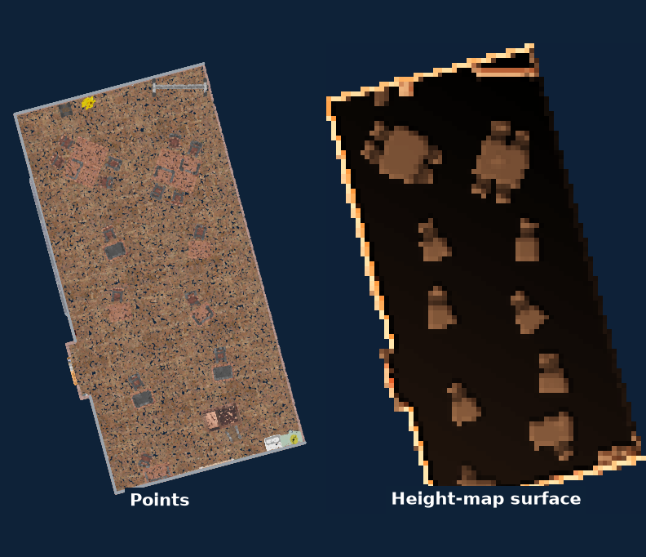
TECHNIQUE · SURFACES
Surface reconstruction
Meshing turns points into a continuous surface of triangles that is easy to render, measure and simulate with.
Algorithm | What it does | Good for
Poisson reconstruction | Solves for a smooth, watertight surface | Objects and rooms with normals
Ball pivoting | Rolls a ball over the points | Clean, dense scans with fine detail
Alpha shapes and Delaunay | Triangulate between neighbours | Terrain and 2.5D surfaces
Marching cubes on a TSDF | Extracts a surface from a distance grid | Depth cameras, KinectFusion style
Greedy projection triangulation | Fast local triangles in PCL | Quick previews
Classroom scan from the Learning Lab
Notes:
A mesh is an interpretation. Poisson smooths over holes, which is good for pretty models and risky for measurement. Ball pivoting leaves holes where data is missing, which is honest.

Slide 15
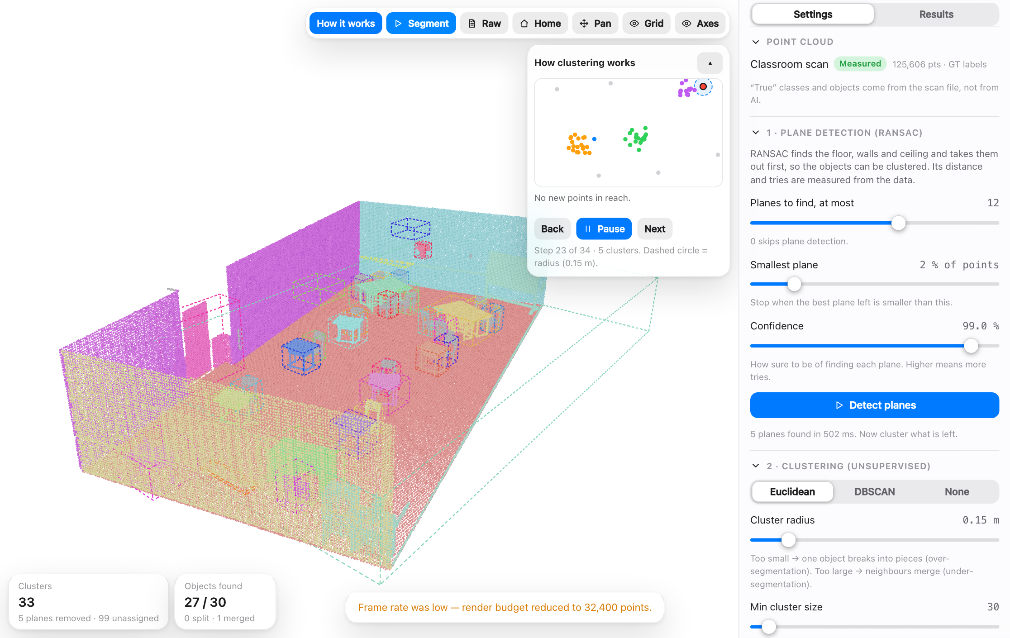
TECHNIQUE · UNDERSTANDING · UNSUPERVISED
Unsupervised: group points without labels
No answers are given: the algorithm groups what is close or similar. A person then names each group.
Algorithm | What it does | Good for
RANSAC plane fitting | Finds the plane most points agree with | Floor, walls, ceiling first
Euclidean clustering | Joins points closer than a radius | Separating objects
DBSCAN | Grows through dense areas, leaves noise out | Uneven density, strays
HDBSCAN | DBSCAN over many radii, no single radius | Groups of different density
K-means | Splits into k groups around centres | Quick, known number of groups
Region growing | Spreads over similar surface direction | Walls, roofs, flat parts
Unsupervised Learning tab: clustering replayed step by step on the classroom scan
Notes:
No labels are given. The algorithm only looks at the geometry. RANSAC takes out the floor and walls, then clustering groups the points that belong together. A person still has to name each cluster. Euclidean clustering and DBSCAN are what the lab uses; K-means needs the number of groups in advance; HDBSCAN removes the single radius setting; region growing follows surface direction. In the lab, the Unsupervised Learning tab replays the grouping step by step.

Slide 16
TECHNIQUE · UNDERSTANDING · SUPERVISED
Supervised: learn from labelled examples
The same three jobs for images and for point clouds. Existing models, trained on large labelled data sets.
Job | The question | Images | Point clouds
Classification | What is it? One answer for the whole input | ResNet, EfficientNet, ViT | PointNet, PointNet++, DGCNN
Detection | What and where? A box around each object | YOLO, Faster R-CNN, DETR | PointPillars, SECOND, PV-RCNN, CenterPoint
Semantic segmentation | Which class is each pixel or point? | U-Net, DeepLab, SegFormer | KPConv, RandLA-Net, MinkowskiNet, Point Transformer
Instance segmentation | Which object is each pixel or point? | Mask R-CNN | PointGroup, Mask3D, SoftGroup
Typical data: SemanticKITTI, ScanNet, nuScenes. A box is 4 numbers on an image and 7 in 3D (centre, size, heading).
Notes:
Supervised learning gives every example its right answer, and the model learns to reproduce it. There are three main jobs. Classification gives one answer for the whole picture or cloud. Detection says what and where: a 2D box on images, a 3D box on point clouds. Segmentation labels every pixel or every point; instance segmentation also tells objects of the same class apart. The names in the table are well-known existing models. For point clouds, PointNet showed that a network can read raw points directly; KPConv, RandLA-Net and MinkowskiNet are common for segmentation; PointPillars, SECOND and CenterPoint are widely used for 3D boxes. They are trained on large labelled data sets such as SemanticKITTI, ScanNet and nuScenes.

Slide 17
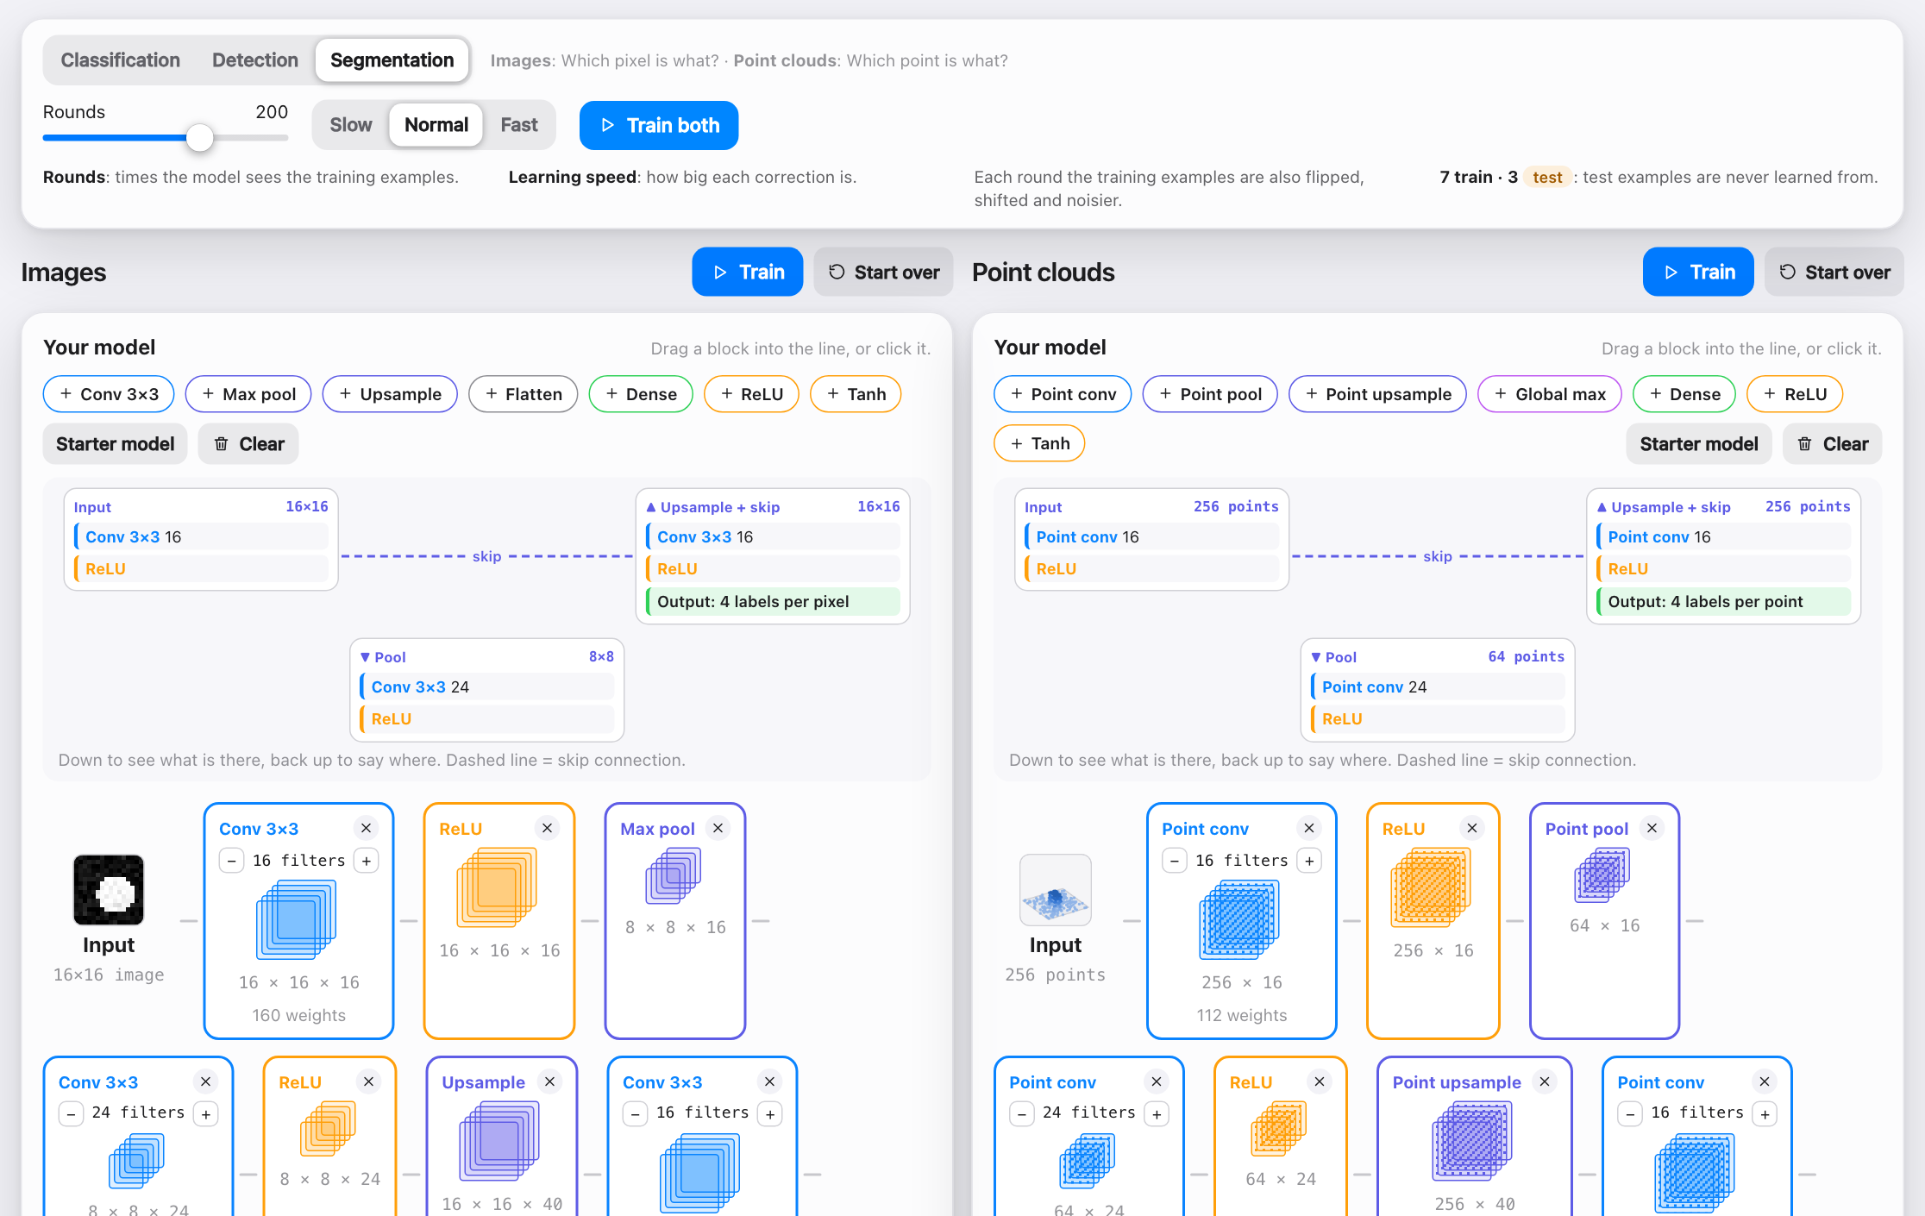
TECHNIQUE · UNDERSTANDING · SUPERVISED
Try it: build and train your own model
Drag blocks: Conv, Pool, Upsample, Dense (and the point-cloud versions).
Train on 7 labelled examples, test on 3 held back.
Pick the job: classify, detect or segment.
Segmentation is a U: down to see what, up to say where, with skip links.
A big gap between learned and unseen scores = overfitting.
Supervised Learning tab: images on the left, point clouds on the right
Notes:
In the Supervised Learning tab you build a small network by dragging blocks: Conv, Pool, Upsample, Flatten and Dense, with point-cloud versions of each. The last layer is added for you. You train it on 10 labelled images and 10 labelled point clouds, seven to learn from and three held back to test it. The learned and unseen scores show whether it really learned or just memorised. For segmentation the model has the shape of a U, as in U-Net: pooling goes down to see what is there, upsampling comes back up to say where, and skip connections carry detail across.

Slide 18
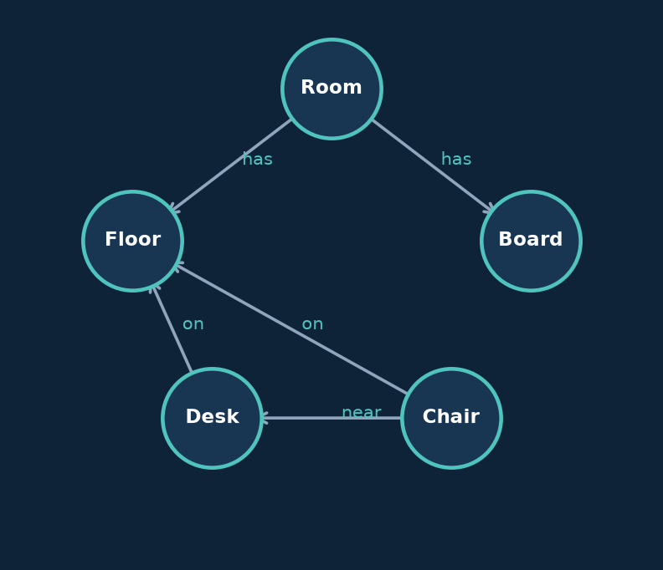
TECHNIQUE · LANGUAGE MODELS
3D scene graphs
A scene graph stores objects as nodes and their relations as edges: a short text a language model can actually read.
Algorithm | What it does | Good for
Clustering plus rules | Builds nodes and relations by hand | Small rooms, easy to inspect
Kimera | Builds a mesh, objects and rooms | Robots mapping buildings
Hydra | Builds a layered graph in real time | Rooms and places on the fly
ConceptGraphs | Open-vocabulary objects from images | Questions in plain language
Large language models | Read the graph as text | Answering questions about the scene
Classroom scan from the Learning Lab
Notes:
Raw points are too long for a prompt and carry no names. The graph is small, so the model answers from structure instead of guessing.

Slide 19
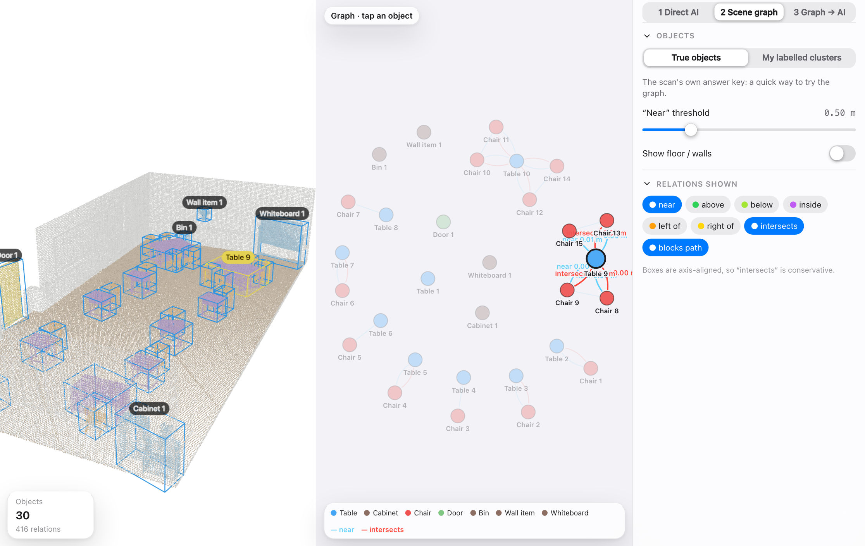
TECHNIQUE · LANGUAGE MODELS
Scene graph and asking questions
Nodes: named objects. Edges: near, intersects, above...
Chat with the AI about the room, or anything else.
Rule-based questions need no AI.
Notes:
Objects become nodes, relations become edges. The graph is short text, so a language model can answer questions about the room from it, and you can keep chatting. Simple questions can also be answered by rules, with no AI.

Slide 20
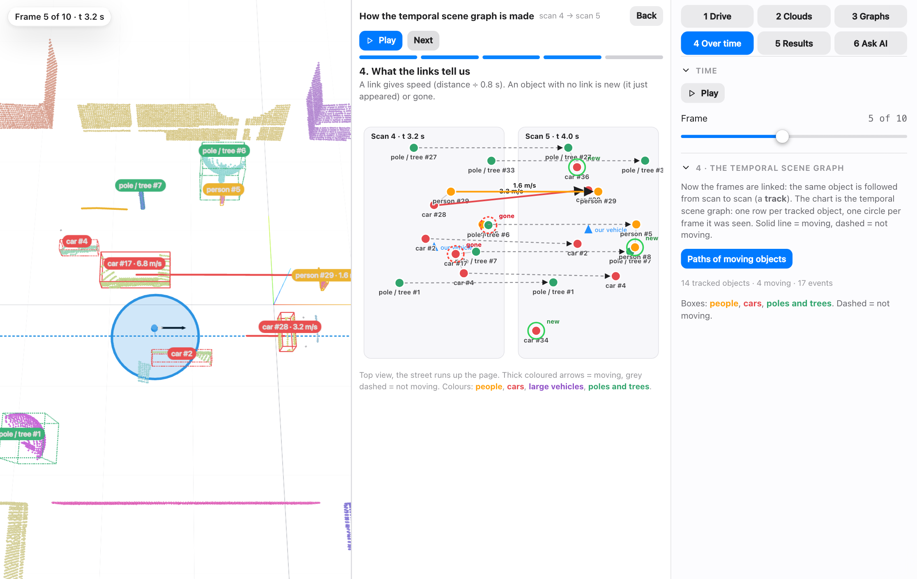
TECHNIQUE · LANGUAGE MODELS
Temporal scene graph: a graph over time
One graph per scan (every 0.8 s).
Links = the same object, giving speed.
Unlinked = new or gone.
Stacked: the temporal scene graph.
Notes:
Each scan gives a scene graph. Link the same object between scans to get speed, new objects and objects that left. Stack all scans: one row per object, one circle per scan. This is what the language model reads to answer questions about a drive.

Slide 21
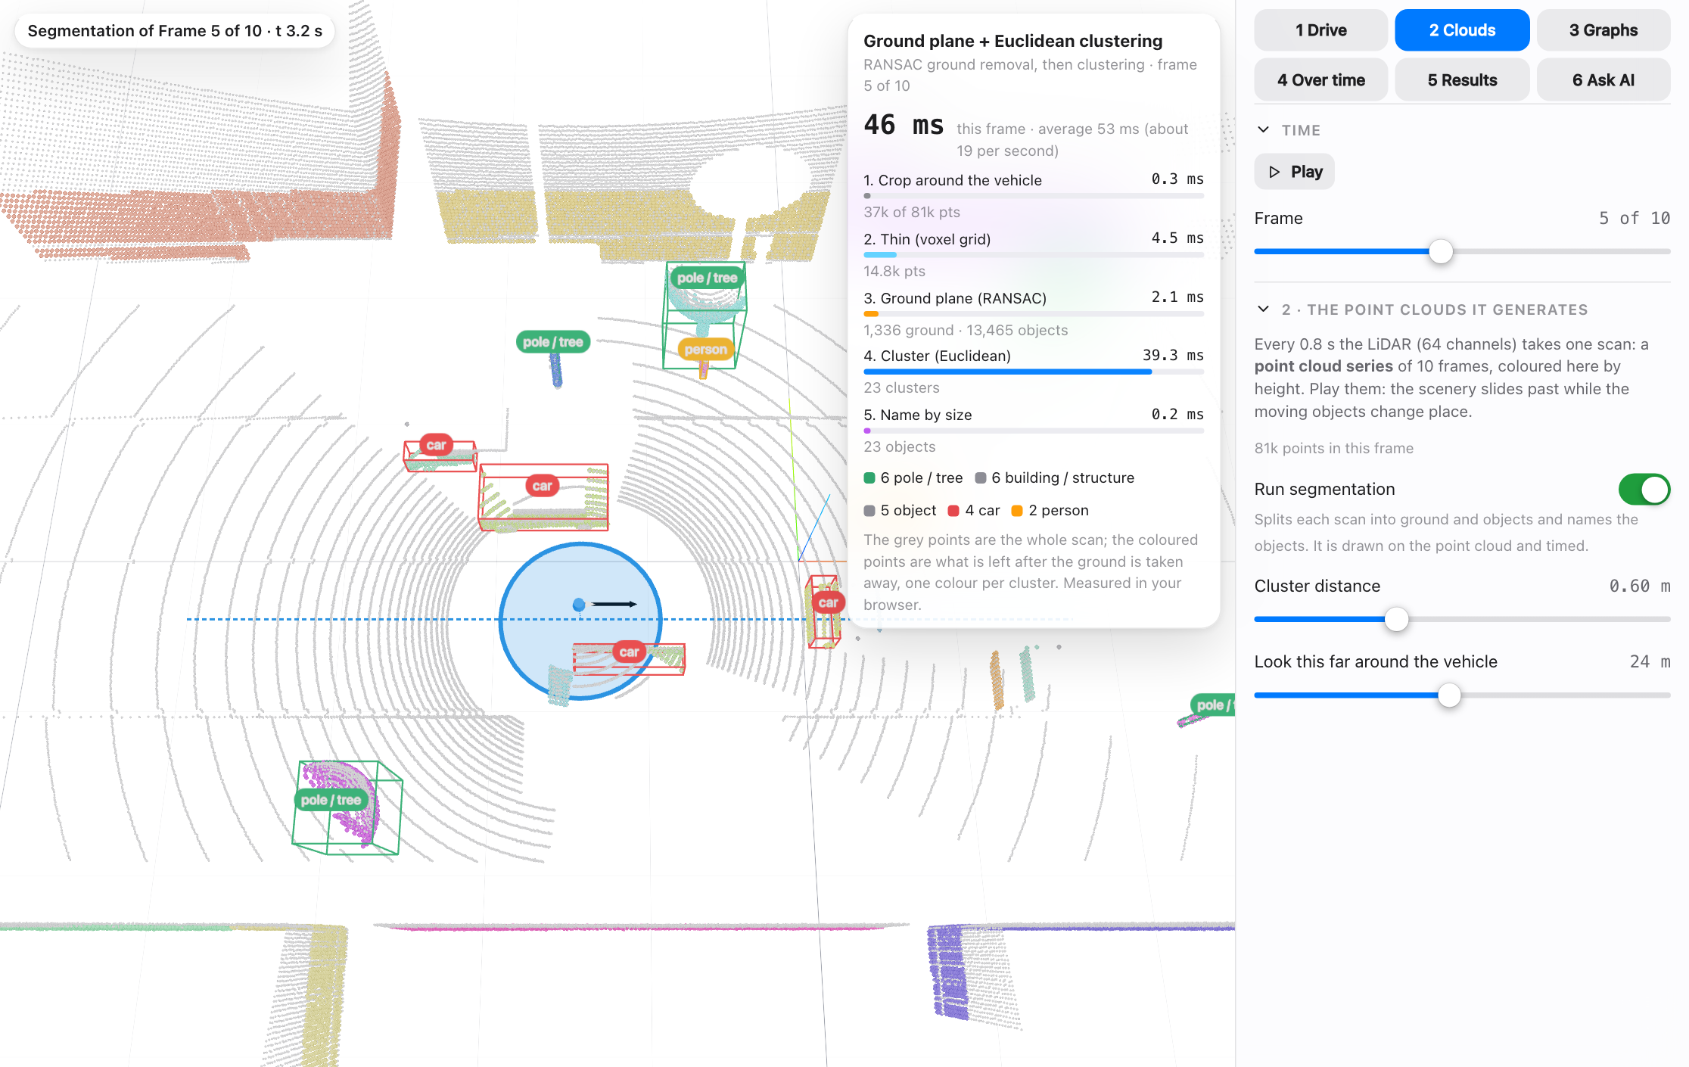
TECHNIQUE · LANGUAGE MODELS
Segmenting a moving scene
Ground plane (RANSAC), then Euclidean clustering.
Each cluster named by its size: person, car, pole.
A few tens of ms per frame.
Notes:
The same ground removal and clustering run on every frame of the drive. The card in the app names the method and times each step, about tens of milliseconds a frame.

Slide 22
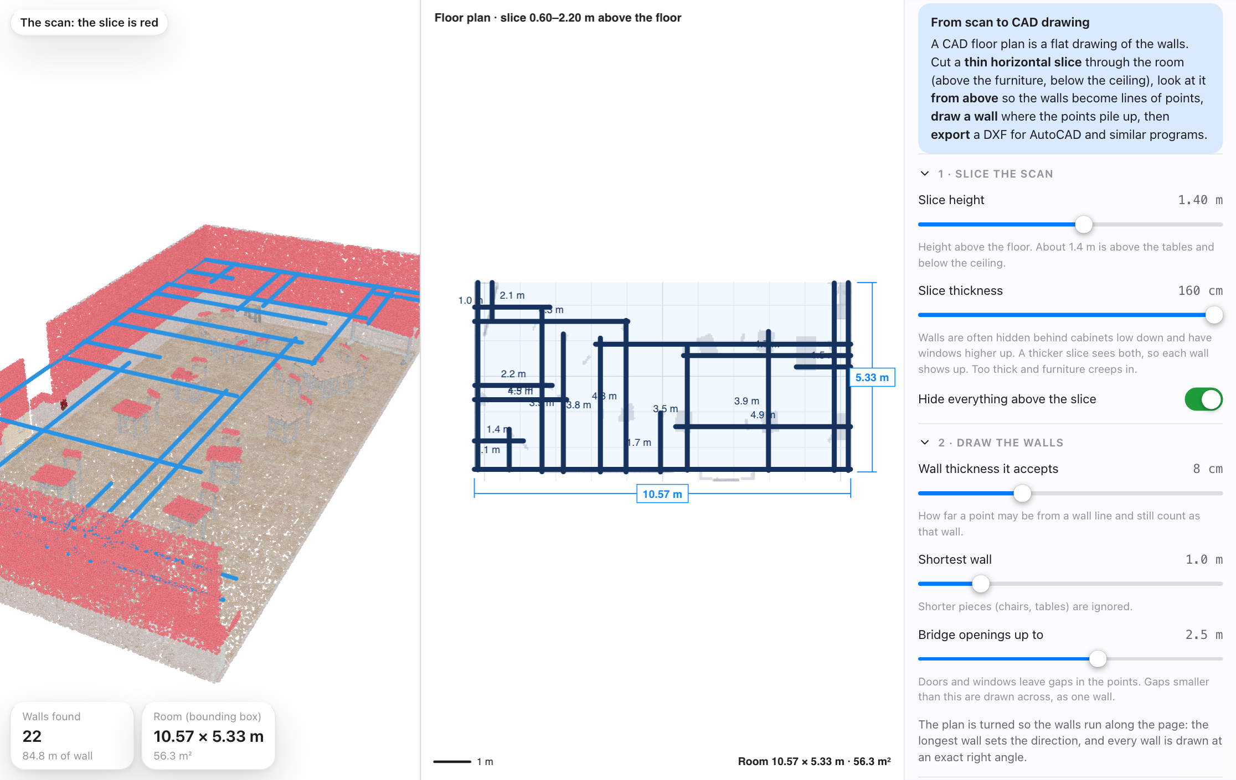
APPLICATION · OPTIONAL
Application: scan to CAD
Slice at one height, look from above.
Walls are where points pile up.
Export a DXF floor plan.
Notes:
Optional application. Slice the cloud at one height, find lines where points pile up, draw walls, export a DXF.

Slide 23
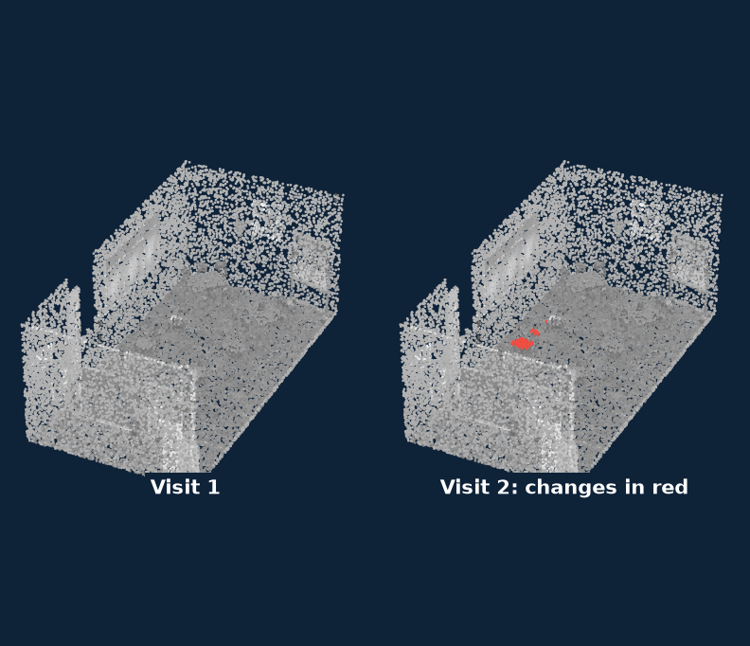
TECHNIQUE · COMPARISON
Change detection
Change detection compares two registered scans of one place to find what moved, appeared or vanished.
Algorithm | What it does | Good for
Cloud-to-cloud distance (C2C) | Nearest-point distance | Quick checks of rooms and objects
M3C2 | Distance along local normals, with confidence | Terrain, cliffs, erosion
DEM of difference | Subtracts two height grids | Earthworks and volume change
Octree comparison | Compares occupied cells | Very large scans
Classroom scan from the Learning Lab
Notes:
All of these need well-registered scans and a threshold above the scanner noise, otherwise everything looks changed.

Slide 24
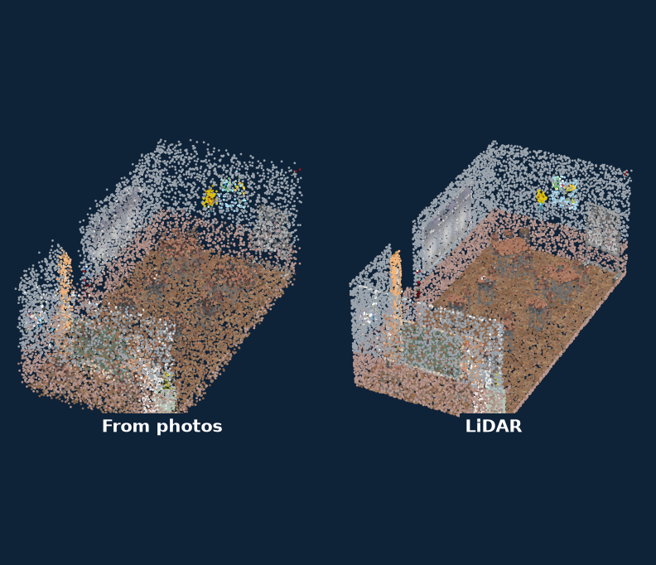
TECHNIQUE · IMAGES TO 3D
Image-based 3D
Image-based methods rebuild a scene from photos. LiDAR measures range directly, so it is the independent check.
Algorithm | What it does | Good for
Structure from Motion + MVS | COLMAP, OpenMVS, Metashape | Many photos of a still scene
NeRF | A neural field of colour and density | Smooth new views
3D Gaussian Splatting | Millions of coloured blobs | Fast, photoreal rendering
Monocular depth | MiDaS, Depth Anything | Quick guesses, no true scale
RGB-D fusion | Depth camera into a TSDF | Small indoor scenes
Classroom scan from the Learning Lab
Notes:
Image-based models have no absolute size, so alignment to LiDAR must include scale. Compare the error map, not just how good it looks.

Slide 25
TO TAKE AWAY
Measure, align, understand
Measure: time of flight gives range; imperfect data is normal.
Align: registration and SLAM put every scan in one frame.
Understand: segment, label and relate, then ask questions of the result.
Credits
Tutorial videos by Dr. Florent Poux. Photos from Wikimedia Commons, credited on each slide.
github.com/maninka123/lidar-learning-lab
Notes:
Close on the three verbs. Invite questions, then point people to the lab and the repository so they can keep experimenting. Thank Dr. Florent Poux for the video tutorials that accompany several tabs.

