Slide 1
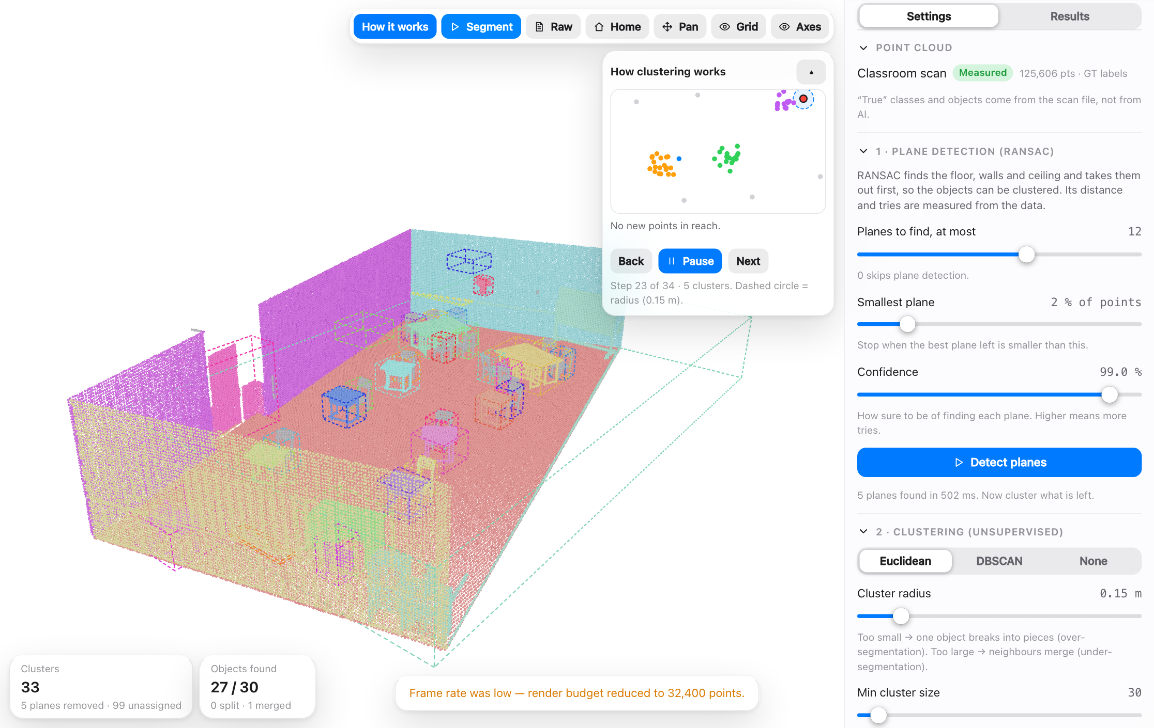
TECHNIQUE · UNDERSTANDING · UNSUPERVISED
Unsupervised: group points without labels
No answers are given: the algorithm groups what is close or similar. A person then names each group.
Algorithm | What it does | Good for
RANSAC plane fitting | Finds the plane most points agree with | Floor, walls, ceiling first
Euclidean clustering | Joins points closer than a radius | Separating objects
DBSCAN | Grows through dense areas, leaves noise out | Uneven density, strays
HDBSCAN | DBSCAN over many radii, no single radius | Groups of different density
K-means | Splits into k groups around centres | Quick, known number of groups
Region growing | Spreads over similar surface direction | Walls, roofs, flat parts
Unsupervised Learning tab: clustering replayed step by step on the classroom scan
Notes:
No labels are given. The algorithm only looks at the geometry. RANSAC takes out the floor and walls, then clustering groups the points that belong together. A person still has to name each cluster. Euclidean clustering and DBSCAN are what the lab uses; K-means needs the number of groups in advance; HDBSCAN removes the single radius setting; region growing follows surface direction. In the lab, the Unsupervised Learning tab replays the grouping step by step.

Slide 2
TECHNIQUE · UNDERSTANDING · SUPERVISED
Supervised: learn from labelled examples
The same three jobs for images and for point clouds. Existing models, trained on large labelled data sets.
Job | The question | Images | Point clouds
Classification | What is it? One answer for the whole input | ResNet, EfficientNet, ViT | PointNet, PointNet++, DGCNN
Detection | What and where? A box around each object | YOLO, Faster R-CNN, DETR | PointPillars, SECOND, PV-RCNN, CenterPoint
Semantic segmentation | Which class is each pixel or point? | U-Net, DeepLab, SegFormer | KPConv, RandLA-Net, MinkowskiNet, Point Transformer
Instance segmentation | Which object is each pixel or point? | Mask R-CNN | PointGroup, Mask3D, SoftGroup
Typical data: SemanticKITTI, ScanNet, nuScenes. A box is 4 numbers on an image and 7 in 3D (centre, size, heading).
Notes:
Supervised learning gives every example its right answer, and the model learns to reproduce it. There are three main jobs. Classification gives one answer for the whole picture or cloud. Detection says what and where: a 2D box on images, a 3D box on point clouds. Segmentation labels every pixel or every point; instance segmentation also tells objects of the same class apart. The names in the table are well-known existing models. For point clouds, PointNet showed that a network can read raw points directly; KPConv, RandLA-Net and MinkowskiNet are common for segmentation; PointPillars, SECOND and CenterPoint are widely used for 3D boxes. They are trained on large labelled data sets such as SemanticKITTI, ScanNet and nuScenes.

Slide 3
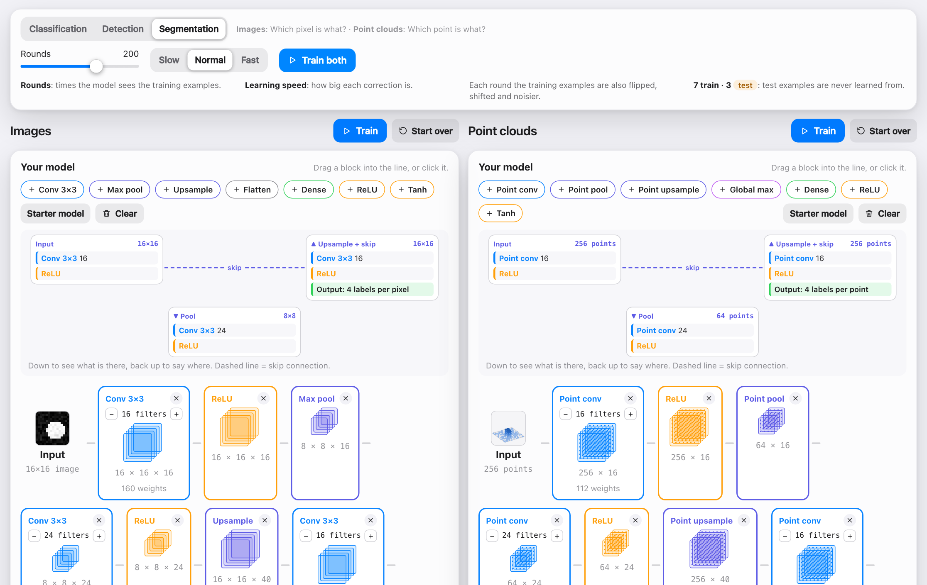
TECHNIQUE · UNDERSTANDING · SUPERVISED
Try it: build and train your own model
Drag blocks: Conv, Pool, Upsample, Dense (and the point-cloud versions).
Train on 7 labelled examples, test on 3 held back.
Pick the job: classify, detect or segment.
Segmentation is a U: down to see what, up to say where, with skip links.
A big gap between learned and unseen scores = overfitting.
Supervised Learning tab: images on the left, point clouds on the right
Notes:
In the Supervised Learning tab you build a small network by dragging blocks: Conv, Pool, Upsample, Flatten and Dense, with point-cloud versions of each. The last layer is added for you. You train it on 10 labelled images and 10 labelled point clouds, seven to learn from and three held back to test it. The learned and unseen scores show whether it really learned or just memorised. For segmentation the model has the shape of a U, as in U-Net: pooling goes down to see what is there, upsampling comes back up to say where, and skip connections carry detail across.

