Slide 1


Bank of Baroda Hackathon - 2022
Technology Partner
Your Team Name : Technocrats
Your team bio : We all are Pre-Final year students in Thapar Institute of Engineering and Technology,Patiala currently pursuing our B.E Computer Engineering.
Date : 20-09-2022

Slide 2
Automated Cheque Processing
Why did you decide to solve this Problem statement?
We decided this Problem statement to reduce the discrepancies in the system. As there our lot of queues in banks where the manual work is cumbersome.
This manual Process costs the bank to Hire more employees .
Slow Processing of cheques leads to bad Customer Experience .
Prevention of Cheque Frauds .
Get Access to Data
Deposit Cheques Remotely
Prevention of Long Queues in the Bank
Transfer of the Money to the Drawee account becomes faster

Slide 3
Prerequisite :- Alternatives/Competitive products for the problem
Magnetic Media Based Clearing System (MMBCS) software :- Automated cheque processing using Magnetic Ink Character Technology (MICR) technology is now available at 66 locations. At centres where the daily volume of cheques cleared is not substantial, Clearing House operations are being automated using Magnetic Media Based Clearing System (MMBCS) software.
Manual Checking :- Cheques deposited at branch counters and Cheques deposited in the drop-box within the branch premises, before the specified cut-off time, will be sent for clearance on same day, for which the clearance period will be T+1 working day.

Slide 4



Azure tools or resources
1.Azure Cloud helps in easier browsing, downloading, upload, and transfer of files between cloud storage services. The cross-platform compatibility with different cloud storage services such as Google Cloud, Microsoft Azure, and Amazon Web Services is one of the notable highlights of this service. Furthermore, it also helps in easier logging into all the cloud services and management of storage resources. 2.Docker is definitely one of the important tools for Microsoft Azure developers. It is presently the recommended option for the creation, management, and deployment of application containers. It is used for testing and deploying Purposes as it makes our work easier 3. The MYSQL Database is used to create databases and store Customer information .

Slide 5
User Segment
Banks will be the early user of the product . This will make the centralised system which can be regulated By RBI because it will automate the process.
Handling of the cheques
Human effort
Accuracy and Efficiency in the work
Small Banks not able to compete big Banks due to less resources.
Bad Customer Experience leads to shifting of bank accounts
Fraud Check
Errors in check
Pain Points

Slide 6
Methodology:
1.) Setting up:
(i). Firstly, we integrates our software with the bank’s workflow using a simple plug-and-play API.
2.) Identification:
(i).Its region-of-interest detector identifies each element of the cheque.
3.) Extraction:
(i). The following information will be extracted from a cheque by defining the Regions of Interest:
Amount in words
Amount in numbers
Account number of the cheque
Date of writing the cheque and the validation period of the cheque
MICR band on the cheque
IFSC Code
Signature(s) on the cheque
Payee Name

Slide 7
4.) Segregation:
(i) It segregates the cheques into processable and non-processable streams.
(ii) Processable fields:The aim of our software is to achieve near 100% accuracy in extracted information.
(iii) Non-Processable field: If Our software found interferences such as stamp, noise or poor quality of image and crossing lines, that prevented the algorithms from extracting information in an accurate manner then such fields are sent for manual edit.
5.) Validation:
(i) The validation is done to check whether the information entered in the cheque satisfies the conditions and requirements for clearing the cheque.
(ii) It will then validates the following data — date is within 90 days, amount in words and figures are the same, signature on cheque matches signature on the core-banking, etc.
6.) Output:
(i) Based on this, it approves, rejects or flags for human intervention.

Slide 8
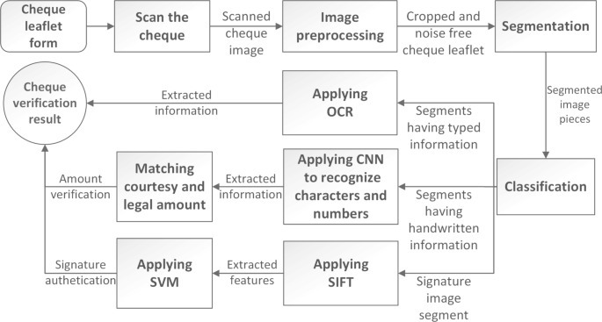
Architecture

Slide 9
Key Differentiators
Fast and Accurate
Language Constraint is fulfilled
Clean and User-Friendly interface for the banks
Reduce Human Efforts
Reduce Processing time
Detecting Potential Frauds
Adoption Plan
Adopting the Software at local banks and Knowing the Problems they our facing so that it can be Grown to bigger banks . This is Basically the testing Phase of the Software.
Minimum Charges so that lot of banks can be attracted with good customer experience.

Slide 10
Scalability
How far it can go?
First We will start our automation process with the local Branches of the same district of different Banks. If this starting Phase gives us the required results.
Then, we will try to take it to next levels i.e. integration within state or national level.
Technical Scalability :-
Building More than one servers and Securing the Banking System So that the security of the customer is not compromised .
GitHub Repository Link :- https://github.com/manipta/BOB_Check

Slide 11
Thank You
Mani Garg
Sahil Jindal
Himanshu Singla
Devyansh Bansal

