Slide 1

Lending Club Loan Data Analysis
-Maniraj Madishetty
-Yashyasvi Agarwal

Slide 2
Agenda
Business Data Understanding
Analysis

Slide 3
Business Data Understanding
Customer Demographics: these are static and can be analyzed.
Customer Behavioral Data: Not available while applying loan. (these can't be considered for our analysis)
Loan data: this can be analyzed

Slide 4
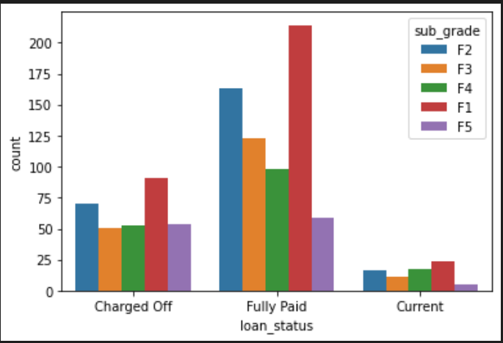
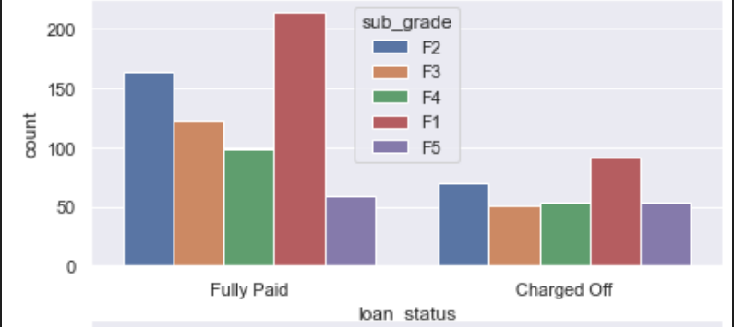
Analysis (category)
A is best performing & F,G are worst performing catrgories.
F5 is worst performing sub category with 50% chargeoff ratio

Slide 5
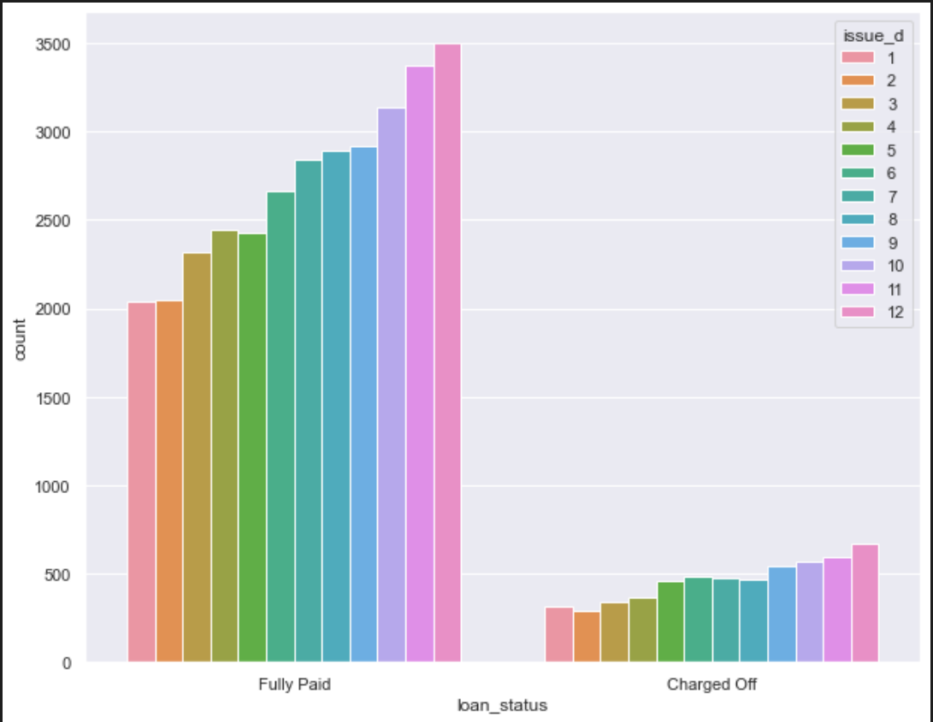
Analysis (Month of loan_date):
Month on Month loan amounts are upward trend so as charge off

Slide 6
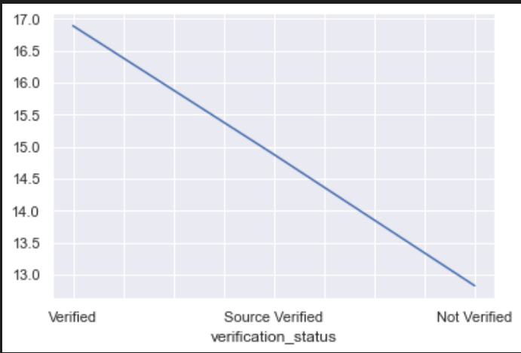
Analysis (Verification_status):
Surprisingly, there is an interesting trend, verified users have high chargeoff% where as least for not verified.

Slide 7
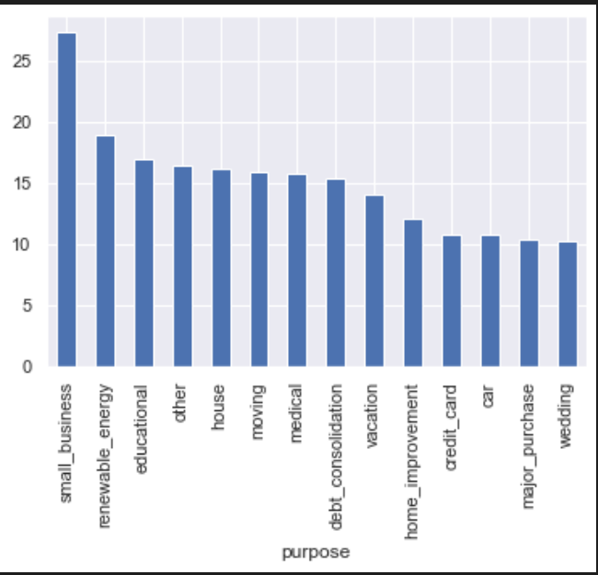
Analysis (Purpose):
Loans taken for small_business have high charge off ratio.

Slide 8
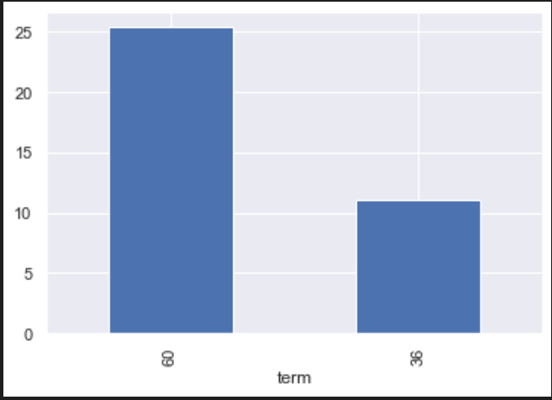
Analysis (Term):
Longer the loan duration, higher the chances of chargeoff.

Slide 9
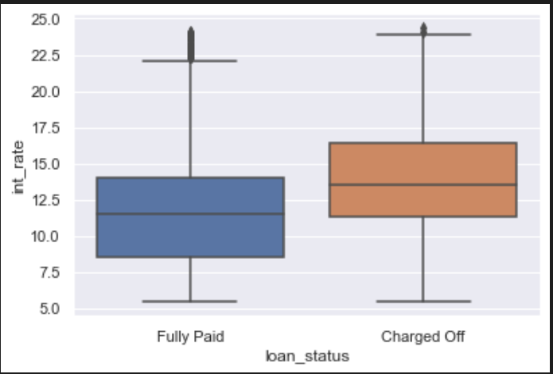
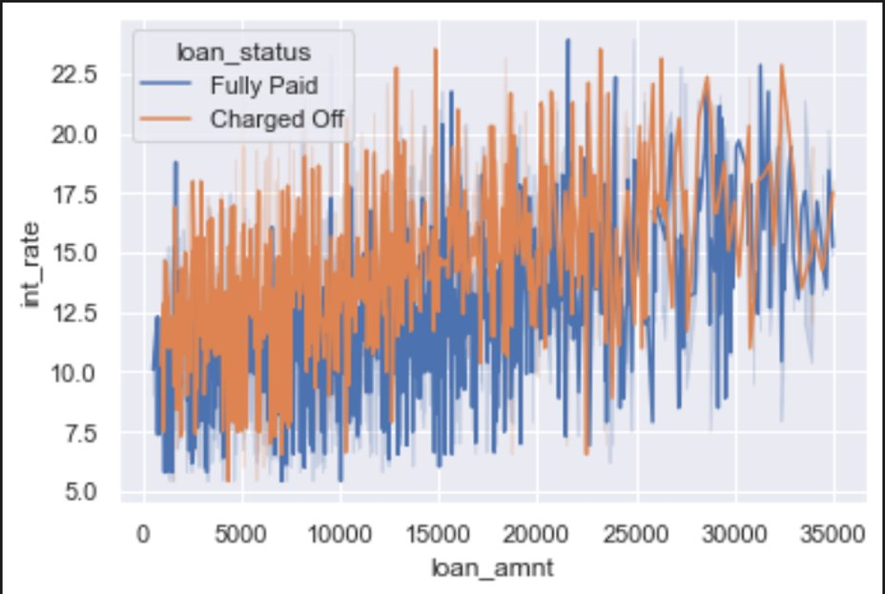
Analysis (Interest rate):
Charged off loans have higher interest rate compared to fully paid ones.

Slide 10
Analysis (loan amount, loan status) vs Interest rate
Higher the interest rate, higher the chances of charge off ratio regardless of loan amount.

Slide 11
Other factors:
State : huge variance in chargeoff% from state to state.
Zip code : huge variance in chargeoff% from one to other.
House category: others have high chargeoff%
Chargeoff% = proportion of charged off members across total sampling.

Slide 12

Thank you

