Slide 1
Data analytics in business
Investing analytics

Slide 2
Lesson Objectives
At the end of this lesson, you will be able to:
Understand the basics of performance analysis using the market regression model
Introduced to concepts of ETF and local regression
Understand the R code to create portfolios from individual stocks and analyze using regression models and visualizations

Slide 3
Performance Analysis
Financial asset (individual stocks, securities, etc.) and portfolio (groups of stocks, securities, etc.) performance analysis is a deep field with a wide range of theories and methods for analyzing risk versus reward.
An important concept is that performance analysis is based on the statistical properties of returns (not prices).

Slide 4

Calculating Alpha and Beta using Market Model Regression
In this method, we regress the company’s stock returns (r_{i}) against the market or the benchmarks returns (r_{m}).
where, r_{i} is the stock or portfolios return
α represents the intercept which is used to describe an investment strategy's ability to beat the benchmark, or it's "edge“ i.e. often referred to as “excess return” or “abnormal rate of return”
β is the stock or portfolios beta which is a measure of stock/portfolios sensitivity to the benchmark
r_{m} is the market or benchmarks returns

Slide 5

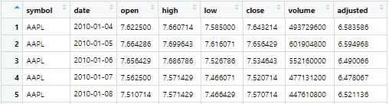
Example – Single Portfolio
Now, we will go through an example of analyzing the portfolio returns of a single portfolio which has 40% invested in AAPL, 30% in GOOG and 30% in NFLX.
We use tidyquant i.e., tq_get() to get the stock prices :
A snippet of the data of the daily stock prices pulled out can be shown as follows:
The important column here for us is the ‘adjusted’ column which represents the adjusted closing price.

Slide 6

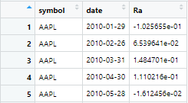
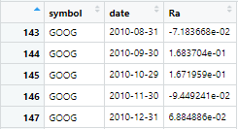
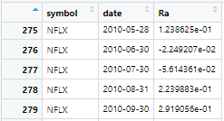
Example – Single Portfolio
Next, we use tq_transmute() selecting “adjusted” to calculate the monthly stock returns:
The adjusted closing price amends a stock's closing price to reflect that stock's value after accounting for any corporate actions, such as stock splits, dividends, and rights offerings.
The closing price is the raw price, which is just the cash value of the last transacted price before the market closes.
The data snippet of the monthly stock returns can be shown as follows:

Slide 7

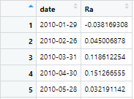
Example – Single Portfolio
Finally, we calculate the portfolio return of the stocks monthly returns using tq_portfolio:
The data snippet of the portfolio returns can be shown as follows:
Ra represents the column of asset returns

Slide 8
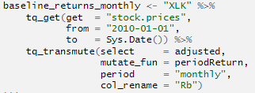
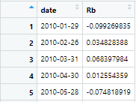
Example – Single Portfolio
We will benchmark this against the SPDR Technology ETF (XLK).
The benchmark monthly returns can be calculated as follows:
The data snippet of the benchmark’s returns can be shown as follows:
Rb represents the column of baseline/benchmark returns

Slide 9
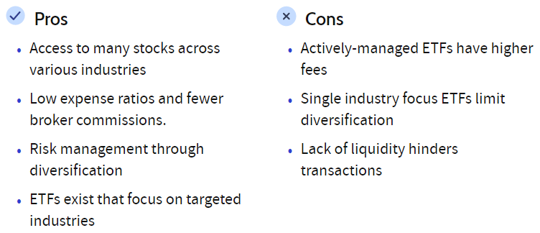
What is ETF?
Exchange traded fund (ETF) is a basket of securities that trade on an exchange, just like a stock.
ETF share prices fluctuate all day as the ETF is bought and sold; this is different from mutual funds that only trade once a day after the market closes.
ETFs can contain all types of investments including stocks, commodities, or bonds; some offer U.S. only holdings, while others are international.
ETFs offer low expense ratios and fewer broker commissions than buying the stocks individually.
Source: Investopedia

Slide 10


Example – Single Portfolio
Once, we have the benchmark/baseline and the portfolio returns, we merge them by date and apply tq_performance function
The Market Regression Model can be depicted as follows:
Alpha = used to describe an investment strategy's ability to beat the benchmark, or it's "edge“ i.e., often referred to as “excess return” or “abnormal rate of return”
Beta = measure of stock/portfolios sensitivity to the benchmark
Correlation = measures degree to which two securities move in relation to each other

Slide 11
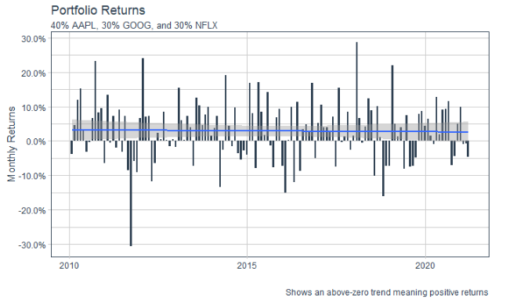
Example – Single Portfolio (Visualization)
The portfolio returns can be depicted as follows (refer lines of code 254-266):
This is good; however, we want to see how our initial investment is growing.

Slide 12
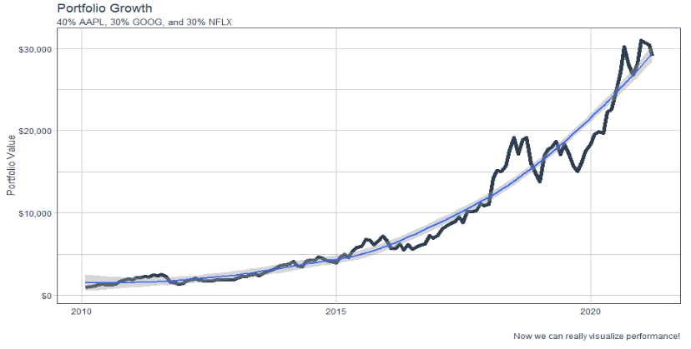
Example – Single Portfolio (Visualization)
The portfolio growth can be depicted as follows (refer lines of code 281 – 293):
The smoothed blue line has been generated using local regression.
Therefore, a $1000 investment in 2010 would grow to $29,100 as of today’s date!

Slide 13
What is Local regression?
Local regression or local polynomial regression, also known as moving regression, is a generalization of moving average and polynomial regression. Its most common methods, initially developed for scatterplot smoothing, are LOESS (locally estimated scatterplot smoothing) and LOWESS (locally weighted scatterplot smoothing).
LOESS combines much of the simplicity of linear least squares regression with the flexibility of nonlinear regression.
A smooth curve through a set of data points obtained with this statistical technique is called a loess curve, particularly when each smoothed value is given by a weighted quadratic least squares regression over the span of values of the y-axis scattergram criterion variable.

Slide 14
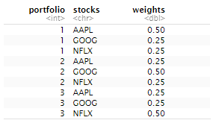

Example – Multiple Portfolio
Now, lets analyze multiple portfolios with different weights in the stock:
We proceed through the same steps as for the single portfolio
The Market Regression Model for the three different portfolios can be shown as follows:

Slide 15
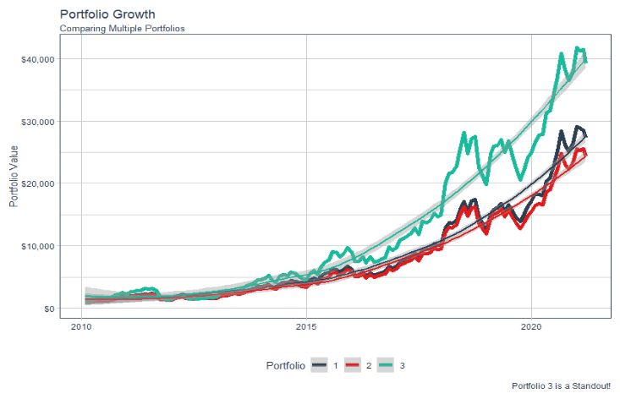
Example – Multiple Portfolio (Visualization)
The portfolio growth for the three portfolios can be depicted as follows:

Slide 16
Key Takeaways
Portfolio 3 performs better than portfolio 1 and portfolio 2 as depicted in the visualization.
This is verified by the much higher alpha of portfolio 3 of 1.97% as compared to 1.24% of portfolio 1 and portfolio 2.
Alpha is used in finance as a measure of performance, indicating when a strategy, trader, or portfolio manager has managed to beat the market return over some period.
Portfolio 1 has the maximum beta of 1.03 which indicates that Portfolio 1 is slightly more volatile than the benchmark i.e. SPDR Technology ETF (XLK).

