Slide 1
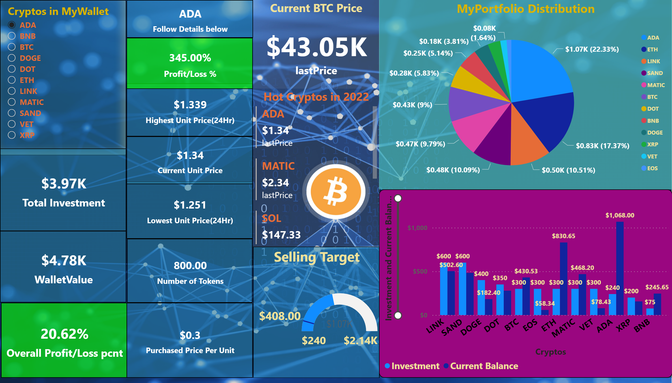
Page 1
Notes:
slicer
No alt text provided
card
No alt text provided
card
No alt text provided
card
No alt text provided
Overall Wallet Status
No alt text provided
Unit Price in 24Hrs
No alt text provided
card
No alt text provided
Profit/Loss Per Token
No alt text provided
Selling Target
No alt text provided
card
No alt text provided
card
No alt text provided
card
No alt text provided
clusteredColumnChart
No alt text provided
Current BTC Price
No alt text provided
Hot Cryptos in 2022
No alt text provided
MyPortfolio Distribution
No alt text provided

