Slide 1
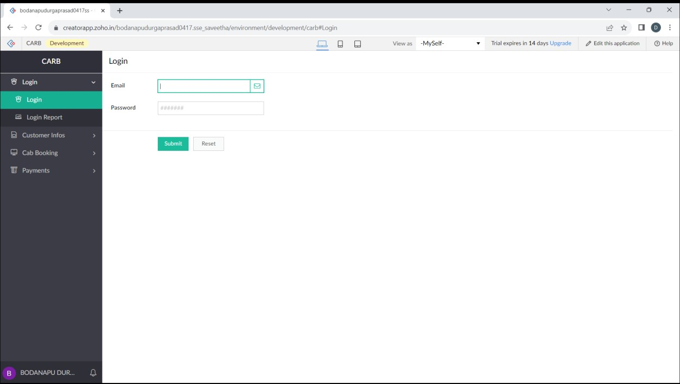
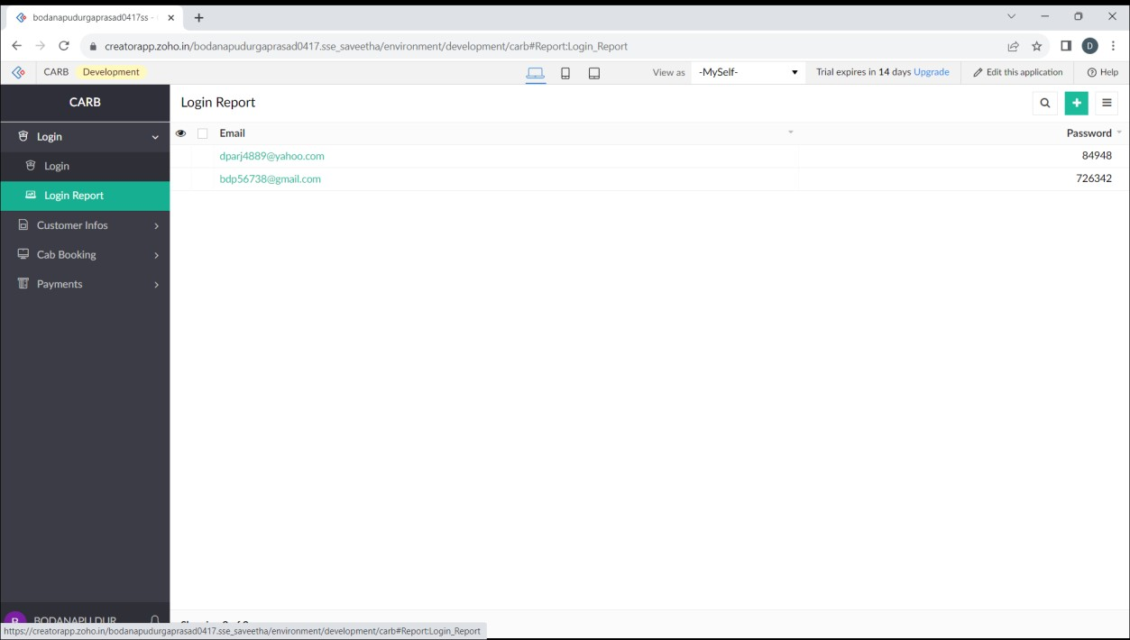
Experiment-3
Create a simple cloud software application for Car Booking Reservation System using any Cloud Service Provider to demonstrate SaaS.

Slide 2

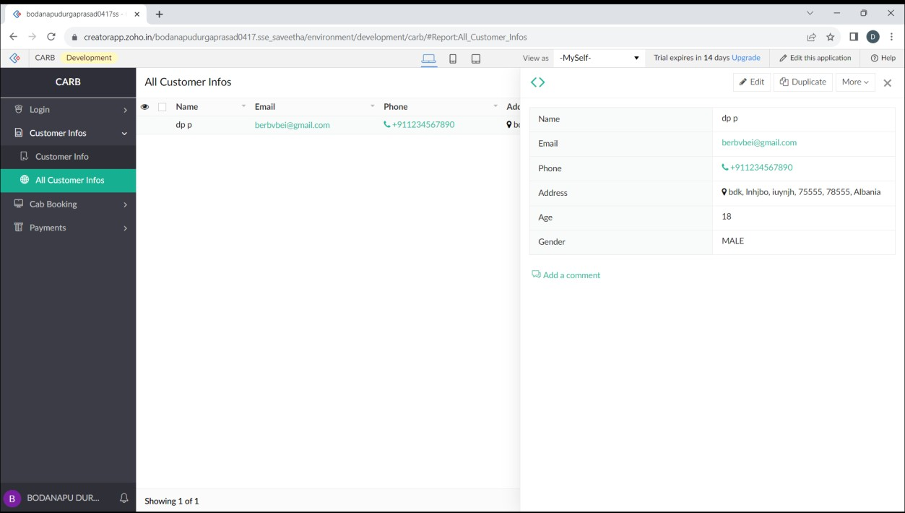

Slide 3
