Slide 1
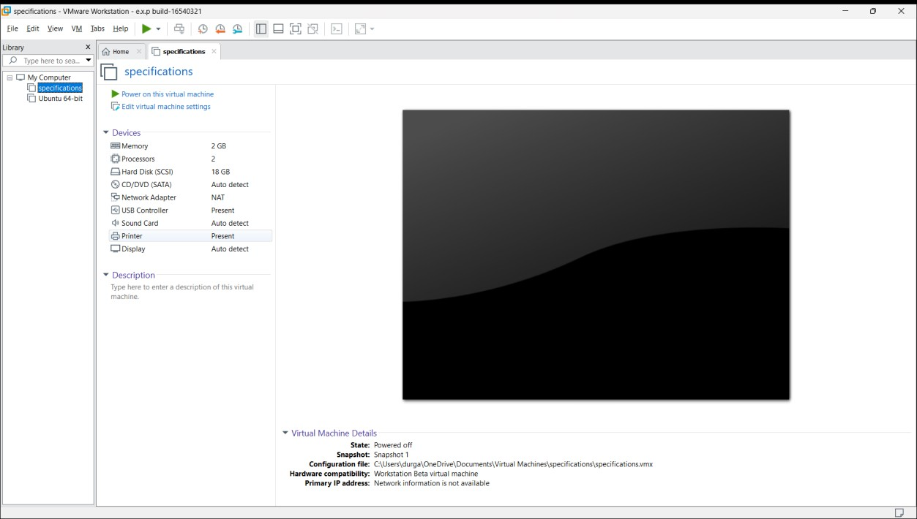
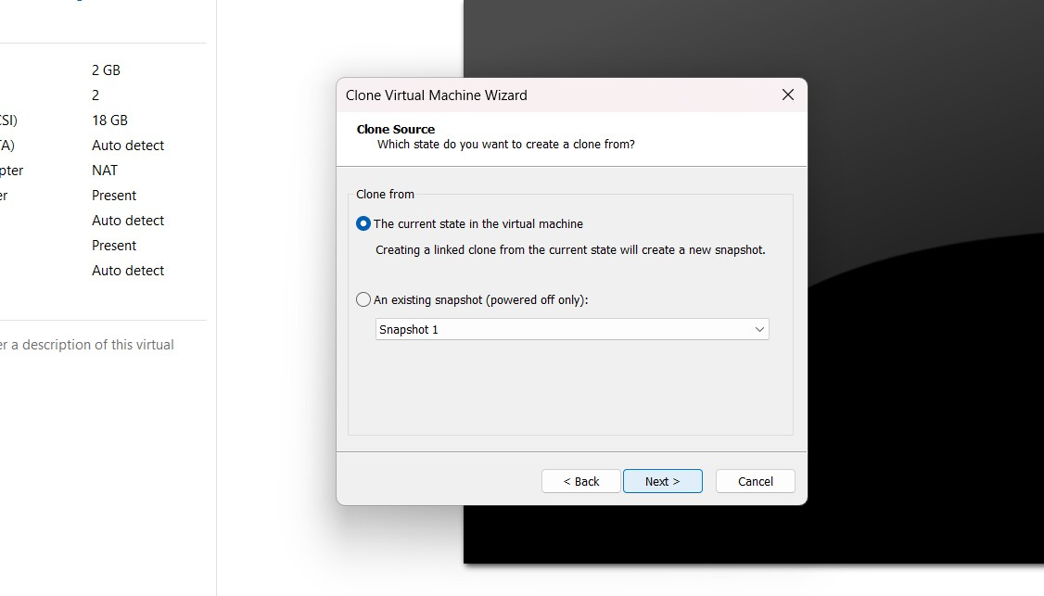
Experiment-10
Create a Cloning of a VM and Test it by loading the Previous Version/Cloned VM

Slide 2
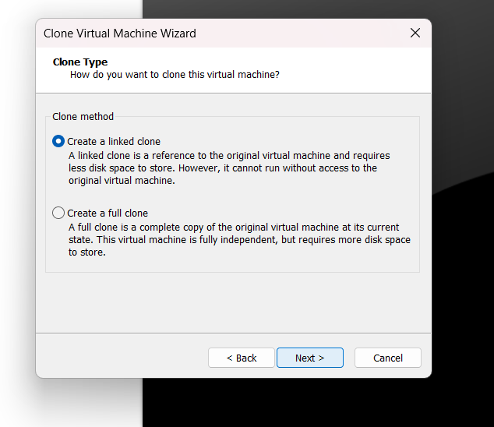

Slide 3
