Slide 1
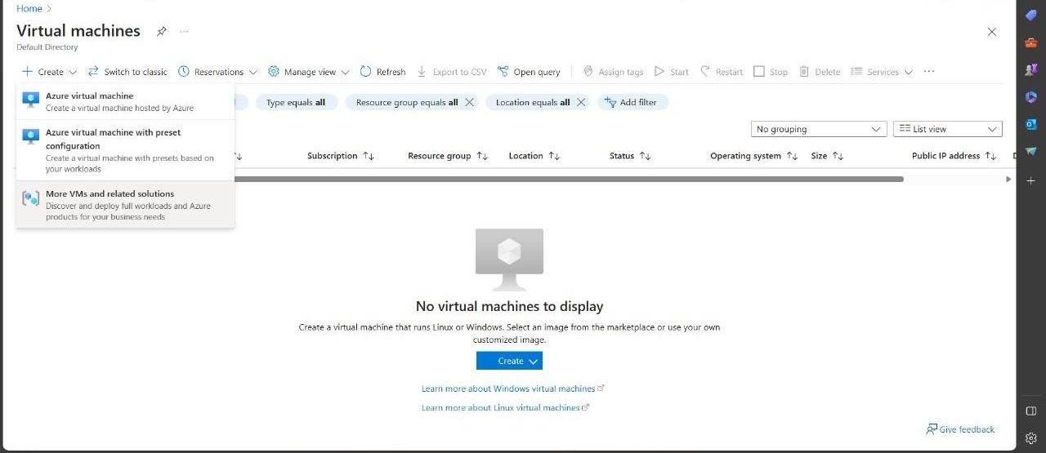
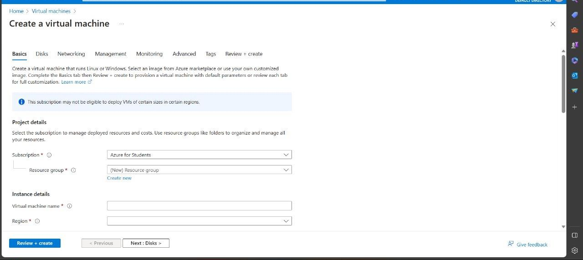
Experiment-13
Demonstrate Infrastructure as a Service (IaaS) by creating a Virtual Machine using a Public Cloud Service Provider (Azure), configure with required memory and CPU.

Slide 2
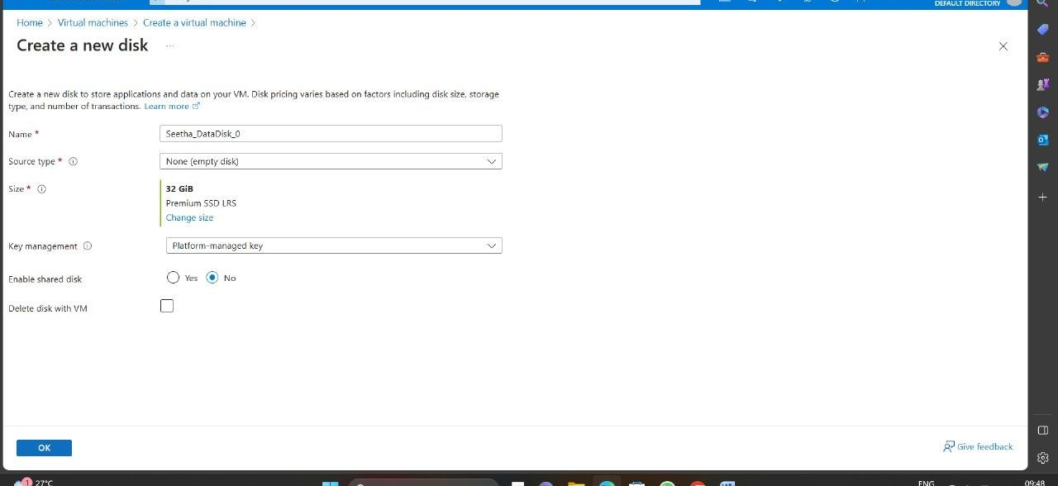
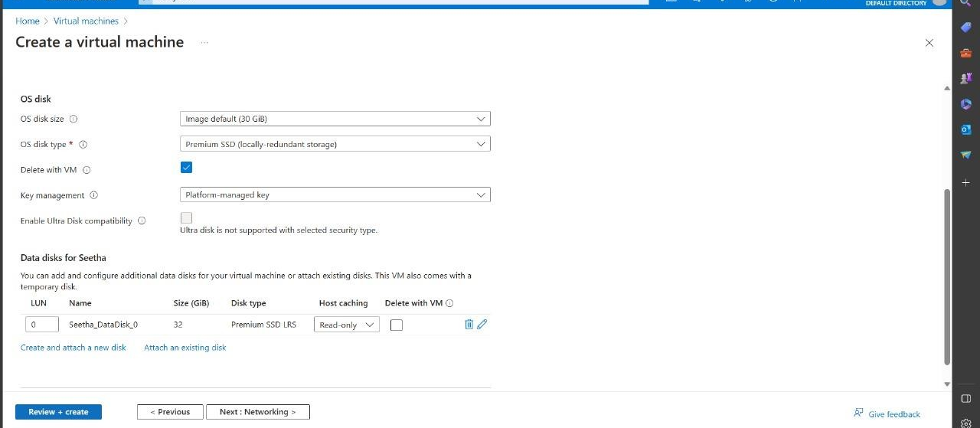

Slide 3
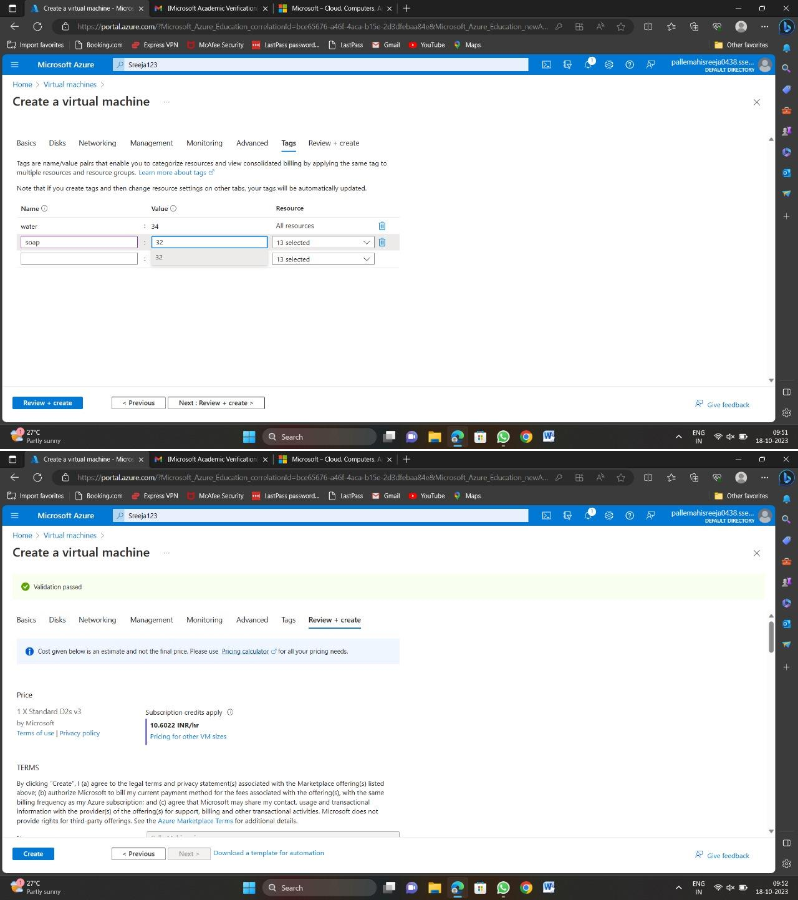

Slide 4
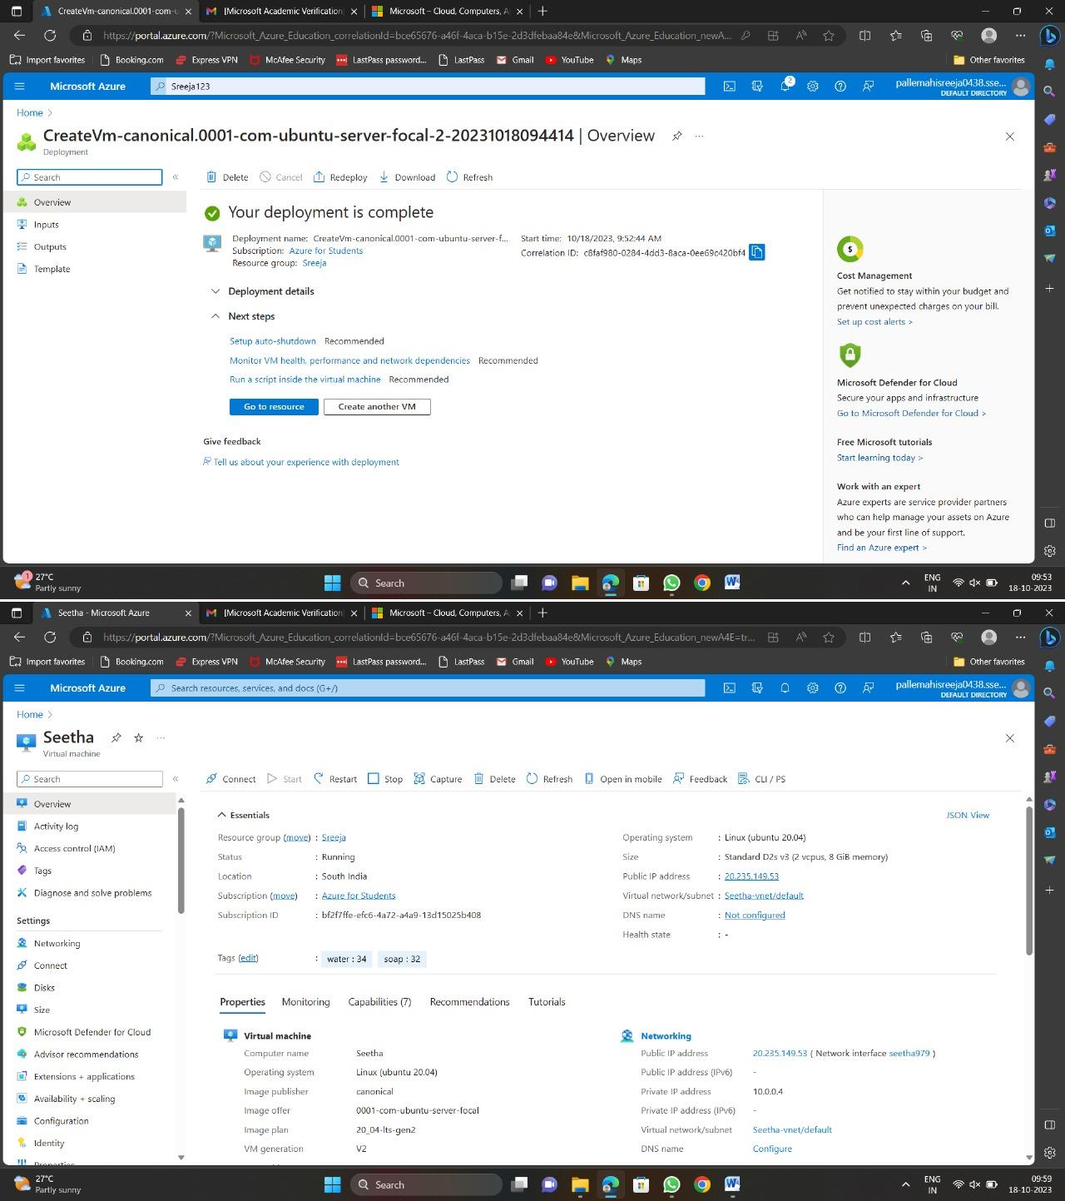

Slide 5
